Slide 1

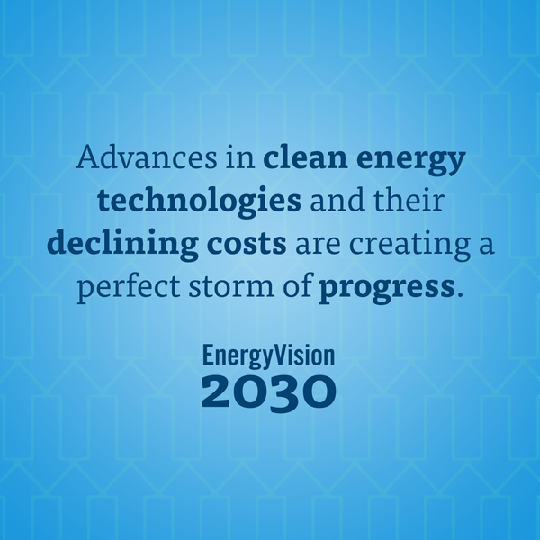

Slide 2





Restructuring Roundtable
March 24, 2017
Boston, MA
Jamie Howland Director, Climate and Energy Analysis Center

Slide 3

Climate Goals
Scientific Consensus is generally 80% GHG emissions reductions by 2050
State-level emissions limits reflect this
Questions that need to be asked:
How much clean energy are states on track to adopt?
What technologies have the greatest impact?
What emissions reductions will be achieved?

Slide 4
The LEAP Model
Long-range Energy Alternatives Planning System
Integrated scenario-based modeling
Models entire energy system, consumption, emissions
All sectors

Slide 5
Modeling Overview
Populate model with regional data
Build baseline
Construct policy scenarios

Slide 6
Baseline Development
Largely based on 2016 AEO and EIA SEDS
Includes phase 2 standards for diesel trucks
Added ISO New England and NY ISO forecasts
Continued on trendline to 2030 when needed
Adjusted for:
NY CES
New Rhode Island RPS level
Hydro import authorizations

Slide 7
Policy Scenarios - Overview
Two policy scenarios
Primary
Achieves 45% emissions reduction (from 1990) by 2030
This is the point on the straight-line path from today to 80% by 2050
Accelerated
50% emissions reduction by 2030
Scenario components generated using existing data, other forecasts, emerging trends

Slide 8

Policy Scenarios
Policy levers are the same in both scenarios
Energy Efficiency
Vehicle Electrification
Locational efficiency (VMT reductions)
Fossil heating and water heating electrification
Renewables
Grid flexibility (storage and demand management)
A few smaller levers – waste management, solar hot water, etc

Slide 9
Primary Scenario
Comparison of selected policy levers

Slide 10
Primary Scenario - Transportation
Cars and light trucks – 13% electrified by 2030
Medium-duty trucks – 2.5% electrified by 2030
Locational efficiency and VMT reductions – 5%

Slide 11
Primary Scenario - Buildings
Electric EE– 2.5% annual savings
Gas EE – 1.4% annual savings
Oil/Propane EE – 1.2% annual savings
14% of fossil residential heating converted to heat pumps
7% fossil commercial heating converted
12% fossil residential water heating converted to heat pump

Slide 12
Primary Scenario - Generation
Distributed PV – 10.9 GW
Includes shared solar installations
Grid-scale PV – 5.3 GW
Onshore wind – 4.5 GW
Offshore wind – 4 GW
New hydro imports – 10 TWh / year

Slide 13
Primary Scenario - Generation

Slide 14
Primary Scenario - Generation

Slide 15
Primary Scenario - Generation
Peak day analysis
Performed for both summer and winter peak using LEAP model’s dispatch capability
Sufficient resources in both instances
Not a substitute for a full reliability analysis

Slide 16
Primary Scenario – Energy Grid
Increased resources to provide flexibility
Demand response – 2200 MW in 2030
Active Load Management – 900 MW
Storage – 2200 MW (current MA target is 600 MW by 2025)

Slide 17
Modeling Results – New England

Slide 18
Accelerated Scenario
Comparison of selected policy levers

Slide 19
Policy Recommendations
Set stronger RPS targets
Strengthen RGGI targets
Expand carbon pricing to all sectors
Maintain or expand Energy Efficiency
Significant new efforts needed on electrification and demand management
Continue efforts to reform grid planning and modernization
Align utility incentives with policy goals

Slide 20
Conclusions
Deep emissions results are possible with current and emerging technologies
Leading states have demonstrated good progress on many of the pieces needed
States need to do more to build full market penetration of these clean technologies

Slide 21


Slide 22


