Slide 1
Wind Energy in Distributed Power Systems
John B. Howe, Director of Public Affairs
Massachusetts Regulatory Roundtable – 131st Session
Boston, Massachusetts – October 26, 2012

Slide 2

US Wind Energy Faces an Enormous Opportunity
80% CO2 reduction by 2050 implies and enormous need for all forms of renewable energy
Experience worldwide indicates wind can provide up to ≈20% of grid energy without unacceptable impacts on reliability and grid integration costs
USDOE has proposed a target of 20% wind penetration by 2030
…But as of today (2012), nationwide, wind provides only ≈3.5% of all kwh (although much higher in some states, e.g., ≈19% in Iowa)

Slide 3
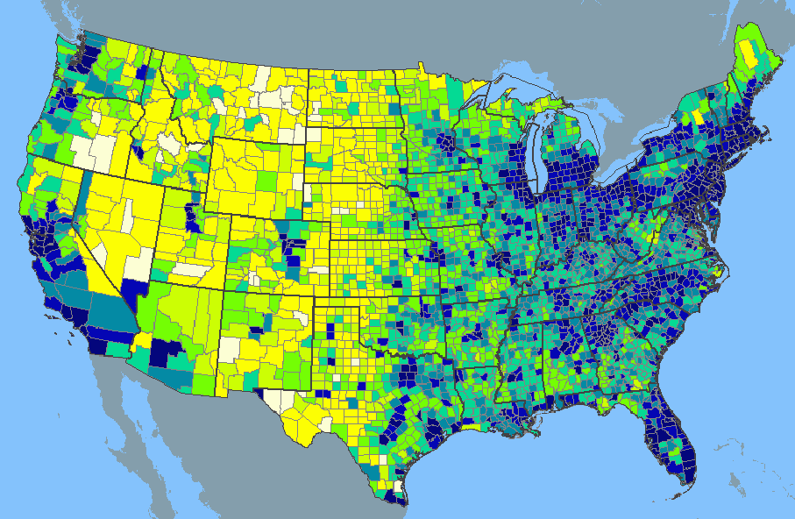
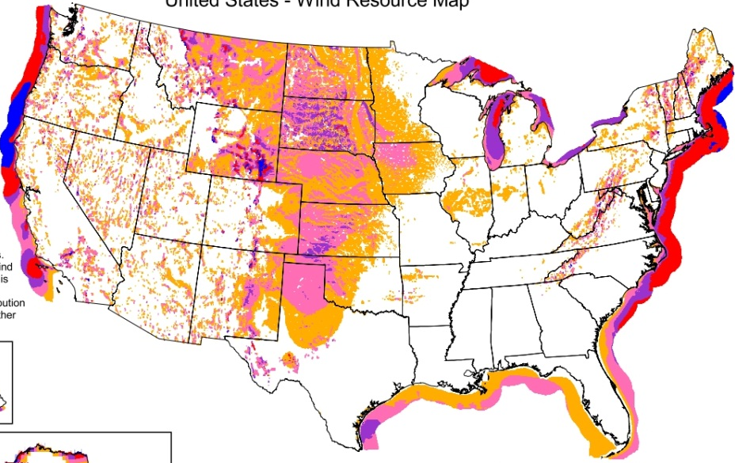
US Wind Energy Faces a Big Geographic Challenge
Wind is the lowest-cost and most technologically-mature renewable resource…
US Population Density by County
US Average Annual Wind Speed
…but this resource is most abundant where local demand is lowest!
New solutions are needed to extend wind energy into geographies where siting large utility turbines is infeasible

Slide 4





FloDesign Wind Turbine: Corporate Profile
Developer and manufacturer of high-efficiency wind turbine technologies
  Founded in 2007
  Headquartered in Waltham, MA
  ±80 employees worldwide
Core expertise in wind, aerospace, manufacturing complex engineered products
Strong IP position (200+ patent applications, with 19 awarded)
>$140M of funding to date includes prestigious awards:
  2008 – MIT CEEP & ICE (now Cleantech Open Northeast) Winner
  2009 – $8.3 million award
  2010 – Mass CEC provided $3M financing package
Blue chip private investors:
  Kleiner Perkins Caufield & Byers
  Vantage Point Venture Partners
  Goldman Sachs
  Technology Ventures
  Plus several strategic investors

Slide 5
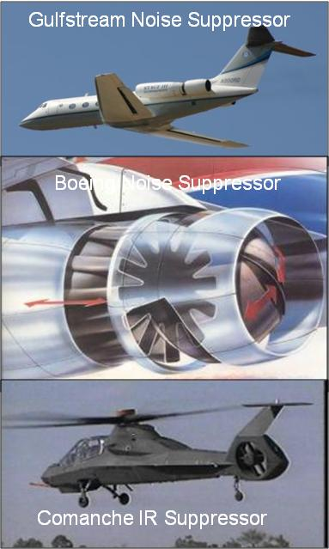
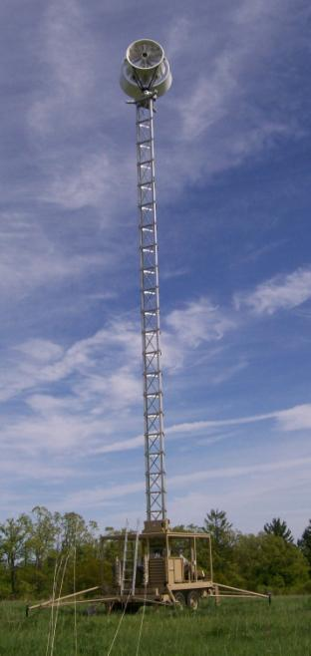
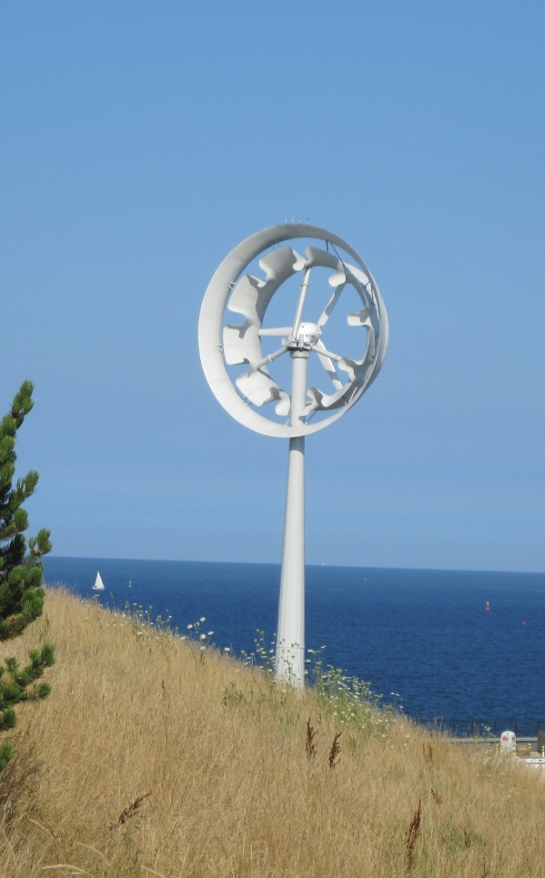
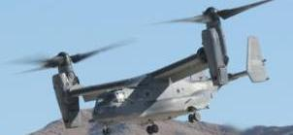
Mixer Ejector Wind Turbine:
A Proven Technology – In a New Application
V-22 Osprey
Aerospace applications for noise & infrared suppression, enhanced thrust, fuel economy (1970s-80s)
First (1kW) in-field MEWT prototype, Central MA
(Dec 2009)
First (100kW) commercial-scale MEWT prototype,
Deer Island, Boston, MA
(May 2011)

Slide 6
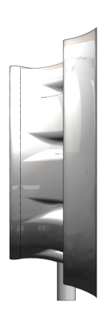
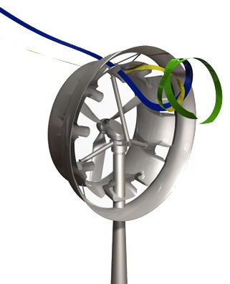
Mixer Ejector Wind Turbine Technology: How It Works
Fast Air Deflected In
Fast air deflected in
Mixer Shroud
Mixing vortex of slow and fast air pumps more flow through rotor
Air Flowing Through Rotor:
Slows as Energy Is Extracted
Mixer Lobes
Fast air deflected in
Ejector Shroud
Mixer Shroud
Ejector Shroud
Net result: large (up to ≈3x) increase in output per unit of swept area – and an all-in LCOE comparable to utility turbines

Slide 7
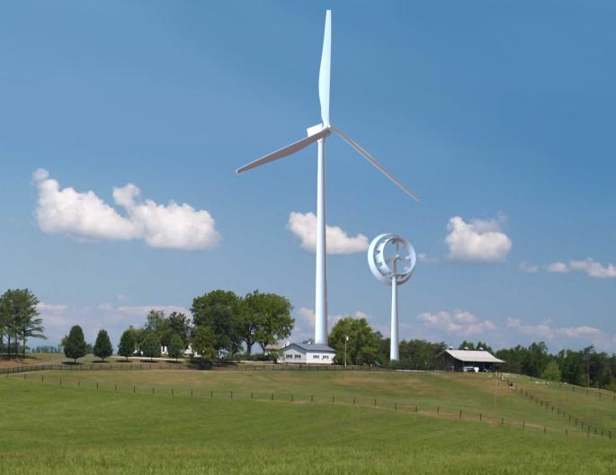
A New Tool for Wholesale Distributed Wind
Re-scaling wind energy to address local power needs
and local siting concerns

Slide 8
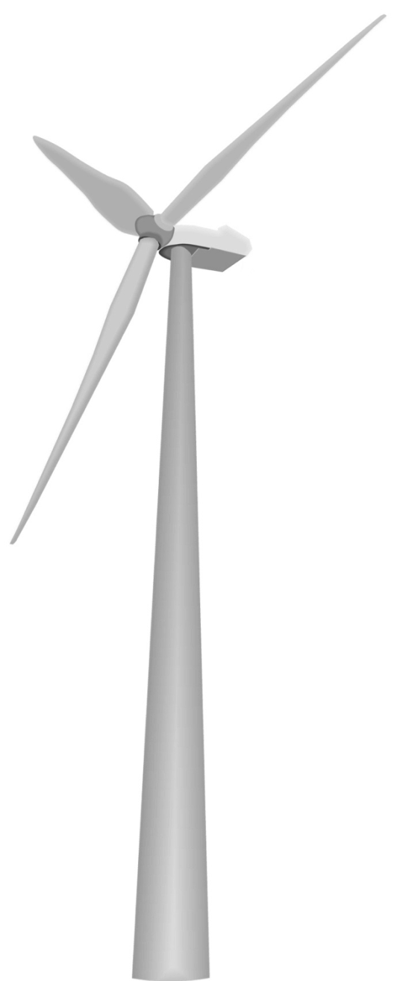
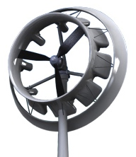
Key Impediments to Wind Energy Siting
Noise
Wildlife
  Birds
  Bats
Airspace/FAA/Military
  Radar impacts
  Aviation lights
Visual
  Height
  Shadow Flicker
Construction
  Site
  Road Access
Transmission Upgrades
The sources of siting objections must be addressed to enable
major growth of wind energy near populated load centers

Slide 9
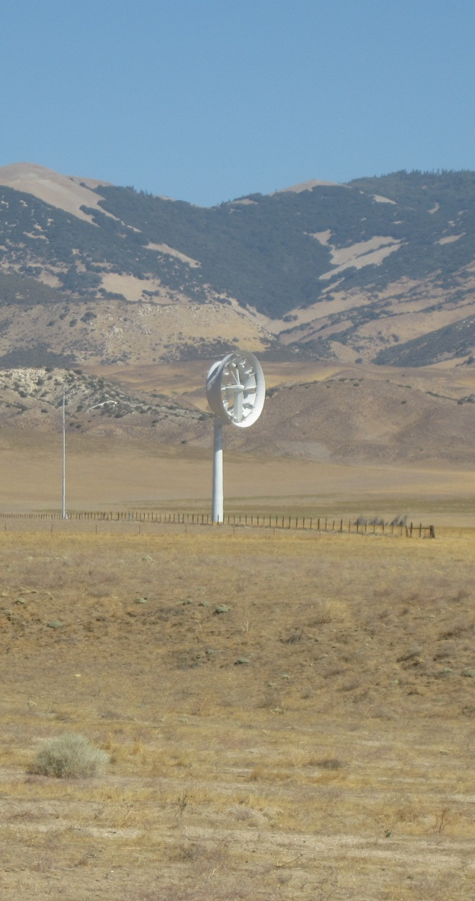
Wind and the Clean, Distributed 21st C Energy System
80% CO2 reduction before 2050 is essential – the longer we wait, the costlier (and more chaotic) the eventual transition!
All forms of RE will be essential!
  Peaking/as available (e.g., solar PV, thermal)
  Non-peaking/as available (e.g., wind)
  Baseload (geothermal)
  Dispatchable (biomass, hydro, tidal/ocean)
  Efficiency, demand response
  …and STORAGE! STORAGE! STORAGE!
Solar PV and wind have been shown to be highly complementary in power systems worldwide
Adding large amounts of one enables (and in time will require) adding large amounts of the other!

