Slide 1
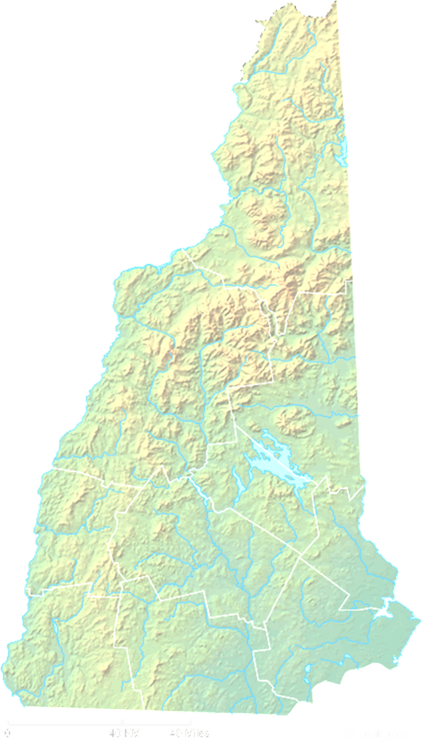
Grid Modernization in New Hampshire
Martin Honigberg
Chairman, NH Public Utilities Commission
October 12, 2018

Slide 2
Background
July 8, 2015: HB 614 directs PUC to open a docket on Grid Mod and implement goals of 2014 State Energy Strategy
July 30, 2015: Commission Order of Notice - Request comments on scope
Docket IR 15-296 - Investigation docket into Grid Modernization
April 1, 2016: Commission Order No. 25,877 - Establishing the working group, defining the objectives, and listing specific questions to be answered
Raab Associates and Synapse Energy Economics hired to help with Grid Mod working group meetings
March 20, 2017: Working Group report, Grid Modernization in New Hampshire, issued
Since report, Staff has researched other Grid Mod dockets in various states and attended DOE and NECPUC training sessions. DOE training focused on investment and traceability
Commission anticipating Staff report and recommendations very shortly

Slide 3
Grid Modernization Objectives and Benefits
From Order 25,877
Improve reliability, resiliency and operational efficiency of the grid
Reduce generation, transmission and distribution costs
Empower customers to use electricity more efficiently and to lower their electricity bills
Facilitate the integration of distributed energy resources (DERs)
Overall benefits of grid mod initiatives must exceed the overall costs
All customers must have a meaningful opportunity to enjoy grid mod benefits
The costs of grid mod are allocated fairly among all customers

Slide 4
Grid Modernization Objectives and Benefits
From Grid Mod Working Group
Align interests of energy consumers & producers
Ensure customer access to usage data
Keep New Hampshire technologically innovative and economically competitive
Decrease carbon emissions and environmental impacts

Slide 5
Working Group Report
Outcomes and Capabilities Table
Grid Mod Planning, including content, filing requirements and GMP
Safeguard stakeholder engagement
Customer Engagement,via rate design, data considerations and education
Cost Recovery & Reconciliation
Performance Metrics
Next Steps

Slide 6
Next Steps
Staff to issue a recommendation to the Commission
Solicit public comment on Staff’s recommendation
Commission issue an Order regarding grid modernization plans
Commission and stakeholders to condition next steps by progress in the following concurrent dockets:
Distributed Generation Net Metering Tariff (and Time-of-Use Rates, Value of DER, and Locational Value Analysis) (DE 16-576)
Interconnection Process (DE 15-271)
Energy Efficiency Programs (DE 15-137, DE 14-216, DE 17-136)
Peak Demand Reduction Goals (DE 16-714, DE 17-101)
Utility DER Ownership/Time of Use Rate Design (DE 09-137, DE 17-189)
Least Cost Integrated Resource Plans (DE 15-248, DE 16-097, DE 16-463)
Distribution Service Rate Cases (DE 09-035, DE 16-383, and DE 16-384)
Reliability Enhancement Program/Vegetation Management Program (DE 16-383, DE 13-384, DE 17-196)

