Slide 1

A Comparison of legal issues for microgrids in Massachusetts, New York and D.C.
Seth Hoedl, Ph.D., J.D.
Summer Fellow
Emmett Environmental Law & Policy Clinic
Harvard Law School
6 Everett Street, 4th Floor, Suite 4119
Cambridge, MA 02138
June 29, 2015
This presentation was prepared for informational purposes only. It does not, and is not intended to, constitute legal advice. Because of the rapid pace of change in this area of law and regulation, this presentation should not be used as a substitute for competent legal advice from a licensed professional attorney.

Slide 2
Key Insights
Conventional wisdom does not always match the statutes.
An engineer’s definition of a term does not always match a statute’s
Regulatory oversight depends on operation, ownership, and jurisdiction.
Regulatory environment is rapidly changing.

Slide 3
Microgrid regulation is in flux
Mass. | Grid Modernization Order requires utilities to submit “Research, Development and Deployment Plans” by August 5, 2015. Microgrids are explicitly mentioned.
N.Y. | REV Order requested microgrid regulation comments by May 1, 2015. Expect a microgrid proposal from the PSC for further public comment soon.
D.C. | PSC expects to open a new docket to consider grid modernization, microgrids and storage.

Slide 4
Presentation discusses a few key issues:
Limitations on utilities
    Generation ownership
    Microgrid distribution infrastructure
Limitations on non-utilities
      “Franchise”
      Crossing a public right-of-way
Potential regulatory obligations of non-utilities
      “Electric company” regulation
      Forms of licensure

Slide 5

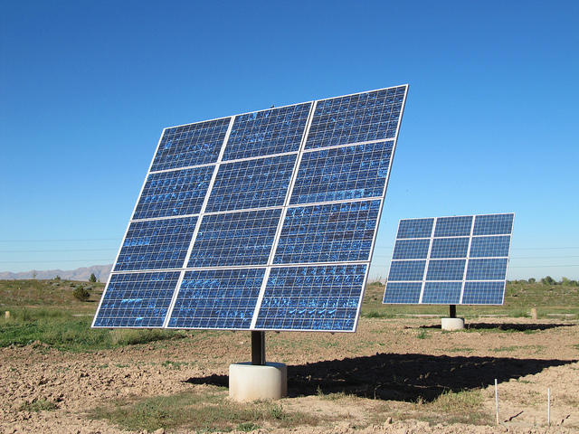
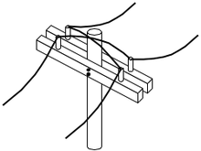
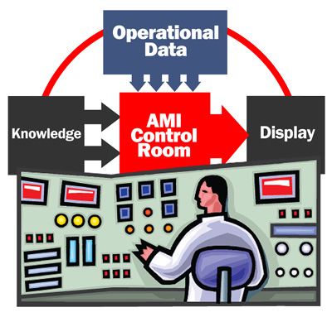
Legal Components of a Microgrid
Microgrid Participants
Microgrid Generator
Microgrid Distribution Infrastructure
Utility
Microgrid Operator

Slide 6
Utility
Utility
Provides “distribution service” in the macrogrid.
In some jurisdictions, may be able to own and operate the internal distribution infrastructure.
In some jurisdictions, may be able to offer one-stop microgrid service including operation and generation.
Could be paid through a tariff, or by contract. Either would likely require regulator approval.

Slide 7
Microgrid Participant
Single legal entity that consumes electricity.
Could be single building with a single owner.
Could be multiple buildings with a single owner.
Could have tenants.
Could own on-site generating assets. Could provide electricity to microgrid or macrogrid.
Could contract with operator, generator, competitive supplier and distribution company.
In some jurisdictions, having tenants or multiple buildings may trigger different types of regulatory oversight.

Slide 8
Microgrid Generator
Provides electricity to participants and macrogrid.
Could be CHP natural gas, solar, wind, storage.
Operates during islanding event.
Could be paid by participants through distribution company or directly by contract.
Depending on the jurisdiction, could be third party, could be a participant, could be jointly owned and controlled by participants, could be owned by competitive supplier, the utility, or a utility affiliate.
Regulatory oversight depends on type of technology, generator capacity and jurisdiction.

Slide 9
Microgrid Operator
Operates the microgrid by balancing supply with demand, especially when islanding.
“Controls” the electricity, in the engineering sense, but not the legal sense.
Does not necessarily sell electricity.
Does not necessarily own/operate microgrid distribution infrastructure.
Depending on the jurisdiction, could be any participant, a third party under contract, a utility, or the generator.
Regulatory oversight depends on ownership structure and jurisdiction.

Slide 10
Microgrid Distribution Infrastructure
Owns and operates the internal distribution infrastructure, in the engineering sense.
Depending on the jurisdiction, could be any participant, a third party under contract, the operator, a utility, or the generator.
In Mass., ownership/operation in a multi-participant microgrid is constrained by the utility’s franchise.
Regulatory oversight depends on ownership structure, jurisdiction.

Slide 11
Limitations on utilities…

Slide 12
Utility ownership of generation assets
Utility
In most jurisdictions, utility ownership is limited.
Mass. | Utilities are prohibited by statute from directly owning, operating or controlling “generating facilities.” M.G.L. c. 164 §1A.
N.Y. | The REV Order states that “utility ownership of DER will not be allowed unless markets have had an opportunity to provide a service and have failed to do so in a cost-effective manner.” REV at 68.
D.C. | Utilities are prohibited by statute from “engaging in the business of an electricity supplier,” which includes “generating electricity.” DC Code §34-1513(a).

Slide 13
Utility role in operation and distribution infrastructure
In most jurisdictions, utilities can operate the microgrid and own and operate the microgrid distribution infrastructure.
Mass. | No limitation.
N.Y. | May be limited by REV Order. Some commenters have asked that the limitations on DER ownership be imposed on microgrid operation. See NRG Comment.
D.C. | No Limitation.

Slide 14

Possible roles in a utility-wired microgrid
Participants, operator, generator, and utility can all enter into contracts that define their respective roles and relationships.
Participants can likely bind themselves into the microgrid.
But keep in mind:
Jurisdictional limits on generation ownership, and microgrid operation.
Regulatory implications of some types of contracts.
Microgrid Participants
Microgrid Operator
Microgrid Generator
Macrogrid
Lines represent wires, not contracts
Utility owns and operates the distribution infrastructure

Slide 15
Limitations on non-utility entities

Slide 16
“Franchise” limitations on non-utility ownership or operation of microgrid distribution infrastructure
In some jurisdictions, a utility has a monopoly, granted by law or regulation, to “distribute” electricity or cross a public right-of-way, a so-called exclusive “franchise.”
It is commonly believed that a utility’s “franchise” prevents ownership and operation of a non-utility microgrid.
Although a “franchise” does impose limits on non-utilities in Mass., there likely is no “franchise” barrier to non-utilities in N.Y. or D.C.
Irrespective of whether there is a franchise, microgrids in all three jurisdictions will be required to comply with regulation and licensing requirements.

Slide 17
Mass. Franchise Statute
  Franchise is granted by statute:
    “ the distribution company shall have the exclusive obligation to provide distribution service to all retail customers within its service territory, and no other person shall provide distribution service within such service territory without the written consent of such distribution company.” M.G.L. c. 164, § 1B(a).
  Statute defines “distribution” and “distribution service” in terms of “delivering” electricity. M.G.L. c. 161, § 1
  “delivery” is suggested by case law to be the “transfer of control and ownership of electricity.” Massachusetts Electric Company, D.T.E. 98-122, 2002 WL 1162710 (Mass. D.T.E. Feb. 7, 2002).

Slide 18
Possible Mass. Franchise Synthesis
  A distribution company, operating in its service territory, is the only entity legally permitted to transfer control and ownership of electricity to a customer over lines operating between 110 and 69,000 volts from either the transmission system or a generating plant.
No reference to crossing a public-right-of-way: transferring electricity across a public-right-of-way does not, in itself, violate the franchise law. (City consent is still required).
No reference to property ownership or electricity meters.
No reference to electricity sale or resale.

Slide 19
N.Y. Franchise
  The New York Constitution prohibits the legislature from establishing an exclusive franchise. N.Y. Const. Art. 3 § 17
  Municipalities are prohibited by statute and case law from granting their own exclusive franchise by contract. See Bartholomew v. Village of Endicott, 59 N.Y.S.2d 84, 87-89 (1945).
  Municipalities may be able to create an exclusive franchise by city council action.
  There are many examples of non-utility owned and operated microgrid distribution infrastructure in N.Y. on both private and public property and that crosses a public right-of-way.

Slide 20
D.C. Franchise
  PEPCO does not have an explicit franchise by statute or regulation.
  Since 1913, the DC PSC has had exclusive authority to grant a franchise:
  “No franchise nor any right to or under any franchise to own or operate any public utility […] shall be assigned, transferred, or leased, […] unless the assignment, transfer, lease, contract, or agreement shall have been approved by the Commission in writing.” DC Code §34-1001.
  There is, at present, no record of a written franchise assignment to PEPCO or its predecessors.
  PEPCO may not have a “franchise” right

Slide 21
Scope of the D.C. “Public Utility” Franchise is limited
  A “public utility” must serve “retail electric customers”
      “public utility” = “electric company” = “Every corporation [who] physically transmit[s] or distribute[s] electricity in [D.C.] to retail electric customers.” DC Code §34-207,214.
  A “public utility” franchise is likely not exclusive.
    The DC Code explicitly recognizes the possibility of multiple “electric companies” by use of the word “every” in the statutory definition.
    DC favors non-exclusive franchises. See cable franchise, DC Code § 34-1254.01.
  The franchise is likely limited to providing those services which are not “potentially competitive.”
    PSC has authority to develop a competitive market for “any component of electric service declared to be a potentially competitive service.” DC Code §34-1504(c)(7).

Slide 22
D.C. “Public Utility” Franchise and microgrids
  Non-utility microgrids likely do not infringe on a “public utility” franchise.
  Microgrid participants may not be “retail electric customers.”
  Even if a microgrid is a “public utility” it cannot infringe on a non-exclusive franchise.
  Microgirds likely qualify as a potentially competitive service.
  Even if PEPCO has a franchise, non-utility microgrids likely do not infringe.

Slide 23
Crossing a public right-of-way
In some jurisdictions, such as CT., utilities have an exclusive right to cross a public right-of-way. See Texas Ohio Power v. Connecticut Light and Power, 243 Conn. 635, 651 (Conn. 1998).
In Mass., N.Y., and D.C., neither statute nor regulation give utilities the exclusive right to cross a pubic right-of-way.
  In all three jurisdictions, statutes explicitly provide for non-utility crossing of a public right-of-way by requiring municipal consent. M.G.L. c. 166 § 24; NY Gen. city Law §20(10); DC Reg 24-3302.1, DC Code § 34-1402,1406,1407.
  In Mass. and N.Y., existing microgrids cross public rights-of-way.
Non-utility Microgrids can likely cross a public right-of-way in all three jurisdictions

Slide 24
“Electric Company” or “Public Utility” Designation
In most jurisdictions, entities deemed “electric companies” are typically subject to extensive regulation.
An “electric company” is defined as …
Mass. | Any entity which manufactures and sells or distributes and sells electricity. M.G.L. c. 164 § 2(i).
N.Y. | Any entity which “owns, operates or manages” any real or personal property “used for or to facilitate the generation, transmission, distribution, sale or furnishing of electricity[.]” PSL § 2(13), PSL § 2(12).
D.C. | Any entity which physically transmits or distributes electricity in the District of Columbia to “retail electric customers.” DC Code §34-207.
N.Y. and D.C. both have statutory exemptions to “electric company” designation.

Slide 25
Licensure of non-utility entities
Irrespective of “electric company” regulation, non-utility entities may need to comply with other regulatory requirements.
Mass. | DPU has authority to license “all generation companies, aggregators, suppliers, energy marketers, and energy brokers.” M.G.L. c. 164 § 1F(1).
N.Y. | NY PSC licenses “Energy Services Companies.” Case 94-E-0952. Future regulation of DER assets that sell “DER services” into DSP market. REV at 105.
D.C. | “Electric Suppliers” are licensed by DC PSC. DC Code §34-1505. Construction of any “generation facility” for the “purpose” of “selling” electricity requires DC PSC pre-approval. DC Code §34-1516.

Slide 26
As an illustration of non-utility ownership, we have analyzed four scenarios using distributed generation “building blocks” ranging from a single consumer on a single parcel to a multi-participant, multi-parcel microgird.

Slide 27
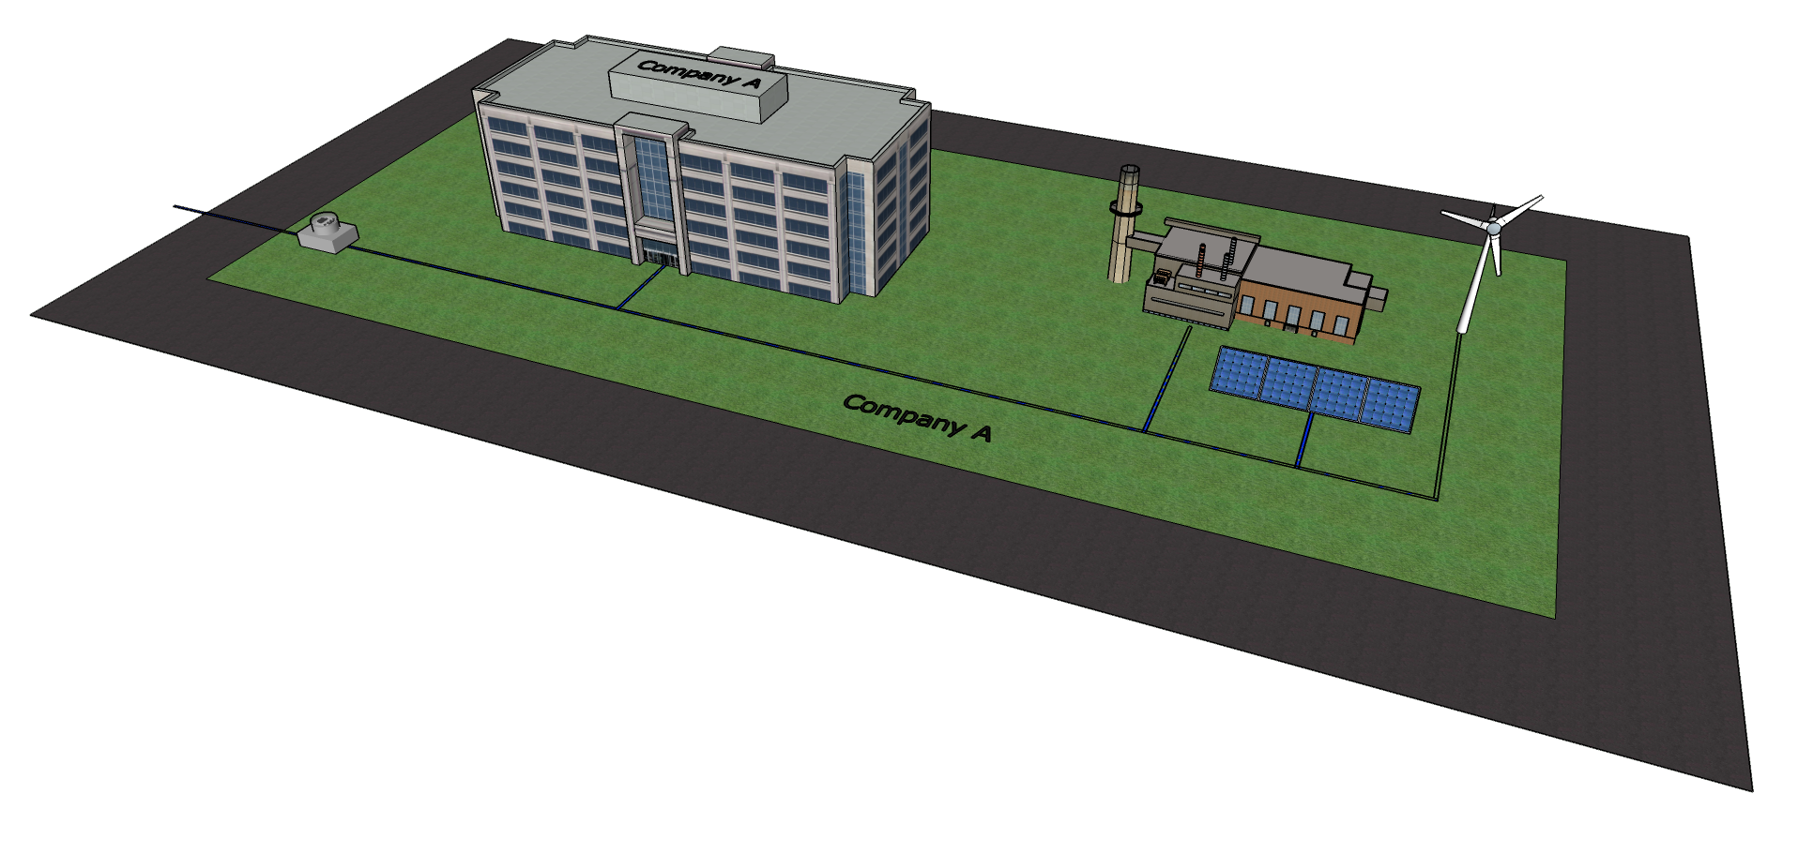
Scenario 1
Single consumer with consumer-
controlled on-site generating equipment.
This scenario is allowed in all three jurisdictions.
Mass. | Does not violate the franchise because electricity is continuously owned and controlled by the consumer.
N.Y. | Not regulated as an “electric company” by a property-based exemption.
D.C. | Likely not regulated as an “electric company” because not distributing to “retail customers.”

Slide 28
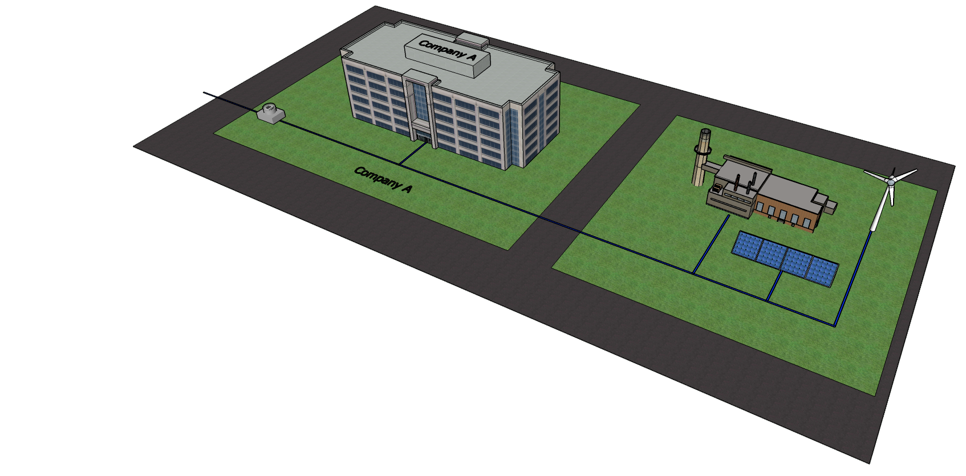
Scenario 2
Single consumer with consumer
controlled off-site generating equipment.
This scenario is also allowed in all three jurisdictions.
Mass. | Does not violate the franchise because Mass. law makes no reference to crossing a public right-of-way.
N.Y. | May qualify for either a property-based or technology-based exemption from “electric company” regulation.
D.C. | Same as scenario 1.

Slide 29
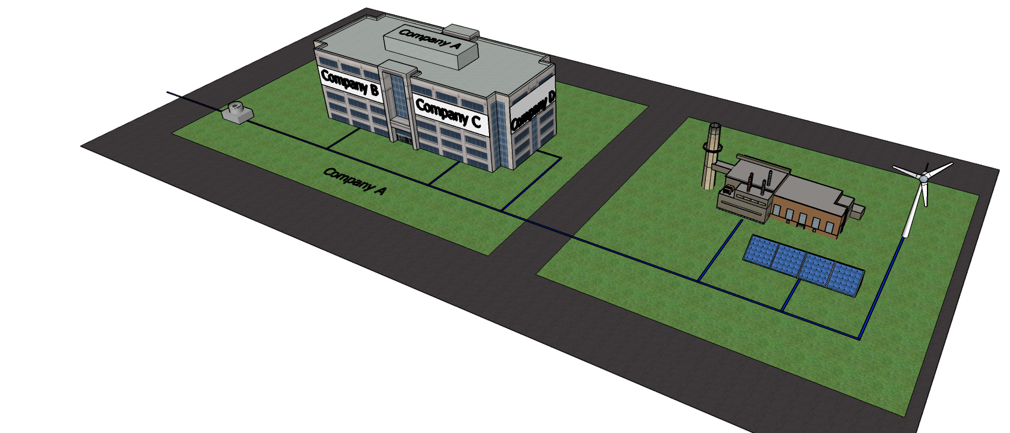
Scenario 3
Single property with tenants and owner
controlled off-site generating equipment.
This scenario is also allowed in all three jurisdictions.
Mass. | Landlord provision of electricity has never been challenged as a violation of the franchise.
N.Y. | May qualify for technology-based exemption from “electric company” regulation. But, the owner cannot consistently distribute macrogrid electricity. May qualify for property-based exemption. But, tenants cannot have “separate accounts.” See REV at 110.
D.C. | May qualify for a building-based exemption from “electric corporation,” provided that distribution line is considered “internal distribution system.”

Slide 30
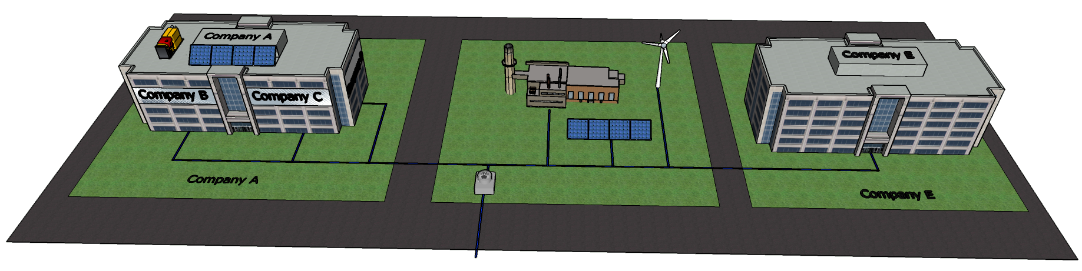
Scenario 4
Multi-participant “microgrid”
Mass. | Non-utility ownership and/or operation of distribution infrastructure likely violates the franchise because it involves the transfer of control and ownership of electricity. A “joint venture” structure might be allowed.
N.Y. | Non-utility ownership/operation of distribution infrastructure is allowed. May qualify for technology-based exemption from “electric company” regulation. But, same legal entity must own/operate generator and distribution infrastructure.
D.C. | Non-utility ownership/operation of distribution infrastructure is allowed. May qualify for building-based exemption from “electric company” regulation. But, same legal entity must own/operate the generator and all the distribution infrastructure, including the wires inside the buildings.

Slide 31
Conclusion
Most microgrid ownership/operation configurations are likely permitted in N.Y. and D.C.
In Mass., non-utility ownership/operation of the microgrid distribution infrastructure is constrained by the franchise clause.
Regulatory implications of different configurations is highly dependent on jurisdiction.

Slide 32
Additional Slides

Slide 33
A microgrid is likely a “competitive” service in D.C.
  A service is competitive if
  “Provision of the service by alternative sellers will not harm any class of customers;”
  “Provision of the service will decrease the cost of providing the service to customers in the District of Columbia or increase the quality or innovation of the electric service to customers in the District of Columbia;”
  “Effective competition in the market for that service is likely to develop;”
  “Provision of the service by alternative sellers will not otherwise jeopardize the safety and reliability of electric service in the District of Columbia.” DC Code §34-1504(e)(1).
Non-utility Microgrids likely qualify

Slide 34
Definitions of Distribution and Distribution Service in Massachusettes
“distribution service” = “the delivery of electricity to the customer by the electric distribution company from points on the transmission system or from a generating plant at distribution voltage.” M.G.L. c. 161, § 1.
“Distribution” = “the delivery of electricity over lines which operate at a voltage level typically equal to or greater than 110 volts and less than 69,000 volts to an end-use customer within the commonwealth.” M.G.L. c. 161, § 1.

Slide 35
Limitations on utility participation: owning distributed generation in N.Y.
Utility ownership or leasing will be allowed if
“(1) procurement of DER has been solicited to meet a system need, and a utility has demonstrated that competitive alternatives proposed by nonutility parties are clearly inadequate or more costly than a traditional utility infrastructure alternative;
(2) a project consists of energy storage integrated into distribution system architecture;
(3) a project will enable low or moderate income residential customers to benefit from DER where markets are not likely to satisfy the need; or
(4) a project is being sponsored for demonstration purposes.”
REV at 70.

Slide 36
N.Y. definition of “electric corporations”
“electric corporations” are “any corporation, association, joint-stock association, partnership and person […] owning, operating or managing any electric plant[.]” NY PSL § 2(13).
“electric plant” “includes all real estate, fixtures and personal property operated, owned, used or to be used for or in connection with or to facilitate the generation, transmission, distribution, sale or furnishing of electricity for light, heat or power and any conduits, ducts or other devices, materials, apparatus or property for containing, holding or carrying conductors used or to be used for the transmission of electricity for light, heat or power.” PSL § 2(12).

Slide 37
N.Y. “Realistic Appraisal”
When tailoring Public Service Law the NYPSC applies a three part test:
  (1) Is the PSL Requirement applicable on its face?
  (2) Can the new entity comply with the requirement?
  (3) Is imposing the requirement necessary to protect the public interest, or would it intead, adversely affect the public?
  See Carr Street, N.Y. PSC CASE 98-E-1670, April 23, 1999.

Slide 38
“Electric company” Regulation and Electric Vehicles
Regulation of electric vehicle charging station is informative analogy for regulation of microgrids.
In both Mass. and N.Y., regulator held that charging stations are not “electric companies” because they offer a complete “charging service” rather than the sale of electricity, irrespective of how the stations are paid. Mass. DPU 13-182, August 4, 2014. N.Y. PSC 13-E-0199, November 14, 2013.
Similarly, microgrids offer a complete “energy service” that is distinct from the retail sale of electricity.
This approach to microgrids is untested in all three jurisdictions.

Slide 39
Example microgrid exemptions from full “electric company” regulations in N.Y.
NYU –
  NYU operates a 13 MW CHP microgrid in Manhattan that serves only its own property. It crosses several public rights-of-way. It is not regulated as an “electric corporation.”
Halletts
  Halletts Vendee, LLC is building a 4.7 MW CHP microgrid that serves five buildings, one of which is across a public right-of-way. It is not connected to the macrogrid and is not regulated as an “electric corporation.” N.Y. PSC Case 14-M-0508, February 9, 2015.
Kodak
  In 2004, Kodak was granted permission to operate a 200 MW microgrid that served property owners in its former business park. The NY PSC granted a tailored regulatory regime. N.Y. PSC Case 04-M-0388, August 2, 2004.

Slide 40
Regulation of Residential Customers / Submetering
In all three jurisdictions, service to residential customers is explicitly regulated by the utility regulator.
Submetering is highly jurisdictional dependent:
Mass. | Residential billing and termination is regulated. 220 CMR 25.00. Submetering is prohibited by DPU Order. Boston Real Estate Board v. DPU, 334 Mass. 477,479-80 (1956).
N.Y. | Residential service is regulated under Home Energy Fair Practices Act, PSL Article 2. Residential submetering is regulated under 16 NYCRR Part 96. Submetering to commercial tenants is explicitly unregulated. NYPSC Case 26998.
D.C. | Residential service is regulated by DC PSC. DC REG 15-300. Commercial submetering is allowed and regulated. DC Code §34-1552(a). Residential submetering is not permitted.

Slide 41
Obligation to Serve
Mass. | “The distribution company shall have the exclusive obligation to provide distribution service to all retail customers within its service territory.” M.G.L. c. 164 §1B(a).
N.Y. | Utilities are the “Provider of Last Resort.” NYPSC Order 96-12. By statute, any entity that serves residential customers is obligated to connect such customers who apply for service. PSL §31(1). But, by regulation, only “distribution utilities” have this obligation. 16 NYCRR Part 11.3(a), 11.2(1-a),(1-b). By statute, any “electric corporation” must connect any building within 100 feet of distribution infrastructure. NY TCL § 12. But, by regulation, electric corporation can deny service. 16 NYCRR Part 13.2.
D.C. | “The electric company shall provide distribution services to all customers and electricity suppliers […].” DC Code §34-1506(a)(1).

Slide 42
Customer Choice
Mass. | All distribution companies must “accommodate retail access to generation services and choice of suppliers by retail customers.” M.G.L. c. 164 § 1A(a). Distribution companies must offer “all products and services […] to all customers and suppliers simultaneously […] to the extent technically possible.” M.G.L. c. 164 §1C(ii).
N.Y. | Retail choice is provided by individual utility tariffs for distribution service. See, for example, ConEd’s Tariff PSC-10, §19.2.1
D.C. | Both electricity suppliers and consumers have the right to “use and interconnect with the electric distribution system on a nondiscriminatory basis in order to distribute electricity from any electric supplier to any customer.” DC Code §34-1501(14).

Slide 43
Standby Rates in N.Y.
NY PSC is attempting to minimize barriers to microgrids created by standby rates.
Standby Rates will be addressed in Track 2 of the REV proceeding.
In an April 20, 2015 Order, the PSC extended standby rate exemption to qualifying DER systems with a capacity up to 15 MW. N.Y. PSC Case 14-E-0488.
New qualifying DER systems installed begore May 31, 2019, can choose existing standby rate, standard delivery rates, or REV-based standby rates.

Slide 44
Utilities cannot likely bind participants to a microgrid
In all three jurisdictions:
  The utility has an obligation to provide distribution service.
  The utility must accommodate “retail choice.”
    The utility likely cannot bind participants, or their successors, into the microgrid, by, for example, refusing connection to the macrogrid.
Mass. | Obligations are by statute: M.G.L. c. 164 §1B(a), M.G.L. c. 164 § 1A(a)
N.Y. | Obligations for residential customers, i.e., provider of last resort, are by PSC Order, tariff, regulation and statute. Unclear for commercial customers.
D.C. | Obligations are by statute: DC Code §34-1506(a)(1), DC Code §34-1501(14)

Slide 45
Participants can bind themselves by contract
Contracts can impose penalties for leaving the microgrid, in effect, limiting retail choice.
Possible contracts with penalties:
  Between participants and microgrid generator.
  Between participants and utility, if utility is operator or distribution infrastructure owner.
A property-based covenant may also be possible.
Any penalty in a contract between a participant and a utility would likely need approval from the regulator.

Slide 46
N.Y. Exemptions to “electric company” regulation
Property-based:
    “where electricity is generated or distributed by the producer solely on or through private property […] for its own use or the use of its tenants and not for sale to others.” PSL § 2(13).
Technology-based:
If electricity “is generated by the producer solely from one or more co-generation, small hydro or alternate energy production facilities or distributed solely from one or more of such facilities to users located at or near a project site.” PSL § 2(13).
NYPSC will tailor regulatory requirements for “new forms of electric service providers that differ in character from traditional electric utility monopoly providers” through a “realistic appraisal” approach. Carr Street.
Many existing microgrids qualify for an exemption

Slide 47
D.C. Exemptions to “electric company” regulation
Single Owner:
Distributing electricity to oneself likely does not qualify as distributing electricity to “retail electric customers.”
Building-based:
Electric company “excludes any building owner, lessee, or manager who, respectively, owns, leases, or manages, the internal distribution system serving the building and who supplies electricity and other related electricity services solely to occupants of the building for use by the occupants.” DC Code §34-207.
May be limited to a single building.
DC PSC could likely lighten regulatory burden by holding that a microgrid participant is not a “retail electric customer.”

Slide 48
Scenario 4
Mass.
Multi-participant “microgrid”
Non-utility ownership and/or operation of distribution infrastructure likely violates the franchise because it involves the transfer of control and ownership of electricity.
However, a joint venture microgrid in which every participant has continuous ownership and control of electricity might not violate the franchise because control and ownership is never transferred.
In the joint venture model, the participants would have to control the generator, operator and distribution infrastructure.

Slide 49
Scenario 4
N.Y.
Multi-participant “microgrid”
Non-utility ownership/operation of distribution infrastructure is allowed.
Cannot qualify for property-based exemption from “electric corporation.”
Could qualify for technology-based exemption if (1) “cogeneration,” or “alternative energy” is generation; (2) microgrid does not consistently import electricity from macrogrid; (3) same legal entity owns and controls generator and distribution infrastructure.
If “electric corporation,” NYPSC will likely impose “lightened” regulation.

Slide 50
Scenario 4
D.C.
Multi-participant “microgrid”
Non-utility ownership/operation of distribution infrastructure is allowed.
Licensure as an “electricity” supplier and regulation as an “electric company” will likely be triggered.
However, if the building-based exemption covers multiple buildings, and if the same legal entity owns/operates the generator and all the distribution infrastructure, including the wires inside the buildings, then the building-based exemption may apply to this scenario.

Slide 51
Key Insights
Conventional wisdom does not always match the statutes.
  The “franchise” likely constrains non-utility microgrids only in Mass.
  Non-utility entities can likely cross public rights-of-way in Mass., N.Y. or D.C.
An engineer’s definition of a term does not always match a statute’s
    In Mass., “distribution” means to transfer ownership and control of electricity.
Regulatory oversight depends on operation, ownership, and jurisdiction.
      Some microgrid configurations that consistently import electricity would likely not be regulated as an “electric company” in DC, but would be in NY.
Regulatory environment is rapidly changing.

