Slide 1
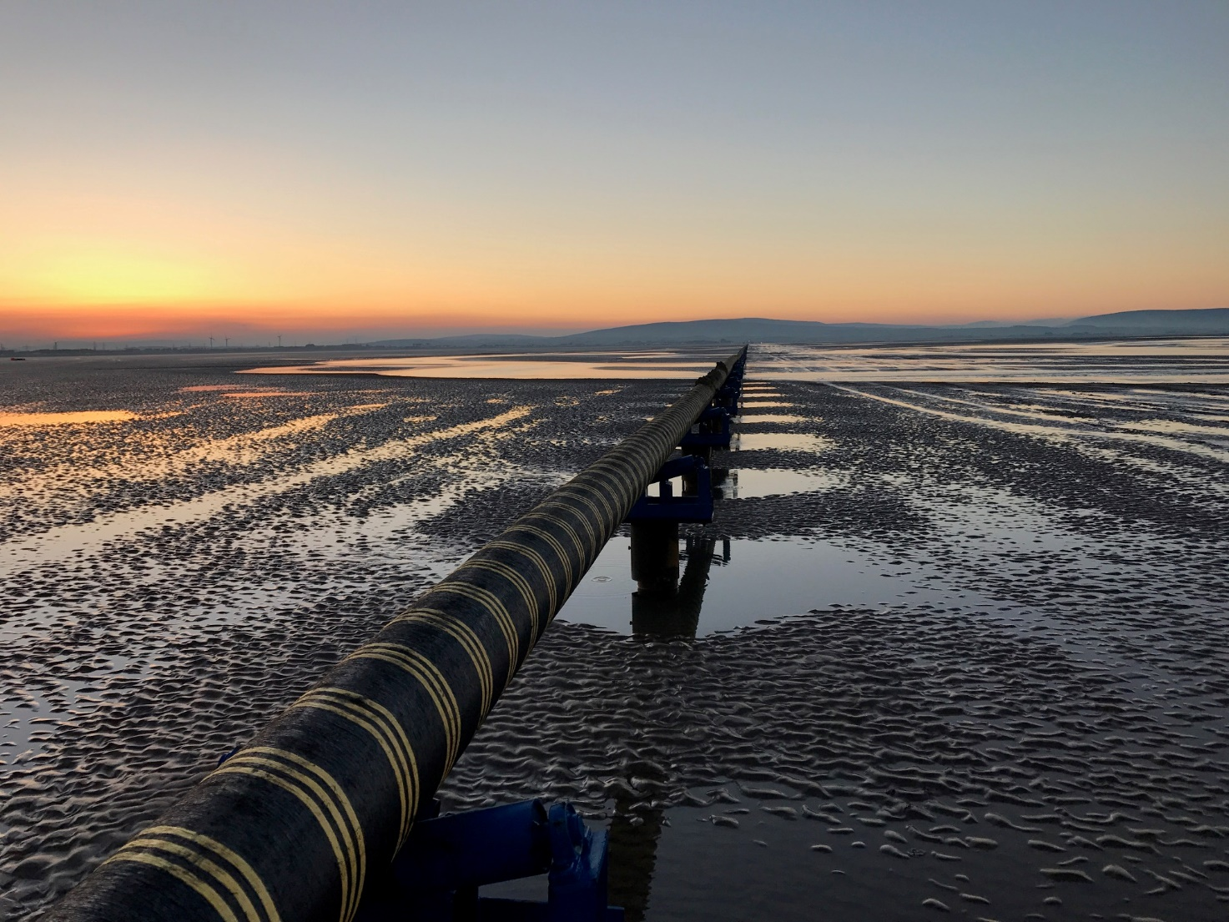
Bringing Off-Shore Wind to New England's Shores
Key learnings from pioneering offshore wind transmission
Søren Hindbo, Head of Electrical Systems
Friday, June 16, 2017

Slide 2




DONG Energy Wind Power is the global market leader in Offshore Wind
DONG Energy Wind Power geographical footprint
Unparalleled experience and track record
Bay State Wind
1991
26 years of experience and track record in the offshore wind sector
2017
Ocean Wind
APAC
Taipei office
Anholt
21 offshore wind farms in operation
7 offshore wind farms under construction
Walney 1 + 2
Horns Rev 1 + 2
Middelgrunden
Walney Extension
Westermost
Rough
Avedøre
West of Duddon Sands
Hornsea 1
Vindeby
Hornsea 2 + 3 + 4
Nysted
Isle of Man
Race Bank
Gode Wind 2
3,591 MW Constructed capacity
2,000 Dedicated employees
3,840 MW under construction
Barrow
Lincs
Gode Wind 3
Burbo Bank Ext.
Gunfleet Sands 1 + 2
Gode Wind 1
Burbo Bank
Borssele 1+2
Borkum Riffgrund 1
Gunfleet Sands 3
Borkum Riffgrund 2
London Array
German Cluster
7.5 million
Europeans with clean electricity
3,662 MW
World's leading operator
15 Partnerships
In operation
Under construction
Under development

Slide 3
Key learnings from pioneering offshore wind transmission
Scope for grid connection in Europe
“HVAC vs HVDC”
Export cables
Interlink

Slide 4
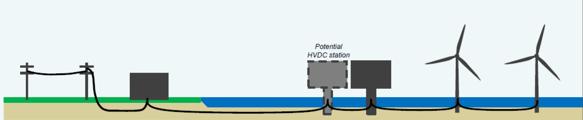





Scope of offshore grid connection in Northern Europe
Transmission System Operator | Onshore substation | Export cable | Offshore Substation |  | Array cables | Wind turbines
UK NGET | Wind Farm scope / divested to OFTO ¹⁾ |  |  |  | Wind Farm scope
DE TENNET FR RTE | Offshore TSO scope |  |  | Wind Farm scope
DK Energinet.dk NL TenneT | TSO scope / Offshore TSO scope |  |  |  | Wind Farm scope
NO COMPENSATION
COMPENSATION
COMPENSATION
¹⁾ Offshore Transmission Owner (3rd party)

Slide 5
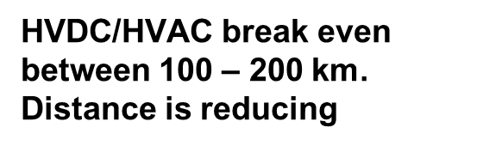
HVAC vs HVDC, based on Hornsea “One” 1,2 GW, 160 – 190 km
 | HVDC (VSC) | HVAC
CAPEX | Higher | Potential for lower
OPEX | Lower, due to electrical losses, but higher maintenance costs offshore | Higher, due to electrical losses
Availability | Lower | Potential for higher
Section able | Not able to section without significant extra cost | Potentially split in 3 separate systems and stage investments
HVDC/HVAC break even between 100 – 200 km. Distance is reducing

Slide 6
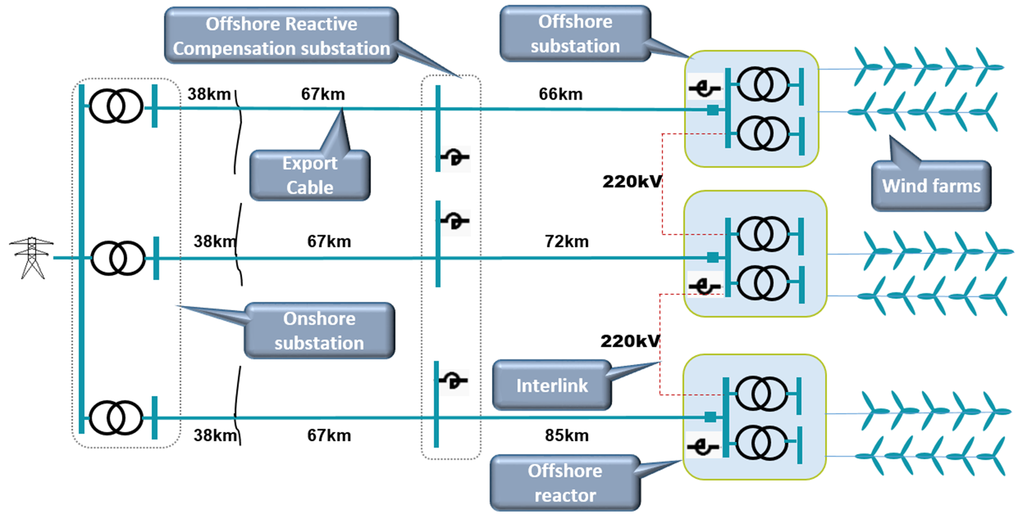

Hornsea One HVAC
Hornsea One HVDC

Slide 7
Export cable – the weakest and most expensive part
We expect 2-3 export cable faults pr. 100km pr. 20 year (CIGRÈ)
Cost of export cables are up to 60% of the transmission system
Walney 3+4 659 MW, HVAC, 2OSS, 1OnSS, 400/220/34 kV, 68+4 km (WR)

Slide 8
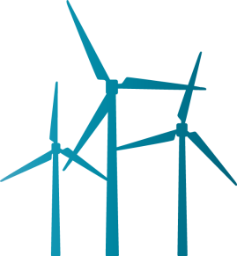
Interlink between platforms
The Solution
High Voltage interlink cable
Improving wind farm availability via interlink between platforms either at High Voltage or Medium Voltage
Advantage: Export energy during export cable faults
No permanent diesel generator offshore substation will reduce HSE and fire requirements
Reduce need for diesel gen-sets at WTGs
Possibly postponing of second export cable and reducing O&M costs
Disadvantage: Additional cost for interlink: Interlink cable, switchgear for interlink cable , extra j-tubes
Onshore substation
Wind farm
High Voltage
Medium voltage
Wind farms
Offshore substation

Slide 9
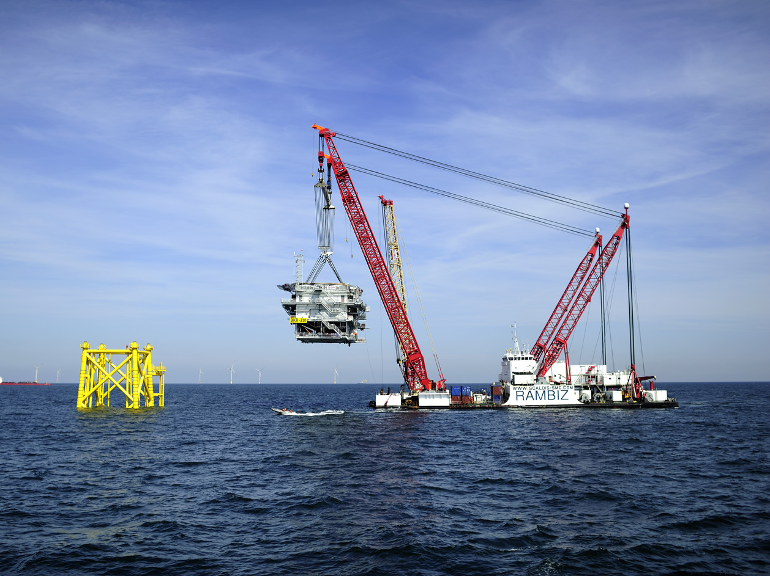
Thank you for listening!

Slide 10
Back-up

Slide 11
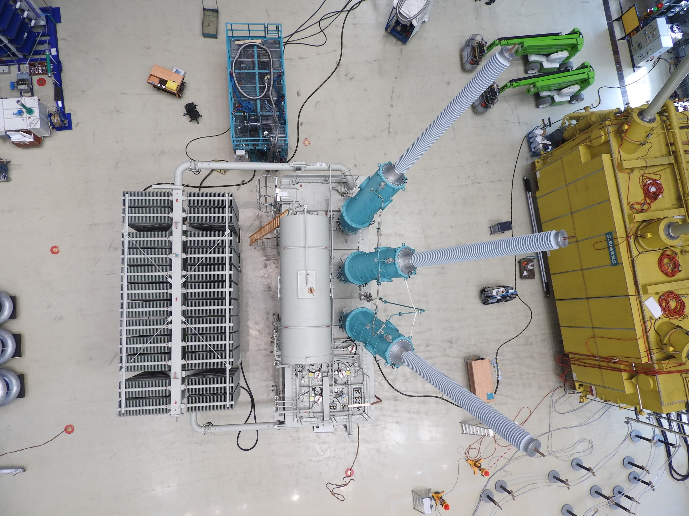
World largest Variable Shunt Reactor; 120-300MVAr, 220kV
Hornsea 1, 1218 MW, HVAC 3OSS, 1RP, 1OnSS, 400/220/34 kV 142+38 km (WR)

Slide 12
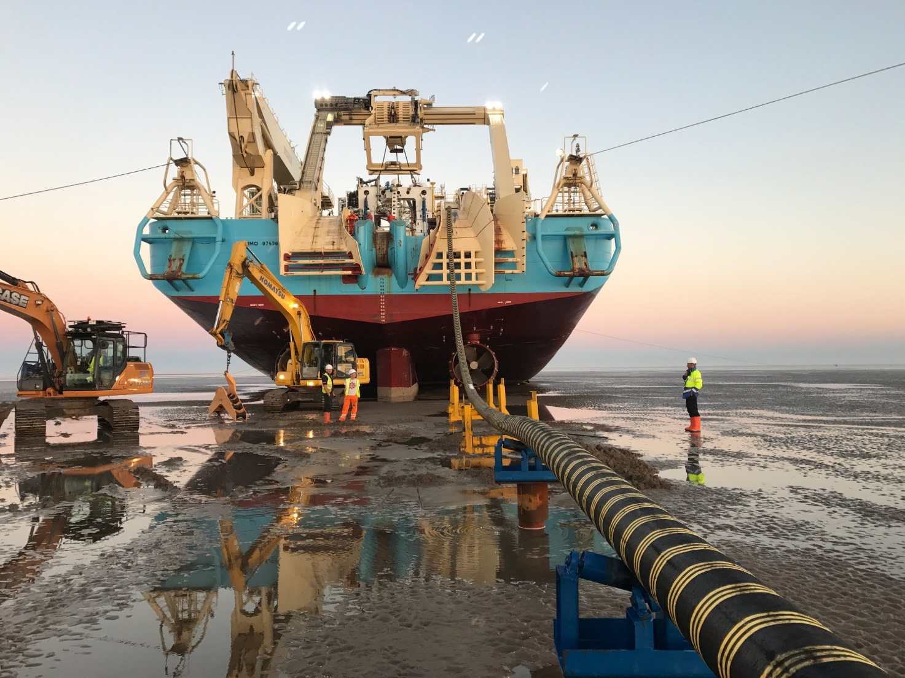
Longest power cable pull, 3.4km of cable within the intertidal zone
Walney 3+4 659 MW, HVAC, 2OSS, 1OnSS, 400/220/34 kV, 68+4 km (WR)

Slide 13
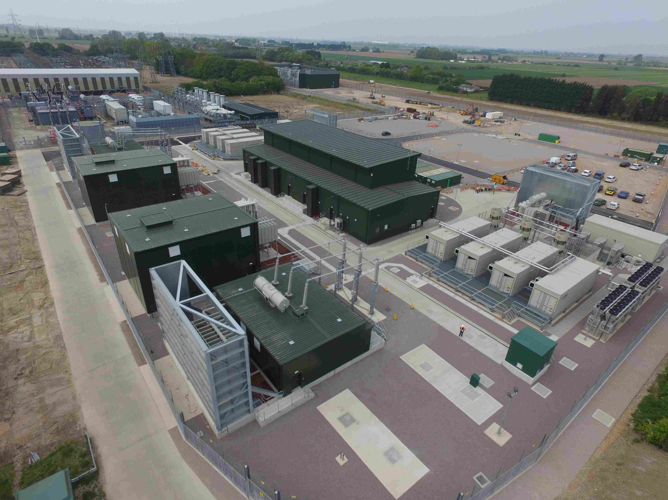
Onshore substation, Racebank
Race Bank 573 MW, HVAC, 2OSS, 1OnSS, 400/220/34 kV 74+12 km

Slide 14
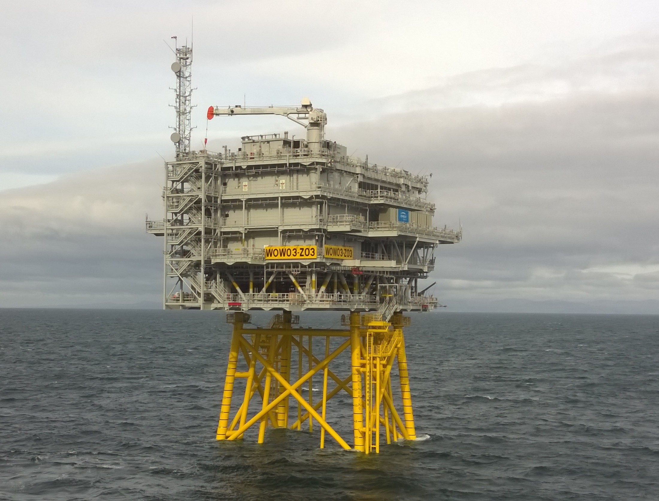
Offshore substation
Walney 3+4 659 MW, HVAC, 2OSS, 1OnSS, 400/220/34 kV, 68+4 km (WR)

