Slide 1

Reducing GHG Emissions from our Transportation System: Opportunities and Challenges
John Heywood
Sun Jae Professor of Engineering, Emeritus
Sloan Automotive Laboratory, MIT
NE Electricity Restructuring Roundtable #158
Decarbonizing the Transportation Sector
Panel: Pathways and Policies, June 15, 2018

Slide 2
The Context for Our Discussion
Transportation (land, sea, air) is responsible for some 30% of U.S. greenhouse gas emissions (15% worldwide).
Limiting the rise in global temperatures to 2 degrees C will need an 80% reduction in global GHG emissions by 2050.
Land transportation vehicles are dominated by internal combustion engines using petroleum-based fuels (90%).
Major impacts: congestion and environmental damage.
2

Slide 3








A Car: What Are Our Choices?
Small Car
Compact Hatchback Car
Standard Sedan
Pick-up Truck
Crossover – Smaller SUV
Standard – Larger SUV
3
Sports Car
Van

Slide 4
There’s a broad spread in ….
Type of vehicle we buy, and how much we spend.
What we use our light-duty vehicles for.
Types of trips we make, how many, mileage.
How we drive: “eco” or aggressive driving?
Where we live: urban/rural, warm/cold climate, …
How we look after our car; service, tires, roof racks, …
How we “think about our car”?
4

Slide 5
Three Potential Transportation Revolutions …
Vehicle electrification (with green electricity).
Autonomous (self-driving) vehicles.
Shared, and connected, vehicles.
Billions of $ are being invested in these technologies.
To what degree will we buy in to these changes?
Are they “convenient”? Are they “compelling”?
5

Slide 6
Pathways that would move us forward
Improve mainstream engines, transmissions, and vehicles.
Transition to cleaner alternatives: electrified vehicles: hybrids, battery electric; fuel-cells, hydrogen; lower-carbon fuels
Conserve: reduce amount of driving; e.g. reduce energy use per task….
6

Slide 7
Relative Fuel Consumptions (Tank to Wheels): Different Propulsion System Light-Duty Vehicles
7

Slide 8
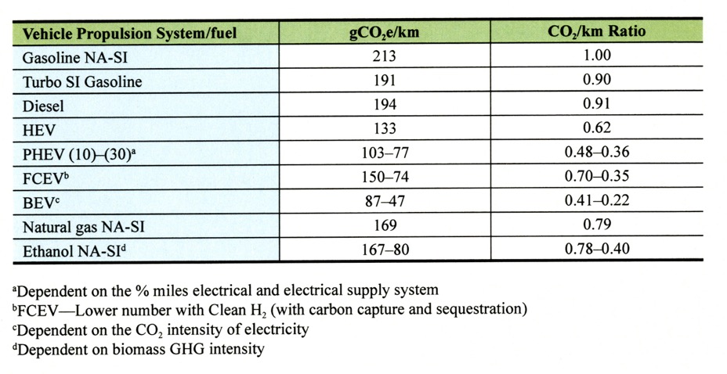
Well-to-Wheels GHG Emissions Data: Average New U.S. Car in 2030
8

Slide 9
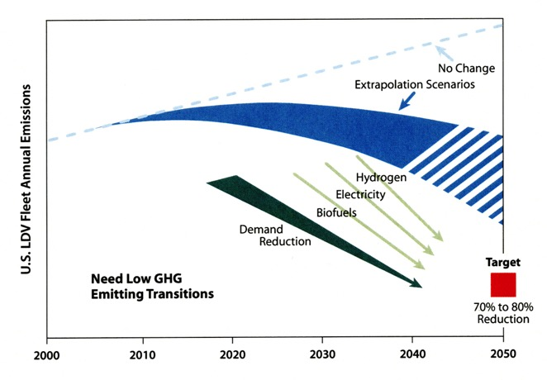
Strategic Summary of Prospects for Reducing
Greenhouse Gas Emissions from the U.S. In-Use
Light-Duty-Vehicle Fleet, 2000 to 2050
9
Source: On the Road Toward 2050 (2015)

Slide 10
Light-Duty HEV, PHEV, BEV Deployment Issues
EV sales currently need to be “pulled” by significant financial purchase incentives.
Initial costs of these vehicles are significantly higher (e.g. 2030 estimates): HEV ~ $2,500, PHEV (30 mile range) ~ $5,000, BEV ~ $10,000 (depending on size, range).
BEVs: range anxiety, long recharging times, limited number of recharging stations, are major uncertainties.
EVs mostly recharge at home: How many US “homes” have capacity and on-site space for recharging?
10

Slide 11
Looking Ahead at Anticipated Trends
Reducing the fuel consumption of mainstream technology vehicles is especially important (next few decades).
More hybrids (HEVs) will be an important component in reducing vehicle impacts (cost reduction needed).
With incentives, plug-in electric vehicles (PHEVs and BEVs) likely to bring significant electricity use into passenger transportation.
4. 2030 US LDV sales mix: John Heywood’s projections:
ICE 70%, HEV, 15%; PHEV 8%; BEV 6%; FC 0.5%
5. Task is to “reduce emissions”.
11

