Slide 1
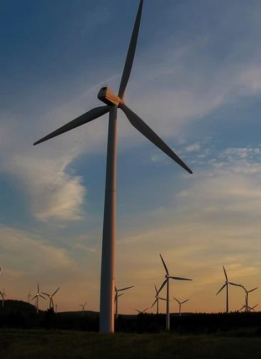
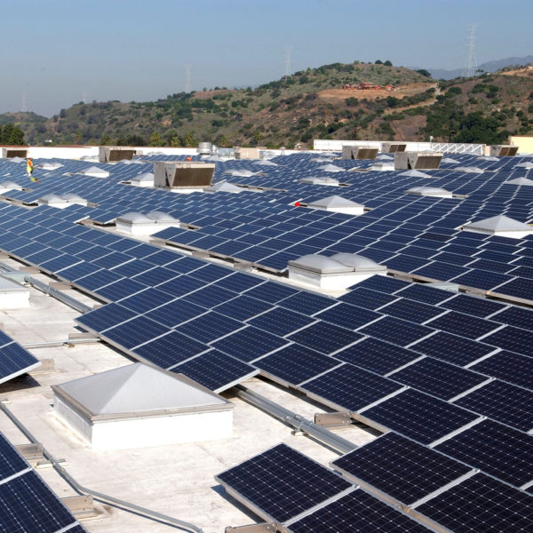

Federal policy To Spur The clean energy transition
Hal harvey
@hal_harvey

Slide 2
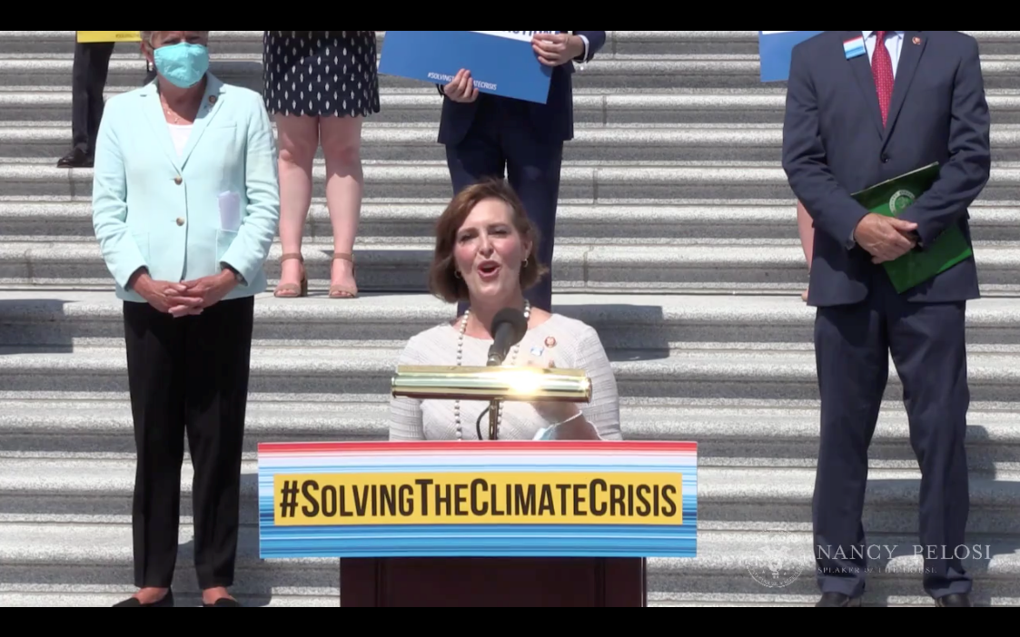
Targeting Net Zero By 2050
Political Momentum
Stimulus/ Green New Deal
Biden
House Select Committee

Slide 3
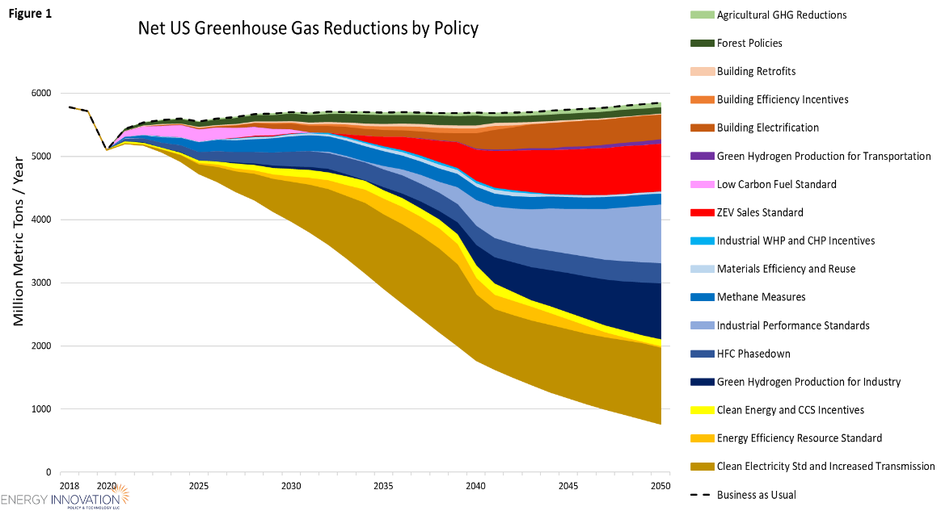
How Do We get There?
Which policies are needed to hit net zero?
EI has analyzed policies to hit net zero, including modeling House Select Committee proposal
www.energypolicy.solutions

Slide 4
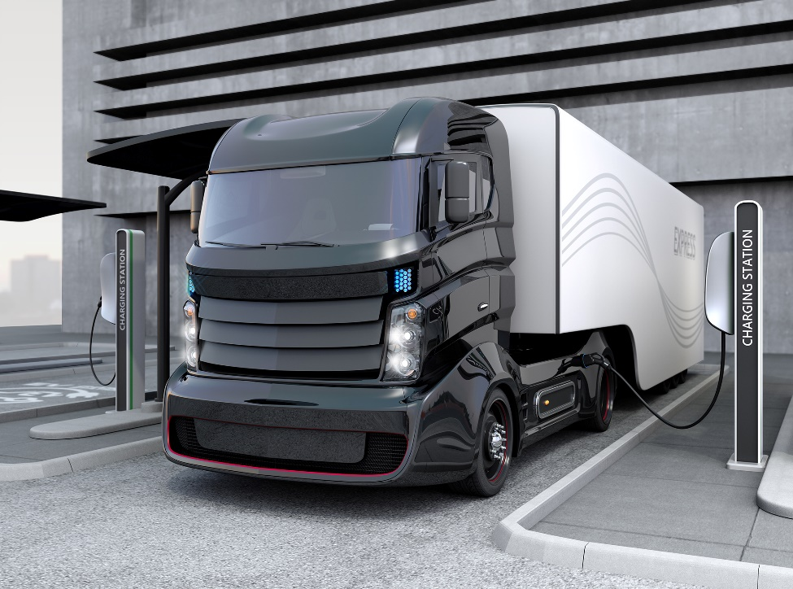
How Do We get There?
Roadmap : Decarbonize power sector then electrify transport, buildings, industry
Stock turnover is key: Fossil fuel equipment can last for decades
Lock in 90% clean power, then target clean vehicles and building sales by 2030-2035

Slide 5
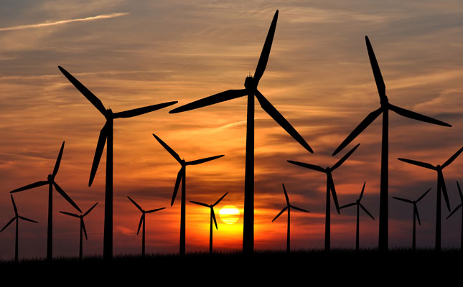
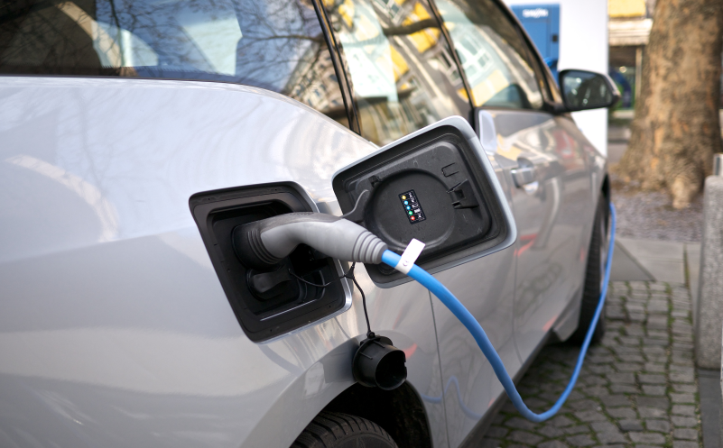


Decarbonizing four sectors

Slide 6
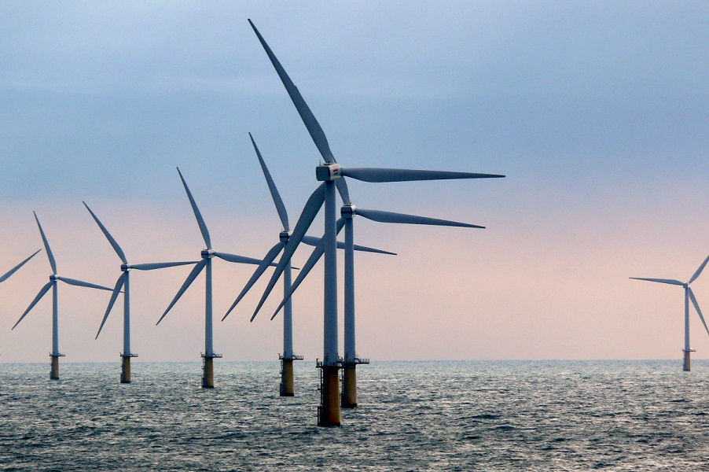
Zero-carbon grid
Implement strong clean energy standard: We can hit 90% by 2035 while cutting consumer costs. This may be politically impossible, so:
Expand state commitments, and..
Extend renewable tax credits: Target nascent tech like offshore wind
Add transmission, grid flexibility
Incent batteries, DR
And watch the wholesale markets..
Notes:
Image is utility-scale solar farms in California

Slide 7
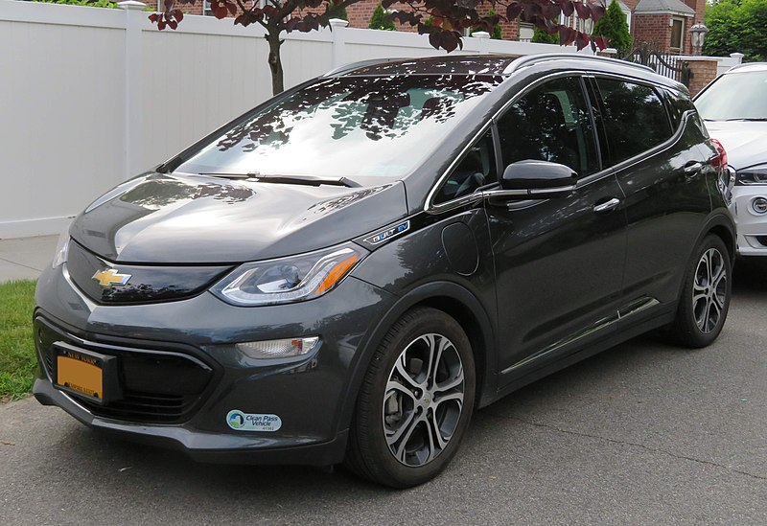
Zero-emission vehicles
Reestablish CA authority.
Implement strong EV sales mandate, EV tax credits; Set strong vehicle emission standards with continuous improvement
Utilities as prime movers in charging
Invest in R&D to decarbonize non-road transport, trucking, aviation
Notes:
Image is traffic in Albuquerque

Slide 8
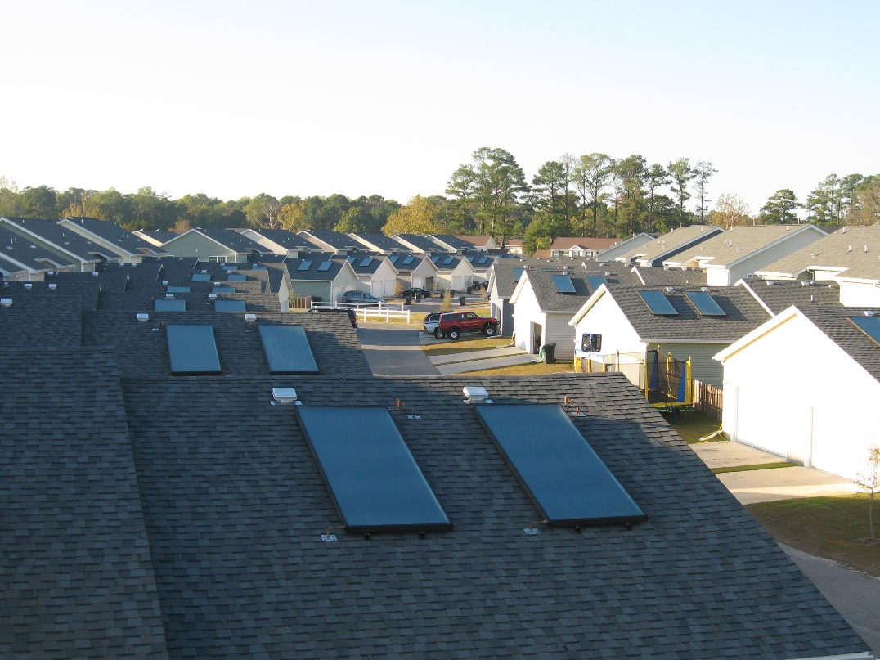
Zero-emission buildings
Target 100% clean new building and component sales by 2035. Heat pumps!
Incent energy efficiency, building electrification retrofits
Tighten appliance, equipment standards
Implement federal green building standard

Slide 9
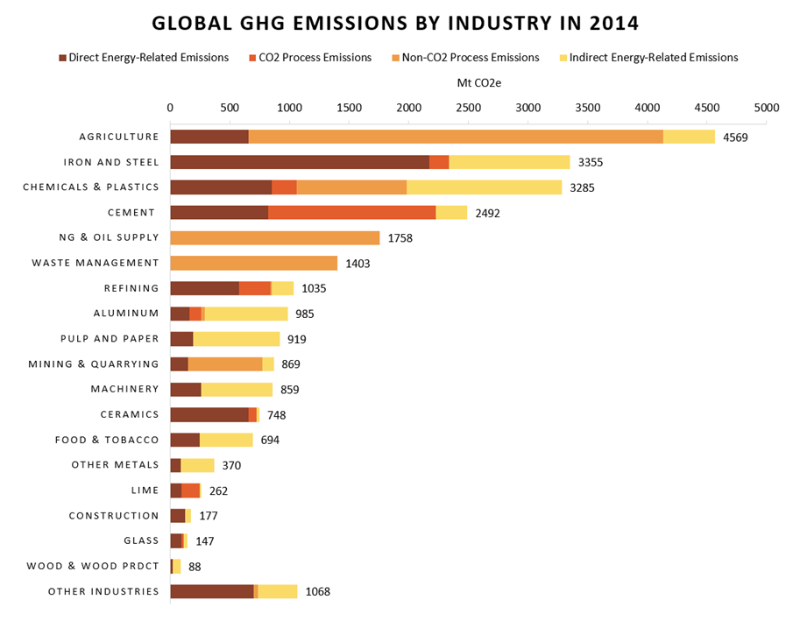
Zero-emission Industry
Target process emissions: Kigali Amendment, plug methane leaks
Electrify key industrial processes.
Use green hydrogen to power difficult realms.
Set carbon intensity standard
Create federal “Buy Clean” program

Slide 10

What does comprehensive clean energy transition really mean?
Financial upside: good jobs, lower costs, less local pollution
>3.3 million clean energy jobs in U.S. at start of 2020, >40% of total U.S. energy workforce
Notes:
Statistics from E2 Clean Jobs America 2020 report https://e2.org/reports/clean-jobs-america-2020/

Slide 11
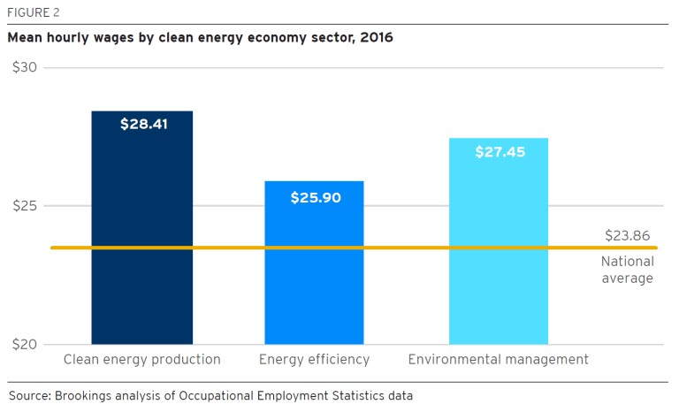
What does comprehensive clean energy transition really mean?
Solar installer, wind technician forecast to be two fastest growing U.S. jobs through 2025
Clean energy job can equal 8%-19% increase in income
45% of all clean energy workers have only high school diploma
Notes:
Bullet point #1 via U.S. Bureau of Labor Statistics
Bullet point #2 + #3 via Brookings Institution https://www.brookings.edu/research/advancing-inclusion-through-clean-energy-jobs/

Slide 12
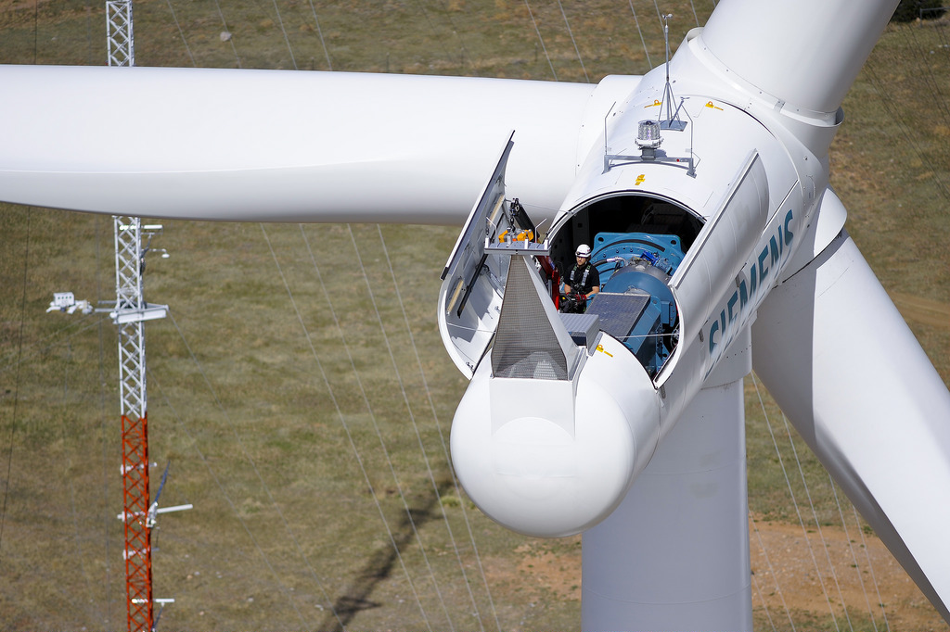
ensure clean energy transition includes a just transition
Ensure affected workers and communities are part of transition
Spur economic growth for disadvantaged communities and working people
Address environmental justice concerns in frontline communities

Slide 13

Thank you
@hal_harvey
@EnergyInnovLLC
Hal Harvey
www.energyinnovation.org

