Slide 1
3 Year Plans for Energy Efficiency: lessons learned and forging forward
Christina Halfpenny
Director, Energy Efficiency Division
www.mass.gov/doer

Slide 2

Milestones
Green Communities Act (GCA)
Electric and natural gas resource needs shall first be met through all available, cost-effective energy efficiency and demand reduction resources
Energy Efficiency Advisory Council
  11 voting members, includes AG, DEP, DOER as Chair
  Program Administrators as non voting Councilors
  Stakeholders: business groups, unions, environmental groups, consumer advocates
  Council consultants provide 3rd party expertise and review
Statewide programs
  Integrated gas & electric programs
  8 unique Program Administrators collaborating
  Streamlining processes, reducing costs
  Single efficiency brand and marketing
  Statewide Evaluation, Verification and Monitoring practice

Slide 3
Accomplishments
ACEEE Ranking #1 for Energy Efficiency
2010: 99% electric savings 2011: 91% electric savings
83% gas savings 84% gas savings
ISO- NE EE Forecasting Model

Slide 4
Rise in Efficiency Efforts
Savings as a % of annual retail sales
Notes:
ACEEE (Massachusetts earned 45.4 points out of 50. California earned 44.5)
Categories include:
utility efficiency programs and policy
transportation
building energy codes
combined heat and power projects
state government initiatives
appliance efficiency standards
2011 Massachusetts Clean Energy Industry Report
The Massachusetts clean energy economy now employs more than 64,000 people in , 4,909 clean energy companies across the state that saw a 6.7 percent increase in jobs between July 2010 to July 2011, and expect employment growth rate of 15.2 percent from July 2011 to July 2012.

Slide 5
Costs of Increasing Efficiency Efforts
 | 2010 | 2011 | 2012
Plan | $279 | $453 | $551
$/kWh | $0.447 | $0.454 | $0.447
Actual | $236 | $275
$/kWh | $0.38 | $0.33
Notes:
ACEEE (Massachusetts earned 45.4 points out of 50. California earned 44.5)
Categories include:
utility efficiency programs and policy
transportation
building energy codes
combined heat and power projects
state government initiatives
appliance efficiency standards
2011 Massachusetts Clean Energy Industry Report
The Massachusetts clean energy economy now employs more than 64,000 people in , 4,909 clean energy companies across the state that saw a 6.7 percent increase in jobs between July 2010 to July 2011, and expect employment growth rate of 15.2 percent from July 2011 to July 2012.

Slide 6
Costs of Increasing Efficiency Efforts
Plan $/kWh
 | 2010 | 2011 | 2012
Plan | $279 | $453 | $551
$/kWh | $0.447 | $0.454 | $0.447
Actual | $236 | $275
$/kWh | $0.38 | $0.33
Notes:
ACEEE (Massachusetts earned 45.4 points out of 50. California earned 44.5)
Categories include:
utility efficiency programs and policy
transportation
building energy codes
combined heat and power projects
state government initiatives
appliance efficiency standards
2011 Massachusetts Clean Energy Industry Report
The Massachusetts clean energy economy now employs more than 64,000 people in , 4,909 clean energy companies across the state that saw a 6.7 percent increase in jobs between July 2010 to July 2011, and expect employment growth rate of 15.2 percent from July 2011 to July 2012.

Slide 7
Critical Sectors for Savings
Notes:
ACEEE (Massachusetts earned 45.4 points out of 50. California earned 44.5)
Categories include:
utility efficiency programs and policy
transportation
building energy codes
combined heat and power projects
state government initiatives
appliance efficiency standards
2011 Massachusetts Clean Energy Industry Report
The Massachusetts clean energy economy now employs more than 64,000 people in , 4,909 clean energy companies across the state that saw a 6.7 percent increase in jobs between July 2010 to July 2011, and expect employment growth rate of 15.2 percent from July 2011 to July 2012.

Slide 8
Developing the Next 3 Year Plans
Stakeholder engagement in 3 year plans 2013-2015
Council Priorities 2012
Market opportunity assessment - PAs
Economic assessment and C&I surveys - Council
EM&V review
Best Practices Review
EEAC Consultant Recommendations
Notes:
ACEEE (Massachusetts earned 45.4 points out of 50. California earned 44.5)
Categories include:
utility efficiency programs and policy
transportation
building energy codes
combined heat and power projects
state government initiatives
appliance efficiency standards
2011 Massachusetts Clean Energy Industry Report
The Massachusetts clean energy economy now employs more than 64,000 people in , 4,909 clean energy companies across the state that saw a 6.7 percent increase in jobs between July 2010 to July 2011, and expect employment growth rate of 15.2 percent from July 2011 to July 2012.

Slide 9
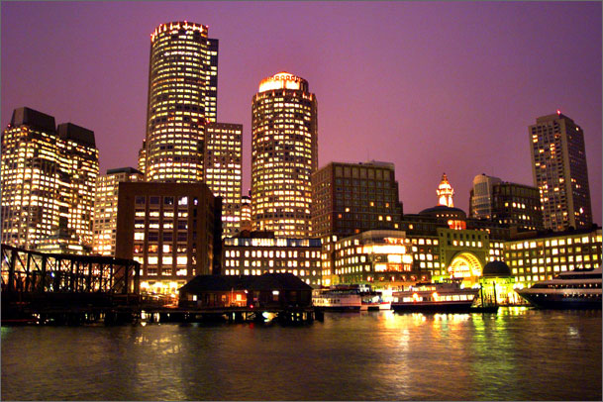

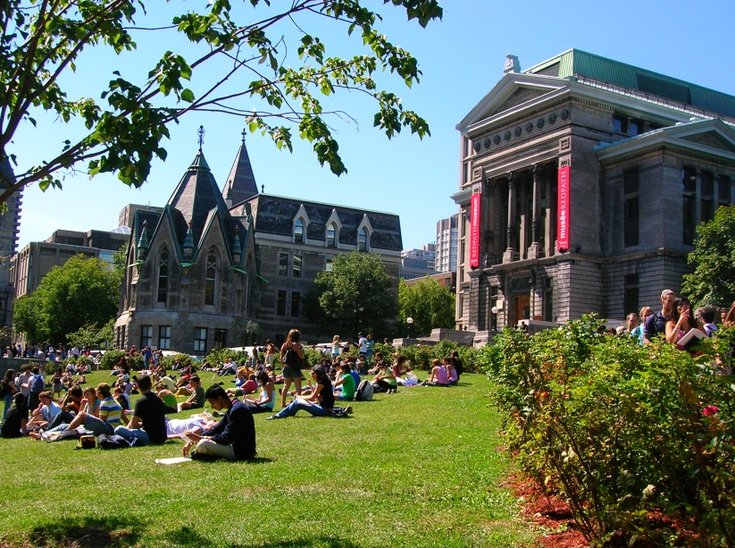

High Potential
Notes:
ACEEE (Massachusetts earned 45.4 points out of 50. California earned 44.5)
Categories include:
utility efficiency programs and policy
transportation
building energy codes
combined heat and power projects
state government initiatives
appliance efficiency standards
2011 Massachusetts Clean Energy Industry Report
The Massachusetts clean energy economy now employs more than 64,000 people in , 4,909 clean energy companies across the state that saw a 6.7 percent increase in jobs between July 2010 to July 2011, and expect employment growth rate of 15.2 percent from July 2011 to July 2012.

Slide 10
Stakeholder Feedback
January Council Meeting – Public Comment
Commercial Real estate
Healthcare
Community groups – customer equity
Labor Group – data accessibility
Consumer Advocates – multi family, customer equity
Notes:
ACEEE (Massachusetts earned 45.4 points out of 50. California earned 44.5)
Categories include:
utility efficiency programs and policy
transportation
building energy codes
combined heat and power projects
state government initiatives
appliance efficiency standards
2011 Massachusetts Clean Energy Industry Report
The Massachusetts clean energy economy now employs more than 64,000 people in , 4,909 clean energy companies across the state that saw a 6.7 percent increase in jobs between July 2010 to July 2011, and expect employment growth rate of 15.2 percent from July 2011 to July 2012.

Slide 11
Program Barriers to Address
Commercial
marketing and outreach
transaction costs
responsiveness and timing
limited measure offers
insufficient incentives
programs not tailored to unique needs
Residential
tenant landlord – Multi family
hard to reach/hard to serve: lower income, language, elderly
going deeper
Notes:
ACEEE (Massachusetts earned 45.4 points out of 50. California earned 44.5)
Categories include:
utility efficiency programs and policy
transportation
building energy codes
combined heat and power projects
state government initiatives
appliance efficiency standards
2011 Massachusetts Clean Energy Industry Report
The Massachusetts clean energy economy now employs more than 64,000 people in , 4,909 clean energy companies across the state that saw a 6.7 percent increase in jobs between July 2010 to July 2011, and expect employment growth rate of 15.2 percent from July 2011 to July 2012.

Slide 12
Consultant Recommendations
Between 1,100 and 1,300 GWh for electric
Between 29 and 38 MMtherms
Notes:
ACEEE (Massachusetts earned 45.4 points out of 50. California earned 44.5)
Categories include:
utility efficiency programs and policy
transportation
building energy codes
combined heat and power projects
state government initiatives
appliance efficiency standards
2011 Massachusetts Clean Energy Industry Report
The Massachusetts clean energy economy now employs more than 64,000 people in , 4,909 clean energy companies across the state that saw a 6.7 percent increase in jobs between July 2010 to July 2011, and expect employment growth rate of 15.2 percent from July 2011 to July 2012.

Slide 13
Cost Estimates
$.35/kWh ELECTRIC $.42/kWh
Deeper Savings
Comprehensive
Investment in Future
Harder to Reach/Serve
Lower cost initiatives , lighting, upstream, behavior
$5.50/therm GAS $6.35/therm
How do we achieve all cost effective energy efficiency?

Slide 14
Achieving All Cost Effective EE
Requires good data
  Good data collection processes
Effective marketing and outreach
Customized approaches to customers, including financial incentives
Accounting for naturally occurring energy efficiency
High efficiency codes and standards (and compliance)
Building labeling pilots underway through DOER
Notes:
ACEEE (Massachusetts earned 45.4 points out of 50. California earned 44.5)
Categories include:
utility efficiency programs and policy
transportation
building energy codes
combined heat and power projects
state government initiatives
appliance efficiency standards
2011 Massachusetts Clean Energy Industry Report
The Massachusetts clean energy economy now employs more than 64,000 people in , 4,909 clean energy companies across the state that saw a 6.7 percent increase in jobs between July 2010 to July 2011, and expect employment growth rate of 15.2 percent from July 2011 to July 2012.

Slide 15
Next steps to 2013-2015 Plans
April Draft plans
May Appreciative Inquiry
June Response to Draft plans
October 30 in statute for submittal of 3 year plans
90 day review by the DPU
Notes:
ACEEE (Massachusetts earned 45.4 points out of 50. California earned 44.5)
Categories include:
utility efficiency programs and policy
transportation
building energy codes
combined heat and power projects
state government initiatives
appliance efficiency standards
2011 Massachusetts Clean Energy Industry Report
The Massachusetts clean energy economy now employs more than 64,000 people in , 4,909 clean energy companies across the state that saw a 6.7 percent increase in jobs between July 2010 to July 2011, and expect employment growth rate of 15.2 percent from July 2011 to July 2012.

Slide 16
Thank you!
Christina Halfpenny
Director, Energy Efficiency Division
christina.halfpenny@state.ma.us
www.mass.gov/doer
Notes:
ACEEE (Massachusetts earned 45.4 points out of 50. California earned 44.5)
Categories include:
utility efficiency programs and policy
transportation
building energy codes
combined heat and power projects
state government initiatives
appliance efficiency standards
2011 Massachusetts Clean Energy Industry Report
The Massachusetts clean energy economy now employs more than 64,000 people in , 4,909 clean energy companies across the state that saw a 6.7 percent increase in jobs between July 2010 to July 2011, and expect employment growth rate of 15.2 percent from July 2011 to July 2012.

