Slide 1
Québec: a reliable partner for the Northeast
An overview for the participants of the New England Energy Restructuring Roundtable
  M. Mario Gosselin
  Quebec Associate Deputy Minister for Energy
December 9, 2011

Slide 2
Energy portfolio
Over 40,000 MW of clean electricity already
available for domestic and exportation purposes:
Over 97% of our electricity comes from a renewable source

Slide 3
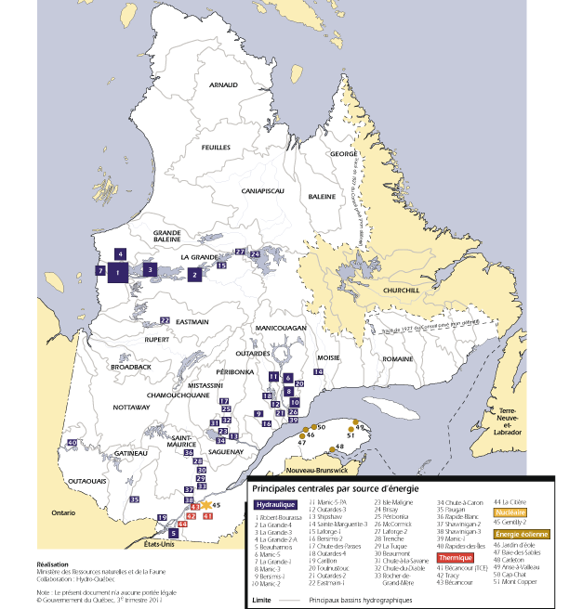
Quebec’s main generating stations by december 31, 2010

Slide 4
Quebec Energy Strategy 2006-2015
4,500 MW of hydropower
4,000 MW of windpower
  1,000 MW tender in 2003
  2,000 MW tender in 2005
  Two tenders of 250 MW for First Nations
  and local communities in 2009
150 MW for smaller hydroprojects
(less than 50 MW)
125 MW for cogeneration projects

Slide 5
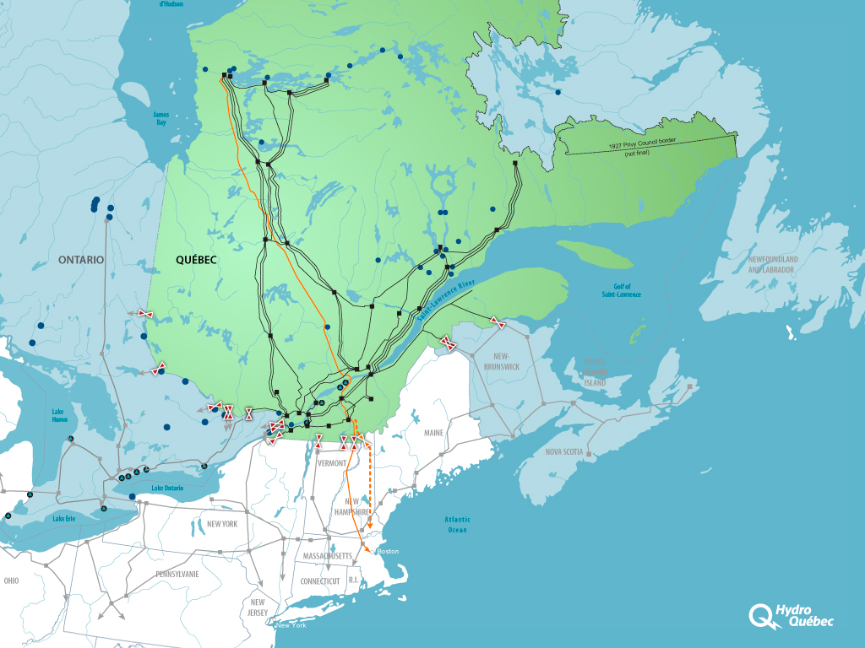
















Hydroelectric Projects
5

Slide 6
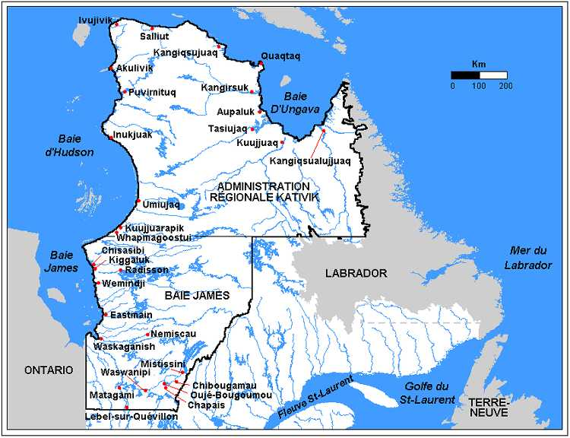
Plan Nord’s energy development target
3,000 MW of hydropower
300 MW of windpower
200 MW of other renewable energy

Slide 7
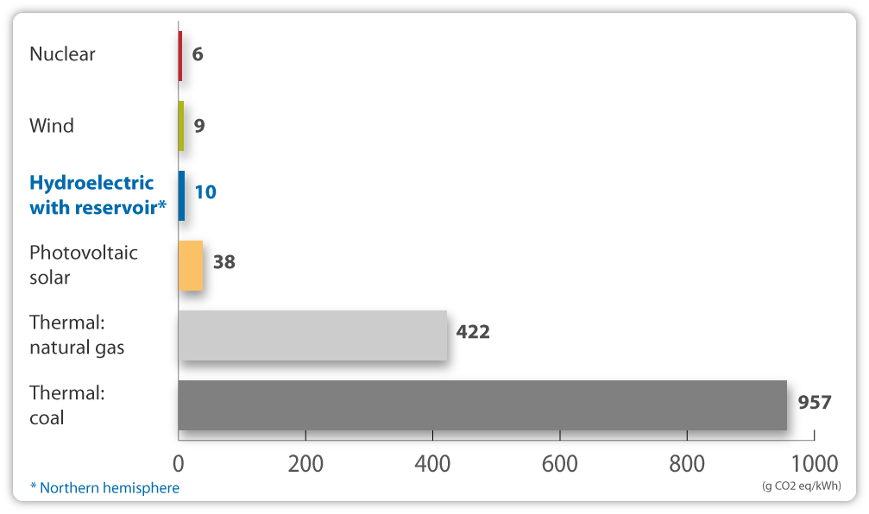
Greenhouse Gas Emissions

Slide 9
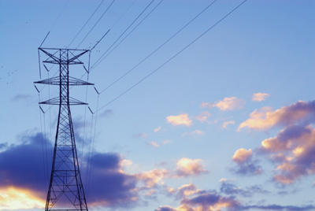
Quebec energy exports/imports with the U.S.
Energy trade with the U.S. (2010):
  15,3 TWH exports
  2,5 TWH imports
Energy trade with New England (2010):
  10,3 TWH exports
  0,8 TWH imports
  80% of exports sold on the spot/short term markets

Slide 10
Opportunities for the U.S.
Support States objectives in reducing their
GHG emissions
Support nation wide economic growth with stable and competitive prices for electricity
Hydropower not in competition with local energy sources, but part of a diversified energy portfolio

Slide 11
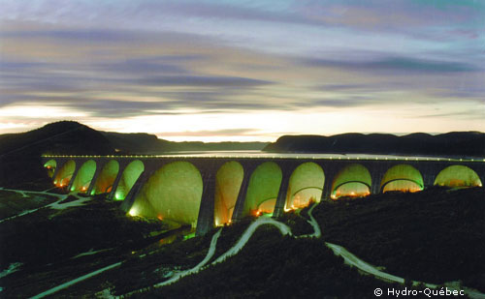
Conclusion
Quebec is open for business
Strong collaborative relationships key
to find common solutions

Slide 12


This presentation was given at the 12.9.2011
New England Electricity Restructuring Roundtable,
“Renewable Energy-Related Transmission for New Englanders: by Land and by Sea” convened and moderated by Raab Associates, Ltd.

