Slide 1
Reducing Pollution from Power Plants
Joseph Goffman
Senior Counsel
US EPA Office of Air and Radiation
October 29, 2010

Slide 2
Key Points
Cutting power plant pollution is required by the Clean Air Act and essential to protecting public health. Power plants are among the largest U.S. emitters of air pollutants with serious health effects including premature death.
The American people have suffered avoidable deaths and illnesses because important Clean Air Act-required power plant controls have been delayed more than a decade. Public health protection is long overdue.
Courts have determined that key rules issued by the last Administration were inconsistent with the Clean Air Act, which contributed to delays. EPA now must meet legal obligations to issue new rules that will require that the power sector become much cleaner.
Forty years of experience under national environmental laws shows that we can pursue a clean, healthy environment while maintaining economic growth and reliable electricity.
EPA has been considering reliability as it develops these new rules, and will continue to do so. EPA, FERC, DOE and state utility regulators, both together and separately, have tools at their disposal to ensure the continued reliability of our electricity supply.
Improved efficiency in electricity use can cut air pollution control costs, help ensure reliability of electricity supply, and reduce emissions of GHGs and other air pollutants.

Slide 3

Guiding Principles
Promoting common-sense strategies that encourage investment in energy efficiency and updated technologies.
Using similar strategies to capture multiple pollutants.
Setting clear, achievable standards while maintaining maximum flexibility on how to get there.
Seeking input from citizens, industry, affected entities, other stakeholders, as well as our partners in state, local and tribal governments.
Setting the standards that make the most sense – focusing on getting the most meaningful results through the most cost-effective measures.

Slide 4
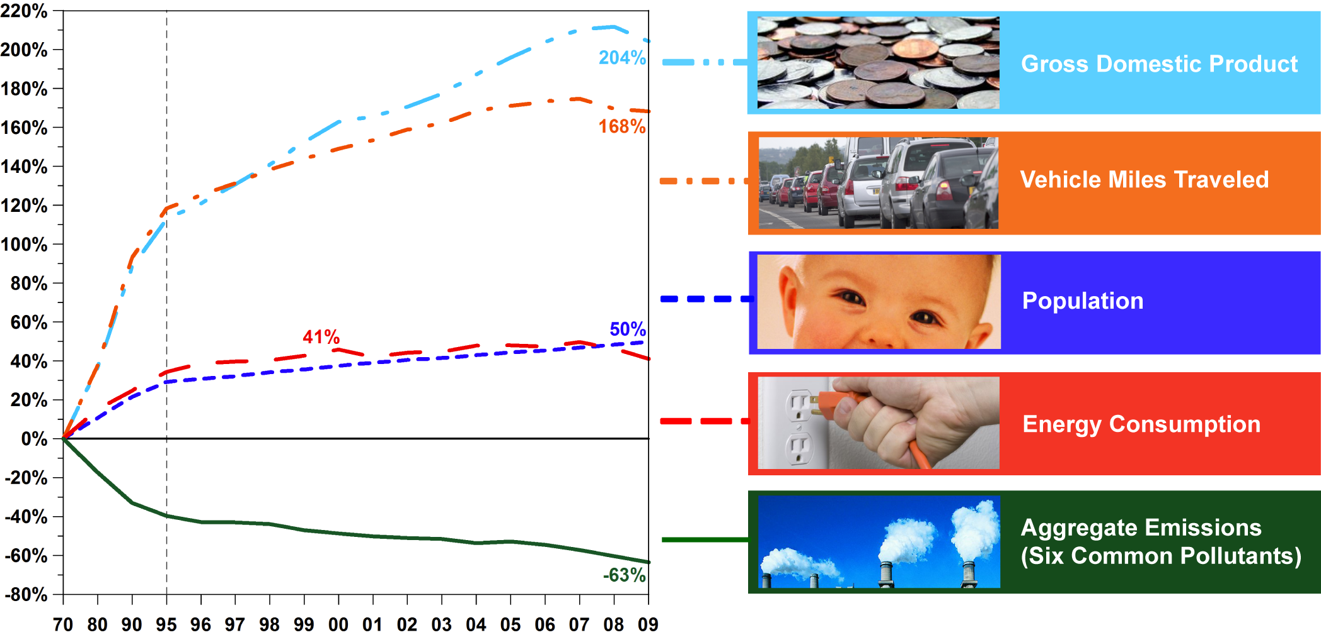
Cleaner air and a growing economy

Slide 5
Power Sector: A Major Share of US Air Emissions
Sulfur Dioxide (SO₂), 2009
9.5 Million Tons
Nitrogen Oxides (NO_{x}), 2009
15.3 Million Tons
Carbon Dioxide (CO₂), 2008
6.5 Billion Tons
3.8 Million Tons
40%
5.7 Million Tons
60%
13.3 Million Tons
87%
2.0 Million Tons
13%
3.9 Billion Tons
60%
2.6 Billion Tons
40%
Other Sectors
Electric Power
Other Sectors
Coal
85%
Coal
97%
Electric Power
Coal 83%
Other Sectors
Electric Power
Particulate Matter (PM₁₀), 2005
14.8 Million Tons
Mercury (Hg), 2005
114 Tons
14.3 Million Tons
96%
52 Tons
46%
Coal-fired power plants: vast majority of power sector air emissions
0.5 Million Tons
4%
Other Sectors
Electric Power
Coal
95%
Other Sectors
Electric Power
Coal
>99%
62 Tons
54%
5
Sources: SO2 and NOx - NEI Trends Data and NEI 2005 Version 2 (2009) and CAMD Data & Maps (2010); PM10 - NEI Trends Data (2009); Hg - NEI 2005 Version 2 (2009); CO2 - Inventory of U.S. GHG Emissions and Sinks: 1990-2008 (2010) and 1990-2007; “Other” sources include transportation, other mobile sources, and industrial sources

Slide 6
Mercury Air Emissions Estimates for Stationary Sources (2005)
6

Slide 7
Stationary Source Emissions of NOX, SO2 and GHGs
† For GHG bar, boilers are within each industry sector.
NOx and SO2 emissions from draft 2005 NEI version 2
GHG emissions from 2006 GHG inventory

Slide 8
Health Benefits for Millions of Americans
Benefits Greatly Exceed Costs
EPA estimates the annual benefits from the proposed transport rule range between
$120-$290 B (2006 $) in 2014 with annual compliance costs at $2.8 billion in 2014.
EPA estimates 2014 prices for electricity, natural gas, and coal prices increase 1 to 2%.
Estimated Number of Adverse Health Effects Avoided Due to Implementing the Proposed Transport Rule*
Health Effect | Number of Cases Avoided
Premature mortality | 14,000 to 36,000
Non-fatal heart attacks | 23,000
Hospital and emergency department visits | 26,000
Acute bronchitis | 21,000
Upper and lower respiratory symptoms | 440,000
Aggravated asthma | 240,000
Days when people miss work or school | 1.9 million
Days when people must restrict activities | 11 million
* Impacts avoided due to improvements in PM_{2.5} and ozone air quality in 2014
Notes:
8
8

Slide 9
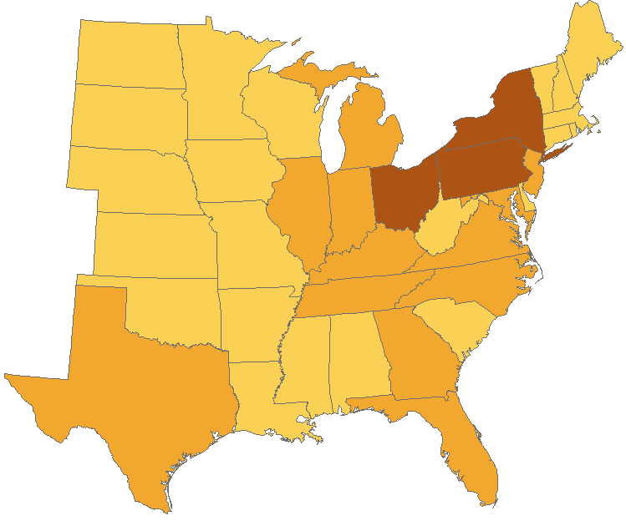
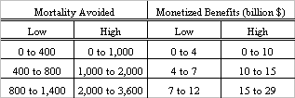

Billions of Dollars of Health Benefits in 2014
Proposed Transport Rule
Ranges of Benefits
Maine, New Hampshire, Vermont, Rhode Island, North and South Dakota receive benefits and are not in the Transport Rule region. Transport Rule RIA, Table A-4 and A-5; mortality impacts estimated using Laden et al. (2006), Levy et al. (2005), Pope et al. (2002) and Bell et al. (2004); monetized benefits discounted at 3%
Notes:
9

Slide 10
Public Health Protection Delayed
The American public has suffered avoidable deaths and illnesses as important Clean Air Act-required power plant controls have been delayed more than a decade.
The Act required states by 2000 to adopt rules as needed to control interstate pollution to help meet health-based air quality standards issued in 1997
  NOX SIP Call Rule (1998) partially addressed ozone transport by 2004, but did not address fine particles.
  Previous administration finalized Clean Air Interstate Rule (CAIR) in 2005 but court found legal flaws and ordered EPA to replace it.
  New Transport Rule to replace CAIR and address 2006 PM NAAQS is to be completed in June 2011.
The Act required studies in the early 1990s and, if appropriate and necessary, control of hazardous air pollutants from power plants.
  Positive determination in 2000 meant final rule due by 2002.
  Previous Administration issued Clean Air Mercury Rule for power plants in 2005 but court found rule legally flawed and vacated it. Also, rule failed to address all air toxics.
  Consent decree requires EPA to propose rule to control toxic air pollutants from EGUs by March 2011 and finalize by November 2011.

Slide 11
Many Coal Plants Remain Uncontrolled for SO₂ &/or NO_{X}
Many are > 40 years old

Slide 12
Rulemaking Schedule
Conventional air pollutant rules: driven by NAAQS attainment deadlines
Hazardous air pollutant rule: court ordered deadline Nov 2011
2010
2012
2013
2014
2011
Transport Rule II (F)
Revised Ozone NAAQS
Transport Rule (P)
Revised PM NAAQS
Transport Rule (F)
Transport rule II (P)
Utility MACT (P & F)
F = Final Rulemaking
P = Proposed Rulemaking
NAAQS = National Ambient Air Quality Standard
PM = particulate matter
MACT = Maximum Achievable Control Technology
Notes:
12

Slide 13
Existing Unit Compliance Periods
 | 2011 | 2012 | 2013 | 2014 | 2015 | 2016 | 2017 | 2018 | 2019
AIR
Transport Rule
Transport Rule update
Utility MACT
WATER
Cooling water intake
Effluent guidelines
WASTE
Coal waste/ash
Phase I caps
Phase II caps
For revised NAAQS – timing TBD
2015: National Emission Standards
(Potential 1-2 year extension)
Compliance timing to be determined
Comply on 5-yr permit renewal cycle after rule final
Timing dependent on whether RCRA C or D
NAAQS = National Ambient Air Quality Standard
MACT = Maximum Achievable Control Technology
RCRA = Resource Conservation and Recovery Act
RCRA C = Special waste
RCRA D = Non-hazardous waste
Notes:
13

Slide 14
Upcoming CAA Power Plant Rules
Interstate Pollution Transport Rule for existing PM and ozone NAAQS
  Proposed rule unveiled in July, published August 2, 2010
  Final rule planned June 2011
Utility MACT (section 112/hazardous air pollutants)
  Propose March 2011, finalize November 2011
Utility NSPS (section 111/criteria pollutants)
  Same schedule as MACT
  2006 utility NSPS is under reconsideration and subject to pending litigation
  Section 111(b) for new and modified/reconstructed sources
Interstate Pollution Transport Rule for 2010 reconsidered ozone NAAQS
  Proposed rule in 2011, final rule in 2012
Response to court remand on Utility NSPS (section 111) for greenhouse gases
  EPA is considering substance and timing of its response.

Slide 15

Toolbox of Emissions Reduction Technologies for Power Plants
Many Have Multi-pollutant Benefits
Pollution reduction controls at utilities are well-understood and available now
SO₂ reduction technologies
  Reduce HAPs to meet requirements of upcoming Utility MACT
  Help in-state areas attain the existing and upcoming PM2.5 NAAQS and 2010 SO₂ NAAQS
  Help downwind states attain PM2.5 NAAQS
  Address visibility (regional haze) improvement goals
NOx reduction technologies
  Help in-state areas attain the existing and new ozone NAAQS
  Help downwind states attain the existing and new ozone NAAQS
  Address visibility (regional haze) improvement goals
Mercury reduction technologies
  Reduce mercury emissions to meet requirements of upcoming Utility MACT
Direct PM reduction technologies:
  Help attain PM2.5 NAAQS and visibility program requirements
  Reduce HAP emissions to meet requirements of upcoming Utility MACT

Slide 16
Industry Capacity to Add New Emissions Controls
Added 20+ GW of SO₂ scrubbers per year 2008 - 2010
Source: David C. Foerter, Executive Director
Institute of Clean Air Companies (ICAC), October 22, 2010

Slide 17
Industry Capacity to Add New Generation
Between 2001 and 2003 the electric industry built over 160 GW of new generation
Capacity (MW)
U.S. Power Plant Capacity Added By In-service Year
Source: Ceres, et al., Benchmarking Air Emissions of the 100 Largest Electric Power Producers in the United States, June 2010.

Slide 18
LBNL forecasts a 250% to 400% increase (Med/High cases) in EE program funding by 2020
Cumulative savings by 2020 equal 6.1% (med) to 8.6% (high).of EIA’s forecast 2020 electricity demand
Energy Efficiency Program Funding and Electricity Savings Projected to Grow Substantially
Source: LBNL’s The Shifting Landscape of Ratepayer-Funded Energy Efficiency in the U.S. (October, 2009) by Galen Barbose, Charles Goldman, and Jeff Schlegel
Notes:
EE funding projected at $7.4B-$12.4B in Medium and High scenario by 2020Equal to approx. 250% (Medium Case) and 400% (High Case) of 2008 funding levels
Cumulative savings by 2020 equal 6.1% (Medium) to 8.6% (High) ofEIA’s reference case forecast of 2020 retail electricity sales

Slide 19
The Role of Energy Efficiency and Demand Response
Multiple benefits of supplementing our rules with actions to reduce electricity demand by improving energy efficiency would:
  Substantially cut total costs to power sector of controlling conventional pollutants
  Achieve reductions in CO₂ through idling or retirement of inefficient fossil-fuel-fired generating stations that would no longer be economic or needed
  Avoid or defer need for new generation
  Reduce conventional air pollutant emissions, especially on high electricity demand days (which coincide with poor air quality)
  Reduce concerns about reliability of electricity supply
  Lower consumer bills
EPA encourages state regulators, including PUCs and State energy offices, system transmission operators, and power companies to take action to reduce demand for electricity.

