Slide 1
Storing Electricity for
Our Future
October 2012

Slide 2

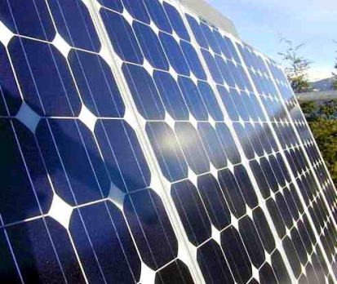

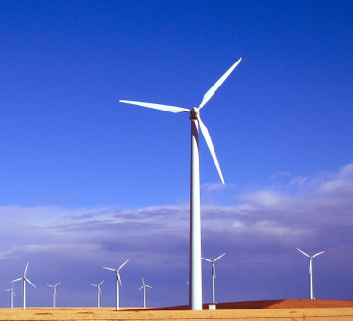
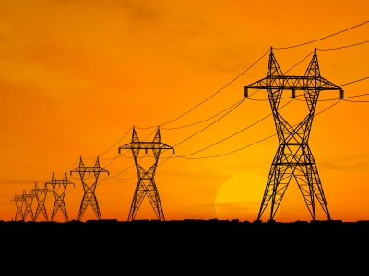
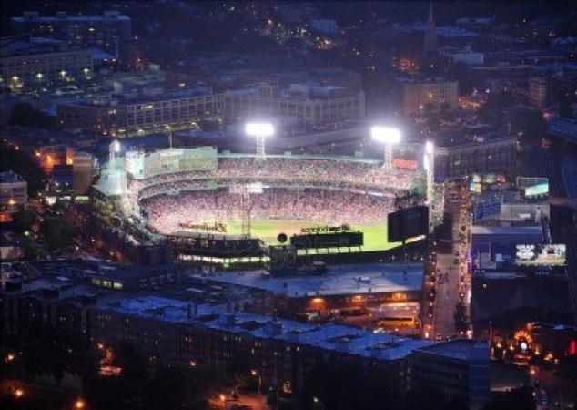
Electricity Storage is a Transformational Opportunity
National Academy of Engineering named the electrical grid the greatest engineering achievement of the 20th century – the largest and most complex machine ever made.
Today
Instant response
Supply
Demand
x
Electricity Storage Changes Everything
Supply
Demand
x

Slide 3



Ambri Overview
Company History
Core Development Principles
Primary focus → low cost
Funding
Private investors include Khosla Ventures, Bill Gates and Total
Spun out of MIT in 2010
Currently 22 employees in Cambridge, MA
Based on 40 years of research by Professor Donald Sadoway in extreme electrochemical processes (e.g., aluminum smelting)
Enabling grants from the Deshpande Center, the Chesonis Family Foundation, Lightspeed, US DOE ARPA-E and Total
Ambri Differentiators
Fast response & high energy: flexibly address a wide range of applications
Safe and silent
Use earth abundant materials
Target Applications
Integrate variable renewable resources like wind and solar
Relieve grid congestion
Avoid or defer investments in generation, transmission and distribution
Enable end-users to optimize rates
High efficiency, long lifespan, reliable
Simple to manufacture
No moving parts
Formerly Liquid Metal Battery Corporation
No subsidies required
2012
Professor Sadoway named Time’s 100 most influential people in the world
2012
Mass High Tech “Startup to Watch”
2010
David Bradwell named MIT Technology Review's 35 innovators under 35

Slide 4
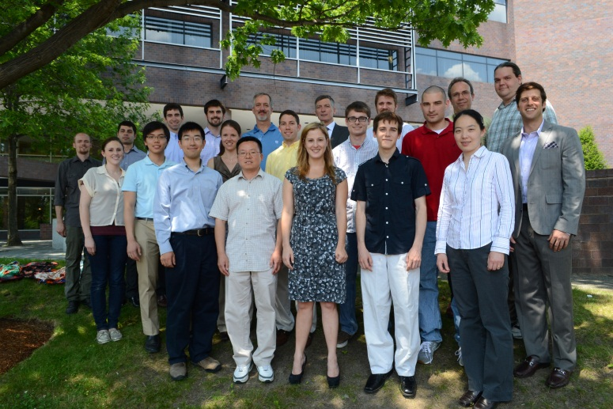
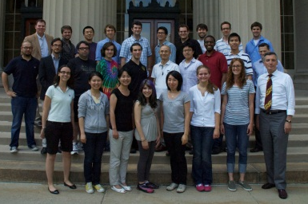


Ambri Origins
Concept Envisioned.
Sadoway’s 40 years of inspiring work on metallurgy and chemistry revealed potential of energy storage at grand scale
Concept Advanced.
Bradwell research (MS 2006, PhD 2010)
Operating Battery Cells.
Research funding from Deshpande Center, Chesonis Family Foundation, Total and ARPA-E
Company Formed.
Founded in 2010
Performance breakthroughs
Team: 22 FTEs currently and expanding
Building working cells in operating lab and managing to a development plan
Identifying commercialization acceleration opportunities
Funding from Khosla Ventures, Bill Gates and Total
Commercialization
2014 and Beyond

Slide 5


Ambri Investors
Ambri’s investors share our long-term vision for developing an electricity storage technology that will transform the electric power industry everywhere.
May 2012 Ambri closed our $15 million series B round, led by Khosla Ventures; series A investors participated fully; funding will enable deploying commercial prototypes in 2014
Khosla Ventures Founded in 2004 $1.05 billion Khosla Ventures IV closed in fall 2011 Over $2 billion under management Returned over $1 billion in profits to investors*
Bill Gates Chair, co-founder and former Chief Executive Microsoft Founder of the Bill and Melinda Gates Foundation
Total S.A Founded in 1924 2011 sales: €185 billion 2011 assets: €164 billion Major investments in Sun Power and Amryis
*Source: http://techcrunch.com/2011/10/13/khosla-ventures-1-billion-fund/

Slide 6
Ambri Team
20 employees and growing to 32 by the end of 2012; 80% of team is focused on technology development; now hiring
Ambri Executives Staffing Levels
Phil Giudice, CEO & President
Over 30 years of experience in the energy industry; most recently Massachusetts Energy Undersecretary and Commissioner; formerly Executive at EnerNOC and senior partner and leader of Mercer Management Consulting's global energy utilities practice
David Bradwell, Co-Founder, CTO & SVP Commercialization
6 years of experience on the Liquid Metal Battery Project; M.Eng and PhD in Materials Science from MIT
Don Sadoway, Co-Founder, Chief Scientific Advisor
Over 30 years MIT Professor Materials Chemistry; author of over 135 scientific papers and holder of 16 U.S. patents; extensive research into the electrochemistry of molten salts
Kristin Brief, Director of Corporate Development & Treasurer
9 years of experience in energy industry as a consultant and entrepreneur; formerly at EnerNOC and NERA Economic Consulting

Slide 7
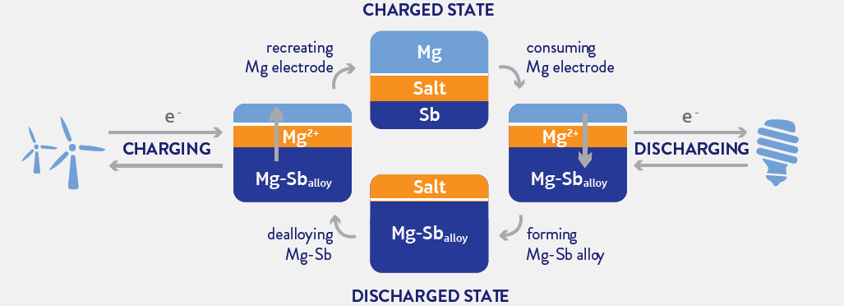
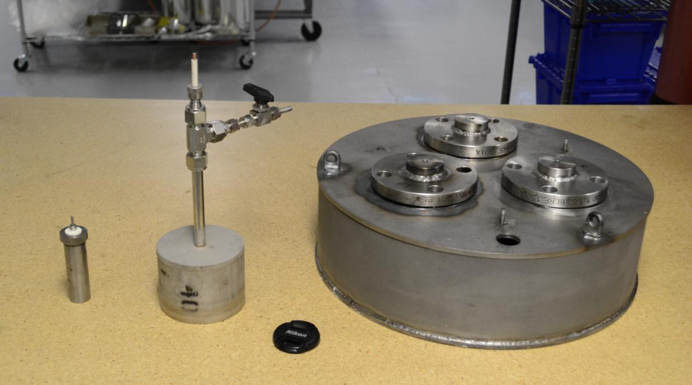
The Liquid Metal Battery Concept
Battery Schematic
Technology scale-up Characteristics
Three liquid layers
Self-separating (like oil and water)
High temperature operation
1 Ah 60 Ah 1000 Ah

Slide 8
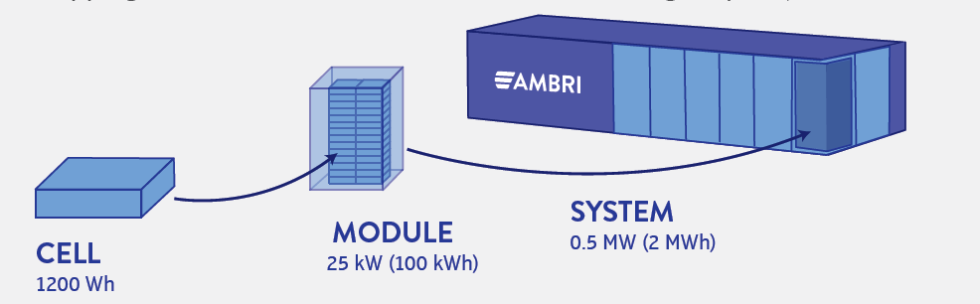
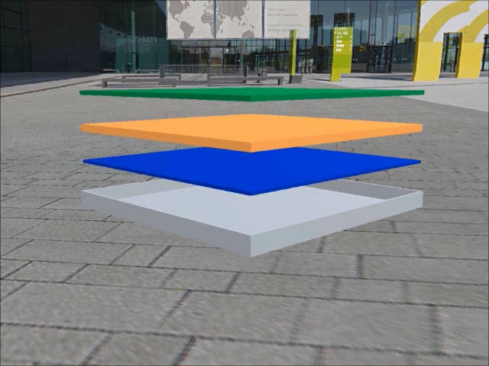
From Cells to Systems

Slide 9
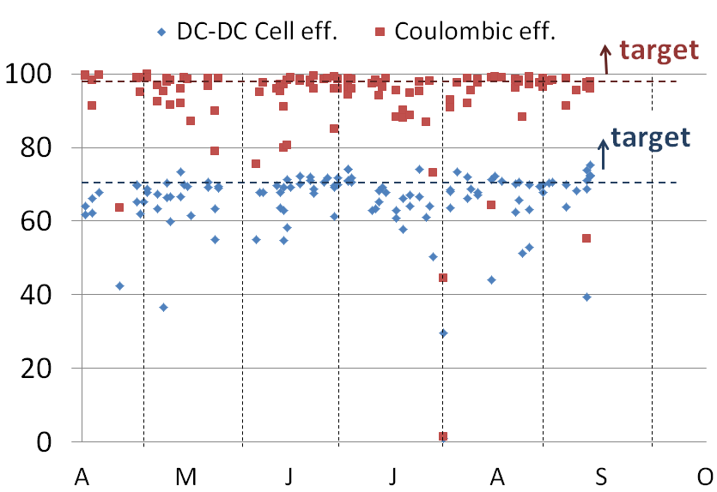
Technology Progress
The Ambri team cycled dozens of cells, demonstrating cost reductions and efficiency improvements.
Bulk Cost ($/kWh) Efficiency
(Metal Electrodes and Salt)
$/kWh
Cell Efficiency (%)

Slide 10
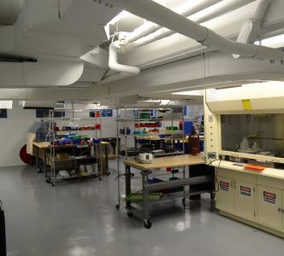
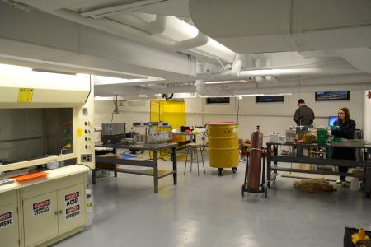
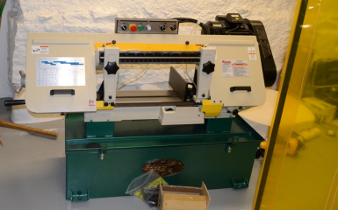
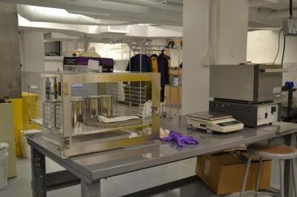
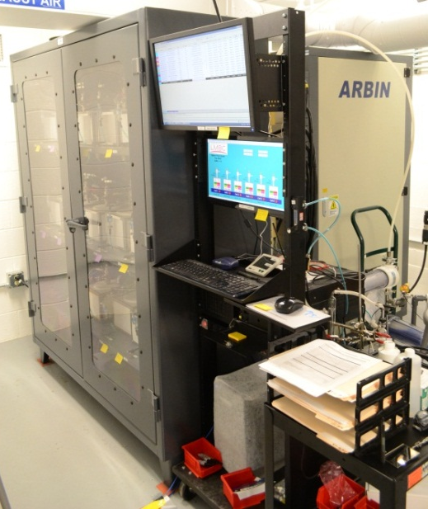
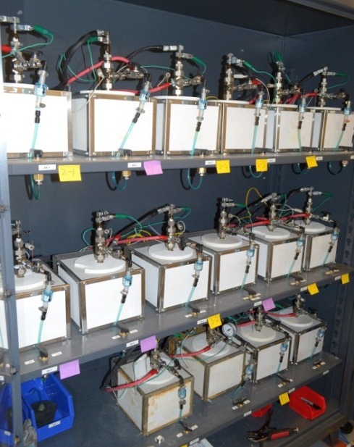
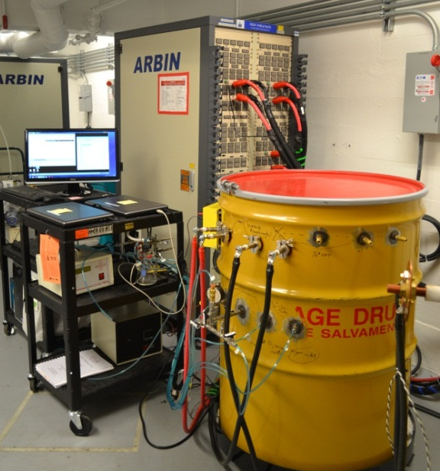
Ambri Laboratory
→ Main Laboratory
→ Cell Testing Equipment
Welding
Machining Equip.
Seal Testing
Cell assembly
Band Saw
Glove box
Cell testing/
storage
Salt Drying
Infrastructure
Fume hood
Salt drying
Test container
100 A Battery Test Stand for Medium Cells 500 A Battery Test Stands for Large Cells

Slide 11
Ambri’s Seven Distinguishing Features
 | Quality | Ambri Feature | Reason
1 | Origins | Large scale systems | Aluminum smelters and other very large scale, highly cost effective commodity electrochemical systems
2 | Cost to achieve scale manufacturing | Comparatively very low | Likely able to utilize existing industrial metal working facilities – heating, stamping, assembly and welding are very familiar processes world wide Minimal specialty equipment required – no clean room, no massive dedicated tooling or equipment, no robotics required, open assembly
3 | Cost of storage | Very low | Earth abundant materials No moving parts Tolerances in millimeters and centimeters not microns
4 | Siting considerations | Straightforward | Silent Emissions free Sealed
5 | Operating flexibility | Versatile | Full power or energy resource as markets and users require Response time in millisecond signals – switching from100% charging to discharging state
6 | Reliability | Very high | No moving parts
7 | Life span | Potentially decades | Observable performance fade – not measureable Analogous systems – electrochemical refining cells do last decades

Slide 12
Ambri Unit Costs Will Decrease
  Ambri cost modeling identifies significant cost improvement areas
  Envisioning dozens/hundreds of manufacturing sites world wide – globally serving local markets with Ambri solutions manufactured locally
  Likely able to utilize existing industrial metal working facilities – heating, stamping, assembly and welding are very familiar processes world wide
  Minimal specialty equipment required – no clean room, no massive dedicated tooling or equipment, no robotics required, open assembly

Slide 13
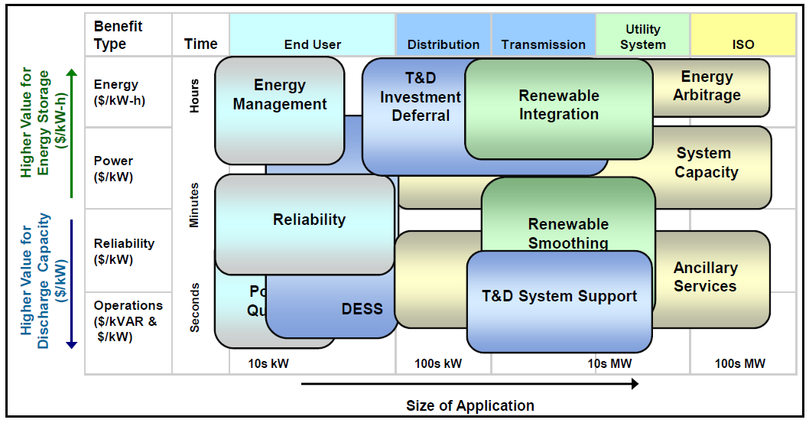
The Opportunity is Large, Many Potential Customers
Retail Value Proposition (end customer)
Integrate and smooth renewable resources
Avoid transmission and distribution investments
Meet peak demand
Ensure reliable system operations
Wholesale Market Opportunities
Energy arbitrage
Capacity
Ancillary services (frequency regulation, spinning and non-spinning reserves)
Voltage/VAR control (reactive power)
Avoid demand charges
Optimize time of use rates
Optimize energy purchasing strategies
Utility Value Proposition
Compliment onsite renewables and distributed generation -- microgrid
Source: EPRI.

Slide 14
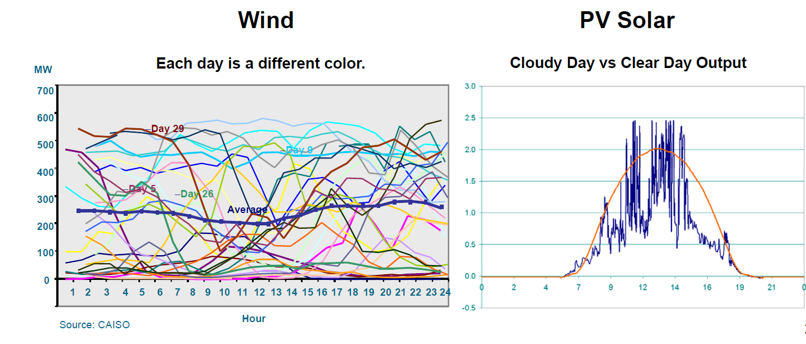
Intermittent Resources Create Opportunity for Storage
Increasing use of variable renewable resources creates new and extremely challenging conditions for electrical system operators – cost effective, reliable electricity storage is well suited to meet this challenge.
Source: CAISO; PG&E Presentation at ESA 2011

Slide 15
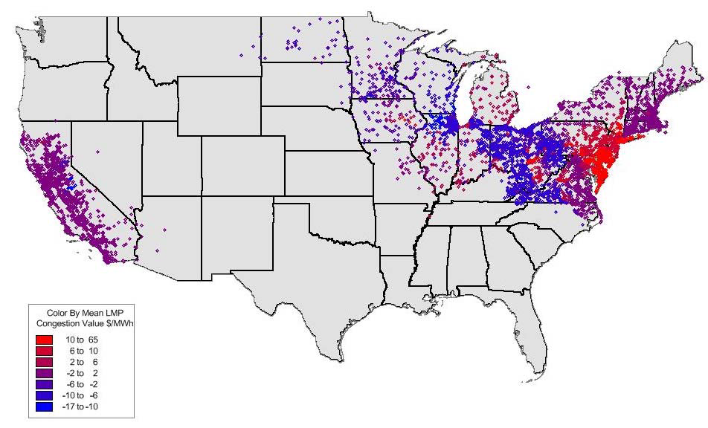
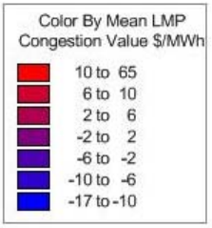
Congestion Creates Opportunity for Storage
Congestion creates substantial price variability in wholesale markets -- cost effective, reliable electricity storage is well suited to reduce congestion.
Total Congestion
Costs 2011
Day Ahead On-Peak Average
Monthly Congestion - July 2011
 | $ (Millions)
PJM | $998
NYISO | $407
ISO-NE | $18
MISO | $502
CAISO | $127
ERCOT | $459
Total | $2,511
Source: FERC, PJM, NYISO, ISO-NE, MISO, CAISO, ERCOT

Slide 16
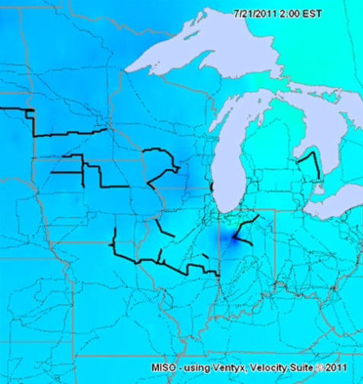
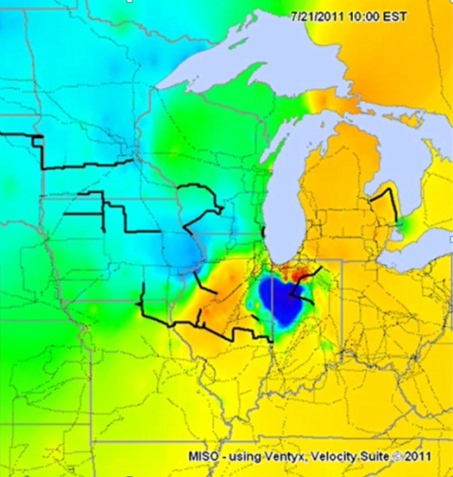
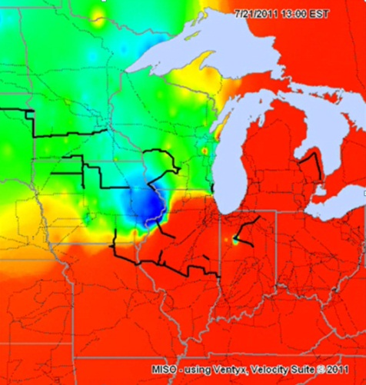
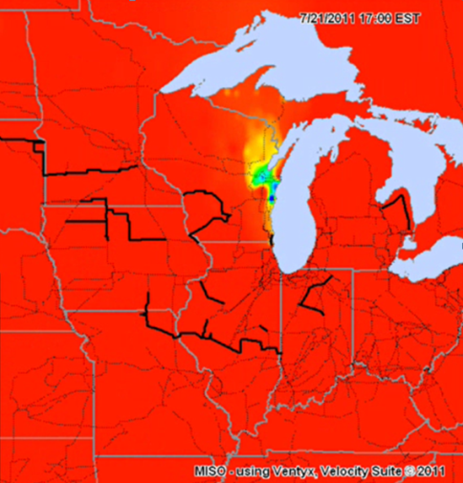

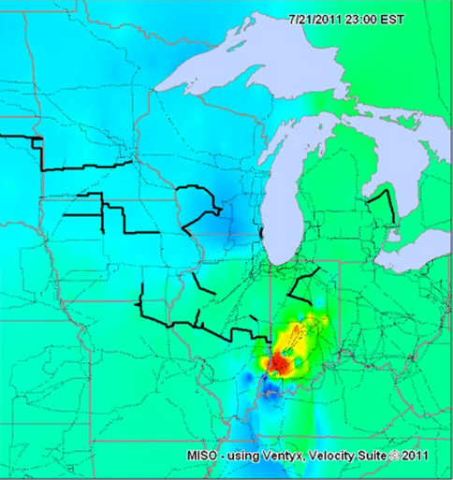
Energy Arbitrage Opportunities Wholesale Markets
MISO electricity prices over 24 hours
2 am 10am 3pm
5 pm 9pm 11pm
$200 $100+ $90 $70 $60 $50 $30 $0
Source: MISO Analysis by Ryan Westphal. July 21, 2011, http://www.EnergyCollection.us/Companies/MidwestISO/MISO_LMP_7-21-2011.wmv

Slide 17

Ambri potential to transform electric industry by
Enabling renewables
Mitigating congestion
Reducing price volatility
Increasing reliability
Lowering costs → $17 trillion investment to meet peak load vs. trillions less to meet average load
Global Market, 1990-2035
Capacity Needed
with and without Storage, in MW
Capacity Today
35.2
Peak
Demand
Capacity
with
Storage
TWh (000)
19.1
Average Demand
10.1
1990
2008
2035
hours
Source: IEA

Slide 18
Ambri 3-year plan
2012
Commercial sized cells operating
Initial power electronics and battery management systems determined
2013
Stacks of cells operating as prototype batteries with power electronics
Market and regulatory prioritization and partnerships identified
2014
Initial prototype installations
Implemented:
Market and regulatory assessments underway
Manufacturing partnerships developed
Determination of further investment needs (if any)
Marketing and sales partnership(s)
Exploration and refinement of manufacturing options
Global growth plans detailed
Regulatory monitoring and influence plans
Manufacturing partnership(s)

Slide 19
Thank you for your interest
Phil Giudice
Chief Executive Officer
pgiudice@ambri.com
617.714.5723 ext. 450

