Slide 1
September 25, 2015 | Boston, ma
Winter Reliability Program Updated
Restructuring Roundtable
Andrew Gillespie
Principal, Market development

Slide 2
For More than a Decade, the ISO Has Identified Winter Reliability Challenges
Region is increasingly reliant on resources with uncertain performance and availability
Natural gas resources lack firm gas transportation or fuel storage and rely on “just-in-time” fuel
More than 8,000 MW of non-gas-fired generation have been identified as being “at risk” for retirement
From 2007-2012, region experienced increased forced outages (specifically fossil-steam units) and poor fleet response during stressed system conditions
Regional Electric Energy Production by Fuel Type (2014)

Slide 3
Winter Programs Are Needed Until Long-term Market Solutions Are in Effect
Generator availability and performance during the winter of 2012/13 underscored shortcomings in the current capacity market design
Winter programs were created for 2013/14 and 2014/15
In early 2014, the ISO filed the Pay-for-Performance (PFP) capacity market design which ties capacity payments to resources’ performance during stressed system conditions
PFP is a comprehensive, long-term, market-based solution to improve resource availability and performance during stressed system conditions
Additional winter programs are needed in the interim because PFP changes won’t be in effect until June 2018

Slide 4
Past Two Winter Programs Provided a Stop-Gap Solution
Programs strengthen fuel adequacy when pipelines are constrained and generators have difficulty replenishing oil supplies in the middle of winter
Programs improved winter fuel assurance by creating an incentive for generators to secure fuel arrangements going into the winter while offsetting the risk of carrying unused fuel
2013/14 program included a prepayment for oil procurement
2014/15 program included a payment for unused inventory
Resource solutions expanded over past two winters
Winter 2013/14 | Winter 2014/15
Oil Demand Response | Oil LNG Demand Response

Slide 5
2013/14 Winter Reliability Program
Region experienced historically cold weather (polar vortex)
High natural gas demand combined with pipeline constraints resulted in sustained high natural gas prices
ISO frequently operated system with little or no gas-fired generation and in some cases oil-fired generators were economic
2.7 million barrels of oil were burned
Cost to the region was approximately $65 million (<2% of wholesale costs)
Program helped ensure reliability
For winter 2013/14 the wholesale cost of electricity totaled about $5 billion in New England

Slide 6
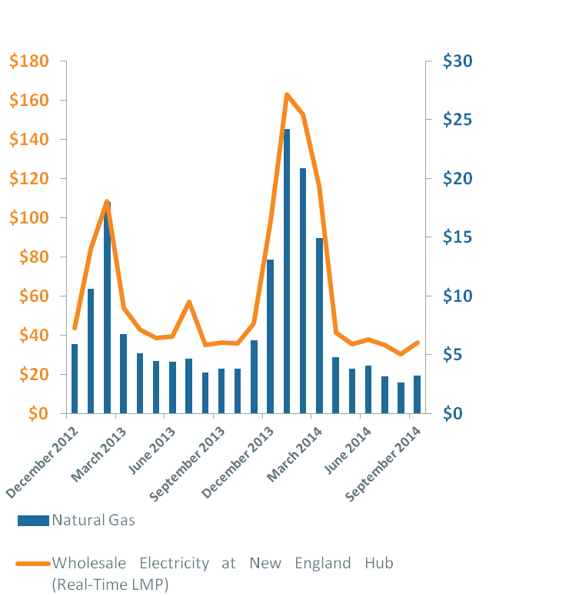
2014/15 Winter Reliability Program
Monthly Avg. Wholesale Electricity $/MWh
and Natural Gas Prices $/MMBtu
High energy prices during the 2013/14 winter attracted LNG to the region this past winter
Increased LNG injections (that were not part of the winter program) helped supplement constrained pipeline supply from the west
2.7 million barrels of oil were burned
Cost to the region was approximately $45 million
Program helped ensure reliability
Winter
2013/14
Winter
2012/13

Slide 7
FERC Has Articulated Market Design Objectives
In early winter program orders, FERC highlighted objectives for overall market design as well as the various winter programs:
Market-based
Out-of-market only in limited circumstances
Fuel neutral
Long-term
Product of stakeholder participation

Slide 8
NEPOOL and ISO Developed Alternative Proposals for Future Winter Program
FERC, in its order approving the 2014/15 winter program, stated future programs should be a market-based solution
On July 15, 2015, the ISO and NEPOOL submitted two alternative sets of market rule changes to establish a winter reliability program for the next three winters
Procedurally, when NEPOOL achieves at least a 60% vote on an alternative to an ISO rule change, a “jump-ball” scenario occurs and FERC may choose to adopt either proposal or a combination of the proposals
Both proposals were intended to address regional winter reliability challenges created by New England’s increased reliance on natural gas-fired generation

Slide 9
There Are Similarities Between the Proposals
NEPOOL’s proposal was based on the design of last winter’s (2014/15) program, which provided compensation for:
Carrying costs of fuel oil that was unused at the end of the winter;
Unused liquefied natural gas contract volumes; and
Supplemental demand response
The ISO’s proposal shared the first two design features of NEPOOL’s proposal, but also provided compensation for any generator that is supplied by on-site fuel
Any assets that are supplied by on-site fuel could participate, including, for example, nuclear units (fueled by uranium), coal-fired units, biomass resources, and units fueled by water, including pumped storage facilities

Slide 10
ISO’s Proposal Would Have Made More Resources Eligible to Participate than NEPOOL’s Proposal
 | ISO Proposal | NEPOOL Proposal
Oil
LNG
Demand Response
Nuclear
Hydro
Biomass
Coal
Payment rate under both proposal is the same based on oil rate determined each July

Slide 11
Order and Implications
FERC’s September 11 Order conditionally accepted the NEPOOL proposal finding it “just and reasonable and preferable” to the ISO proposal
The added cost of expanding last year’s program and stakeholder support for continuing with a similar program were factors in FERC’s decision
Order directs ISO to submit a compliance filing by October 26, 2015, to include the same program compensation formula used in last year’s program to calculate the annual payment rate for the next three winters

Slide 12
Deadline for Winter Program Resource Participation Request Forms is Coming Soon
Request to Participate forms are available at: www.iso-ne.com/participate/support/forms
Forms must be submitted by October 1, 2015, to ISO New England Customer Support at custserv@iso-ne.com

