Slide 1
New England Electricity Restructuring Roundtable
June 14, 2013

Slide 2
Reflections
Source: Black&Veatch, The New England States Committee on Electricity, April 16, 2013

Slide 3
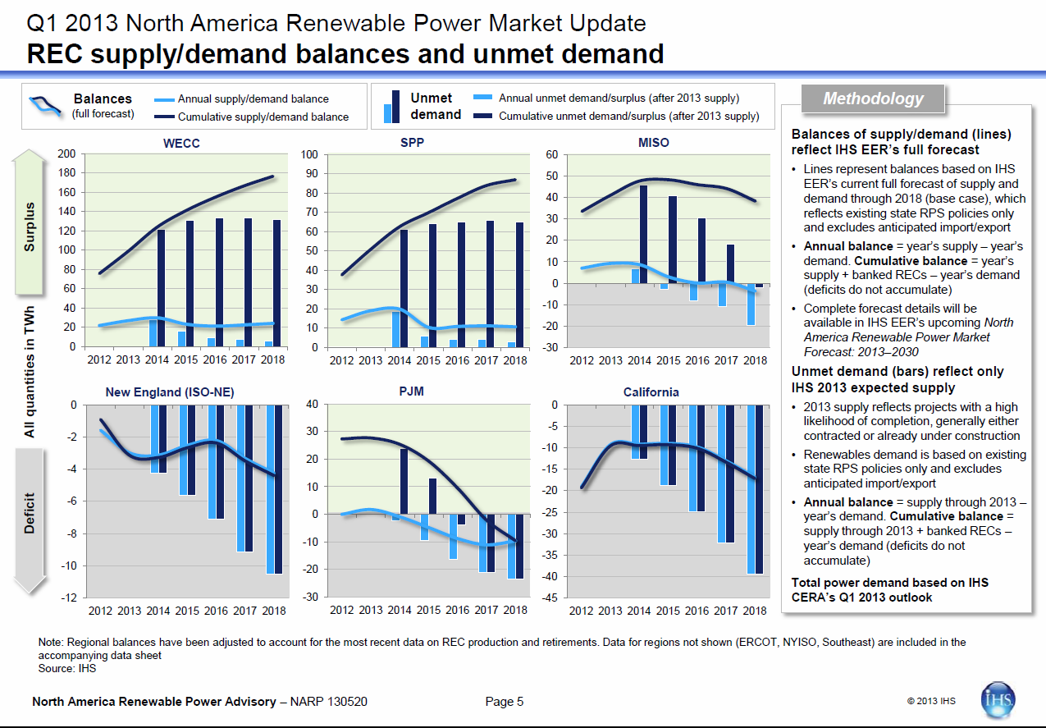
Content w/ bottom blocker

Slide 4
Clean Firm

Slide 5
Reliability
Based on 10 MWh average energy production for New England

Slide 6
Reliability
Based on 10 MWh average energy production for New England

Slide 7
Flexibility/Integration
Sold as one product
LINDA LINDALINDA
Hydro
GWh
LINDA
Wind
t66g
Time

Slide 8
Cost/Ratepayer Savings
1,000 MW hydro + 1,000 MW Class I RECs from wind
  ~9 TWh total energy
  ~3 TWh Class I RECs
Project Life savings from these primary sources:
 | $B
Energy Prices through LTC | 2 – 4
REC Prices | 2 - 3
Energy Price Suppression | 10 – 13
 | $14 – 20 B

Slide 9
Policy
Close the expected gap between RPS supply and demand by 2020
In harmony with several states clean energy/carbon reduction plans, e.g. CT Comprehensive Energy Strategy and MA Global Warming Solution Act
Clean Firm is a Proactive and Cost Effective
Approach to Achieve Region’s Policy Goals

