Slide 1
New Technologies, Practices, and Policies to Transform Retail Energy Markets
New England Electricity Restructuring Roundtable February 26, 2016
James T. Gallagher, Executive Director New York State Smart Grid Consortium
Daniel Schwen, CC Attribution-Share Alike 2.0 Generic License

Slide 2
Consortium Members

Slide 3
NYS Smart Grid Consortium Overview
Unique Public-Private Partnership
Promotes broad statewide implementation of a safe, secure, and reliable smart grid
Members include world’s leading utilities, technology providers, policy makers and research institutions
Established in 2009 as a not-for-profit corporation
Only organization of its kind in the US

Slide 4
NY Reforming the Energy Vision (REV)
Fundamental Changes in Distribution Service
Align utility practices and regulation with technological advances in information management, pricing, power generation and distribution
Improve system efficiency, empower customer choice, and encourage greater penetration of clean generation and energy efficient technologies and practices. Must be customer centric!
Introduce new business models (reduce risk, new capital)

Slide 5
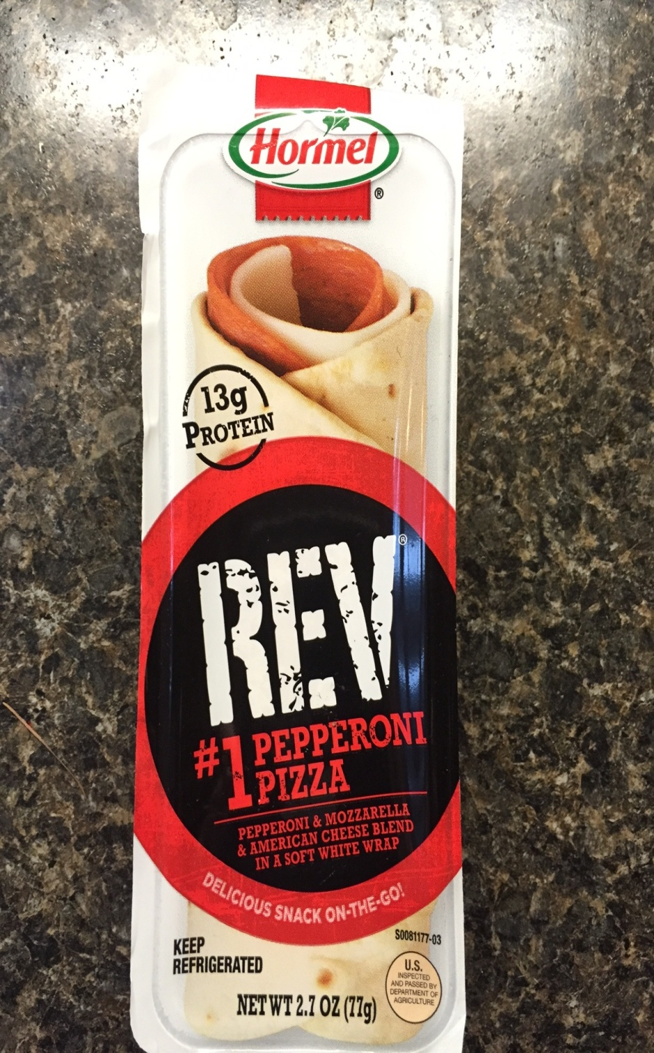

Slide 6
REV – Distribution System Platform
Overview of DSP
Design and operate distribution system that integrates DERs as major means of meeting system and customer needs
Optimize operations by balancing production and load in real time – at the local level
Monetize system & social values
Use market based means where appropriate, leverage outside capital
Coordinate interactions among customers, the distribution system and energy service companies (DSP markets and NYISO)

Slide 7
REV Market Design & Platform Technology Groups (MDPT)
Purpose
Provide guidance for utility 5 year Distributed System Implementation Plans (DSIPs) on near- and mid-term market design and platform technology issues
Process
Two working groups: Market Design and Platform Technology
Final Report issued August 17, 2015
Expert Advisory Group
Co-led by NYS Smart Grid Consortium, NYPSC and RMI

Slide 8
MDTP Working Groups
Final Report: Key Functions and Capabilities of DSP
Enhance Distribution Planning
Expand Distribution Grid Operations
Develop and Implement Market Operations
Ensure Data Availability
Necessary Platform and Customer Technologies

Slide 9
AMI Deployment --
Con Edison AMI Business Plan October 2015
4.7 million meters - gas and electric customers
Complete communications and IT work in 2016 (approved)
Deploy meters 2017 to 2022 (pending approval)
5000 meters per day installation rate
$1.3 billion
Biggest project in Con Edison’s 190-year history
1.5 billion data points daily
AMI for residential sector has positive 20 year NPV
“We don’t think REV can happen without this Project- Con Ed”

Slide 10
Contact Information
New York State Smart Grid Consortium 387 Park Avenue South 3rd Floor New York, NY 10016
James T. Gallagher, Executive Director
jgallagher@nyssmartgrid.com
www.nyssmartgrid.com
www.newyorkREVworkinggroups.com

