Slide 1
Introducing demand charges in residential tariff design
The New England Electricity Restructuring Roundtable
Boston, Massachusetts
Ahmad Faruqui, Ph. D.
June 19, 2015

Slide 2
Existing tariffs do not reflect the cost structure
  Existing tariffs are typically two-part designs
  The first part is a fixed service charge ($/month)
  The second part is a non-time varying energy charge (cents/kWh)
  This is true for network companies that only provide transmission and distribution services; it is also true for network companies that also provide regulated supply and for vertically integrated companies that provide supply, transmission and distribution services
  This structure is not aligned with costs but has been in place for more than a century

Slide 3
Five currents have made change all but inevitable
  Current 1. The emergence of distributed generation, which has created inequities among residential customers
  Current 2. The realization that the cost-causation principle also applies to residential customers
  Current 3. The rollout of smart meters, which makes it relatively easy to offer demand charges
  Current 4. The need to improve load factor and clip peaks
  Current 5. The recognition that a few U.S. and European utilities have been offering demand charges for years

Slide 4
The onset of distributed generation has exposed the failings of existing rate design
While network costs are largely fixed, the bulk of the revenues are variable under traditional volumetric tariffs
As growth slows down due to the deployment of distributed generation and “organic” conservation, networks face revenue risks
Ultimately, tariffs are raised for all customers, creating inequities as customers with low kW demand subsidize customers with high kW demand
With no demand charges, customers have no incentive to lower their kW demand, creating inefficiencies in the deployment of scarce capital

Slide 5
How some utilities are dealing with the issue
Mandating demand charges for distributed generation customers
  In Arizona, two utilities are moving down this path
Giving distributed generation customers a choice between (a) paying a higher fixed charge or (b) paying standard fixed charge along with a demand charge
  In Kansas, Westar Energy is moving down this path

Slide 6
The theory of tariffs revisited
Tariffs should promote economic efficiency and equity, but changes in tariff regimes should be implemented gradually
  For distribution-only utilities, this translates into a two-part rate, where the first part is a (fixed) service charge and the second part is a demand charge; for other utilities, into a three-part rate, where the third part is an energy charge
  In the US, with the exception of Texas, distribution utilities also provide regulated energy supply service
Such tariffs have been offered to commercial and industrial customers for the better part of the last century, inspired by the writings of Professor John Hopkinson in 1892

Slide 7
Demand (or capacity) charges in the U.S.
19 U.S. utilities in 14 states offer them on an opt-in basis
  Included in this category are large utilities such as Duke Energy, Georgia Power, and Xcel Energy
With two exceptions, where participation rates are in the 8-10% range, the offerings have elicited weak customer enrollment
  The tariffs are often poorly designed, poorly marketed, and offered without advice about load control technologies
The situation will change with the deployment of smart meters, which is nearing 40% of all U.S. households, and the realization that distributed generation resources are nearing a point of inflection

Slide 8
Demand charges in Europe
Since the end of the Second World War, some countries have charged customers for energy based on a volumetric tariff and for capacity based on their connected load
  France
  Italy
  Spain
As smart meters are rolled out, the capacity charges will probably be modified to allow for the introduction of demand charges

Slide 9
Demand charges in Australia
The utilities are purely providing distribution network services
As in Texas, they are charging customers based on the amount of energy they purchase from retailers
This is totally out of kilter with their customer structure
Proposals are expected to be filed this fall with the regulator requesting a change, with some proposing to make a transition to demand charges

Slide 10
The ideal new rate design will have five elements
Service charge
  Billing, metering and customer care
Demand charge
  A reservation charge for transmission and distribution capacity
  A reservation charge for generation capacity
  A demand charge for actual utilization of capacity
Energy charge
  Time varying

Slide 11
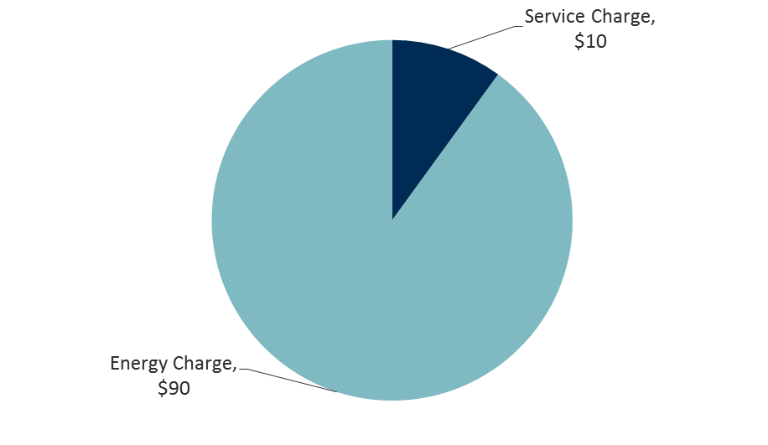
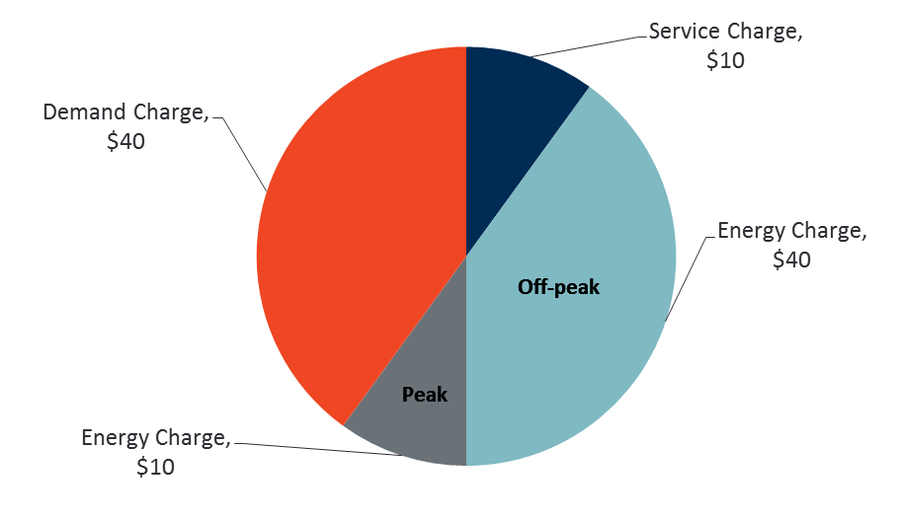
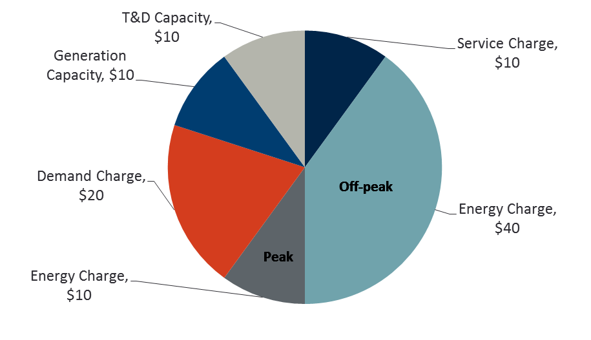
The proposed new structure of a $100 customer bill

Slide 12
References
  Bolton, D.J.. Costs and Tariffs in Electricity Supply: Chapman & Hall LTD: London, 1938.
  Bonbright, James C. Principles of Public Utility Rates, Columbia University Press, 1961.
Brown, Toby and Ahmad Faruqui, “Structure of Electricity Distribution Network Tariffs: Recovery of Residual Costs,” Australian Energy Market Commission, August 2014.
Crew, Michael and Paul Kleindorfer. Public Utility Economics. New York, New York: St. Martin’s Press, 1979.
Faruqui, Ahmad. “Time-variant pricing (TVP) in New York,” The REV agenda and residential time-variant pricing, NYU School of Law, March 31, 2015.
Faruqui, Ahmad and Wade Davis. “Dynamic Pricing 2.0: The Grid-Integration of Renewables,” presented at the IEEE PES GM 2013 Meetings, Vancouver, Canada, July 23, 2013.

Slide 13
References (concluded)
Faruqui, Ahmad and Sanem Sergici, “Arcturus: International Evidence on Dynamic Pricing,” The Electricity Journal, August-September, 2013.
Faruqui, Ahmad, Ryan Hledik, and Neil Lessem. “Smart by Default,” Public Utilities Fortnightly, August, 2014.
Hledik, Ryan. “Rediscovering Residential Demand Charges,” The Electricity Journal, Volume 27, Issue 7, August–September 2014, Pages 82–96.
Hopkinson, John. The Cost of Electric Supply: Presidential Address to the Joint Engineering Society. November 4, 1892. Appears in Original Papers by the Late John Hopkinson, Volume 1, Technical Papers, edited by B. Hopkinson, Cambridge University Press, 1901.
Houthakker, Hendrik S. “Electricity Tariffs in Theory and Practice.” Economic Journal, 61/241(1951): 1-25.
  Little, I.M.D.. The Price of Fuel. Clarendon Press: Oxford University Press, 1953.

Slide 14
References (continued)
  Macdonald-Smith, Angela, “Electricity price reform essential, says United Energy chief Hugh Gleeson,” Sydney Morning Herald, September 19, 2014.
  Neufeld, John L. “Price Discrimination and the Adoption of the Electricity Demand Charge.” The Journal of Economic History, Volume 47, Issue 3, September 1987, pp. 693-709.
  Simshauser, Paul. “Network tariffs: resolving rate instability and hidden subsidies,” Working Paper 45, AGL Applied Economic and Policy Research, October 16, 2014.
  Schweppe, Fred, Richard Tabors, and James Kirtley. Homeostatic Control: The Utility/Customer Marketplace for Electric Power. MIT Energy Laboratory Report. September 1981.
  Vickrey, William. “Responsive Pricing of Public Utility Services.” The Bell Journal of Economics, Spring 1971.

Slide 15
References (concluded)
  Wright, Arthur. “Some Principles Underlying the Profitable Sale of Electricity,” Proceedings of the Institution of Electrical Engineers, Volume 31, Number 155, 1902.
  Yakubovich, Valery, Mark Granovetter, and Patrick McGuire. “Electric Charges: The Social Construction of Rate Systems.” Theory and Society (2005) 34: 579-612.

Slide 16
Appendix

Slide 17
The theory of tariffs (continued)
The Hopkinson tariff contains an explicit demand charge
  E.g., demand charge = $2.50 per month per kW of maximum demand in the month, plus an energy charge of 5 cents per kWh per month
It was followed by the Arthur Wright tariff, which achieves the same objectives without requiring the measurement of demand
  The Wright tariff uses a declining block rate structure where the charge for energy might be 10 cents per kWh for the first 50 hours of use and 5 cents for the next 50 hours of use and so on

Slide 18
The theory of tariffs (concluded)
As Crew and Kleindorfer (1979) put it in their well-known text on public utility economics
  Maximum-demand tariffs, which were to become so popular in the industry over the years were born
  Their original intent was apparently to come to terms with the peak-load problem to the extent that they aimed to improve utilization or load factor
A Midwestern state is considering a law which would mandate demand charges for all residential customers

Slide 19
Back to the Future
Year | Author | Contribution
1882 | Thomas Edison | Electric light was priced to match the competitive price from gas light and not based on the cost of generating electricity
1892 | John Hopkinson | Suggested a two–part tariff with the first part based on usage and the second part based on connected kW demand
1894 | Arthur Wright | Modified Hopkinson’s proposal so that the second part would be based on actual maximum demand
1897 | Williams S. Barstow | Proposed time-of-day pricing at the 1898 meeting of the AEIC, where his ideas were rejected in favor of the Wright system
1946 | Ronald Coase | Proposed a two-part tariff, where the first part was designed to recover fixed costs and the second part was designed to recover fuel and other costs that vary with the amount of kWh sold
1951 | Hendrik S. Houthakker | Argued that implementing a two-period TOU rate is better than a maximum demand tariff because the latter ignores the demand that is coincident with system peak
1961 | James C. Bonbright | Laid out his famous Ten Principles of Public Utility Rates

Slide 20
Back to the future (concluded)
Year | Author | Contribution
1971 | William Vickrey | Proffered the concept of real-time-pricing (RTP) in Responsive Pricing of Public Utility Services
1976 | California Legislature | Added a baseline law to the Public Utilities Code in the Warren-Miller Energy Lifeline Act, creating a two-tiered inclining rate
1978 | U.S. Congress | Passed the Public Utility Regulatory Act (PURPA), which called on all states to assess the cost-effectiveness of TOU rates
1981 | Fred Schweppe | Described a technology-enabled RTP future in Homeostatic Control
2001 | California Legislature | Introduced AB 1X, which created the five-tier inclining block rate where the heights of the tiers bore no relationship to costs. By freezing the first two tiers, it ensured that the upper tiers would spiral out of control
2001 | California PUC | Began rapid deployment of California Alternative Rates for Energy (CARE) to assist low-income customers during the energy crisis
2005 | U.S. Congress | Passed the Energy Policy Act of 2005, which requires all electric utilities to offer net metering upon request

Slide 21

Presenter Information
Ahmad Faruqui, ph.d.
Principal│ San Francisco
Ahmad.Faruqui@brattle.com
+1.415.217.1026
+1.925.408.0149 (cell)
Ahmad Faruqui, a principal with The Brattle Group, leads the firm’s practice in understanding and managing the changing needs of energy consumers. This work encompasses tariff design and evaluation, distributed generation, energy efficiency, demand response, demand forecasting and cost-benefit analysis of emerging technologies. He has consulted with more than 125 clients, including utilities, system operators, and regulatory commissions, in the US and in Australia, Canada, Egypt, Hong Kong, Jamaica, Philippines, Saudi Arabia and Thailand. He has filed testimony or appeared before state commissions, government agencies, or legislative bodies in Alberta (Canada), Arizona, Arkansas, California, District of Columbia, Illinois, Indiana, Kansas, Maryland, Michigan and Ontario (Canada). He has spoken at conferences in Australia, Bahrain, Brazil, Egypt, France, Germany, Ireland, Jamaica, and the United Kingdom. His work has been cited in publications such as Business Week, The Economist, Forbes, The New York Times, USA Today, The Wall Street Journal and the Washington Post. He has appeared on Fox News and National Public Radio. The author, co-author or co-editor of four books and more than 150 articles dealing with energy economics, he holds bachelors and masters degrees from the University of Karachi and masters and doctoral degrees from the University of California, Davis, in economics and in agricultural economics.
The views expressed in this presentation are strictly those of the presenter and do not necessarily state or reflect the views of The Brattle Group, Inc.

