Slide 1

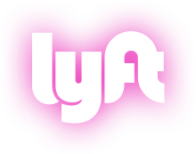
The End of Car Ownership
Sustainable Transportation Through Shared, Electric, Autonomous Vehicles
Corey Ershow | Transportation Policy Manager
Notes:
(Welcome, introduction.)
I’m here because Lyft believes that the United States is currently highly dependent on an unsustainable model for use of passenger vehicles based on personal car ownership. Our experience as pioneers of shared mobility over the last 4 and a half years has given us confidence that we have the opportunity to break that cycle by deploying autonomous and electric vehicle technologies through our shared network, in a form that may dramatically reduce greenhouse gas emissions and improve air quality.

Slide 2
Most commuters drive alone
American Community Survey, 2013
Notes:
I want to start by outlining the problems in our transportation system that Lyft is working to solve. The defining symptom of all of these problems is that 76% of commuters drive to work alone every day.

Slide 3
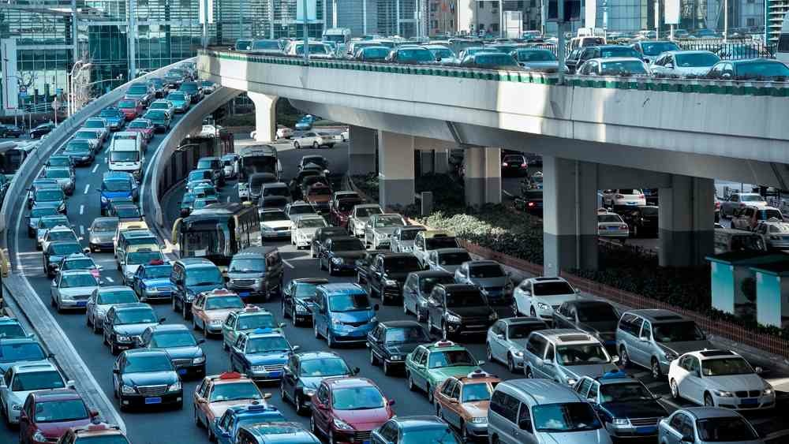

Congestion costs U.S. commuters
$160 billion a year
TTI Urban Mobility Scorecard 2015
Notes:
As a nation, we spend an enormous amount of time commuting in cars, sitting in traffic, consuming oil. And 35,000 people die in traffic crashes every year on roads and highways in the United States.

Slide 4

40,000 Americans died in traffic crashes in 2017
Notes:
Most importantly, the way our society’s current relationship with cars is becoming a public health crisis. 35,200 people died in traffic crashes in 2015 on roads and highways in the United States, up almost 8% from 2014. And the vast majority of these crashes were caused by human error. Distracted driving has become endemic in the age of constant smartphone connectivity.

Slide 5

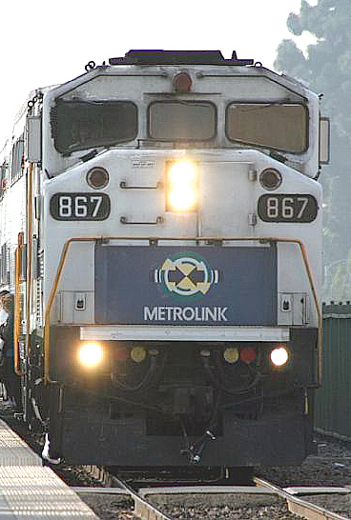

We’ve given commuters
two choices

Slide 6
Twentieth-Century Choice
Macro Transit
vs.
Car Ownership
Fixed route
Fixed schedule
High capacity
Frequent at peak
Slow off-peak
Choice of route
Choice of time
Private vehicle
Always works
Often fastest

Slide 7

Ridesharing has proven
demand for another way

Slide 8

Will autonomous cars
solve our problems?
Notes:
They will certainly result in enormous benefits for safety, and for mobility. But beyond that, I would posit that the question of the impacts, can be boiled down to a question of - will they result in net reductions in total vehicle miles and carbon emissions?

Slide 9
Will autonomous cars
be shared or owned?
Notes:
And I would further suggest that THIS question comes down to whether or not automated vehicles will be shared, or whether they will be personally owned.

Slide 10
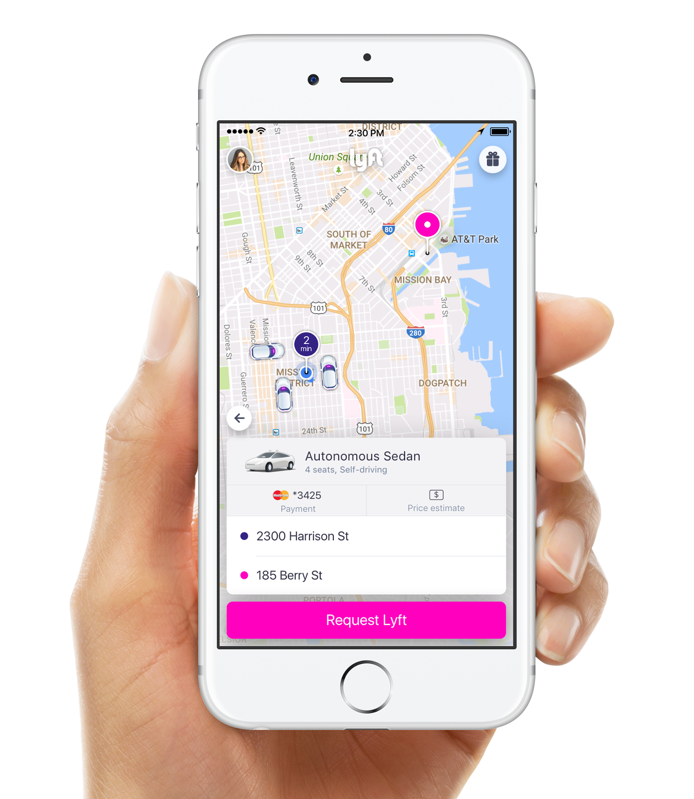
Within five years
a fully autonomous fleet
of cars will provide the
majority of Lyft rides
across the country
Notes:
Our forecast: half of all Lyft rides will be performed by autonomous vehicles within 5 years. This sounds extremely ambitious, but keep in mind the growth trajectory of ridesharing I mentioned earlier - and Lyft will grow even faster with AVs, because the cost of taking a ride will drop tremendously, making it affordable for more people to use more often.

Slide 11
By 2025, private car
ownership will
all but end in
major U.S. cities
Notes:
In fact, we expect this change in the cost structure of Lyft brought by automation to serve as a tipping point moving people away from car ownership. Today, when people calculate the monthly cost of accessing transportation as a service versus owning a car, it is likely to be higher unless you live in the middle of a big city. But with automated vehicle technology, the equation flips, and it will simply no longer make financial sense to own a car when fast, hassle-free Lyft service is available at fraction of the cost, with no upfront investment or depreciation.

Slide 12
How Shared Mobility Can Cut VMT
Increase Vehicle Occupancy
Price Every Car Trip
Connect to Transit
Notes:
The trend toward transportation as a service will also also Lyft to connect and become interoperable with other modes of transportation - public transit, bikeshare, etc.
In recent years, transit agencies have been adopting smartphone technology as well - revolutionizing their fare collection systems to work without physical tokens or even smart cards - and once they go digital, beginning to integrate with Lyft. As people transition to transportation as a service, they will be able to use these different public and private modes seamlessly
graphic: stats of Mobile ticketing apps for transit agencies. How many rides have happened on them since the apps were created.
Chicago Ventra - 1 million rides in the first two months, Portland Trimet - 5 million rides in the last 2 years, NJ Transit: 8 million rides in the last 2.5 years.

Slide 13
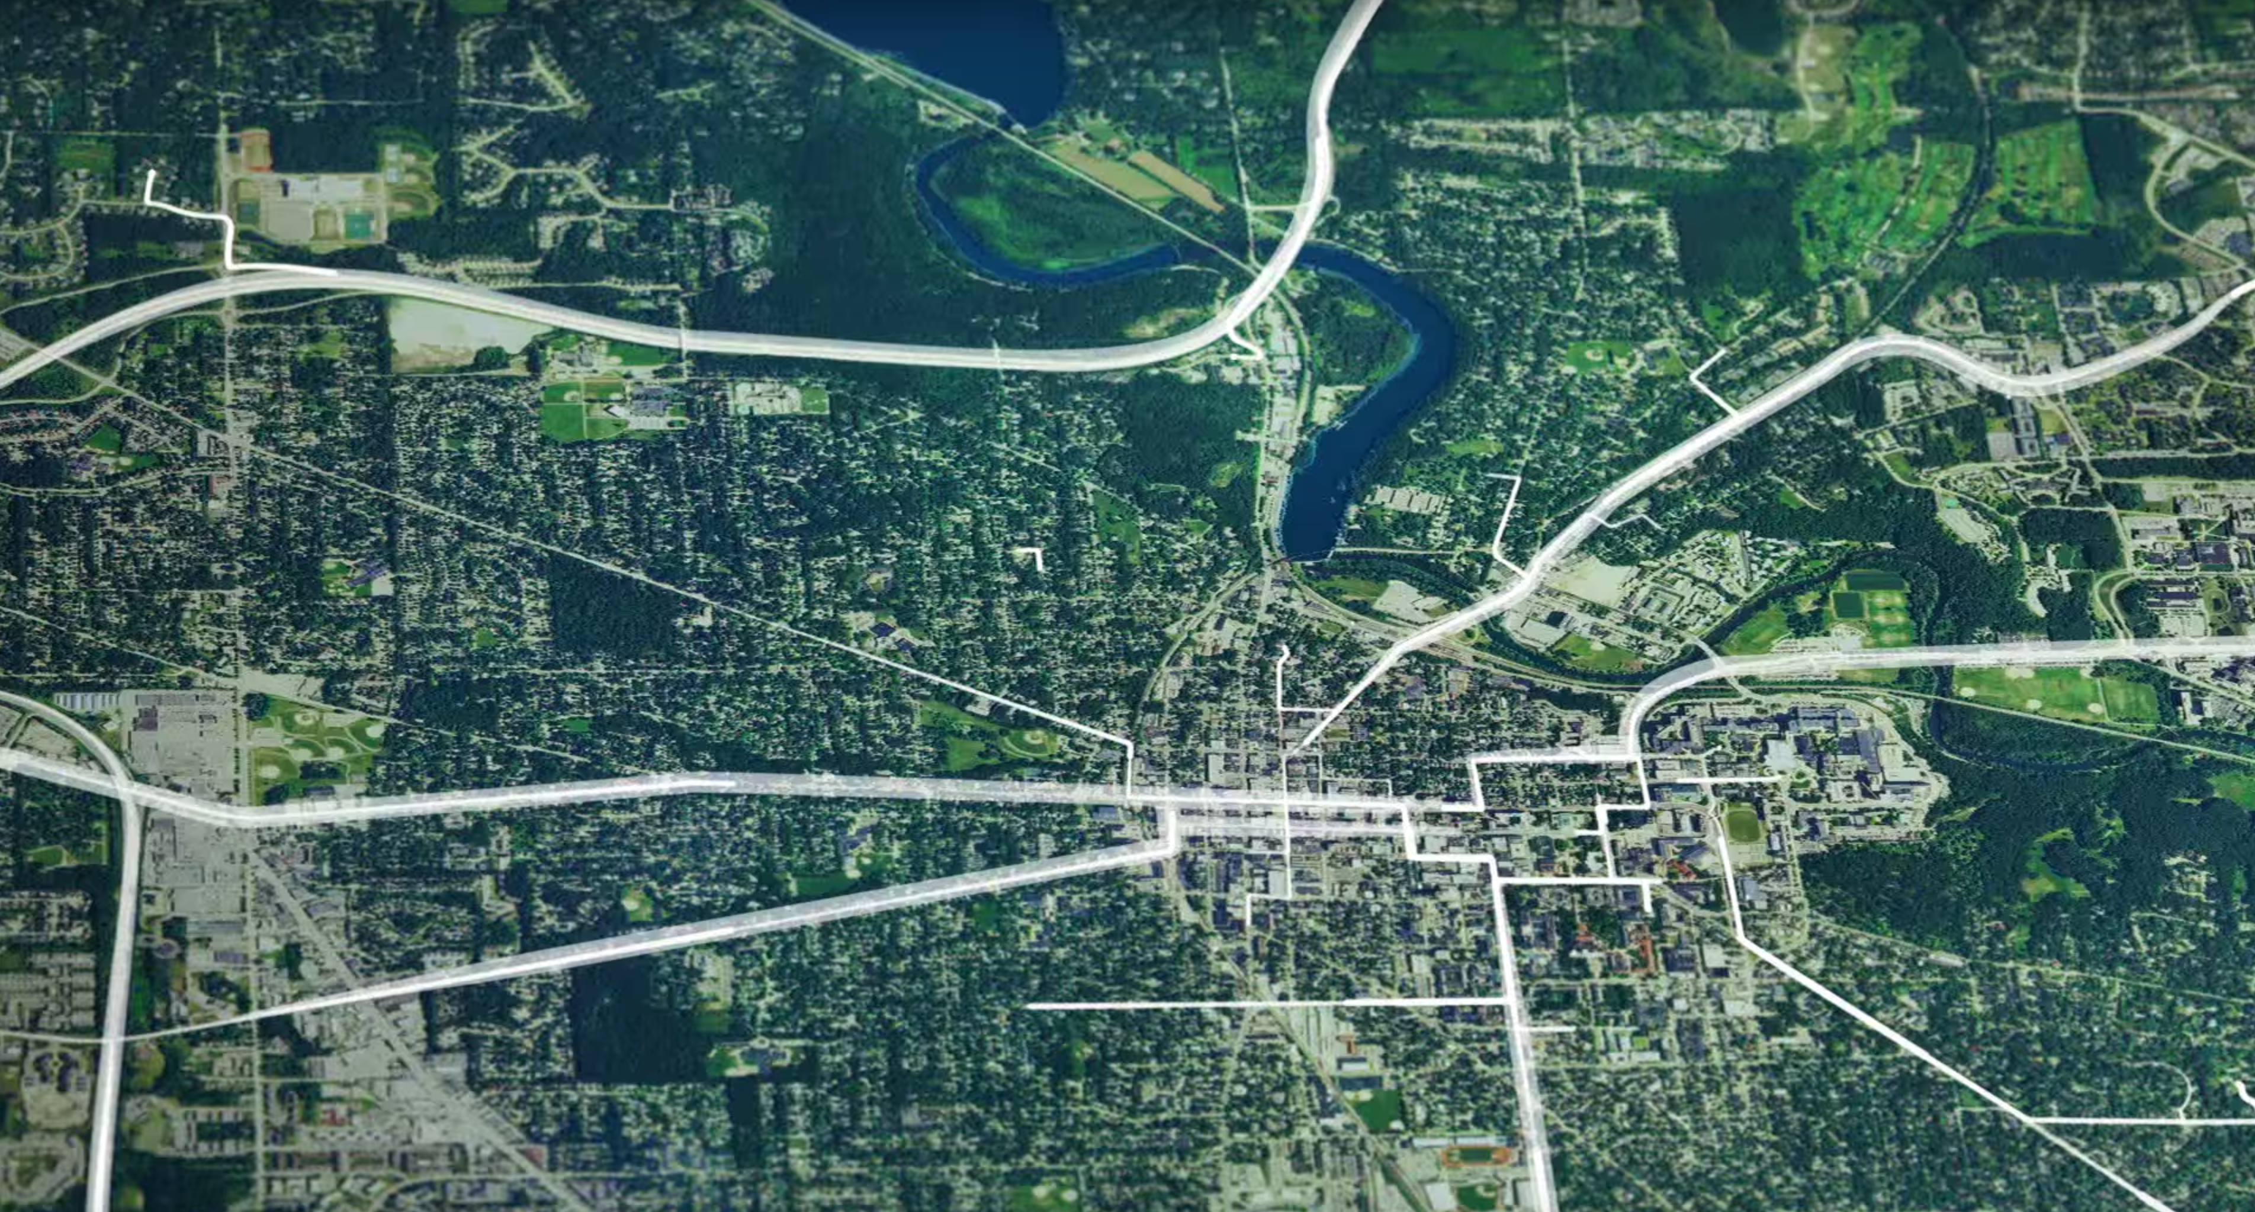
40% of passengers choose Lyft Line
where it is offered
Notes:
The results have been very promising - over 40% of all passengers now choose Lyft Line where it is offered, proving that consumers are willing to share rides when it is hassle-free and delivers quick travel times.

Slide 14
Supporting Transit
Notes:
And I would further suggest that THIS question comes down to whether or not automated vehicles will be shared, or whether they will be personally owned.

Slide 15
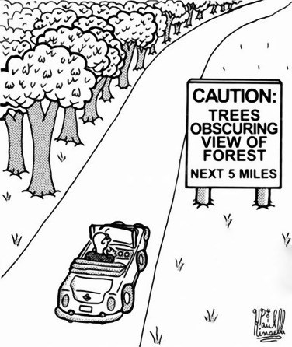
Notes:
And I would further suggest that THIS question comes down to whether or not automated vehicles will be shared, or whether they will be personally owned.

Slide 16
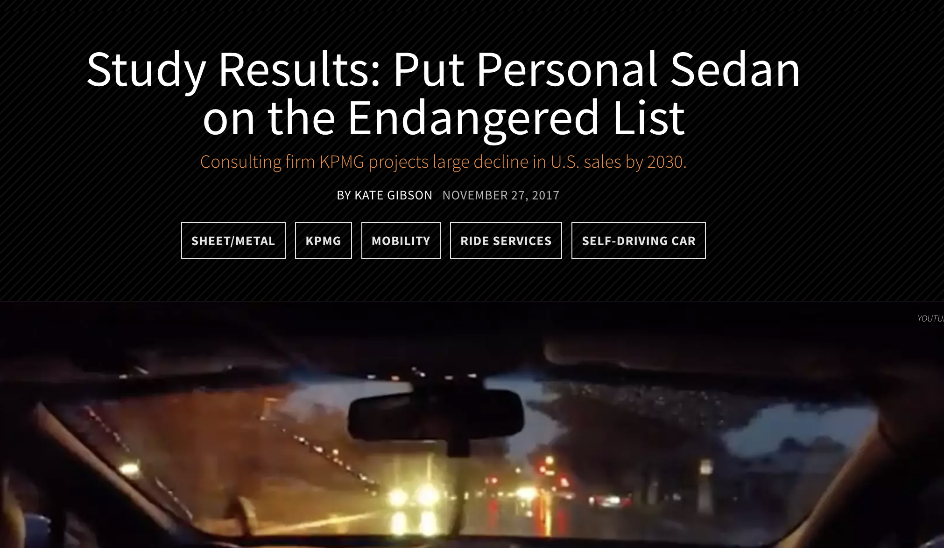

Slide 17
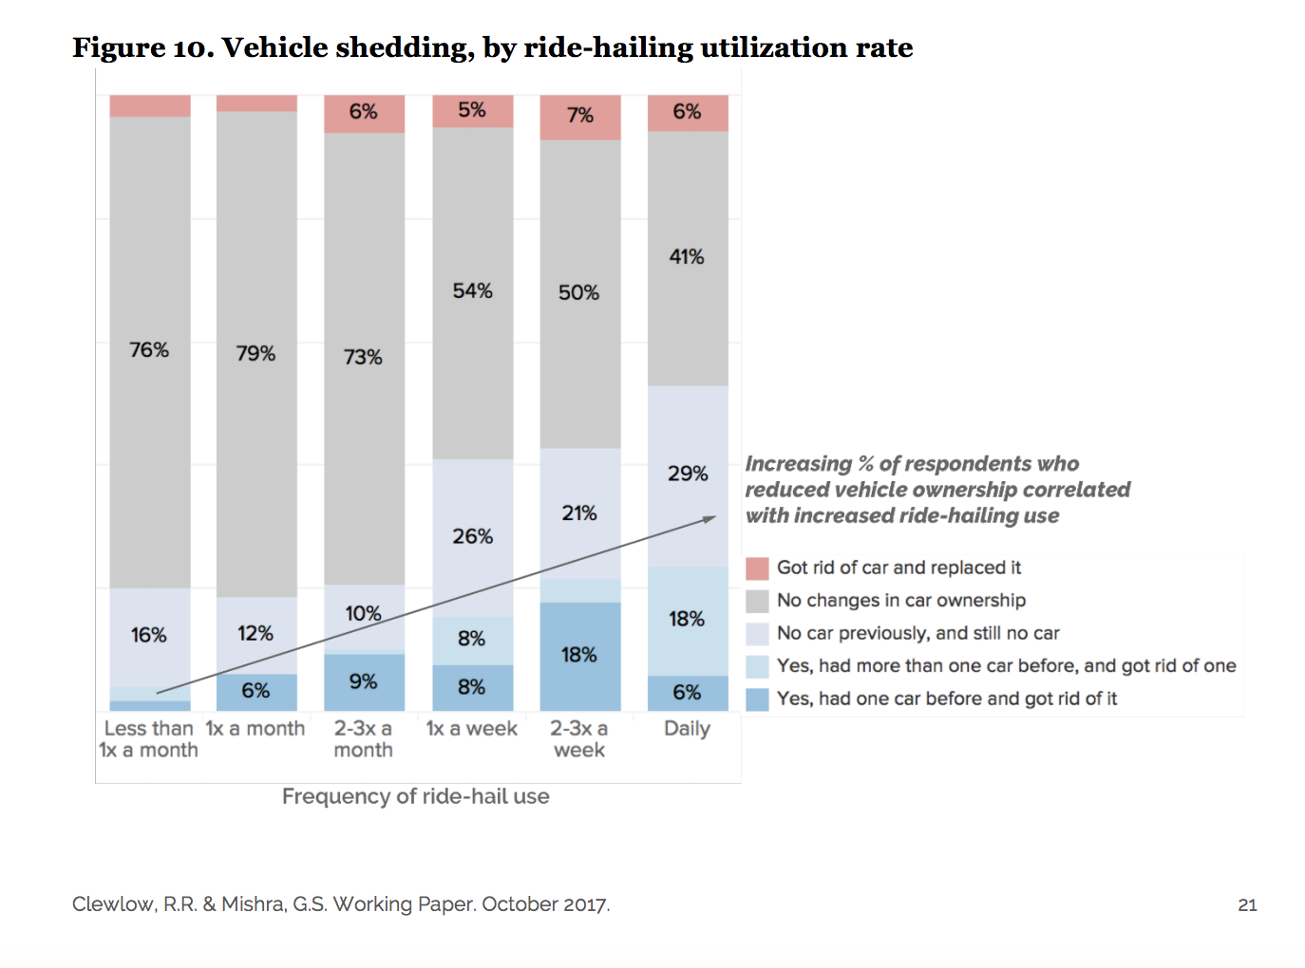
Notes:
And I would further suggest that THIS question comes down to whether or not automated vehicles will be shared, or whether they will be personally owned.

Slide 18
80% of
weekly drivers
never use transit
Notes:
In fact, we expect this change in the cost structure of Lyft brought by automation to serve as a tipping point moving people away from car ownership. Today, when people calculate the monthly cost of accessing transportation as a service versus owning a car, it is likely to be higher unless you live in the middle of a big city. But with automated vehicle technology, the equation flips, and it will simply no longer make financial sense to own a car when fast, hassle-free Lyft service is available at fraction of the cost, with no upfront investment or depreciation.

Slide 19
95% of
Rideshare Users
Use public transit
Notes:
In fact, we expect this change in the cost structure of Lyft brought by automation to serve as a tipping point moving people away from car ownership. Today, when people calculate the monthly cost of accessing transportation as a service versus owning a car, it is likely to be higher unless you live in the middle of a big city. But with automated vehicle technology, the equation flips, and it will simply no longer make financial sense to own a car when fast, hassle-free Lyft service is available at fraction of the cost, with no upfront investment or depreciation.

Slide 20

Deep
Decarbonization

Slide 21

New pathways to
electrify vehicle miles

Slide 22
Barriers to Consumer EV Purchases
High Upfront Cost
Insufficient Range
Charging Access
Lack of Familiarity
Notes:
how we think we can plug into a city’s transportation network

Slide 23
Why Shared Fleets Will Want EVs
Lower Variable Costs
Optimized Management
High Utilization
Notes:
The trend toward transportation as a service will also also Lyft to connect and become interoperable with other modes of transportation - public transit, bikeshare, etc.
In recent years, transit agencies have been adopting smartphone technology as well - revolutionizing their fare collection systems to work without physical tokens or even smart cards - and once they go digital, beginning to integrate with Lyft. As people transition to transportation as a service, they will be able to use these different public and private modes seamlessly
graphic: stats of Mobile ticketing apps for transit agencies. How many rides have happened on them since the apps were created.
Chicago Ventra - 1 million rides in the first two months, Portland Trimet - 5 million rides in the last 2 years, NJ Transit: 8 million rides in the last 2.5 years.

Slide 24
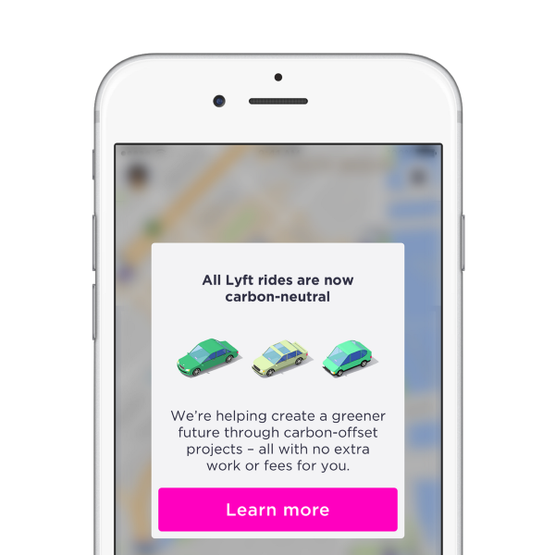

Slide 25
The End of Car Ownership
Sustainable Transportation Through Shared, Electric, Autonomous Vehicles
Corey Ershow | Transportation Policy Manager
Notes:
(Welcome, introduction.)
I’m here because Lyft believes that the United States is currently highly dependent on an unsustainable model for use of passenger vehicles based on personal car ownership. Our experience as pioneers of shared mobility over the last 4 and a half years has given us confidence that we have the opportunity to break that cycle by deploying autonomous and electric vehicle technologies through our shared network, in a form that may dramatically reduce greenhouse gas emissions and improve air quality.

