Slide 1
The Future of the Transportation and the Grid
Presentation to: New England Restructuring Roundtable
May 18, 2016

Slide 2
Key takeaways
Electric-drive vehicles (EDVs) are essential for global climate goals
EDV’s are here today and more are coming tomorrow
EDV’s can provide positive value to utilities, their shareholders, and their ratepayers
You can help!

Slide 3
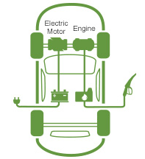
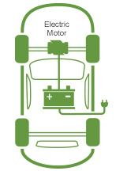
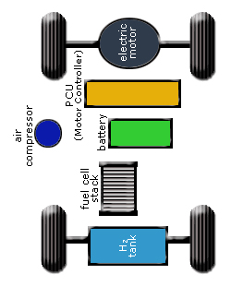
What are electric-drive vehicles?
Plug-in hybrid vehicles
Battery electric vehicles
Hydrogen fuel cell electric vehicles
Liquid Fuel
Electricity
Electricity
Hydrogen fuel
Notes:
https://www.sce.com/wps/portal/home/residential/electric-cars/tools-resources
http://www.afdc.energy.gov/vehicles/fuel_cell.html

Slide 4

A robust and growing global market for electric-drive vehicles is essential
to achieving our climate goals
Notes:
Include reference to global strategy
Automaker/supply – global scale,

Slide 5
Finding from the research
Electric-drive vehicles are an essential part of a 2°C future
75% of light-duty vehicle sales need to be EDV by 2050 (IEA 2012, global 2°C scenario)
EDVs can contribute to 88% reduction in GHG’s from transport by 2050 (National Academies, 2013)
EDVs are necessary to achieve EU CO2 reduction goal of 95% decarbonization by 2050 (McKinsey, 2010)
Electrification of [China’s] transport holds the key to decarbonizing much of the transport sector (Green and Stern, 2015)
Notes:
“China’s “new normal”: structural change, better growth, and peak emissions” Fergus Green and Nicholas Stern

Slide 6
A better product for the climate
With 3-4 greater on-vehicle efficiency current EDVs offer lower carbon emissions than conventional vehicles even with fossil power generation
As the grid(s) shift to lower carbon sources, the GHG benefits will grow
Grid emission from International Energy Agency, 2014; Ecofys, 2014; ENTSOE, 2015; US EPA 2014
Representative Nissan Leaf-like electric vehicle with 0.3 kWh/mile chosen for comparison purposes
Vehicle CO₂ emission from ICCT data: http://theicct.org/info-tools/global-passenger-vehicle-standards

Slide 7
Where are we today?
Source: BNEF

Slide 8
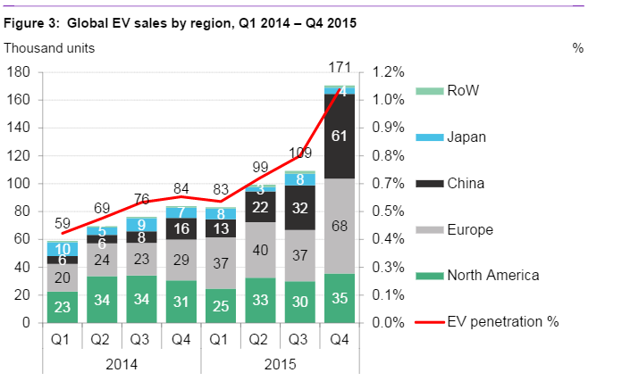
Where are we today?
Source: BNEF, 2016

Slide 9
Some countries are doing very well…

Slide 10






Increasing product availability
Cumulative electric-drive vehicle models (battery, plug-in, fuel cell)
Audi
BMW
Cadillac
Chevrolet
CODA
Fiat
Ford
Honda
Daimler
Mitsubishi
Think City
Nissan
Porsche
Rimac
Smart
Tesla
Toyota
Volvo
Tesla Model S
Toyota Prius plug-in
Nissan Leaf
Chevy Volt
Tesla Roadster
Toyota RAV4
Notes:
Photos: http://www.ucsusa.org/clean_vehicles/smart-transportation-solutions/advanced-vehicle-technologies/electric-cars/electric-vehicle-timeline.html#.VdtAoflgli8

Slide 11
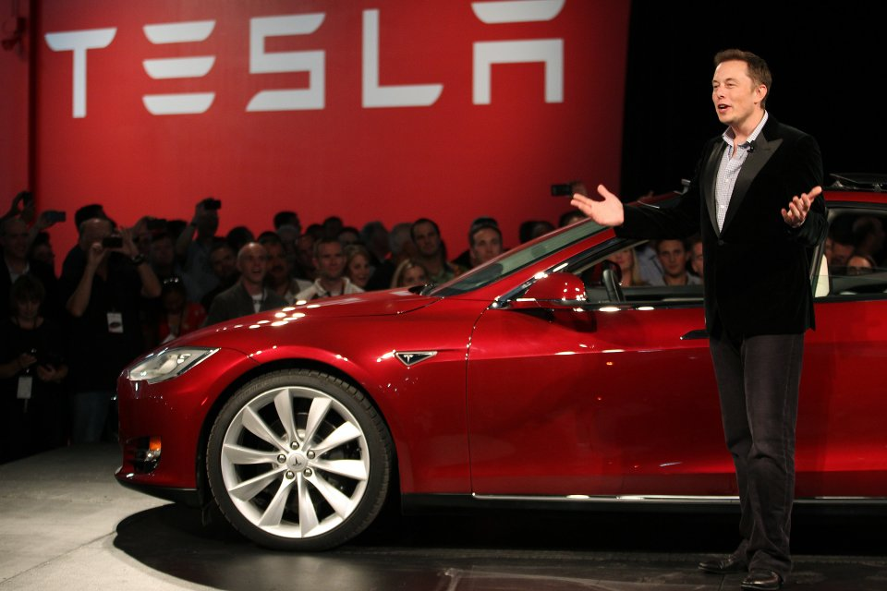
Where are heading?
Tesla Model 3
325,000 orders in 1 week
$14 Billion in implied sales
“Largest one week product launch ever”
Notes:
iPhone 6S - $8.5 billion in sales

Slide 12
Potential tipping point in ~10-15 years?
~15% of global sales EDV by 2030
~15% of sales in key markets EDV by 2025
Key regional markets
Global sales
Global fleet
(turnover)

Slide 13
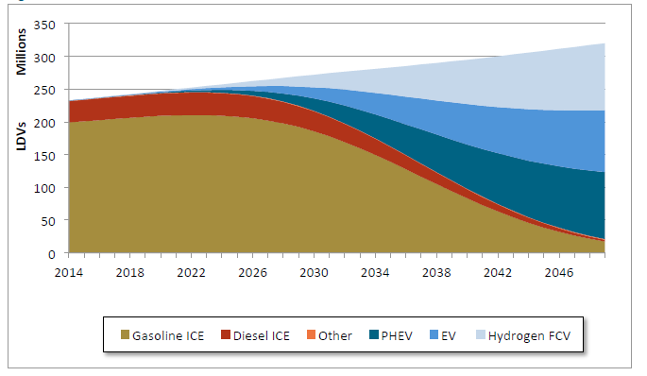

One scenario for the US
  Technologically-feasible pathways consistent with a 2C climate change
  EDVs account for over 65% of new vehicle sales in 2030
Annual Light-Duty Vehicle Stock (Mixed Case)
Source: E3, 2016 Deep Decarbonization Pathways Project
http://deepdecarbonization.org/wp-content/uploads/2015/09/US_DDPP_Report_Final.pdf

Slide 14
One scenario for the US
Transport
CCS
Solar
Source: E3, 2016 Deep Decarbonization Pathways Project

Slide 15

Real challenges remain
Cost
Battery and fuel cell cost
Infrastructure cost
Convenience
Limited range
Limited vehicle choice
Limited public infrastructure
Consumer awareness
Limited knowledge
Lack of targeted marketing
Commitment
Uneven policy support
Varying business/industry commitment

Slide 16

Solutions exist
Incentives
Regulatory
Monetary
Non-monetary
New allies
Infrastructure
Public and workplace infrastructure
Smart charging
Utility investment
Information
Efficacy of policies
Customer education
Business models that work
Familiarity

Slide 17
Why utilities (and their regulators) should be involved and excited
EDV’s can help escape the ‘death spiral’
EDV’s can help teach the duck to fly
EDV’s can help ‘green’ the utilities
  $ for infrastructure - with leftovers for the ratepayers and shareholders!
  Right side of the climate effort

Slide 18

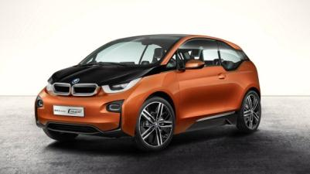
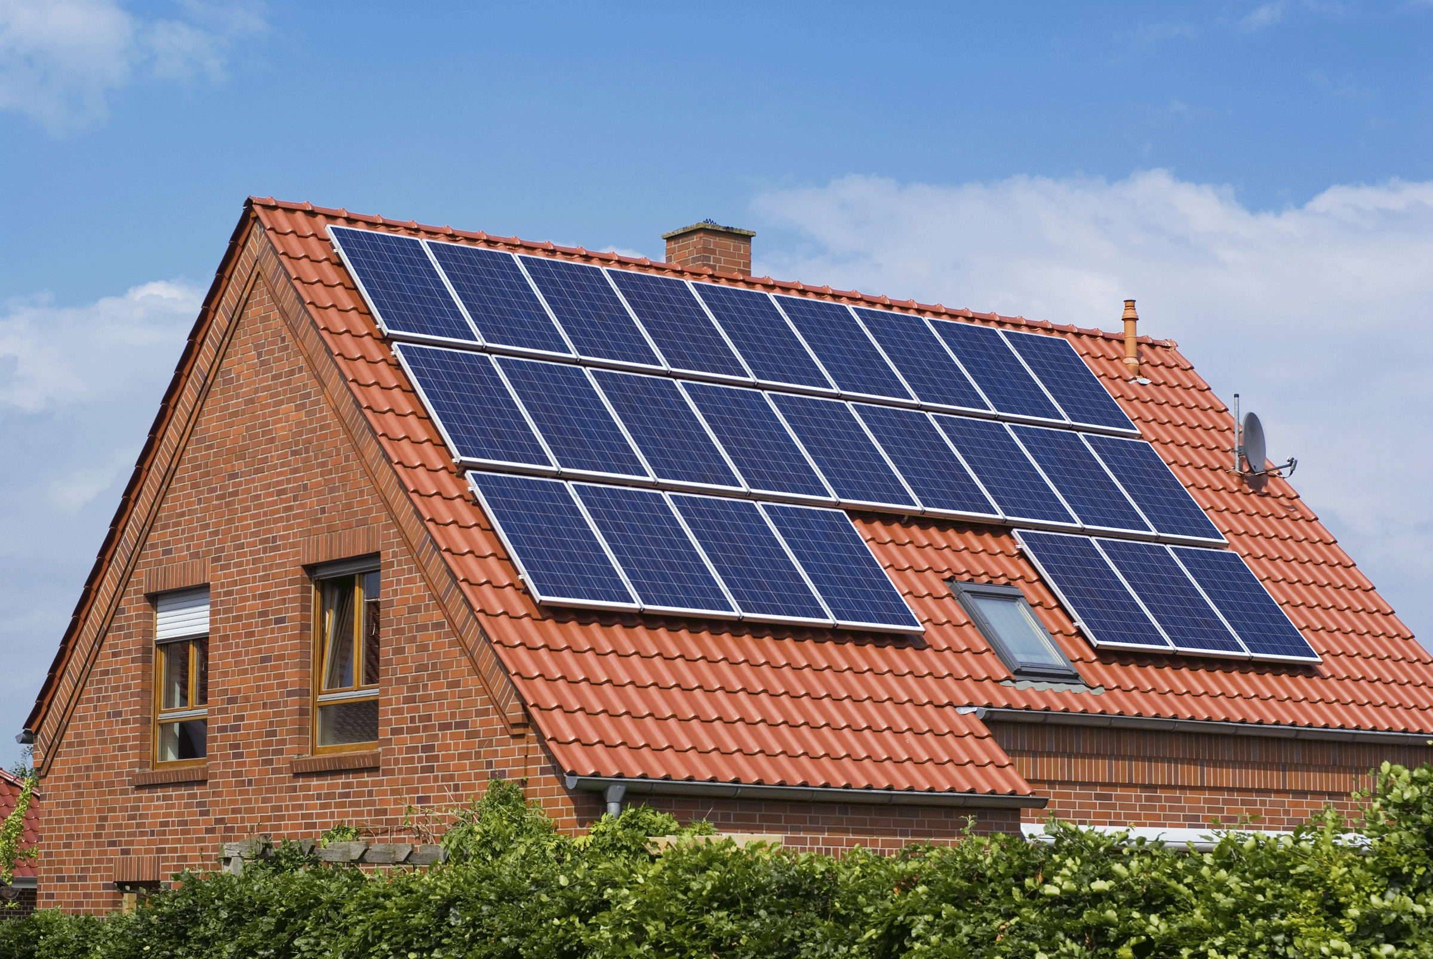
Utility and Ratepayer Perspective:
PEVs are very different from PV and EE
GHG & Emissions
Total Energy Consumption
Utility Infrastructure
Retail Rates
PV and EE can shift asset some costs to other ratepayers
EDVs increase utility asset utilization → lower rates

Slide 19
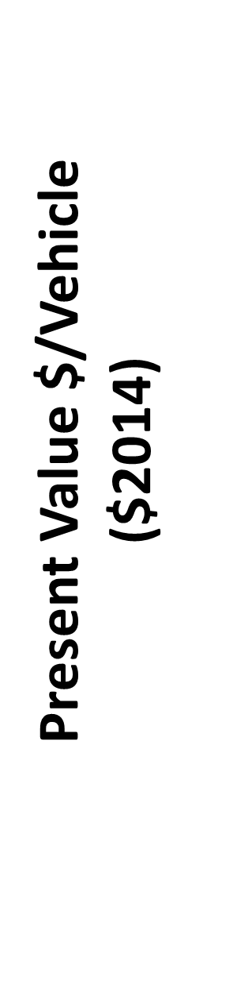
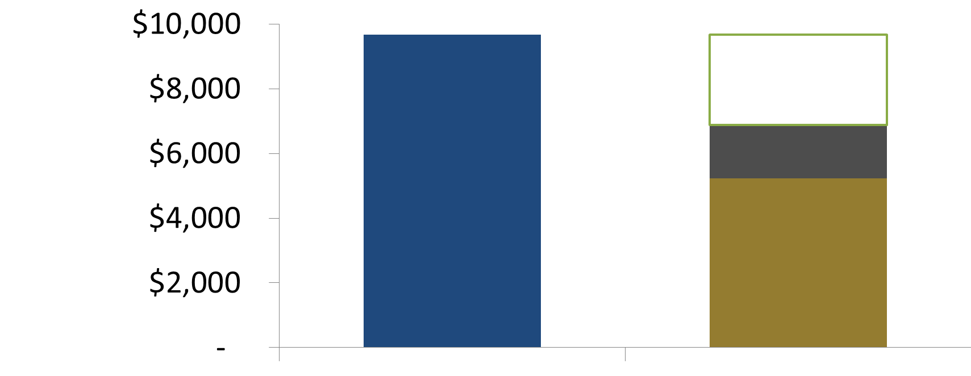
What’s it worth?
Net Revenues from EDV Charging Load
Illustrative results for California Utilities
Net Revenue
$2,778
Utility
Bills
Infrastructure
Energy & Capacity Cost
Revenue
Cost
Utility rates are higher than the marginal cost of delivered energy in most hours
Net revenue can be used to help pay for infrastructure and provide rate-payer/shareholder benefits
EDVs provide environmental & customer benefits and can reduce rates
http://www.caletc.com/wp-content/uploads/2014/10/CalETC_TEA_Phase_2_Final_10-23-14.pdf

Slide 20
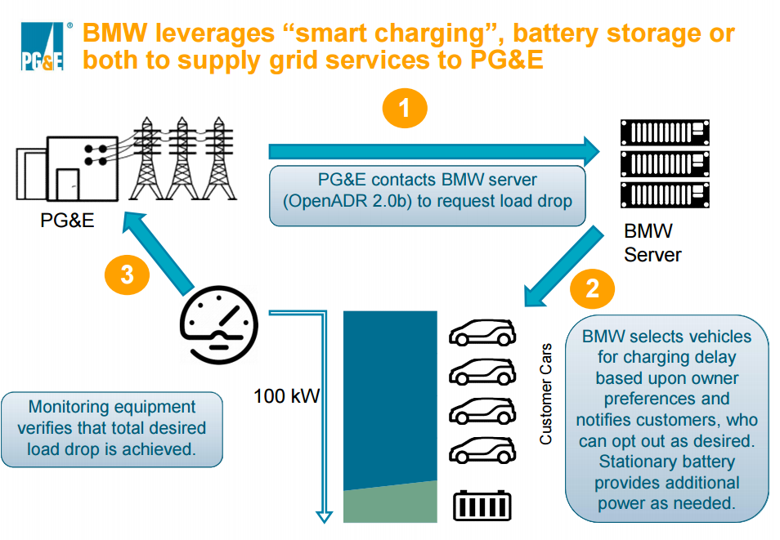
BMW/PGE DR project
DR pilot with 100 BWM I3 vehicles – customers receive up to $1500 for participation
Vehicle charging rates are controlled by the vehicle remotely reducing need for specialized infrastructure
Customers can ‘opt-out’ of individual DR events if they choose to.
Notes:
BMW i is partnering with California-based Pacific Gas and Electric Company (PG&E) to launch the BMW i ChargeForward Program. Based in the San Francisco Bay Area, this 18-month pilot study aims to better understand the relationship between home EV charging and the energy grid with up to $1,540* in charging incentives.

Slide 21
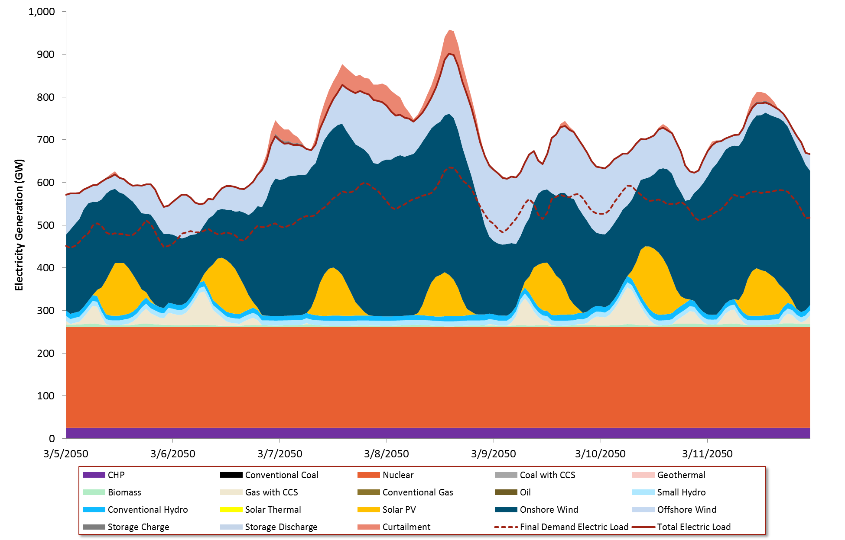
In the future – dispatch the load
Electricity dispatch: Eastern Interconnection, March 2050
Ability to provide ‘flexible load’ from electric vehicles through managed charging and variable hydrogen production avoids curtailment and reduces need for energy storage.
Requires a new paradigm in power system operations and utility policy to manage the flexibility of demand to address load-resource imbalances.
Source: E3, 2016 Deep Decarbonization Pathways Project

Slide 22
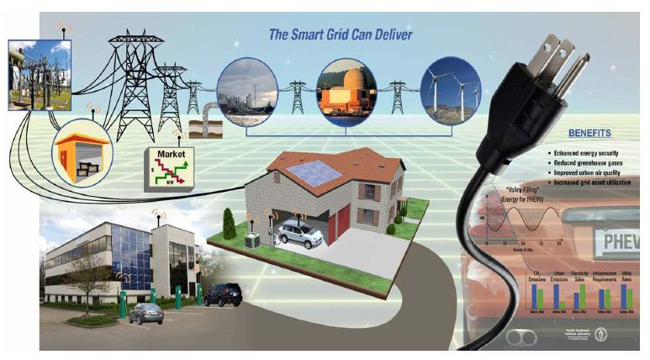
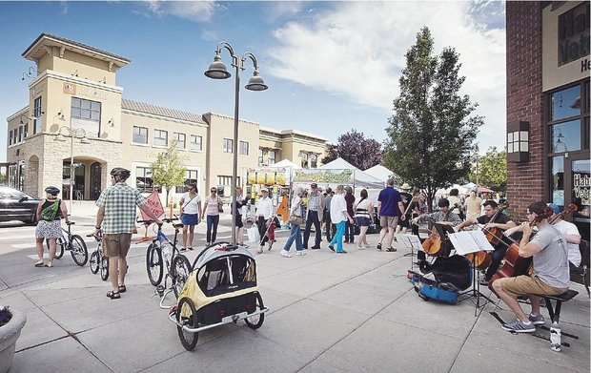

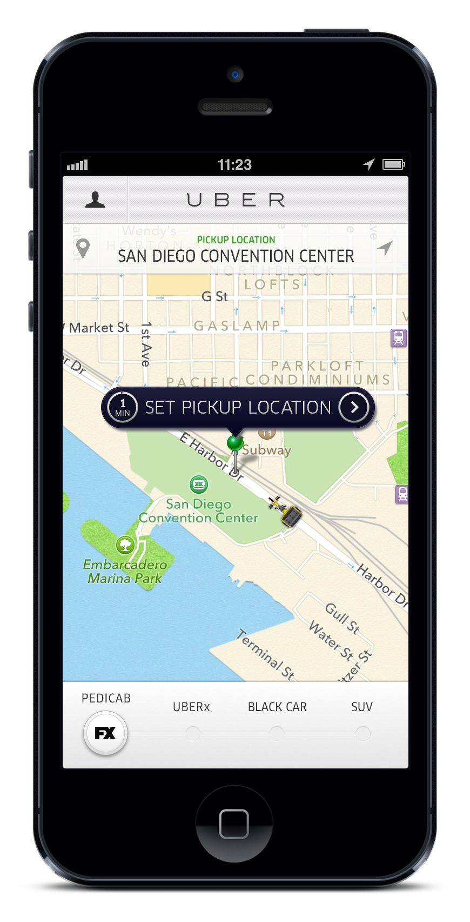
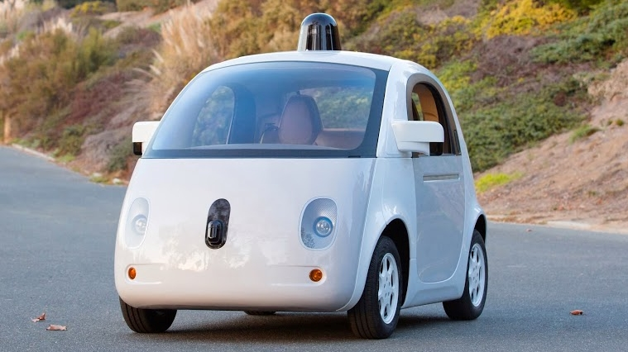
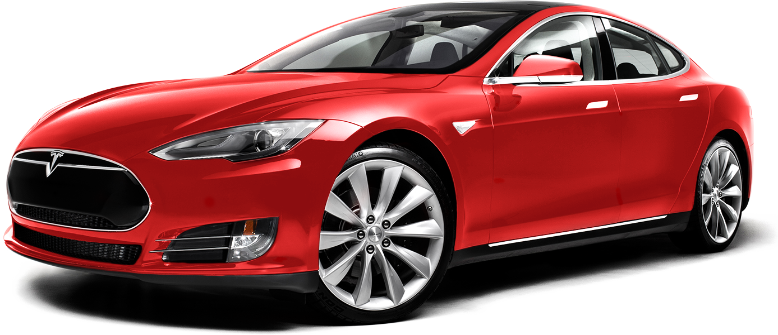
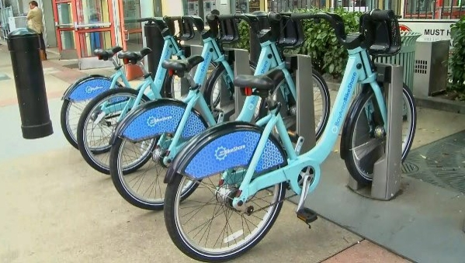
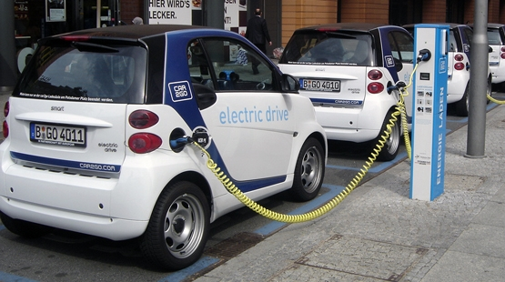
EDVs in the evolving mobility landscape
Grid Integration
Smarter Cities
Demographics
E-Drive Vehicles
Autonomous Cars
Bike Share
E - Car Share
Information Technology
“The future is already here — it's just not very evenly distributed” – W. Gibson

Slide 23
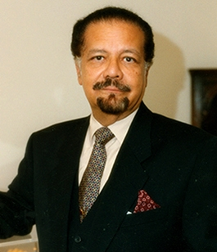
“Thirty years from now there will be a huge amount of oil – and no buyers. Oil will be left in the ground. The Stone Age came to an end, not because we had a lack of stones, and the oil age will come to an end not because we have a lack of oil.”
- Sheikh Zaki Yamani, Former Saudi Oil Minister (2000)

Slide 24
Thank You!
Anthony Eggert
Program Director
ClimateWorks Foundatoin
Anthony.eggert@climateworks.org

