Slide 2
New England
Electricity Restructuring Roundtable
State of the New England States
Connecticut
March 13, 2015
Katie Dykes
CT Deputy Commissioner for Energy

Slide 3
2014 CT Integrated Resources Plan
Ten-year outlook for electric system
CT programs highly effective
  Expanded investment in efficiency will eliminate growth in annual electricity consumption
  Renewable procurements will support 40% of CT 2020 Class I RPS goal (20% by 2020) at lower cost to ratepayers
  Air emissions declining significantly due to coal and oil retirements

Slide 4
Effective Energy Efficiency Programs
Peak Load (net of Energy Efficiency) — Historical and Projected
Connecticut (GW) New England (GW)
Peak load growth 0.5%
Annual Energy Consumption — Historical and Projected
Connecticut (TWh) New England (TWh)
Consumption growth 0.05%

Slide 5
2014 CT Integrated Resources Plan
Ten-year outlook for electric system
CT programs highly effective
  Expanded investment in efficiency will eliminate growth in annual electricity consumption
  Renewable procurements will support 40% of CT 2020 Class I RPS goal (20% by 2020) at lower cost to ratepayers
  Air emissions declining significantly due to coal and oil retirements

Slide 6
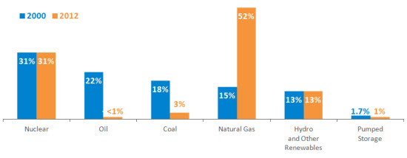
Recent Shift in Generation Fuel Source
Approximately 50% of generation is now natural gas
Oil generation is now less than 1%
Coal generation is now 3%

Slide 7
Pollution Reduction Trends
Annual CO₂ Emissions, 2007-2024
(million tons)
Annual SO2 Emissions, 2007-2024 Annual NOX Emissions, 2007-2024
(thousand tons) (thousand tons)

Slide 8
2014 CT Integrated Resources Plan
Ten-year outlook for electric system
CT programs highly effective
Challenging trends in NE electricity markets
  Inadequate gas infrastructure
  Need for new capacity
  Regional shortage of Class I supply
  Also: modest increases in gas commodity prices, emissions

Slide 10
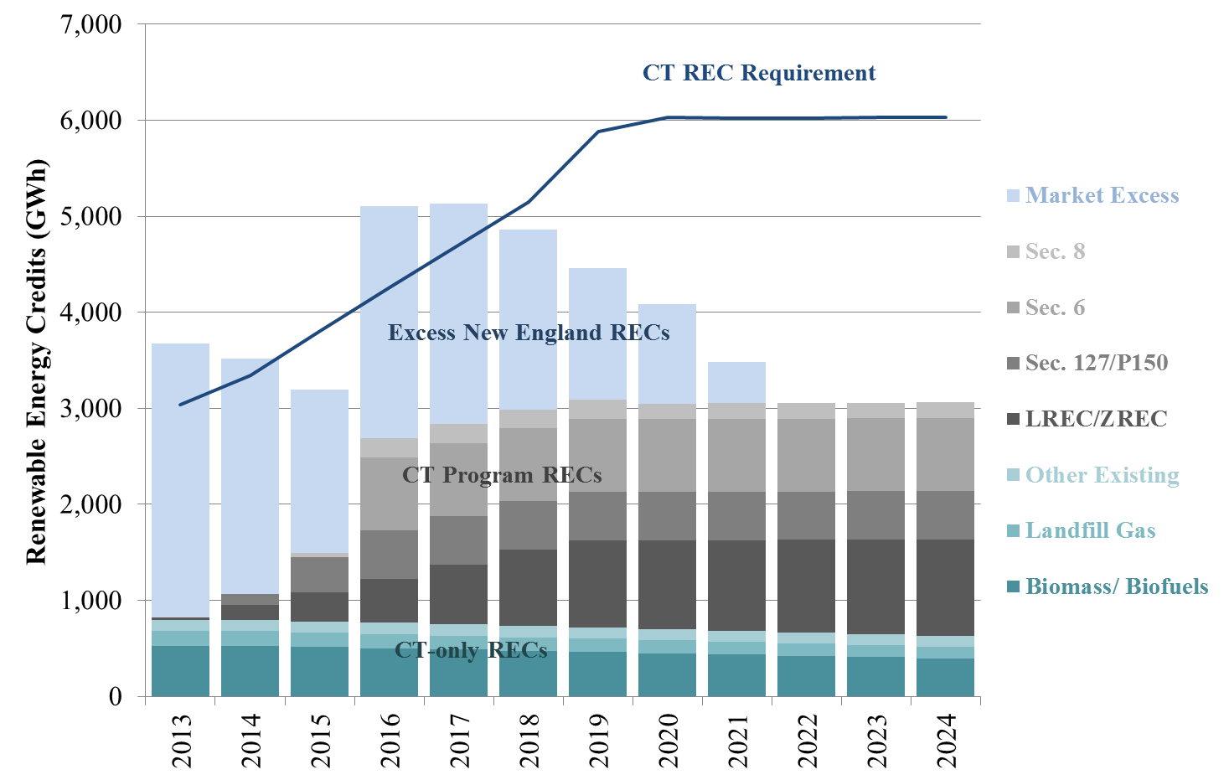
New England Class I Renewable Resource
Shortage
  Since 2011, Connecticut has taken a proactive approach in meeting its renewable energy commitments
  Potential upcoming shortage (still some potential under existing authority to fill some of the gap)

Slide 11
2014 CT Integrated Resources Plan
Eight key recommendations
CT programs highly effective
Challenging trends in NE electricity markets
  Inadequate gas infrastructure
  Need for new capacity
  Regional shortage of Class I supply
  Also: modest increases in gas commodity prices, emissions

Slide 12

Continue to Invest in Cost-Effective Energy Efficiency
In addition to energy efficiency competing in the regional gas infrastructure solutions the 2014 IRP recommends:
  Continue to improve efficiency program design to deliver greater savings at lower costs;
  Refocus efficiency programs on lowering peak demand;
  Continue to invest in efficiency measures for state buildings;
  Continue efforts to pursue energy efficiency improvements codes and standards; and
  Identify unrealized energy efficiency savings.
Notes:
Read slide

Slide 13
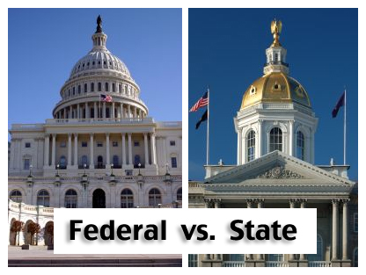
Stepped up participation in the Federal Arena
Connecticut will take a more active stance before federal bodies.
A key area is defending Demand Response’s (DR) ability to participate in the energy and capacity markets.

Slide 14
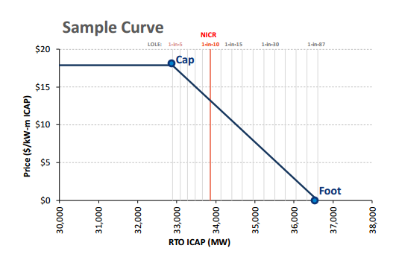
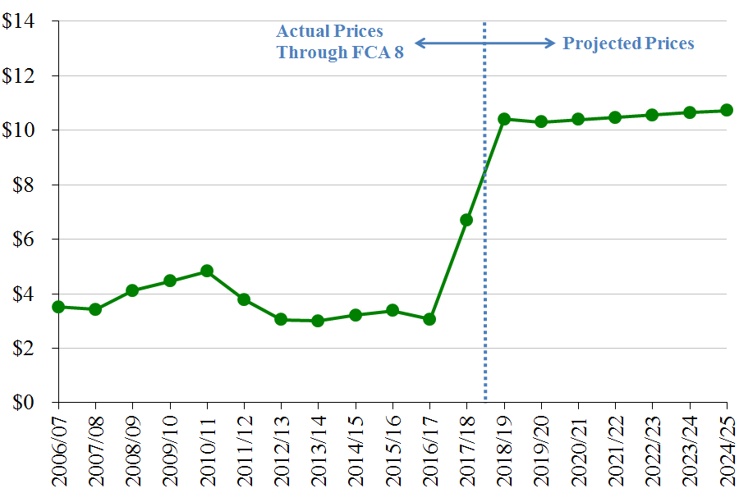
Procure New Generation if Necessary
Projected Capacity Prices (2014$/kW-month)
Higher Forward Capacity Prices expected to bring in sufficient new capacity to New England
If the market fails, the IRP recommends that DEEP pursue options within state authority to procure capacity resources.

Slide 15
A Regional Solution
Existing Interstate Natural Gas Pipelines Serving New England

Slide 16
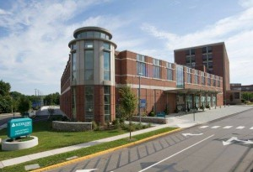
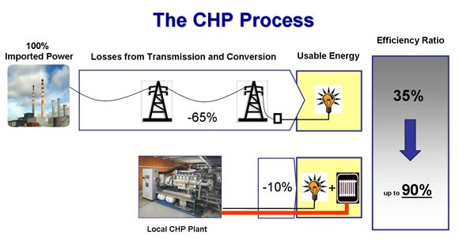
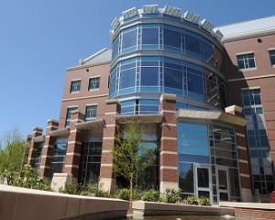
Support Increased Combined Heat and Power Deployment
Revitalize existing incentive programs to help deploy cost-effective CHP potential
CHP systems can provide special value in locations for micro grids avoiding costly upgrades to the utilities’ electric distribution systems.

Slide 17

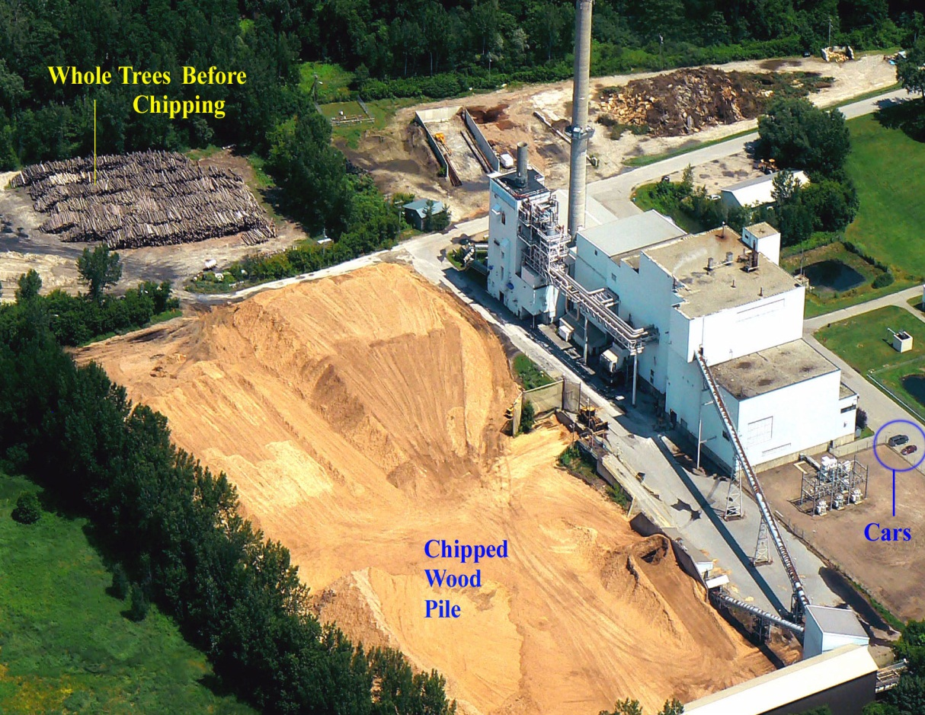
Gradually Phase Down REC Values for Class I Biomass and Landfill Methane Gas Beginning in 2018
Monitor RPS compliance and the capacity market and, in the next IRP, consider establishing a schedule for reduced Class I REC value beginning in 2018 for biomass and landfill methane gas.

Slide 18
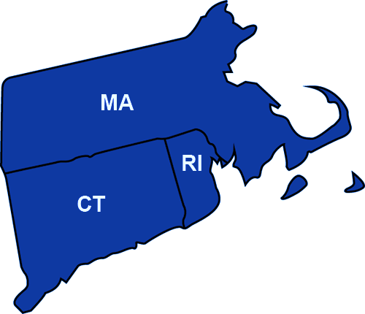
Three-State Clean Energy RFP

Slide 19
Bid Options
CT seeking PPAs of up to 1,500GWh/yr under P.A. 13-303
MA seeking 817GWh/yr under Section 83(a)
RI is not seeking any PPAs
Known as “Delivery Model”
Payment from states directly tied to defined minimum MWh delivery under a FERC tariff
Real regulatory risk with this option
PPA With No Transmission
Transmission Project With Clean Energy Commitment Without PPA
PPA With Transmission
Bid can be a combination of options, i.e. Delivery Model with PPA anchor

Slide 20
Clean Energy RFP Timeline
Comments on Draft RFP
Taking Comment until March 27, 2014
Review of Comments
The participating states and EDCs will review all comments and make changes as appropriate
Hope is to do this in a matter of weeks
Regulatory Review
Massachusetts and Rhode Island statutes require regulatory review of RFP before it can be issued
Process should be about 30 days
Issue Final RFP
Conduct bidder conference, respond to questions, and receive bids over 75 days
Select Winning Bids
Review of bids will take 3-6 months depending on complication of modeling
Winning bids will go through regulatory review (PURA/FERC) hopefully completed by end of 2016

Slide 21





Support Increased Distributed Generation in Connecticut
The IRP recommends continuing to refine and extend programs to support in-state renewable generation such the Connecticut Green Bank’s popular Residential Solar Incentive Program.

Slide 22
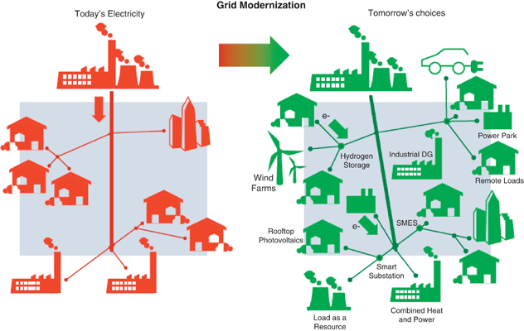
Modernize Regulation and Incentives for Better Integration of Distributed Resources.
As part of an ongoing and evolving process, the IRP recommends initiating a proceeding to evaluate the value of distributed generation.

Slide 23
Questions?
Notes:
.

