Slide 1


Create a planet run by the sun
New England Roundtable Solar and Storage

Slide 2

Sunrun Overview
Who We Are
Market Coverage
Formed in 2007 and headquartered in San Francisco, CA, Sunrun pioneered the residential solar service product
Largest residential solar, storage, home energy management company, with more than 200,000 customers
Sunrun currently operates in 23 states, DC, and Puerto Rico
In 2016, Sunrun expanded its offering to battery storage and, now a leading provider of grid services
Sunrun / Partner Location
Sunrun Solar Service Presence
Sunrun Dealer Network / Lead Generation Presence
Compelling Solar + Storage Value Proposition
$$$$
Value to customer
Save 20% or more on electricity
Little or no upfront cost
Backup power, no fuel or pollution
Bill management
$$$
Illustrative Sunrun Customer Savings
$$
Projected Electricity Bill Without Solar
Value to the Grid
Peak reduction
Resiliency
Dispatchable Virtual Powerplant
Ancillary Services
$
New Electricity Bill
Sunrun Payment
G
TODAY
10 YEARS
20 YEARS
Note: Savings measured over initial 20 year contract term.

Slide 3


Sunrun’s Brightbox solar+storage product serves a range of utility and customer needs
Sunrun is delivering solar+storage to thousands of residential customers with Brightbox. This turnkey solution, integrating hardware from global technology leaders, can be aggregated as a grid resource.
Back-Up Power
(Island during Outage)
Grid Services
(Capacity, Voltage Active/Passive)
2-10 kW Solar
+
9.8 kWh /
5 kW Storage
Bill Management
(TOU, CPP, Hourly)
Energy Self Supply
    Brightbox solves for market and customer needs:
HI: Backup Power and Solar Self Supply
CA: Backup Power, TOU Bill Management, Grid Services
AZ: Backup Power, TOU Bill Management
NY: Backup Power, Grid Services
MA: Backup Power, Grid Services
FL: Backup Power
Puerto Rico: Backup Power; Donated systems on fire stations for 24/7 power, future rebuilding asset

Slide 4
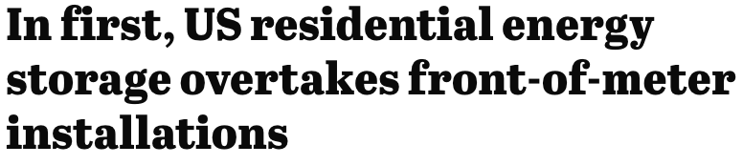

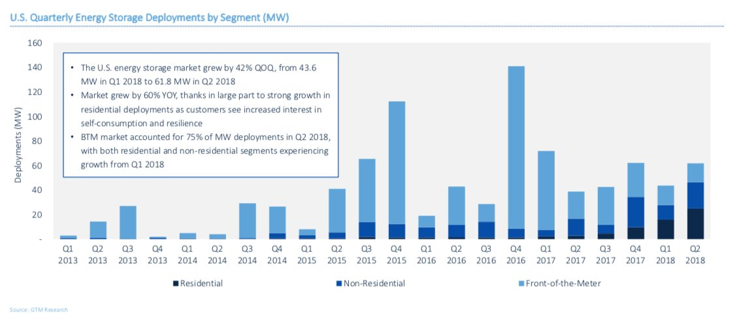
From Q2 2017 to Q2 2018, residential storage deployment grew 10x and outpaced all other storage market sectors.

Slide 5
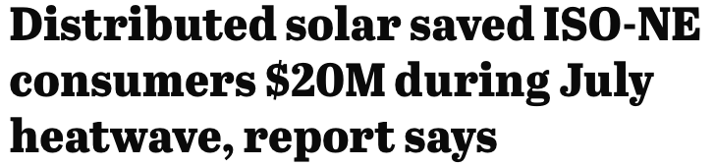



Recent Headlines

Slide 6


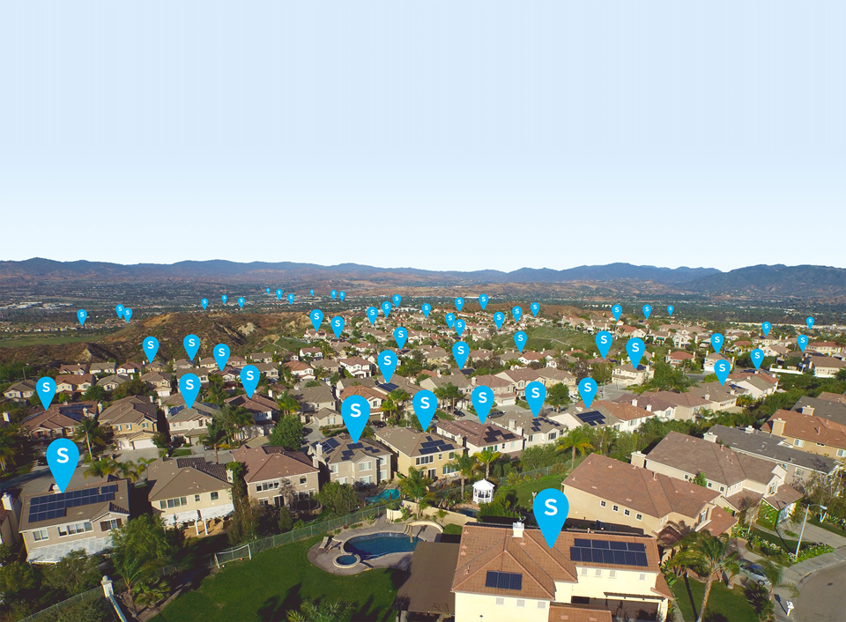
Distributed Solar + Batteries Increases Resiliency
for Customers and the Grid
Sunrun delivers home solar and battery services to thousands of households with Brightbox. These batteries can be aggregated as a grid resource.
Operational when T&D lines are damaged
Less likely to result in widespread outages
Clean, affordable backup power
Reduces need to harden T&D costs and to use dirty peaker plants
Helping to address imbalances or congestion.
Home solar and battery storage can be located at the most valuable grid locations, where energy is consumed.

Slide 7
Regulatory Foundational Elements to Enable Solar Plus Storage Solutions
Support fair compensation for residential solar, which fuels batteries.
Net metering = solar = storage.
Streamline interconnection and metering processes.
Offer tariffs that allow customers to provide services to make the grid more resilient.
Find win-wins for utilities & competitive companies through shared savings mechanisms (i.e., New York).

Slide 8
Thank you!

