Slide 1


Douglas Moore
General Manager Fuel Cell Solutions

Slide 2
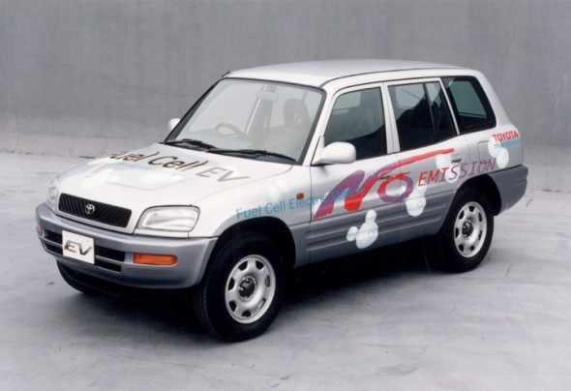
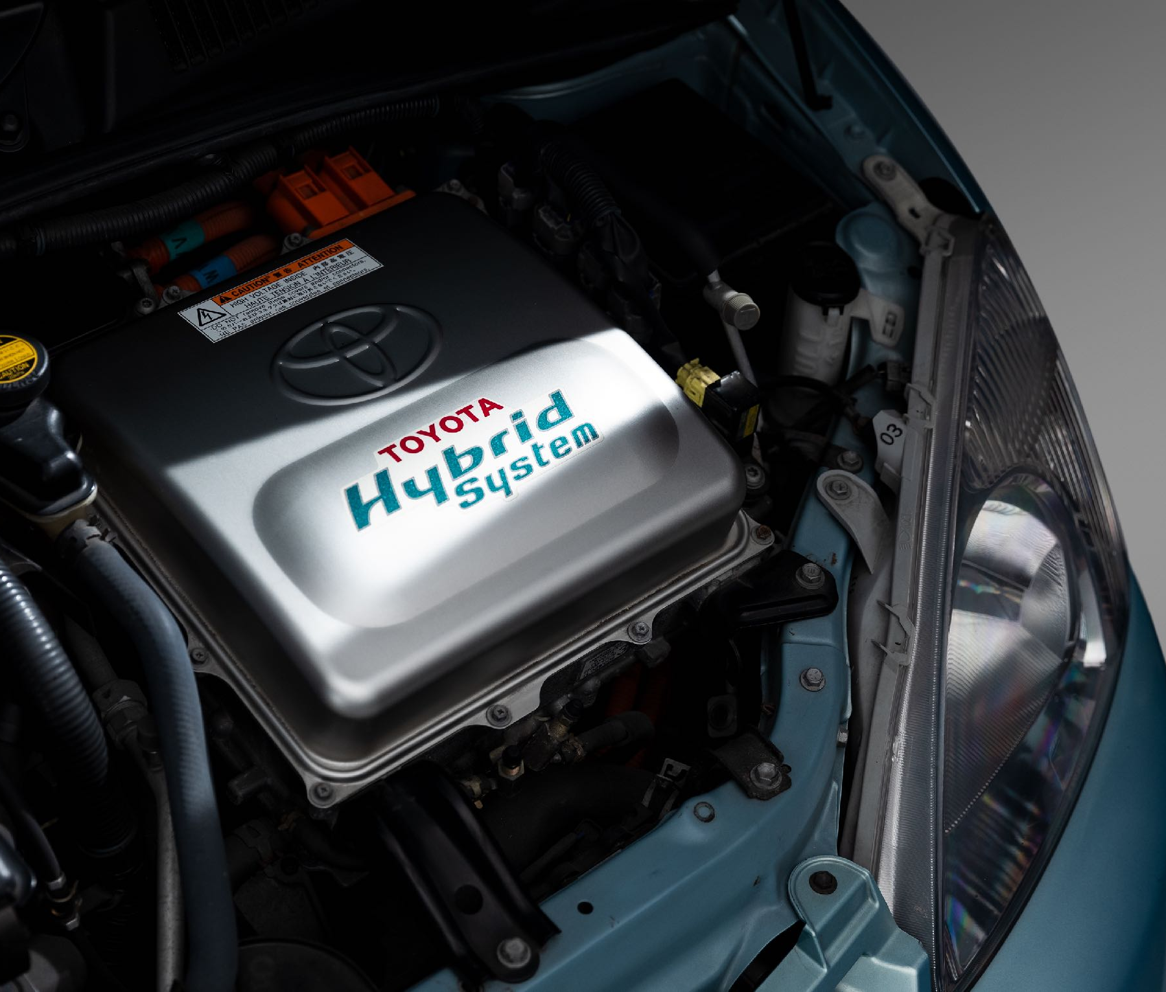
Notes:
And here’s some Toyota history back in the mid-90s Toyota began multiple R&D projects to reduce the environmental impact of our vehicles with the goal of
sustainable mobility.
The first prototypes were the RAV4 fuel cell concept ...
and the Prius gas-electric hybrid concept.
And these became our technology foundation for higher-efficient low-emission and zero emission powertrains.

Slide 3
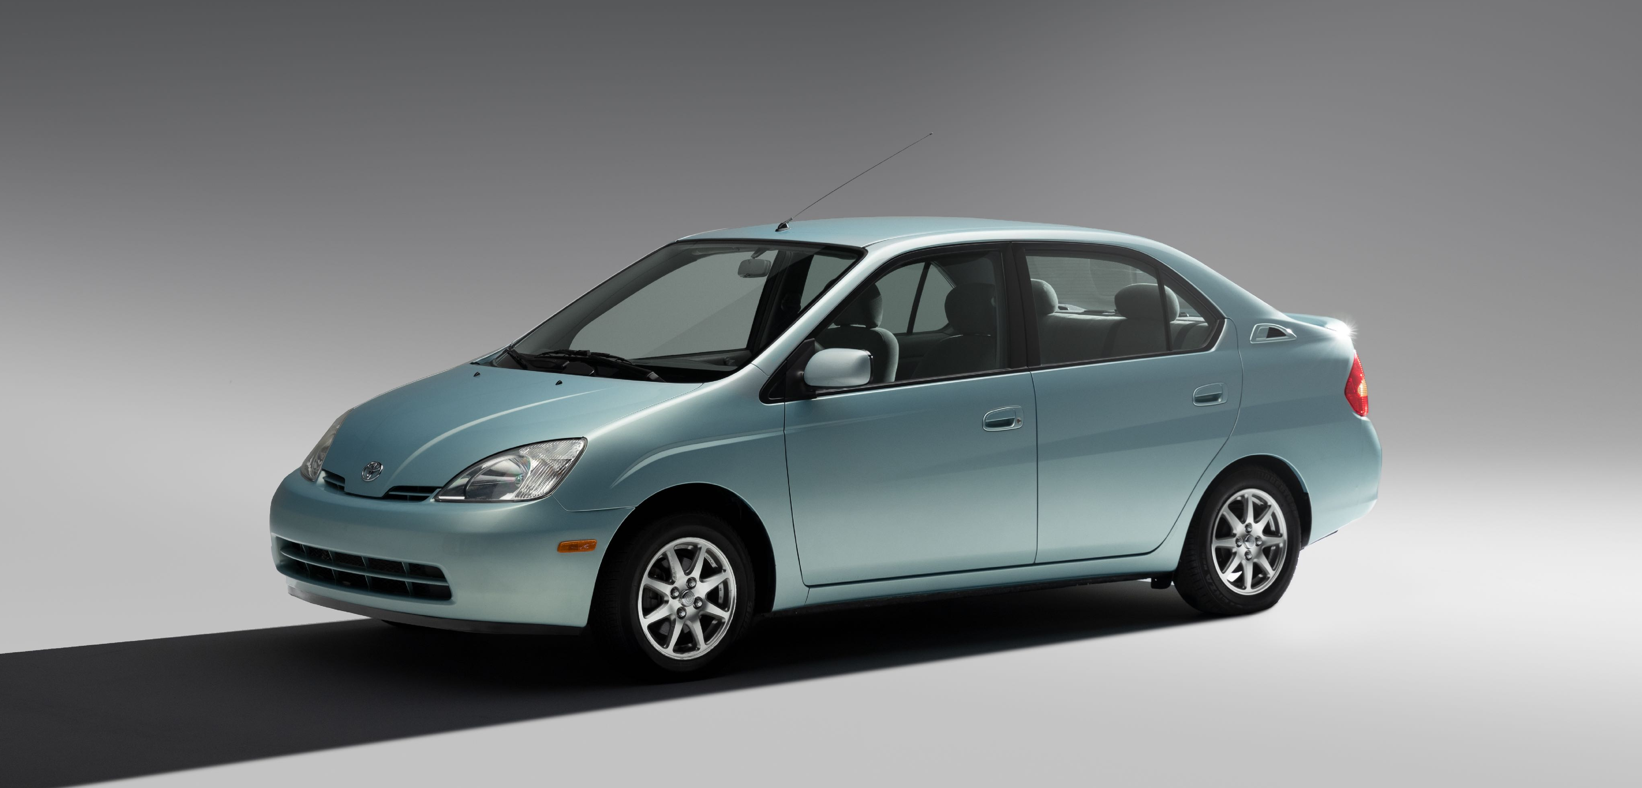
Notes:
The Prius launched first because the development timeline was shorter

Slide 4
Notes:
But it was because of Toyota’s strong commitment
to the environment that our development continued with fuel cells for nearly two more decades validating the concept with over 100 fuel cell Highlanders with customers as part of a demonstration program

Slide 5
Environmental B-Roll
Notes:
until the eventual launch of the Mirai in 2015 the first hydrogen fuel cell vehicle to be offered for sale.

Slide 6
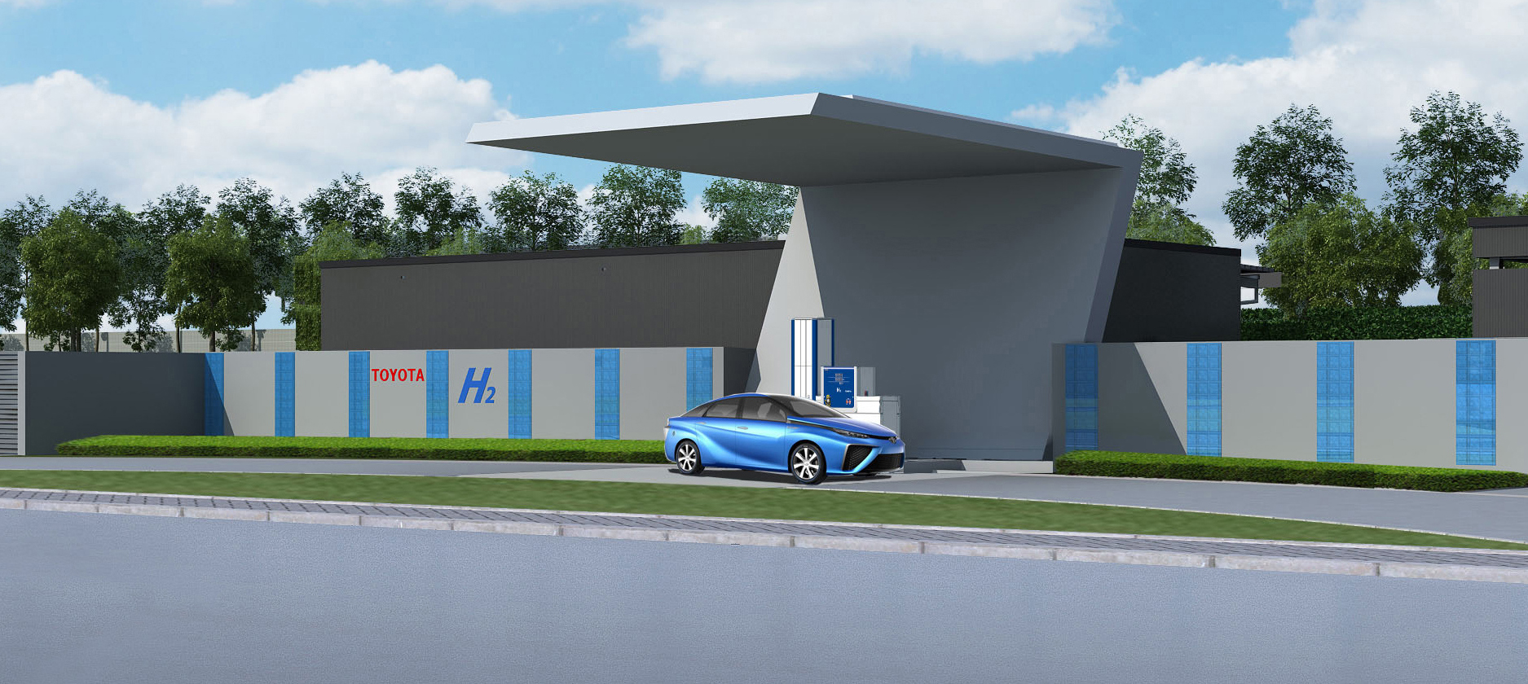
Easy Fueling
Heavy Duty Scalability
Renewable Fuel Sources
Notes:
Toyota's continued development of Fuel Cell technology is because of its potential to replace gasoline the scalability for Heavy Duty vehicles and new applications and the opportunity to use fuel from renewable
and zero-carbon sources.

Slide 7
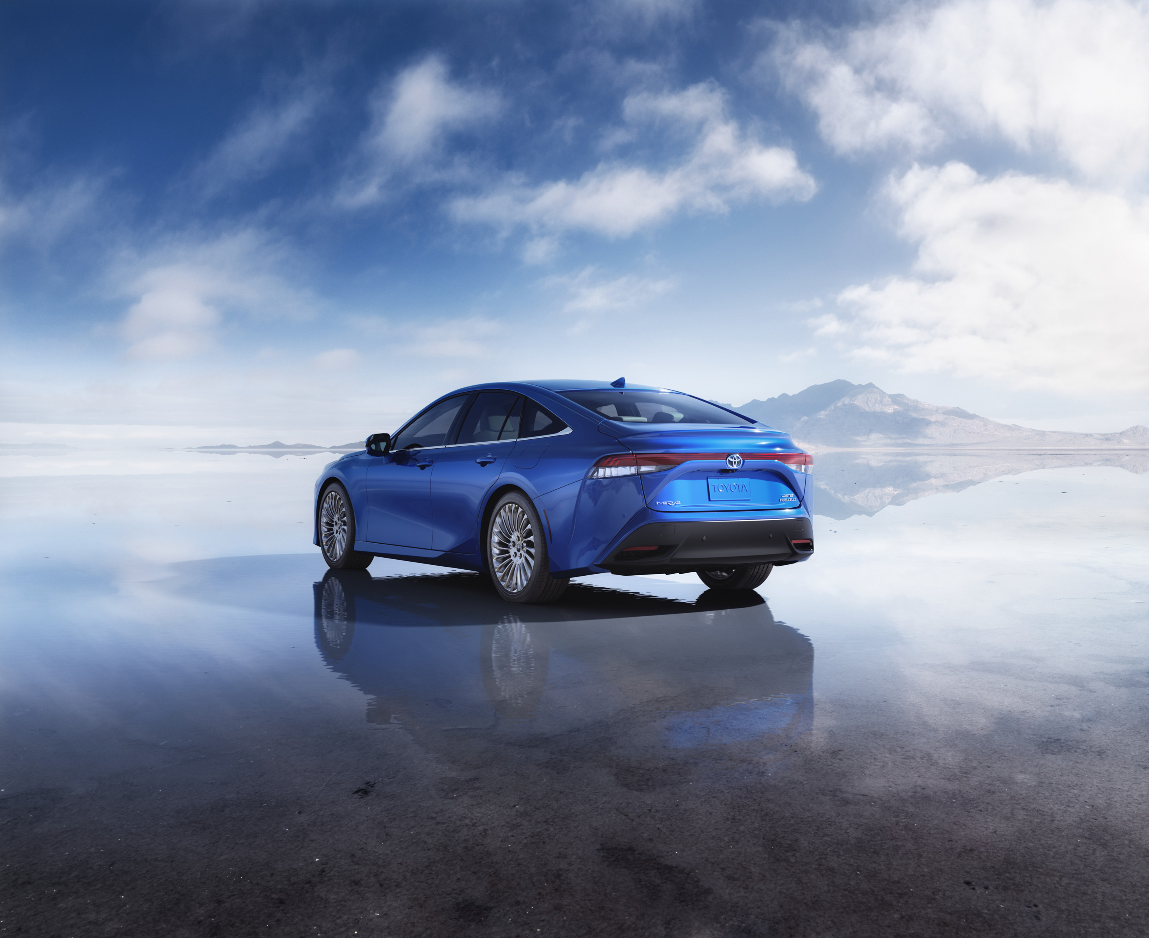
Notes:
We brought the second generation Mirai to market late last year and it’s a stylish vehicle with great driving dynamics.

Slide 8
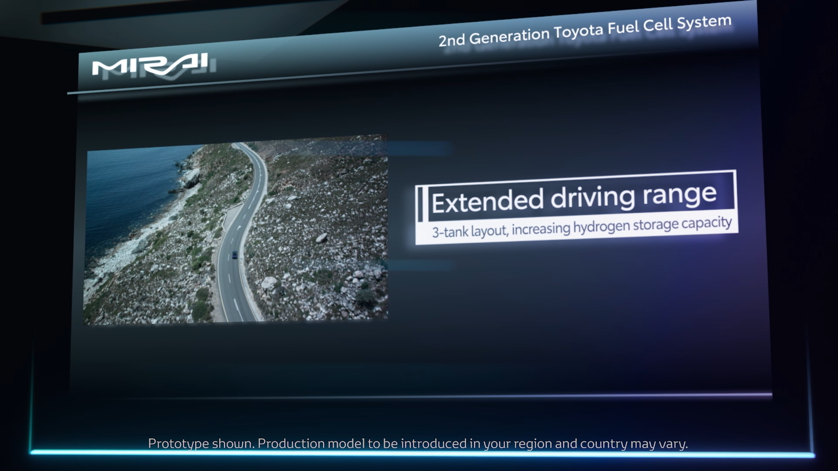
402 Mile Range
Notes:
The improved fuel cell system provides the XLE version a cruising range
of up to 402 miles.

Slide 9




Notes:
Toyota has partnered with First Element Fuels, Iwatani, Air Liquide, and Shell, to help ensure a viable hydrogen refueling network throughout California.

Slide 10
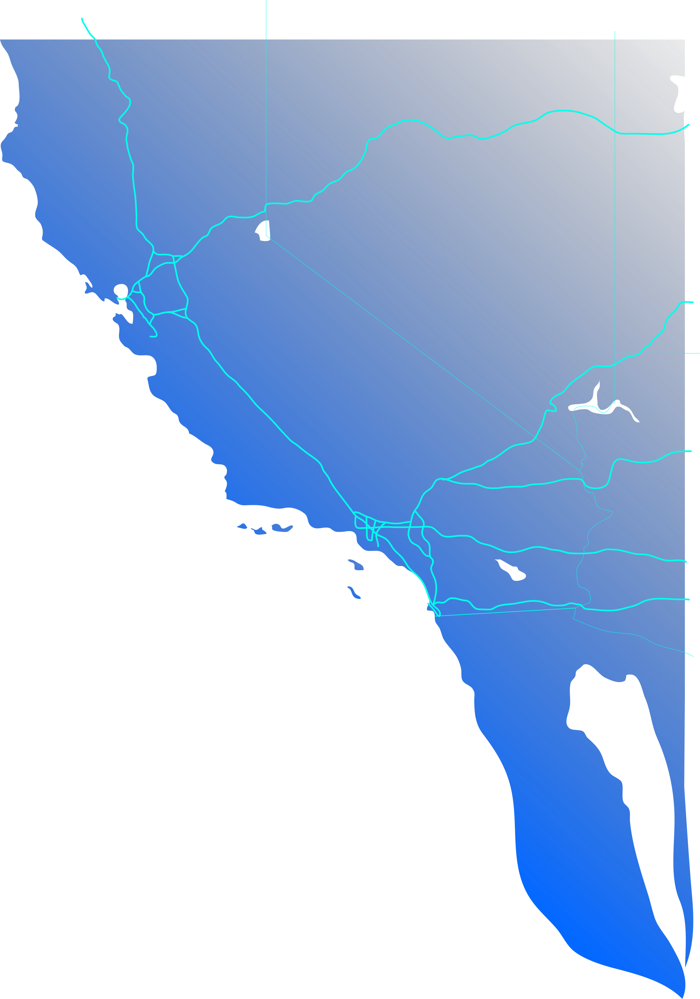

NEVADA
49 Stations Open
CALIFORNIA
120 Under Development
ARIZONA
Notes:
With 49 stations open in the state, 11 more under construction,
And over 120 funded and now in development
We think hydrogen station developers in California are making progress in building out the network, but recognize that consumer demand is outpacing the infrastructure.

Slide 11
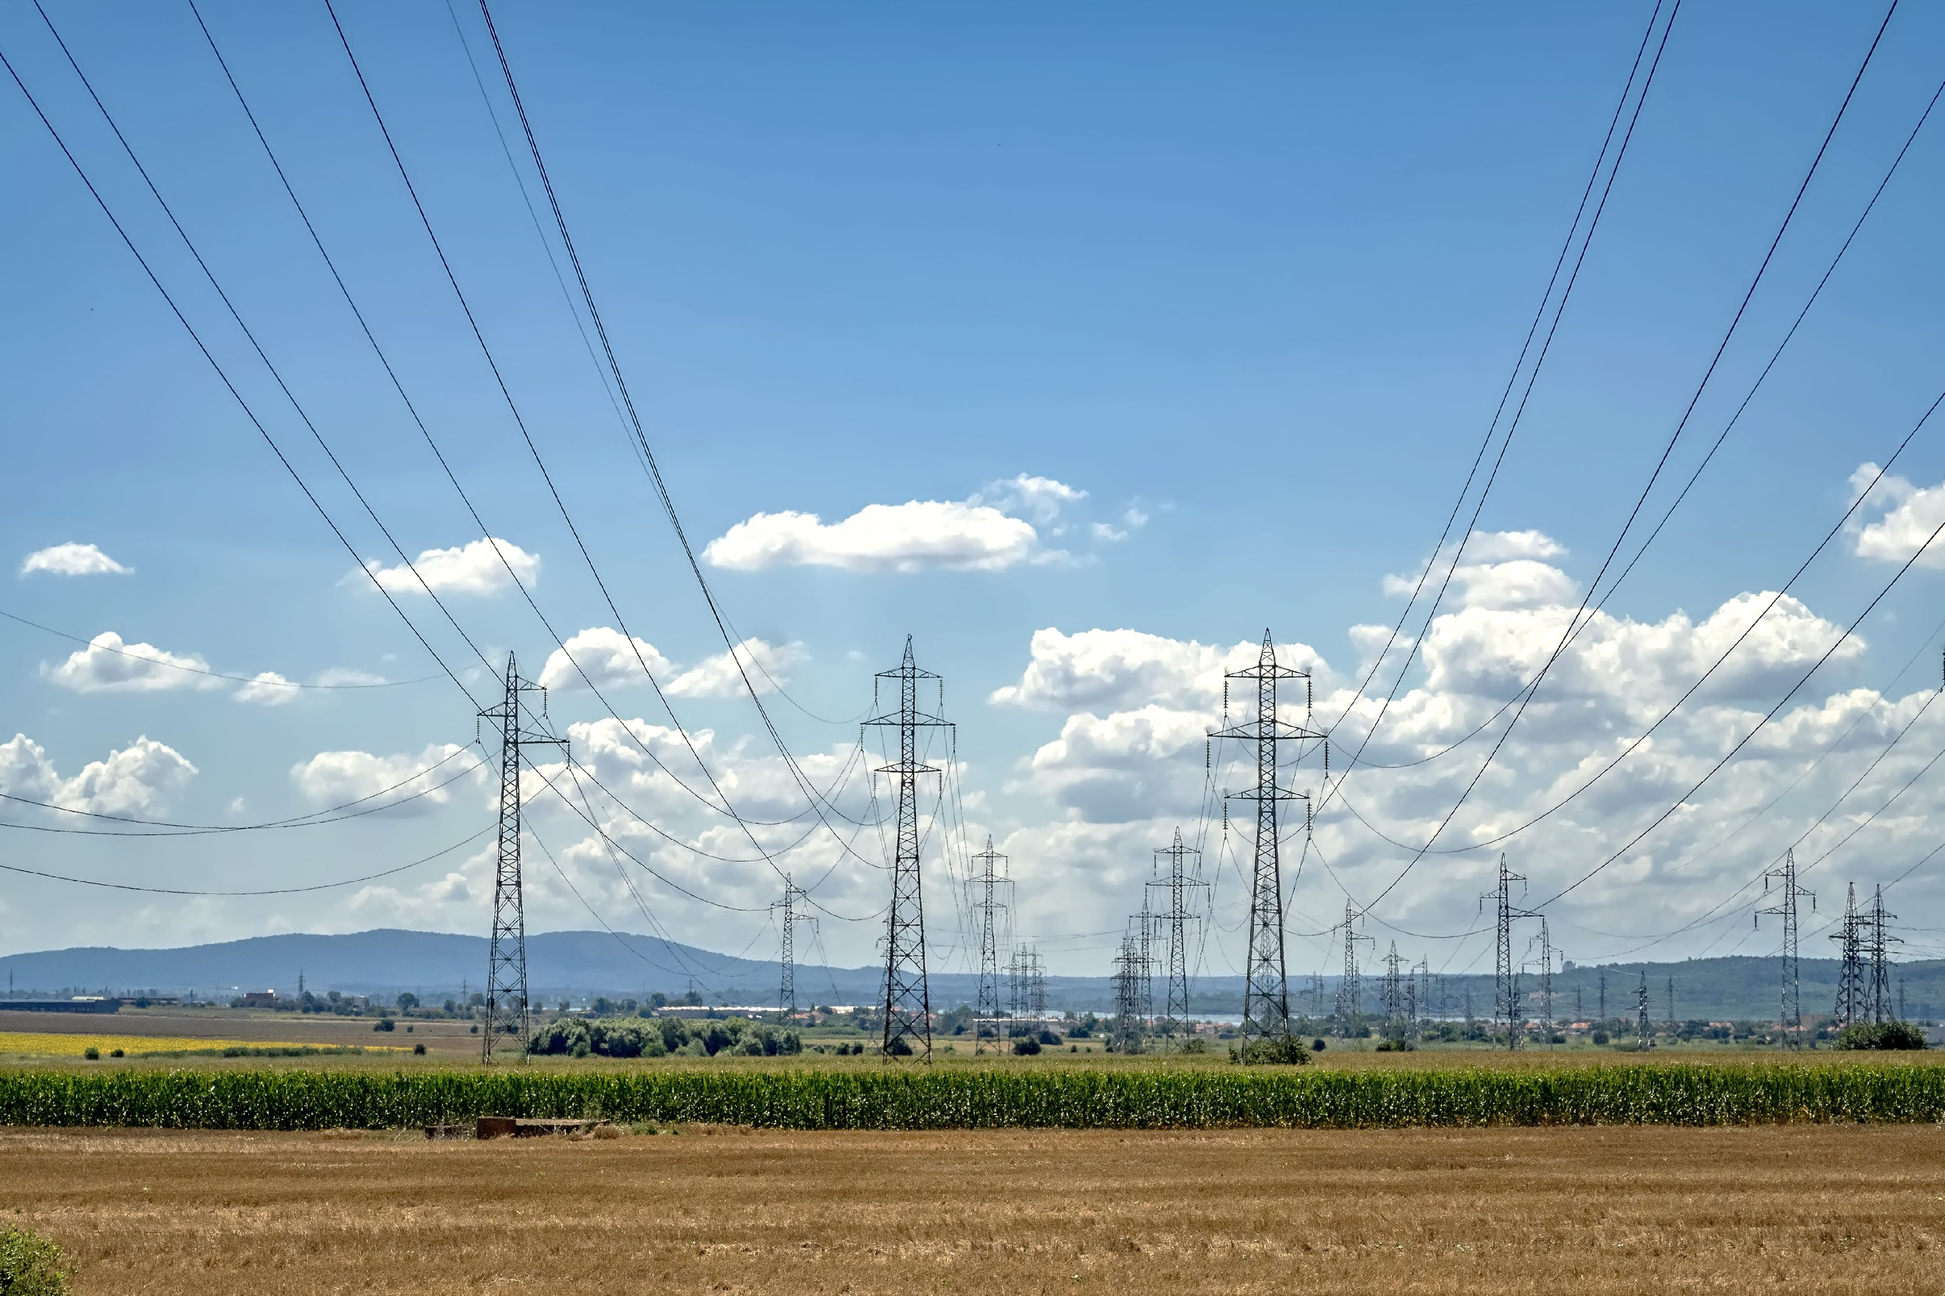
Notes:
It’s the same issue with BEV’s...
...as customers adopt that technology pressure will
increase on charging stations and our electrical grids.

Slide 12
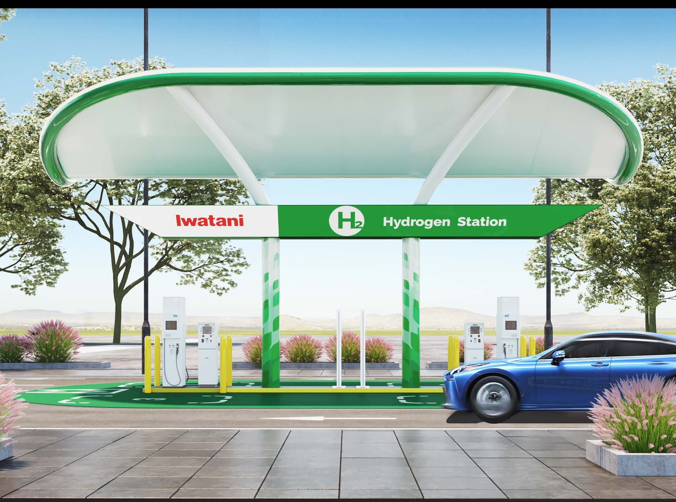
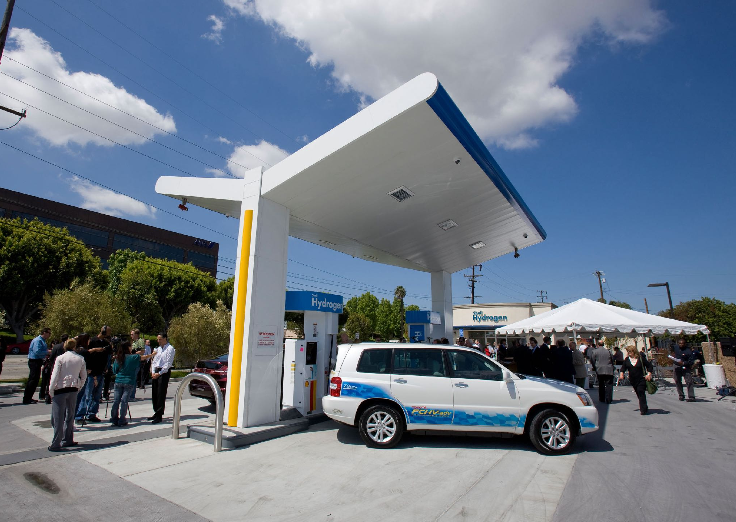
Notes:
For example we announced late last year that we we’re partnering with Iwatani to support the construction
of 7 additional stations and we continue to work
with Shell as it aims to build 50 new stations in California.

Slide 13
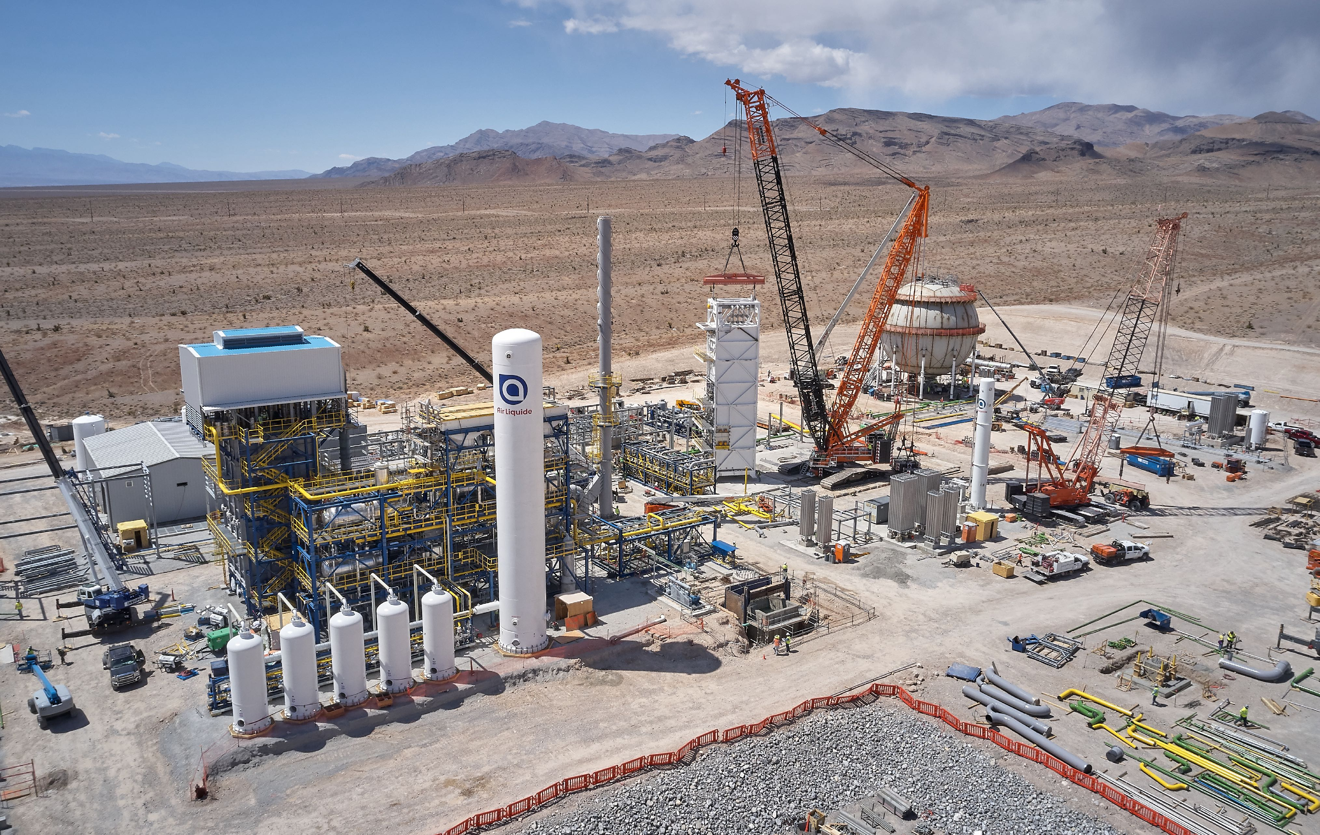
Notes:
But it’s not just about expanding station coverage, Scale-up of hydrogen production is also essential.
More supply is expected, with Air Liquide building a new hydrogen production facility in Las Vegas that will use renewable feedstocks.

Slide 14
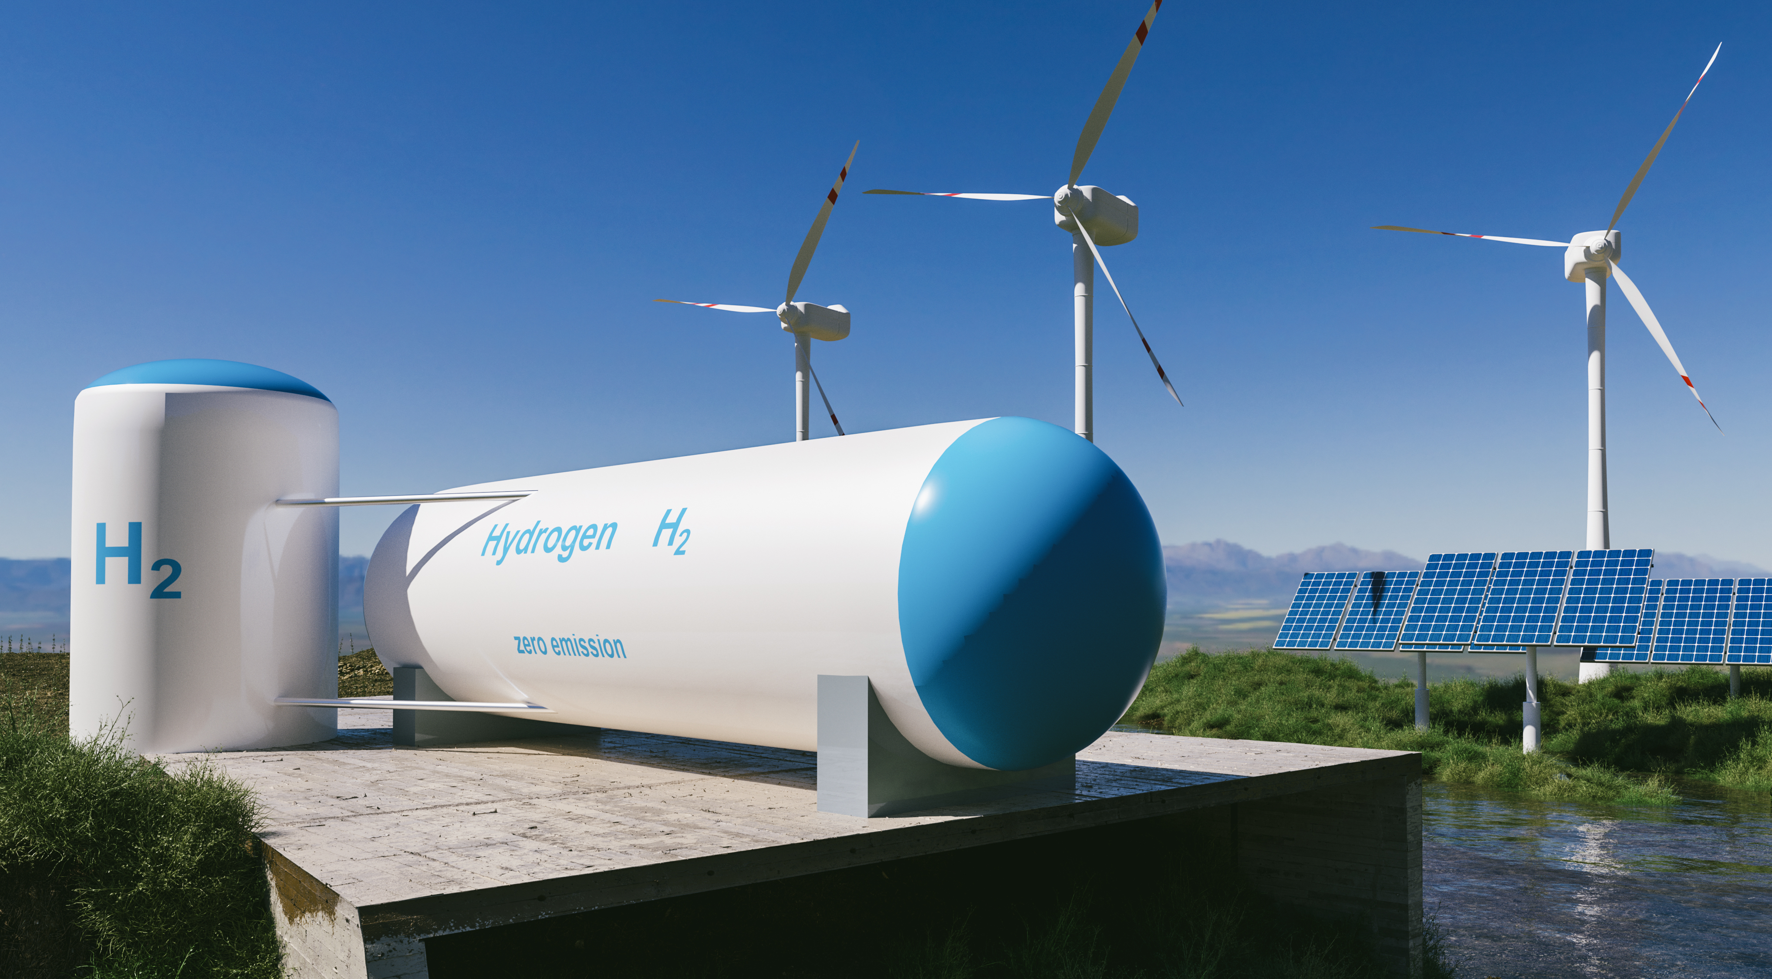
90%+ Renewable Hydrogen
Source: 2021 CARB AB8 Report
Notes:
In fact …
The state of California reported that
over 90% of all hydrogen currently produced
For fuel cell vehicles is from renewable feedstocks.

Slide 15
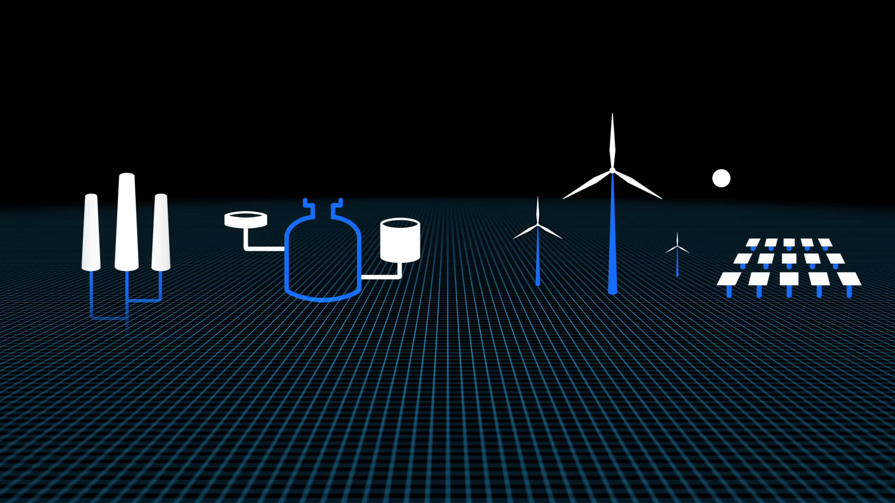
Biogas
Wind
Solar
Renewable Energy
Notes:
There are many ways to make hydrogen cleaner.
Recently…
SG H2 Energy in partnership with Iwatani is planning new

Slide 16
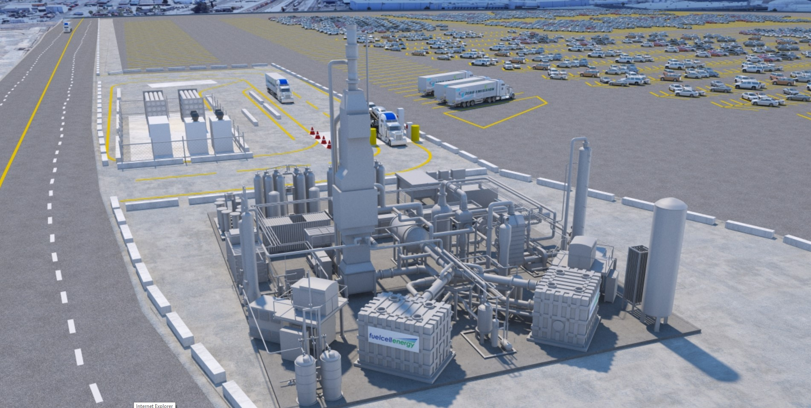
Toyota Logistics Services
Tri Gen Plant, Long Beach CA
Notes:
renewable hydrogen plants in California with a novel process projected to have negative carbon intensity since it’s sourced by bulk waste that would have otherwise ended up in landfills.
And this project plans to have the hydrogen trailers
pulled by trucks powered by Toyota Fuel Cells.
Hydrogen dispensed by large providers in California are estimated to achieve zero carbon intensity by next year.
The take away is that hydrogen for fuel cell vehicles has decarbonized faster then the electric grid.

Slide 17
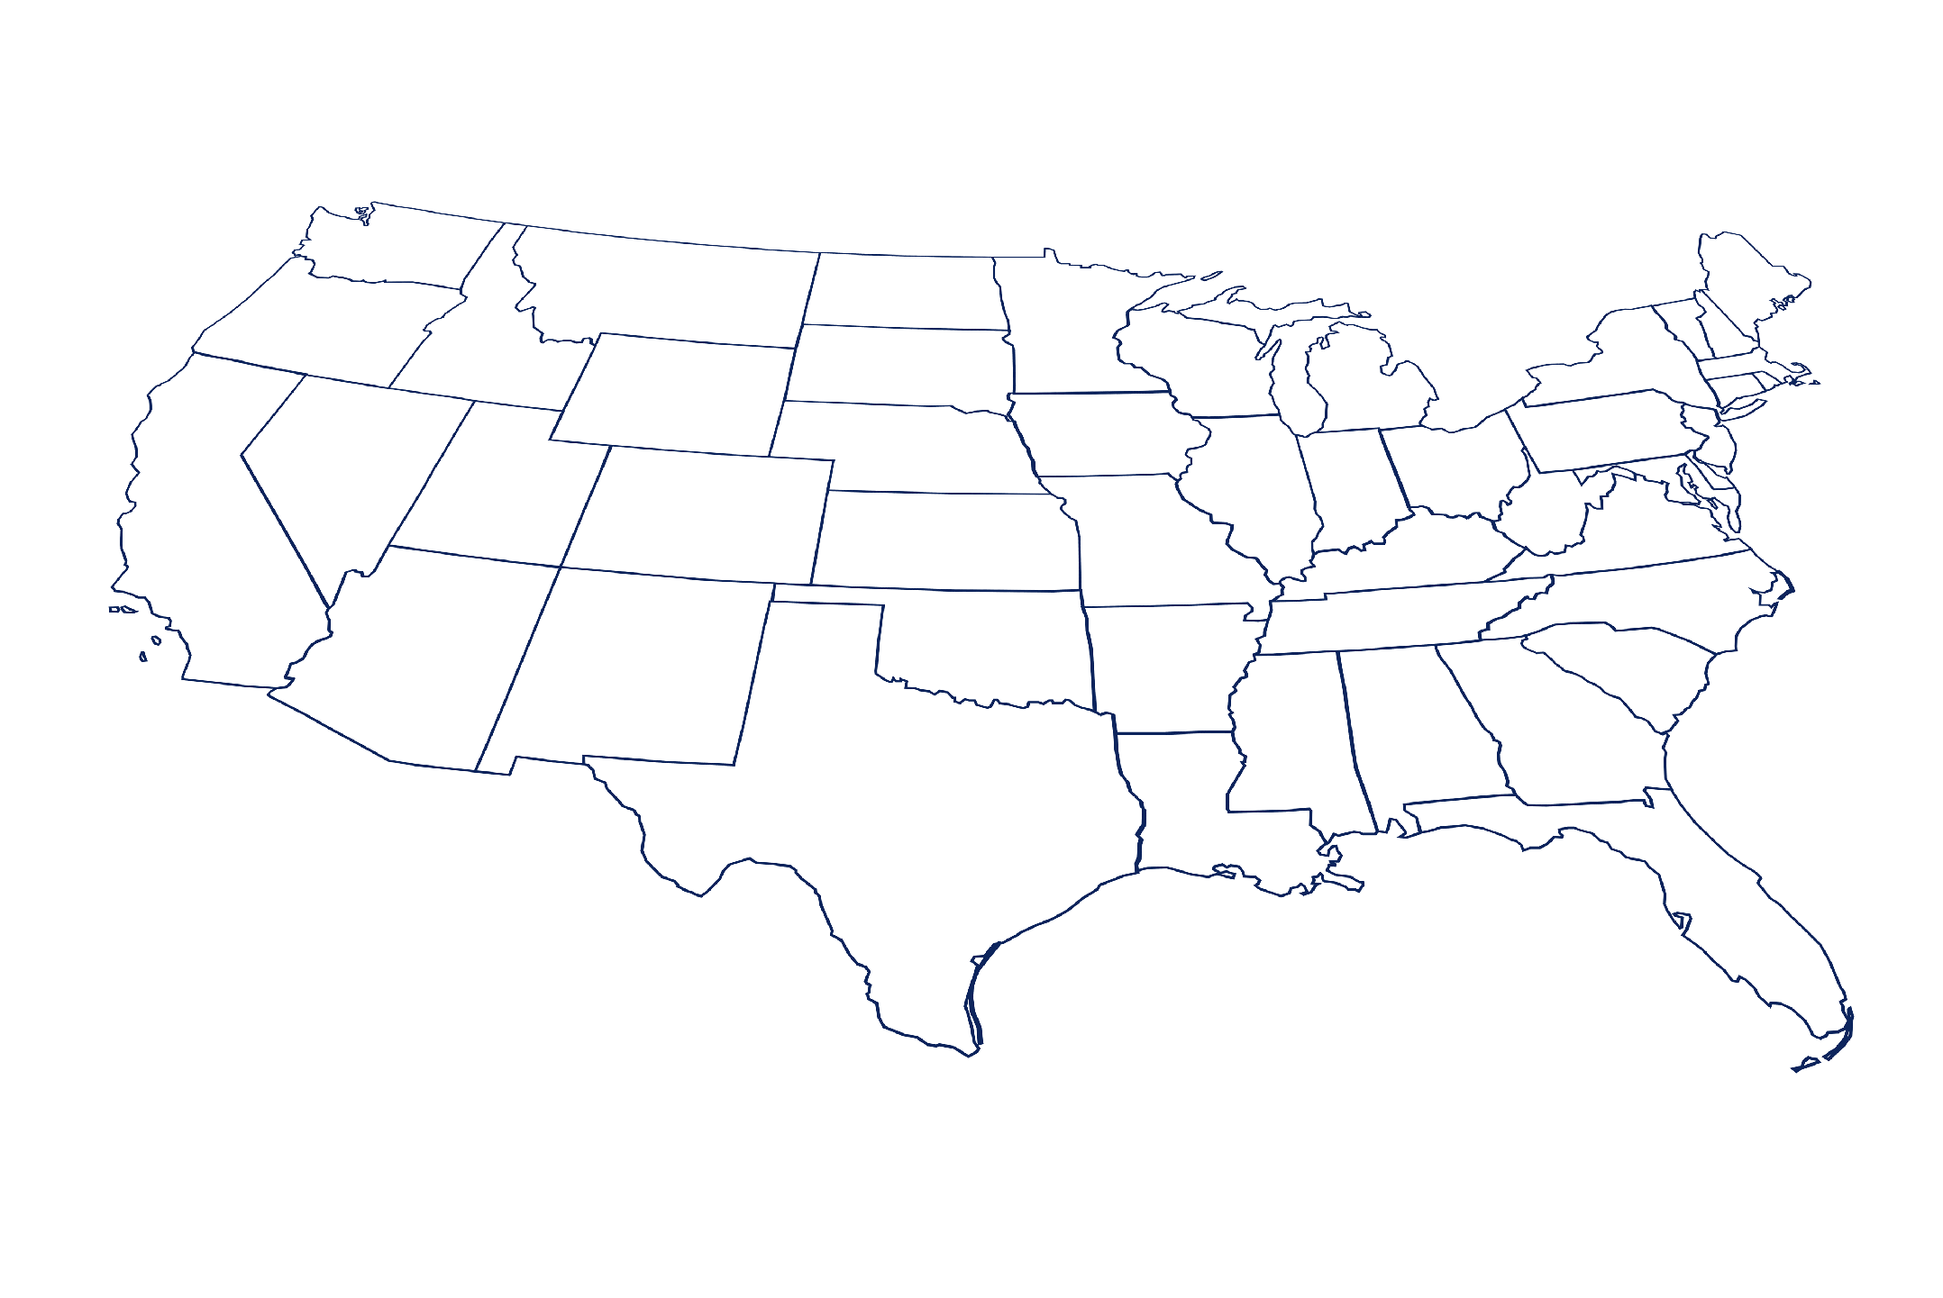
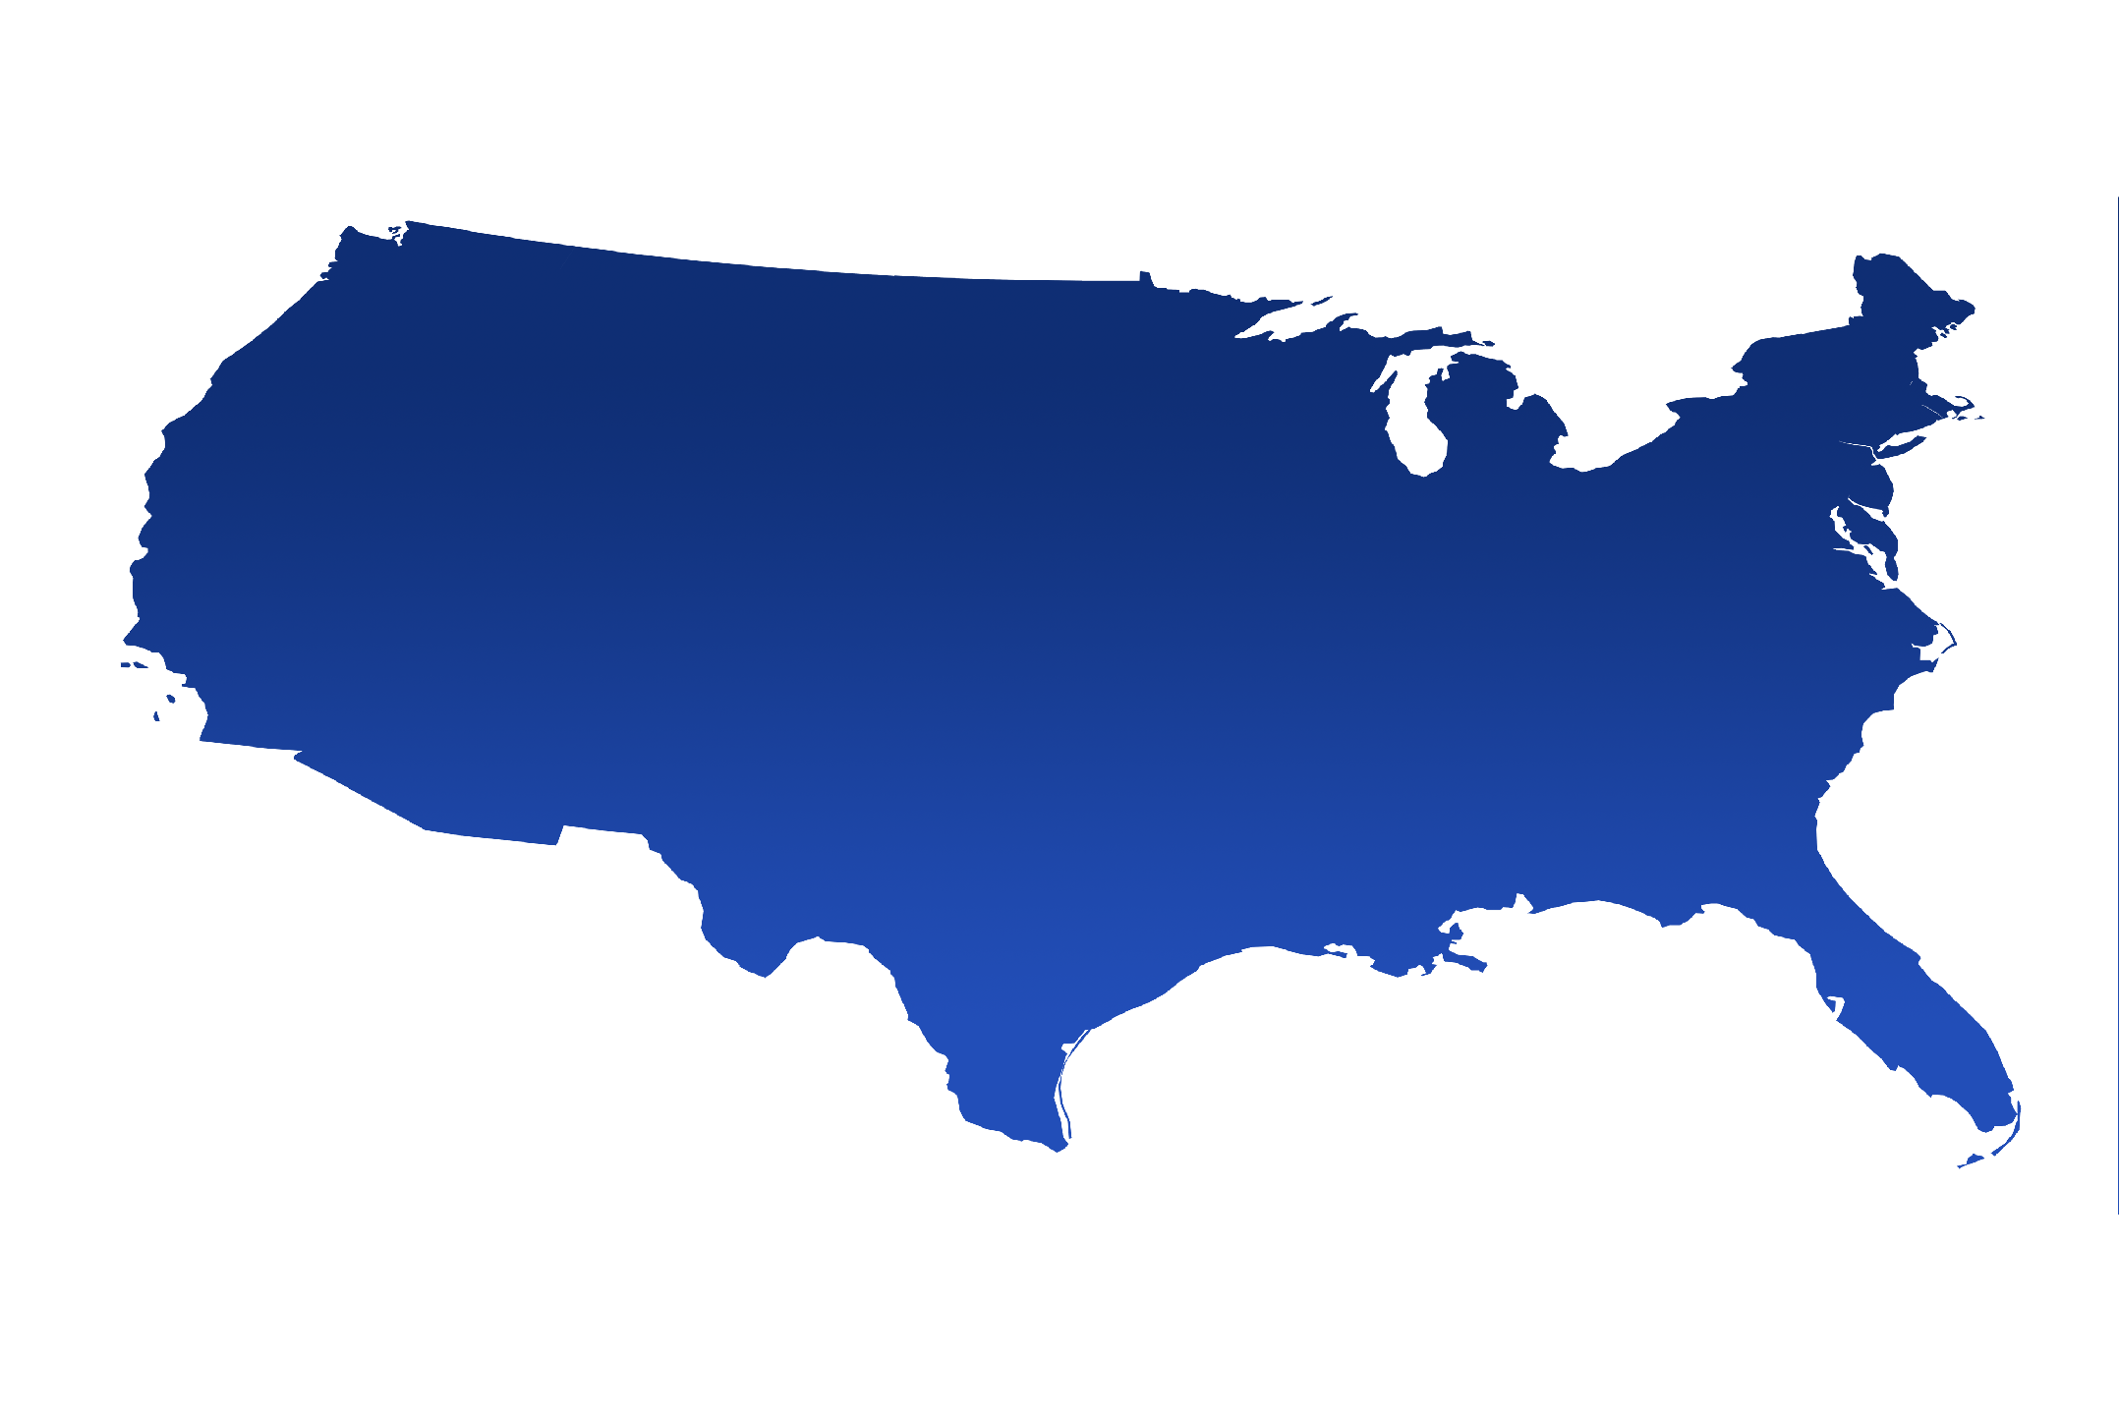
Notes:
We’re also hard at work to support the expansion
of hydrogen infrastructure beyond California.
We’re working with Air Liquide to build a network
in the Northeast.
And the Pacific Northwest ... Colorado ... and Texas ...
are expressing interest in building hydrogen networks too.

Slide 18
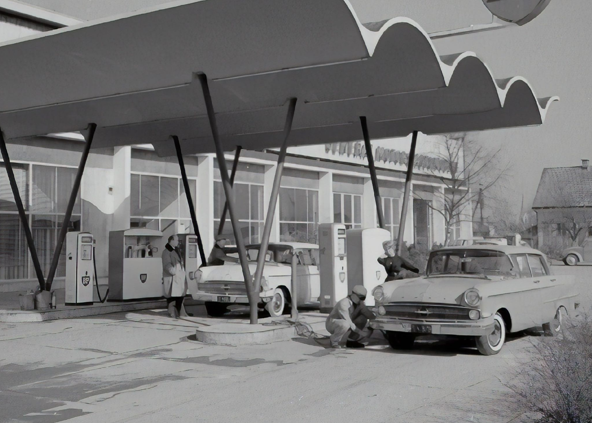
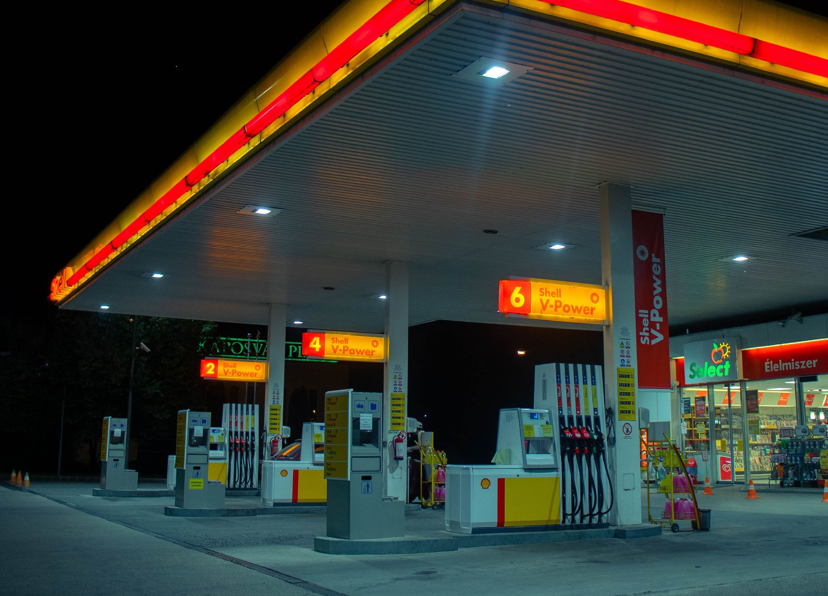
Notes:
We know establishing the production distribution and retail network will take time after all building our current gasoline fueling infrastructure took decades...
but we believe in the potential of hydrogen as an energy source and we remain committed to working with all stakeholders as we move to develop the hydrogen society.
We also know we’ve got our work cut out for us we need to continue to educate consumers and policy makers about why building a hydrogen infrastructure is so important and that a balanced mix of fuel cell and BEV funding are both needed to reach carbon neutrality.

Slide 19
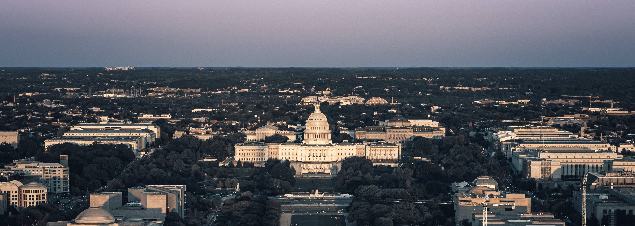
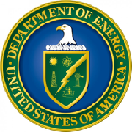
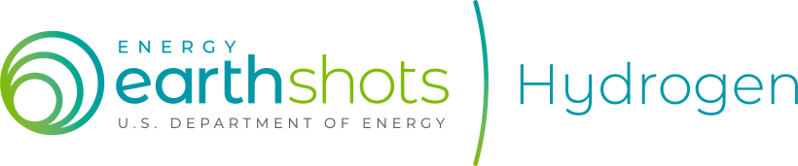
Notes:
A program like the Department of Energy’s Hydrogen Shot is a great start ...
with $400 million in funding to reduce the cost of hydrogen to $1 per kilogram in 1 decade …
A goal that would vastly increase access to clean hydrogen for everyone.

Slide 20
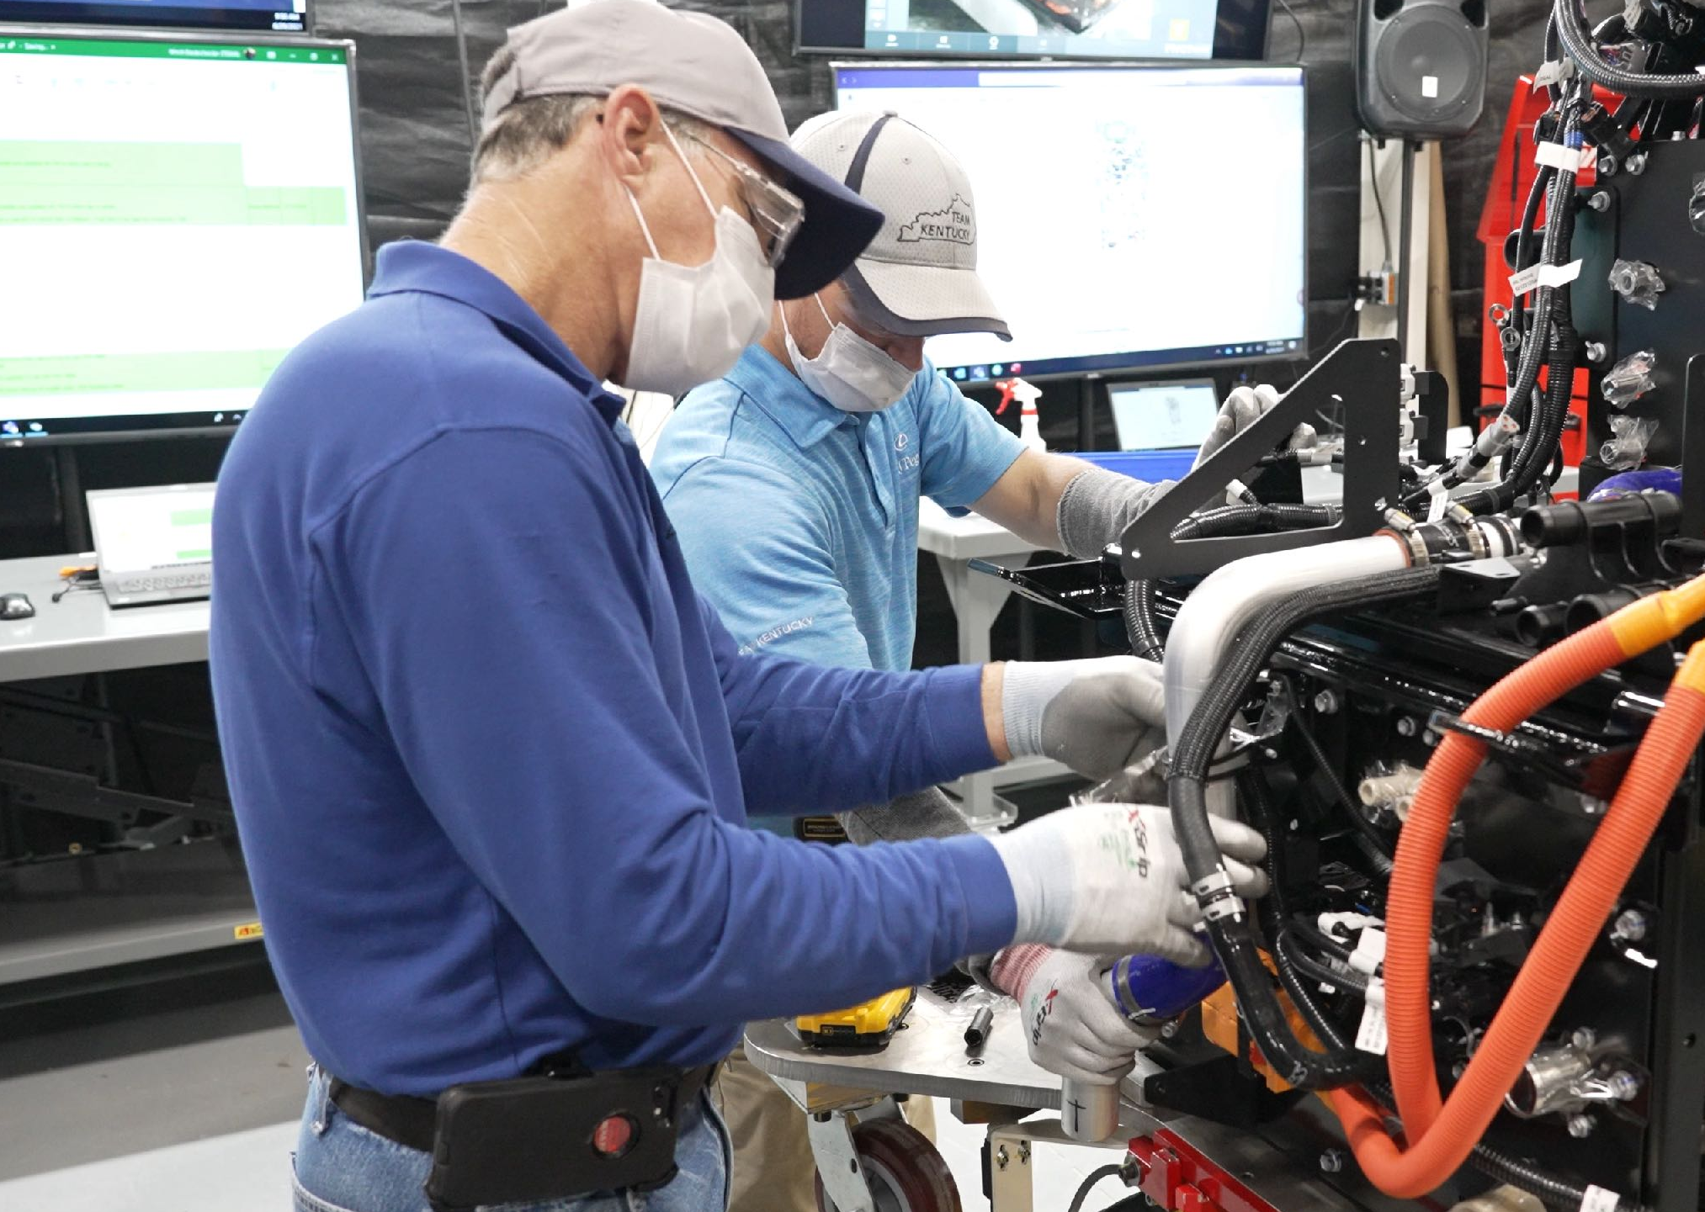
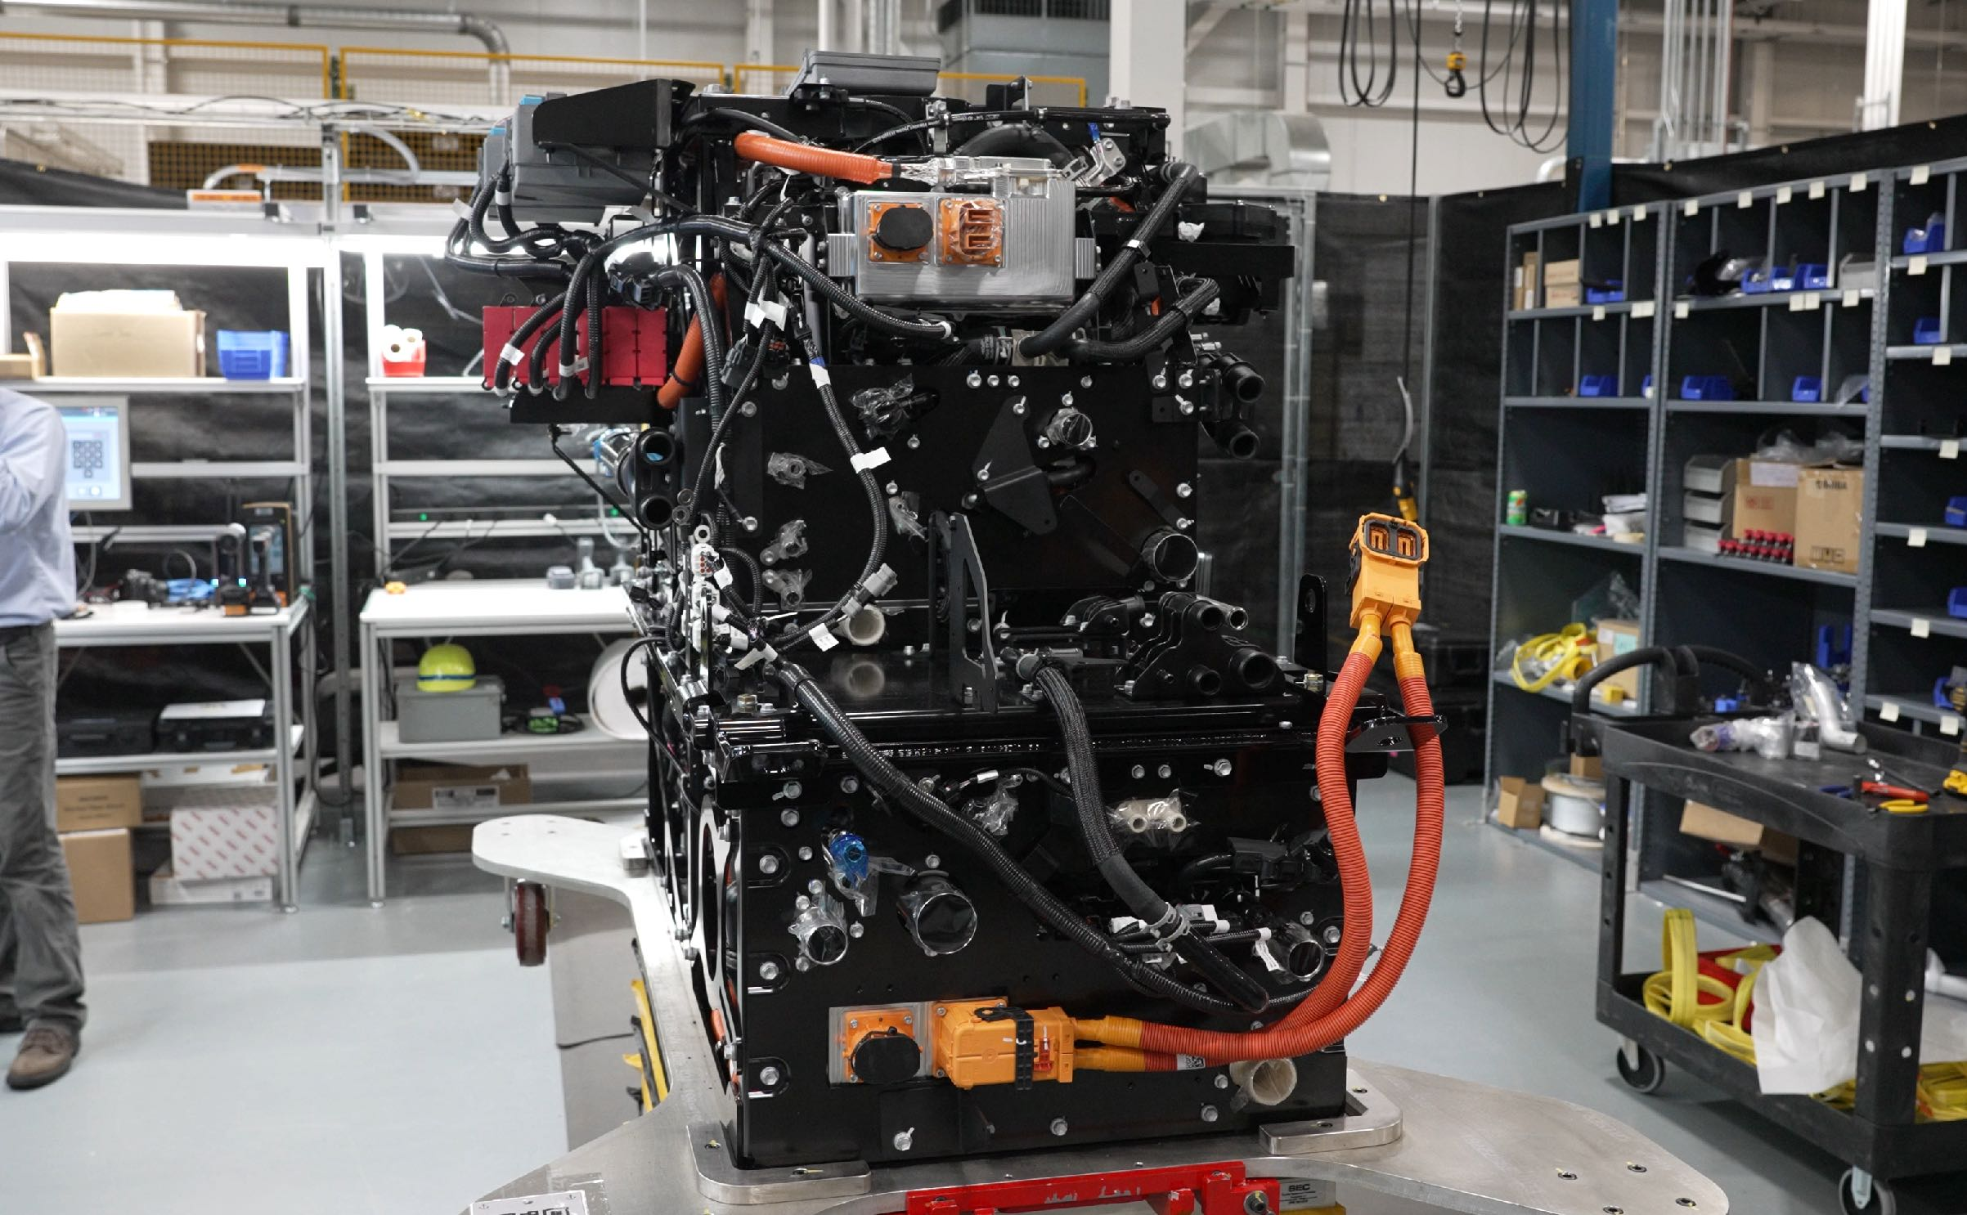
Notes:
Our fuel cell efforts go beyond the Mirai.
Starting in 2023 American workers at Toyota Motor Manufacturing Kentucky will be assembling
a standalone hydrogen fuel cell system to sell to heavy duty truck manufacturers that would normally install
diesel engines.

Slide 21
Notes:
And we’ve already put early versions of this fuel cell system into more than fifteen Class-8 semi-trucks… we have two of those outside for you to check out today.
These trucks along with another demonstration fuel cell truck for drayage or UTR ...

Slide 22
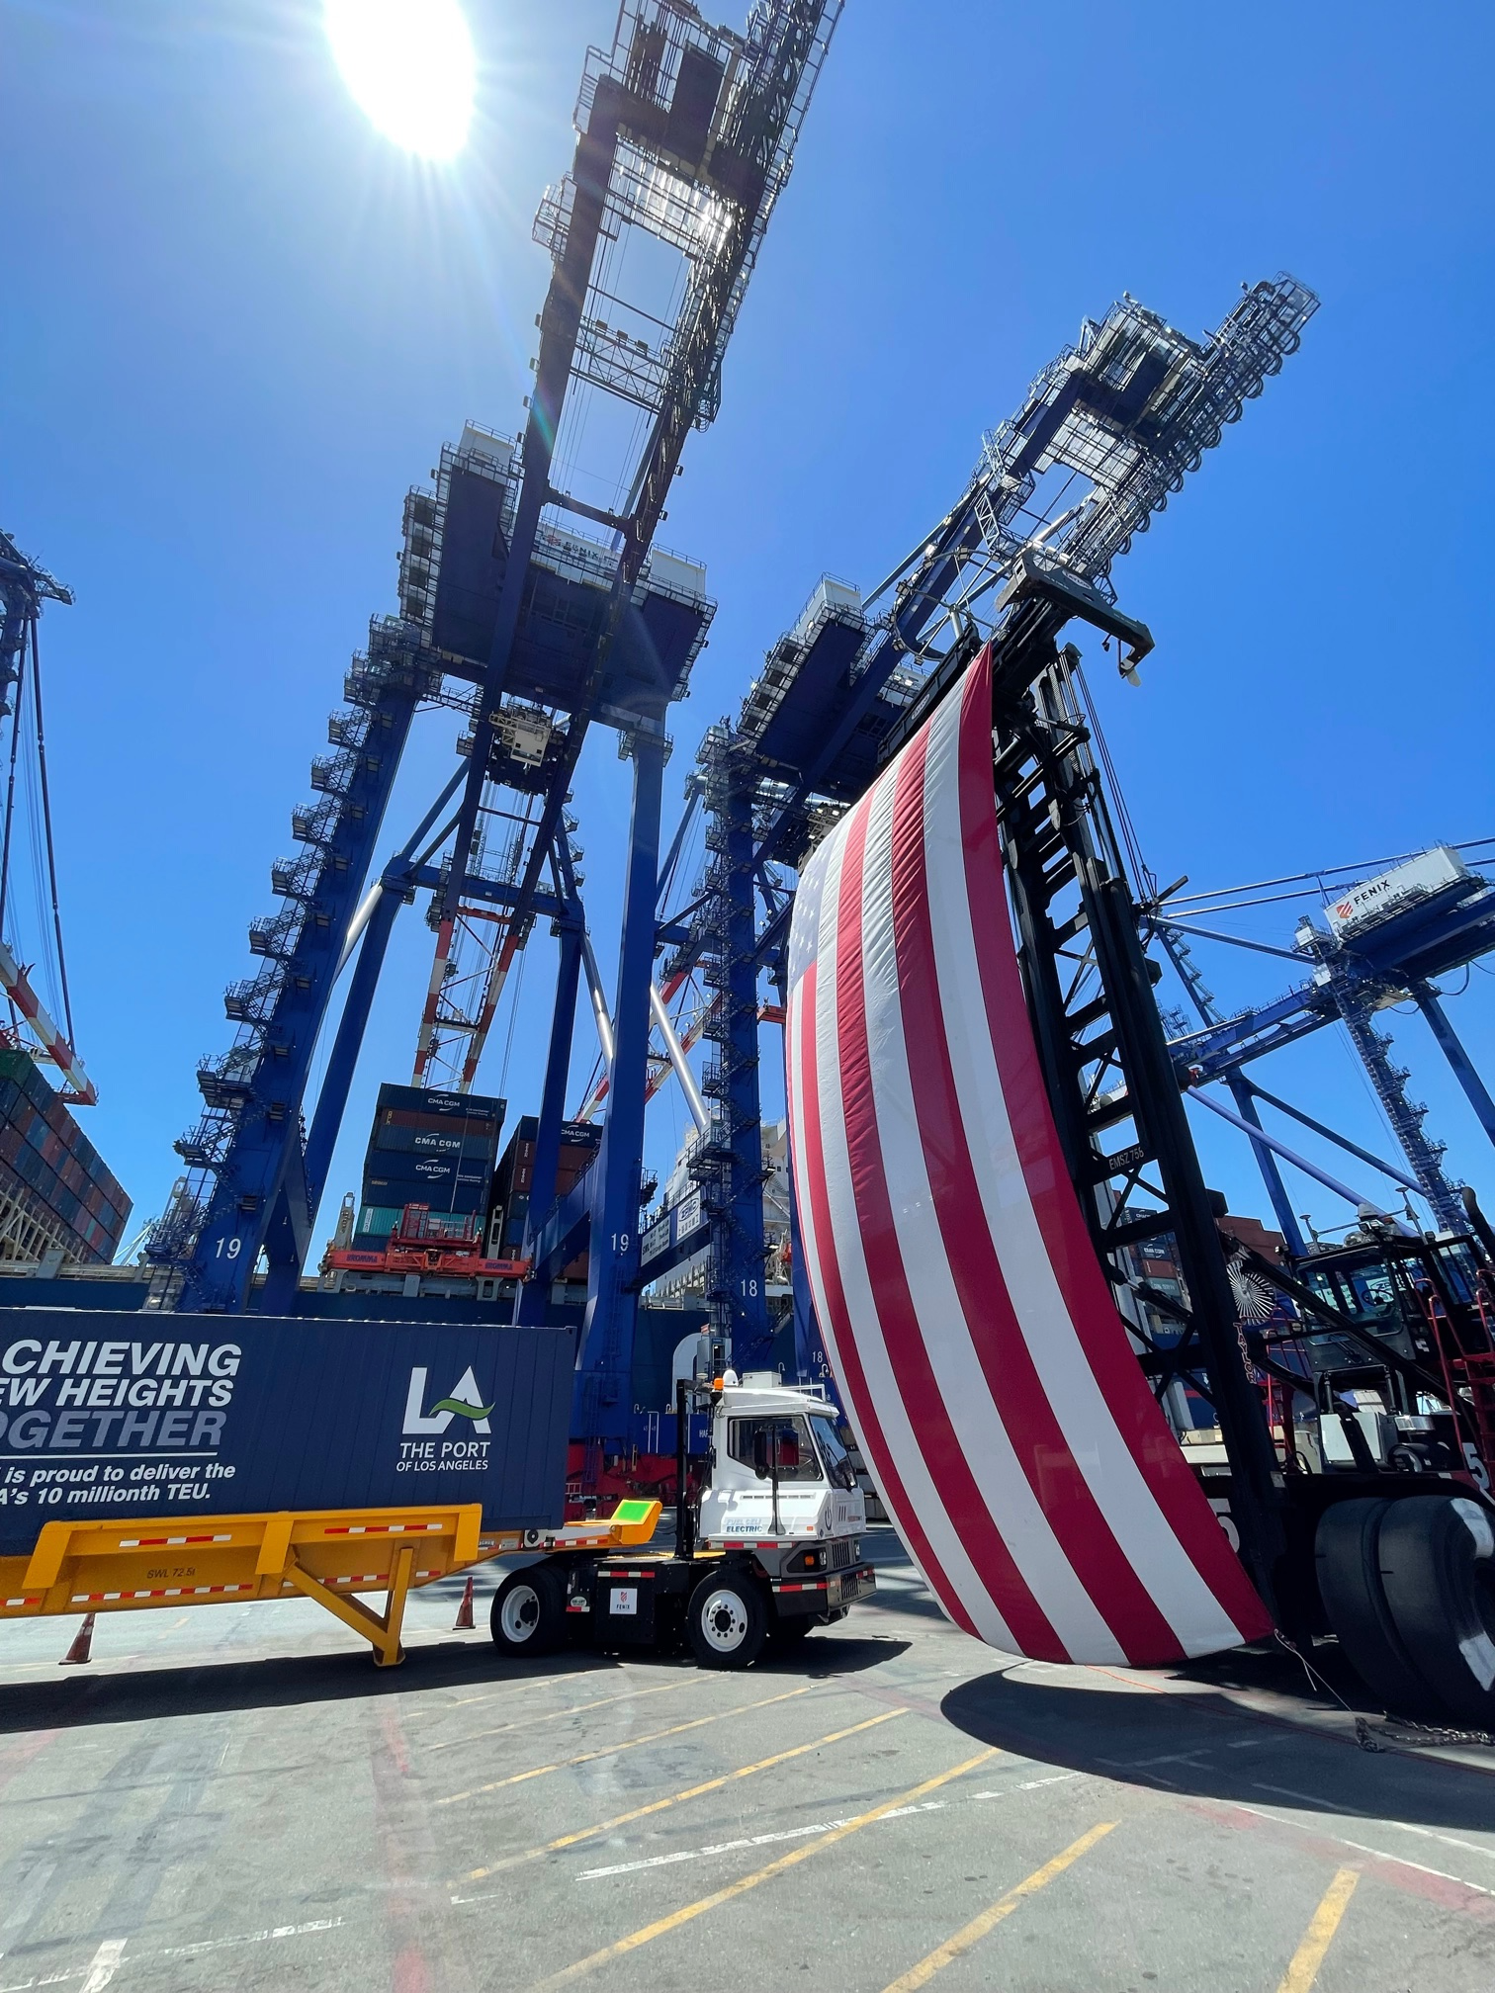
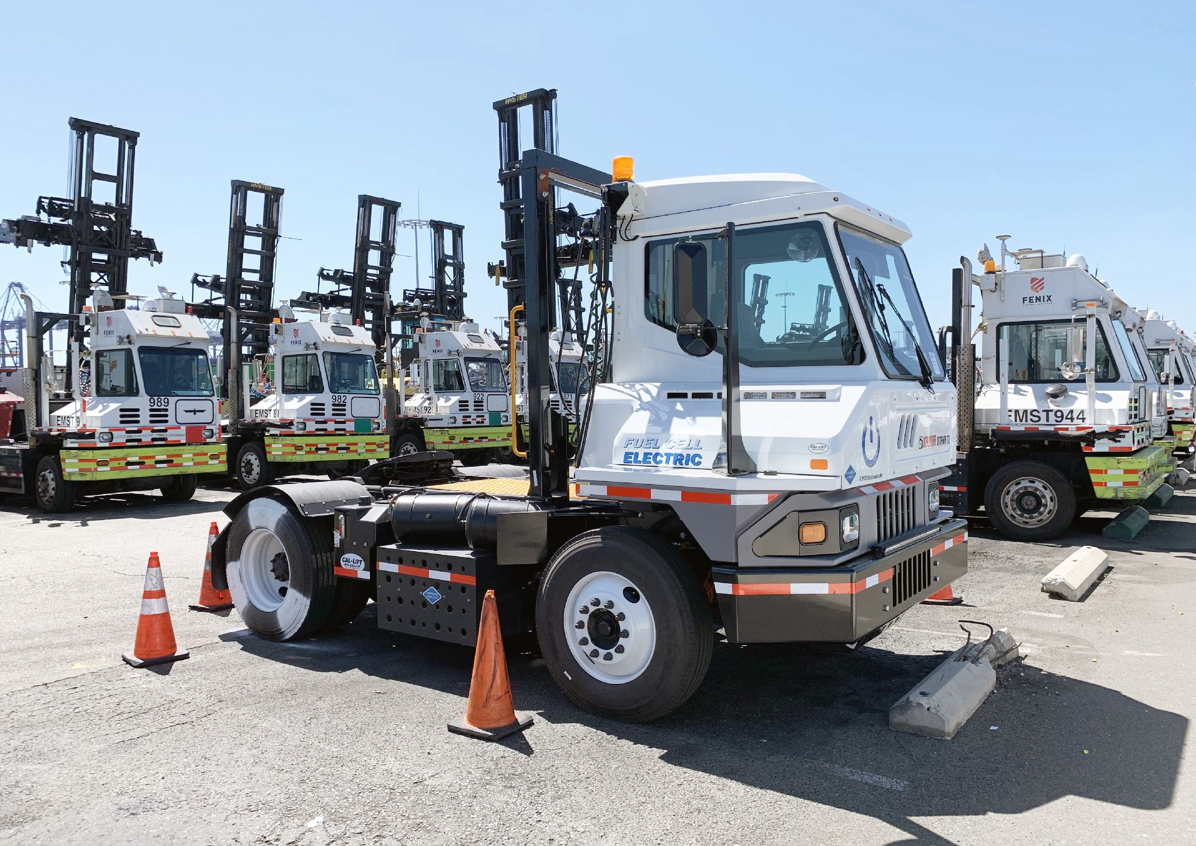
Notes:
are currently moving freight in and around the ports
of Long Beach and Los Angeles all with zero-emissions.
And since these heavy-duty fuel cell electrics have much faster fueling times they can maximize their uptime something that’s essential for industrial and commercial use.

Slide 23
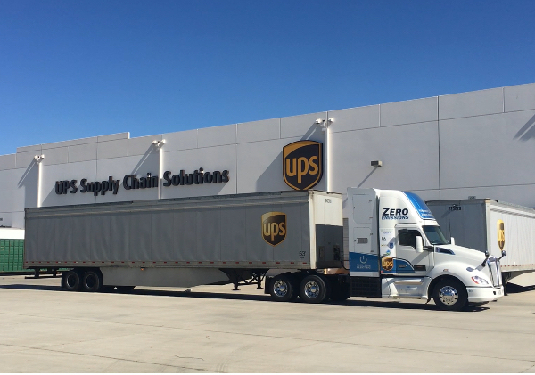
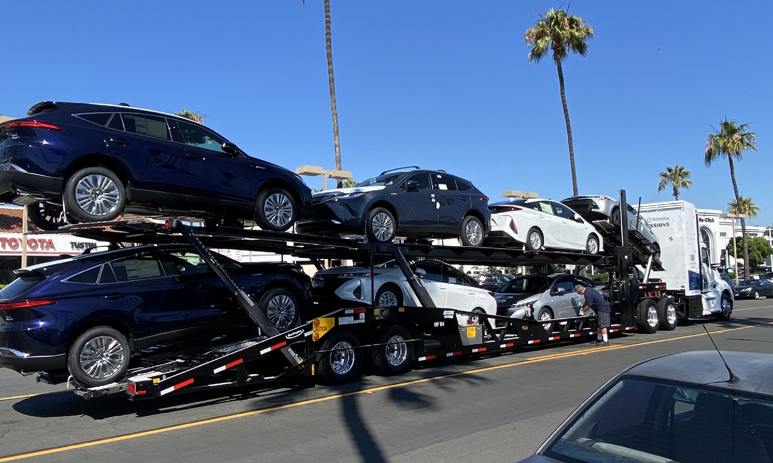
Notes:
We’re proving the concept that we can have zero emission fuel cell transport to meet the 24/7 demands of these customers.

Slide 24
Notes:
It’s exciting to see so much innovation
and altogether, we see the role of hydrogen fuel cell electrics increasing over time
as a vital part of a carbon neutral future.

Slide 25
