Slide 1
Anaerobic Digestion for Distributed Generation
New England Electricity Roundtable
October 26, 2012
Wayne Davis
Vice President, Government Affairs
Harvest Power, Inc.
Notes:
Thank you.
Would like to:
Introduce you to Harvest
Talk about the role and potential for anaerobic digestion as part of the DG solution for New England.
Quick survey of the policy landscape – what’s happening and what needs to happen – across New England states for AD to develop.
First, a few words about Harvest

Slide 2
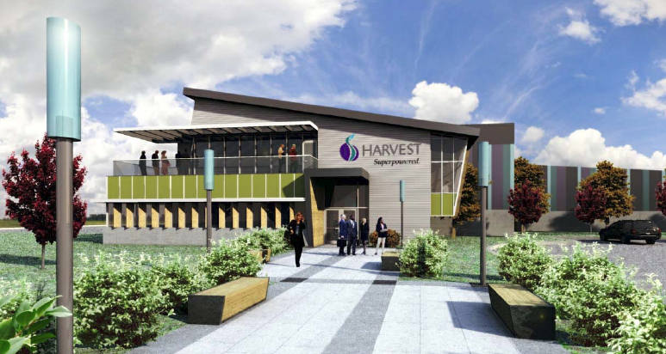
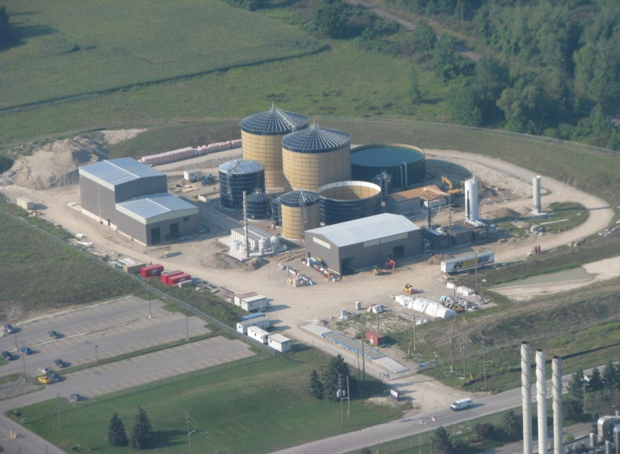
About Harvest
Harvest harnesses the maximum value from organic materials through the production of renewable energy and soils, mulches and natural fertilizers.
Corporate Profile
Leads the industry, managing more than 2 million tons of organic materials, largest composter of yardwaste & foodwaste in North America
Operates 28 processing facilities in North America with more than 430 employees, >$100mm of revenue
Commissioning two of North America’s largest commercial anaerobic digestion facilities this fall. Third facility starting up in 2013
Private company, largest investors include Kleiner Perkins, True North and Waste Management
Notes:
Our mission: help communities harness max value from organic waste through production of renewable energy and soils, mulches and fertilizers.
We are the largest composter of yardwaste and foodwaste in North America
operate 28 processing facilities and have 430 employees in North America
4 years old, with over $100M in revenue and profitable.
We are taking a portion of that material, and turning it into electricity. Our first two AD facilities open this Fall, third has just started cosntruction.
We are a private company, with our largest investors which include Kleiner Perkins, Waste Management and True North.
We call our approach to the market the Harvest Organics Operating System

Slide 3
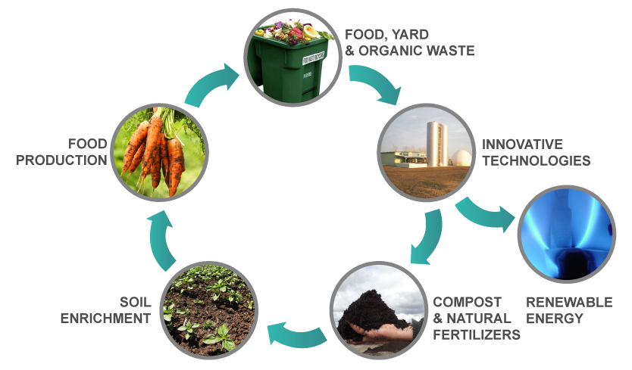
The Harvest Organics Operating System™
Notes:
Review slide
Let’s shift focus now, to consider role of AD as part of electricity infrastructure.
I would characterize AD of organic wastes as an “emerging” technology.
Nevertheless, and not unlike wind and solar, it has been with us for a very long time

Slide 4
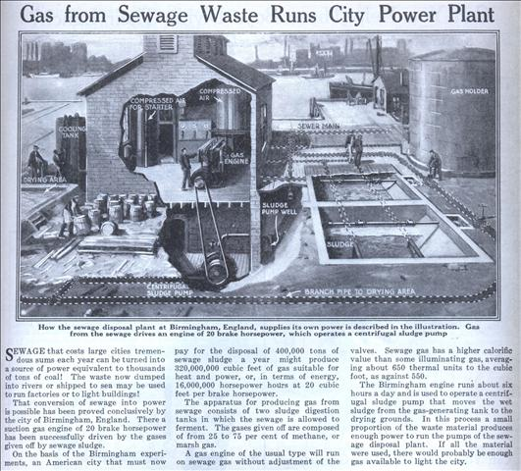
Popular Science, March 1922
Notes:
Gas from Sewage Waste Runs City Power Plant
In March 1922, Popular Science reported from Birmingham England: “SEWAGE that costs large cities tremendous sums each year can be turned into a source of power equivalent to thousands of tons of coal! The waste now dumped into rivers or shipped to sea may be used to run factories or to light buildings!
The article goes on to explain, “The Birmingham engine runs about six hours a day and is used to operate a centrifugal sludge pump that moves the wet sludge from the gas-generating tank to the drying grounds. In this process a small proportion of the waste material produces enough power to run the pumps of the sewage disposal plant. If all the material were used, there would probably be enough gas available to light the city.”
Think about that: 90 years ago, in Birmingham, in the heart of England’s coal producing regions, it made sense to produce renewable energy from organic wastes.
If it made sense then and there, then why not today?
Well, it does, as we know …

Slide 5
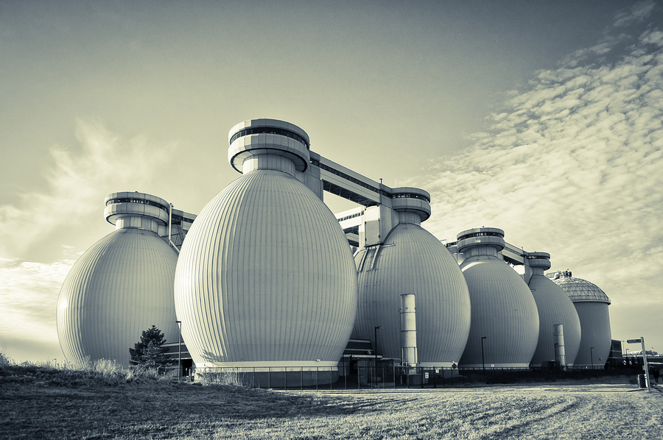
Notes:
Deer Island.
Many of the larger WWTPs in the US operate anaerobic digesters.
Over 16,000 WWTPS in US
1,500 Digesters -- but only 250 use the biogas they produce

Slide 6
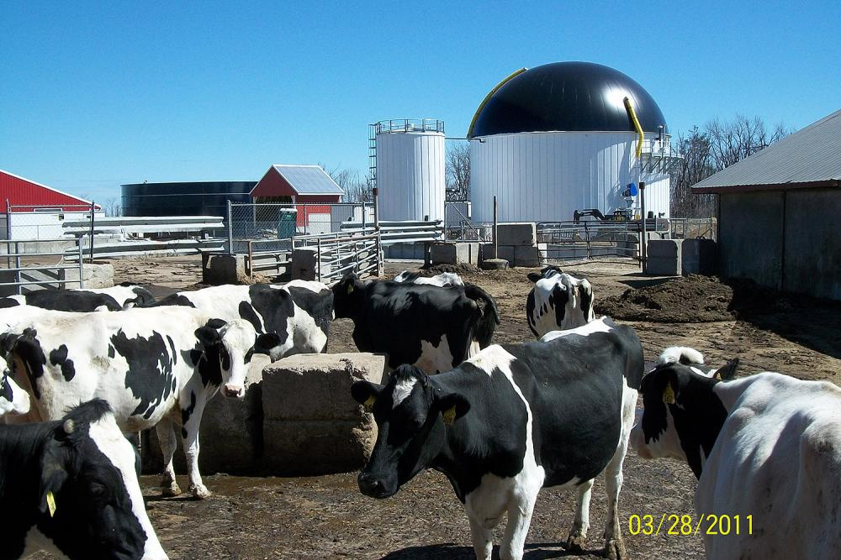
Jordan Farm, Rutland, MA

Slide 7
Harvest Energy Garden – Richmond, BC

Slide 8
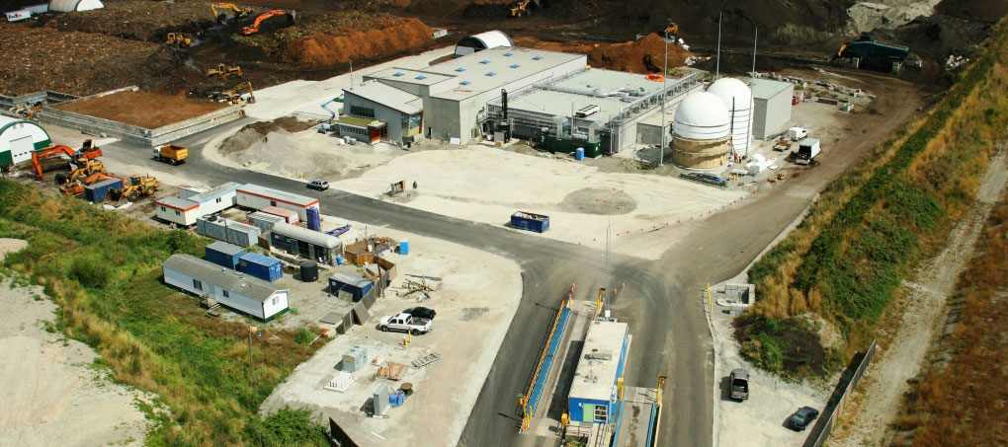
Harvest Energy Garden – Richmond, BC
New 360⁰ Photo Tour at www.harvestpower.com/energygarden

Slide 9
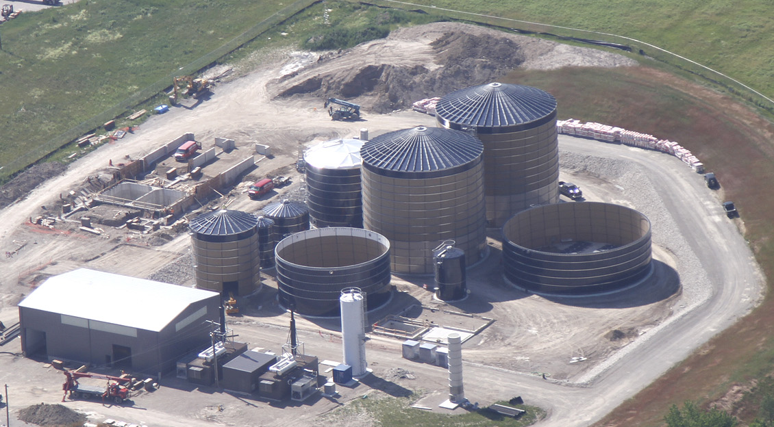
Harvest Energy Garden - London, Ontario

Slide 10
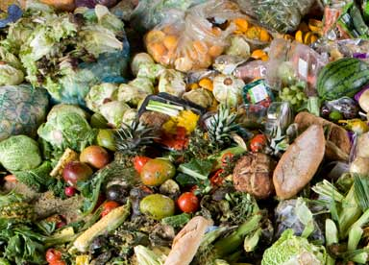
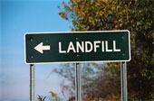
AD Potential in Massachusetts
Solid Waste Master Plan Goal:
Divert 350,000 additional tons of food waste per year

Slide 11
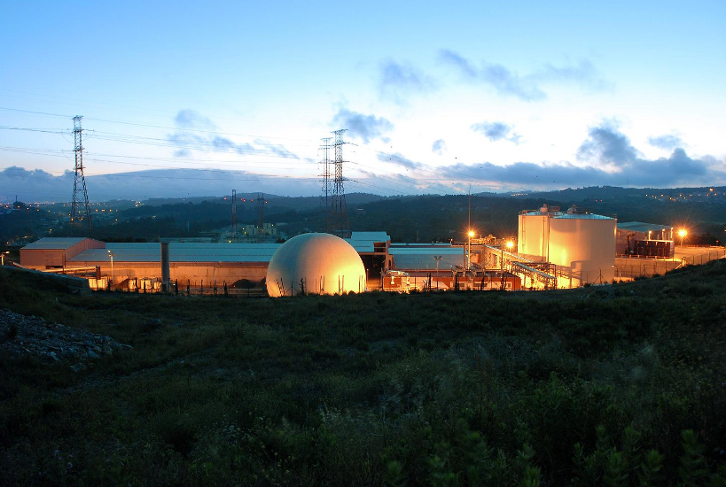
AD Potential in Massachusetts
Solid Waste Master Plan Goal:
Divert 350,000 additional tons of food waste per year
Potential Build-Out
5 – 10 digesters
15 – 20 MW electricity

Slide 12
New England Policy Development
Scorecard
Massachusetts Potential for national leadership
Vermont, Rhode Island Innovative policies
Challenges of scale
Connecticut Aspirations, but gaps
Maine, New Hampshire No policy push
Challenges of scale

Slide 13

There’s a better path for organics — help us get there.
Wayne Davis, VP - Government Affairs
Harvest Power, Inc.
221 Crescent Street, Suite 402
Waltham, MA 02453
781-314-9504
wdavis@harvestpower.com

