Slide 1
Restructuring Roundtable
New England
Electric Rates and Market Drivers
James Daly
Vice President, Energy Supply
Northeast Utilities
November 21, 2014
Notes:
1
1

Slide 2
New England Power & Gas
Market Overview
New England electric markets are approaching a crisis point:
Retail power prices are increasing significantly this winter
Winter reliability concerns have been raised by ISO-NE
Problems will continue until new natural gas pipeline and electric transmission added
2
Notes:
2

Slide 3
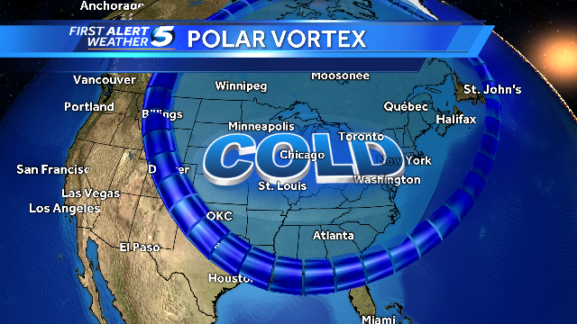
$3 Billion Increase in Wholesale
Costs Last Winter
The cold weather last winter exposed vulnerabilities in electric and gas infrastructure
Winter Season Wholesale Electricity Costs
December thru March; ISO-NE region ($ billions)
$6.8
$3.6
$3.1
$1.6
Winter Weather:
2010 – 2011
Normal
2011 – 2012
Warmer
2012 – 2013
Normal
2013 – 2014
Much Colder
3
Notes:
3

Slide 4
Retail Rate Increases – Energy Only
Residential Rates | Energy Rate (c/kWh) |  | % Change | Upcoming Period
 | Current Rate | Upcoming Rate
Connecticut
CL&P | 10.0 | 12.5 | 25% | Jan '15 - Jun '15
United Illuminating | 8.7 | 13.3 | 53% | Jan '15 - Jun '15
Massachusetts
NSTAR | 9.4 | 15.0 | 60% | Jan '15 - Jun '15
WMECO | 8.8 | 14.0 | 58% | Jan '15 - Jun '15
National Grid | 8.3 | 16.2 | 96% | Nov '14 - Apr '15
Fitchburg | 8.5 | 14.1 | 66% | Dec '15 - May '15
New Hampshire
PSNH | 9.9 | 9.6* | (3%) | Jan '15 - Dec '15
Unitil | 8.4 | 15.5 | 85% | Dec '14 - May '15
Liberty | 7.7 | 15.5 | 100% | Nov '14 - Apr '15
NH Elec Coop | 9.0 | 11.6 | 29% | Oct '14 - Apr '15
*Estimate

Slide 5
NE Gas Pricing: Locking in Shortages
Historical Spot
Forward Pricing
Source: Bloomberg
5
Notes:
5

Slide 6
ICF Study for ISO NE:
Winter 2013/14 Benchmark and Revised Projections for New England Natural Gas Supplies and Demand
Presentation to Planning Advisory Committee April 29, 2014
Given the projected gas supplies, electric system reliability during the winter months would be compromised by sustained cold weather.
– If we assume “Extreme Gas Prices” (>$20/MMBtu, meaning many oil units would be in-merit) and the same weather conditions as this past winter, winter peak day gas supplies will be barely adequate or slightly in deficit through 2020, as long as there are no major non-gas fired capacity outages; a disruption to gas supplies or a nuclear unit outage would result in a serious gas supply deficit.

Slide 7
Policy Costs Growing
Incremental costs of clean energy policies is material portion of rates
RPS requirements continue to grow in all states
Estimated 2015 RPS Rate Impacts
 | RPS Component (c/kWh)
MA | 1.6
CT | 0.75
NH | 0.60
7
Notes:
7

Slide 8
Emerging Challenges
Capacity Costs to Increase
Capacity Rate Impact (c/kWh)
 | 2014 | 2018
NEMA | 0.96 | 3.30
Rest of NE | 0.96 | 2.13
8
Notes:
8

Slide 9
Market Drivers
Natural Gas Generation Reliance
Annual Energy Output
Generating
Capability
Notes:
9

Slide 10
Emerging Challenges
Natural Gas Reliance to Grow
Upcoming Retirements
New Generation – ISO Queue
Announced (3,230 MW)
Salem Harbor Station (749 MW)
  4 units (coal & oil)
Norwalk Harbor Station (342 MW)
  3 units (oil)
Brayton Point Station (1,535 MW)
  4 units (coal & oil)
Vermont Yankee Station (604 MW)
  1 unit (nuclear)
Potential
Up to 8,000 MW at risk of retirement
Capacity
(MW)
Fuel Type
Biomass/Wood Waste 138
Hydro 62
Landfill Gas 0
Natural Gas 1,847
Natural Gas/Oil 2,497
Oil 245
Solar 16
Wind 2,110
Total 6,915
Notes:
10

Slide 11
Solving These Challenges
NE Governors Initiative makes sense for the region:
  Electric transmission to clean renewable energy
  Natural gas infrastructure to address power market disruptions
  New England States Committee (NESCOE) tasked to implement
NU support the use of regional tariffs to expedite construction
of electric and gas infrastructure
  Precedent exists to lean on regulated utilities to address energy policy objectives
  Electric Distribution Companies (EDC) proposal to NESCOE: EDC would contracting for gas transportation capacity

Slide 12
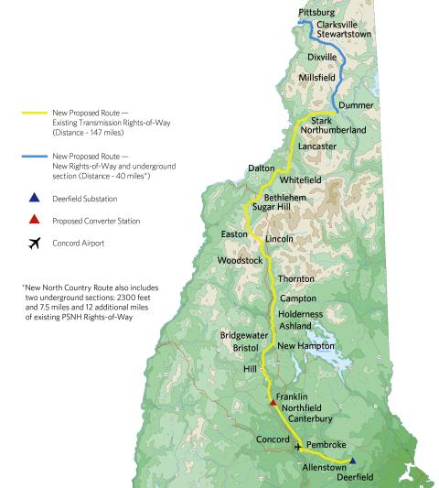
The Northern Pass:
Diversifying Electric Supplies
Benefits all of New England
A partnership between NU and Hydro-Québec
Imports 1,200 MWs of clean hydro electricity into New England
  Enough to power 1 million homes
  Equal to about four natural gas plants
New 187-mile transmission line from Quebec to Deerfield, NH
  147 miles of existing utility owned right of ways
  Plus new ROW including 8 miles of underground along public roads
Targeted completion: 2017
12

Slide 13
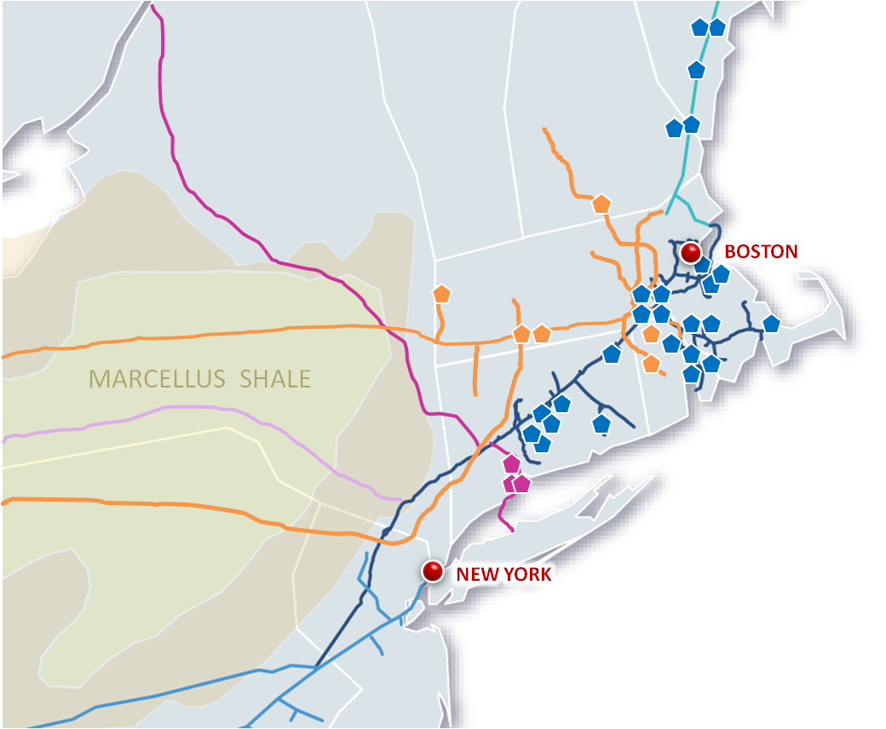
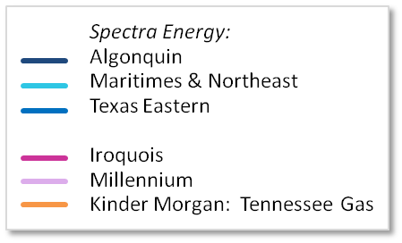
Access Northeast
Access Northeast announced September 16
NU / Spectra Energy partnership to deliver over 1 BCF/day to power plants and LDC customers
Utilizes existing pipeline right of ways
Expands existing infrastructure
Connects to 60% of NE gas generation capacity
13
Notes:
13
13

Slide 14



Energy Efficiency First
We offer energy efficiency solutions to help manage energy costs

Slide 15
Appendix

Slide 16
Energy and Reliability in the News
National Grid: Electric Rates to Rise, Natural Gas Rates to Fall Come November
- Worcester Telegram
& Gazette, 9/24/14
CL&P Electric Rates to Jump 26 Percent Starting in January
- Hartford Courant, 11/7/14
ISO New England Burns Jet Fuel To Keep The Lights On During January Cold Snap
- Forbes 1/24/14
ISO New England Faces Challenges to Electric Grid
- Patriot Ledger, 10/10/14
Unitil Predicts Higher Electricity Costs This Winter
- Concord Monitor, 9/27/14
NSTAR Wants to Charge 29 Percent More Come Jan. 1
- Boston Herald, 11/7/14
16
Notes:
16

Slide 17
Gas Availability
Available natural gas pipeline capacity to fuel winter power generation is shrinking
Growing LDC demand and decreasing LNG imports have, in part, caused gas-fired generation to decline
ISO-NE emergency oil purchase program played significant role this past winter
Pipeline projects currently under development will help relieve natural gas constraints for a period, but growing demand and expensive LNG imports will continue to challenge power market
Increasing Capacity Constraints on Algonquin
Days with Zero Interruptible Capacity
365-DAY YEAR
INTERRUPTIBLE CAPACITY AVAILABLE
DAYS with ZERO INTERRUPTIBLE CAPACITY
Average Gas-Fired Generation
6,400/MW/d
Winter 2010-2011
4,100/MW/d
Winter 2013-2014

Slide 18
Economics of Gas Transportation to Power Generation
Merchant energy revenues have historically been insufficient to support power generation investment in firm pipeline capacity
Future merchant pipeline reservation only viable with sustained high electricity prices.
Winter Profit & Loss Backcast (7,000 Btu/kWh unit)
$million | Dec – Feb Capacity Factor | Power Revenue | Fuel Cost | Annual Reservation Charge | Net Profit / (Loss)
2010/11 | 82% | 70 | 49 | 55.2 | (34)
2011/12 | 96% | 46 | 29 |  | (39)
2012/13 | 98% | 108 | 37 |  | 15
2013/14 | 88% | 153 | 61 |  | 37
4-Year Total: ($21 M)
Assumptions
Size: 600 MW Heat Rate: 7,000 Btu/kWh
Pipeline Reservation Charge: $1.50/Dth/Day
Total Annual Reservation Charge: $55.2 M

Slide 19
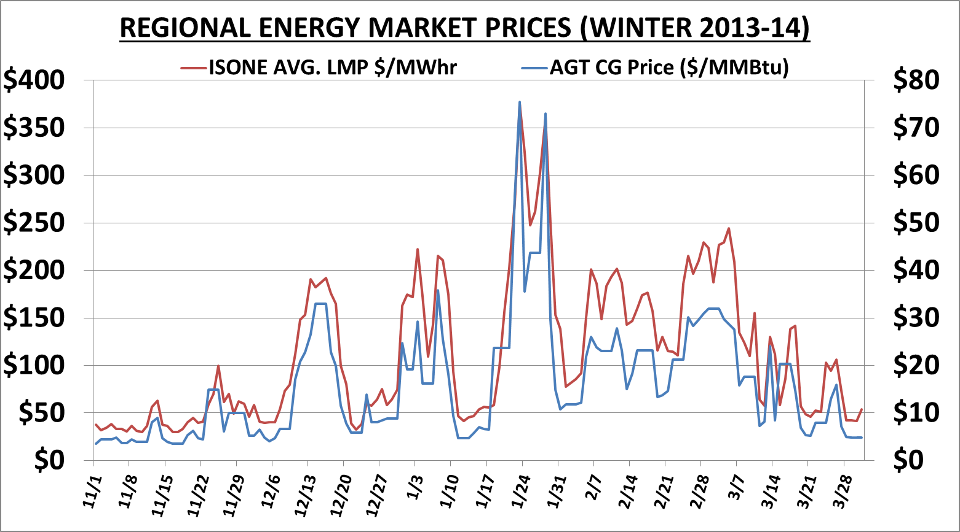
Power v Gas Pricing: High Correlation
19
Notes:
19

Slide 20
Strained Natural Gas Infrastructure
Daily New England Gas Demand (3/1/13 - 2/28/14)
6.0
Domestic Pipeline Capacity
2.7 Bcf
5.0
4.0
Bcf
3.0
2.0
Gas LDC / Ind
1.0
Power
-
3/1/2013
4/1/2013
5/1/2013
6/1/2013
7/1/2013
8/1/2013
9/1/2013
10/1/2013
11/1/2013
12/1/2013
1/1/2014
2/1/2014
Total gas infrastructure capability for New England: 5.7 Bcf
  Pipelines from West: 2.7
  Maritimes New Brunswick / Canaport Imports: 0.8
  Peaking LNG / Propane: 1.5
  Everett, MA LNG Imports: 0.7
Peak gas distribution company & industrial demand: 5 Bcf (est.)
0.7 Bcf
Available for NE Gas Generation on cold days

Slide 21
LNG Import Declining
LNG imports have declined in the face of global competition
Sell to Europe and Asia or gamble on NE price spikes
Increased LNG placed under contract for upcoming winter
Source: Bloomberg
Source: EIA & NEB

