Slide 1
Bringing Off-Shore Wind to New England’s Shores
New England Electricity Restructuring Roundtable
June 16, 2017
Stephen Conant
Anbaric Development Partners

Slide 2
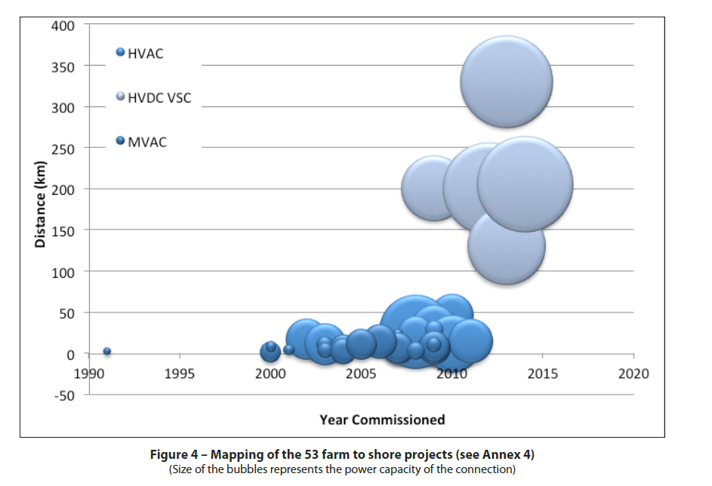
Bringing Off-shore Wind to New England’s Shores
Source: http://think.eui.eu - Offshore Grids: Towards a Least Regret EU Policy, Final Report, January 2012, p. 11.

Slide 3
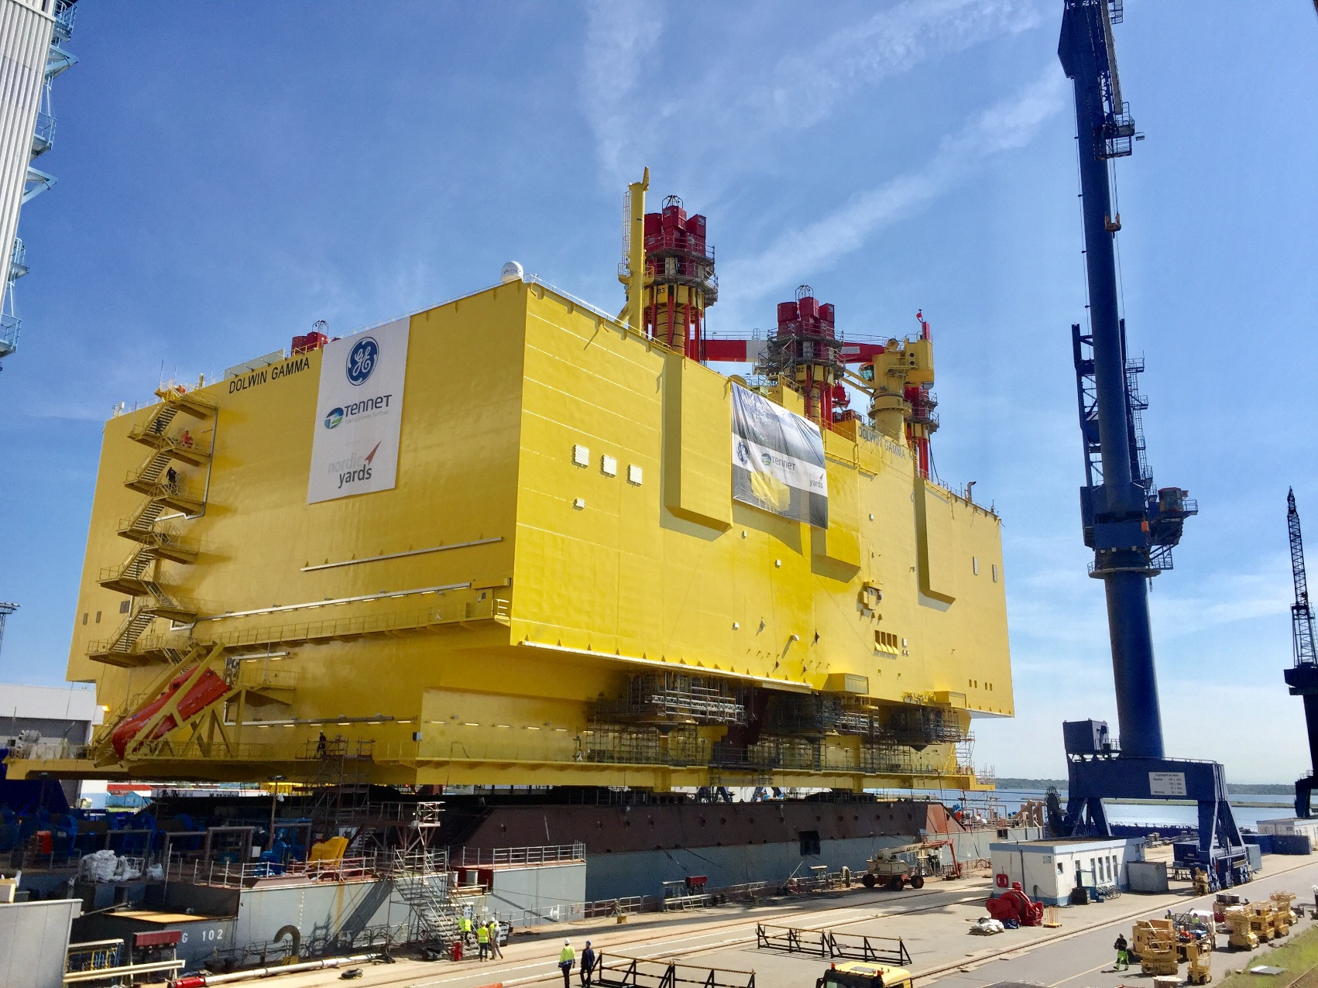
Bringing Off-shore Wind to New England’s Shores

Slide 4
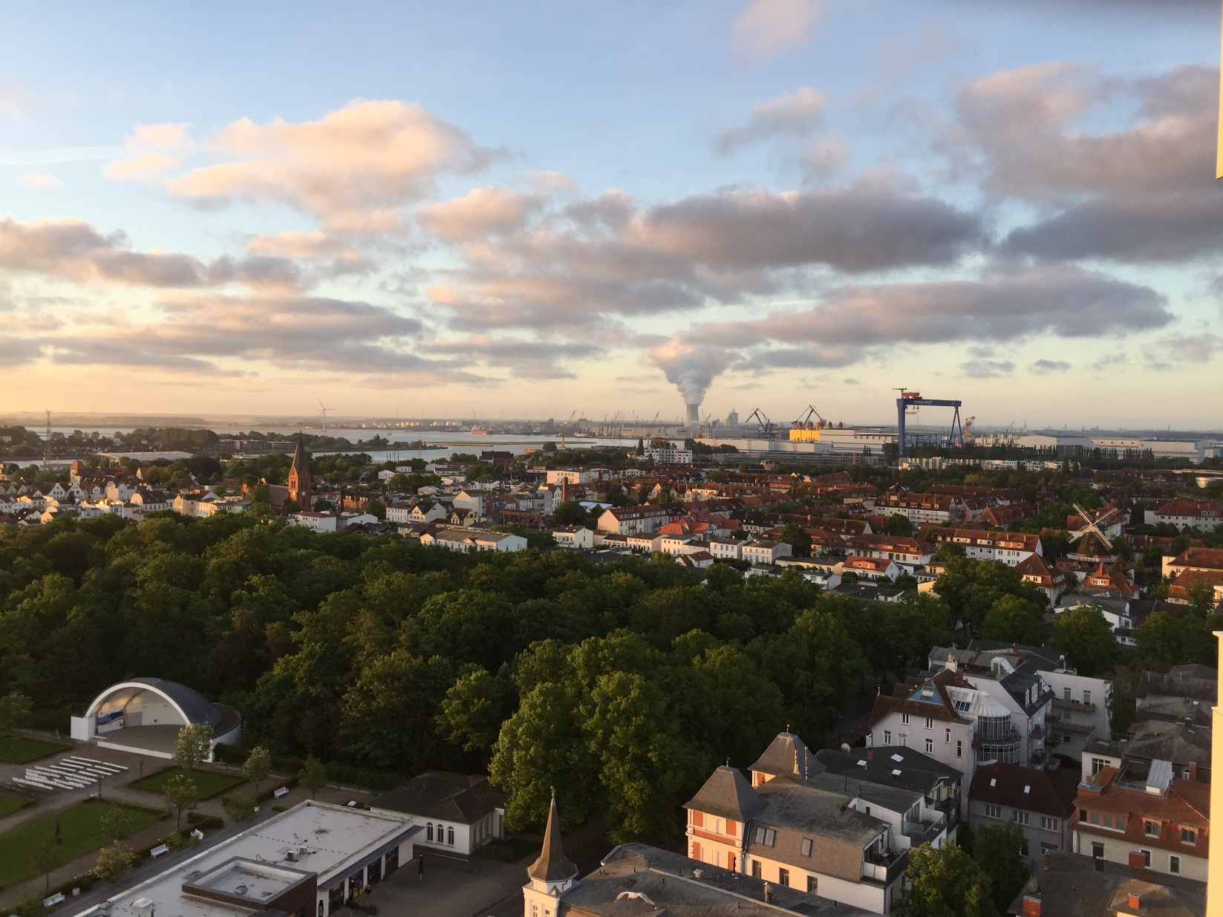
Bringing Off-shore Wind to New England’s Shores

Slide 5
Thank you!
Stephen Conant
sconant@anbaric.com

