Slide 1
Pivoting from Decarbonization Pathways to Policies in Vermont
Commissioner June E. Tierney
New England Electricity Restructuring Roundtable
Pivoting from Decarbonization Pathways to Innovative Policies
March 26, 2021

Slide 2
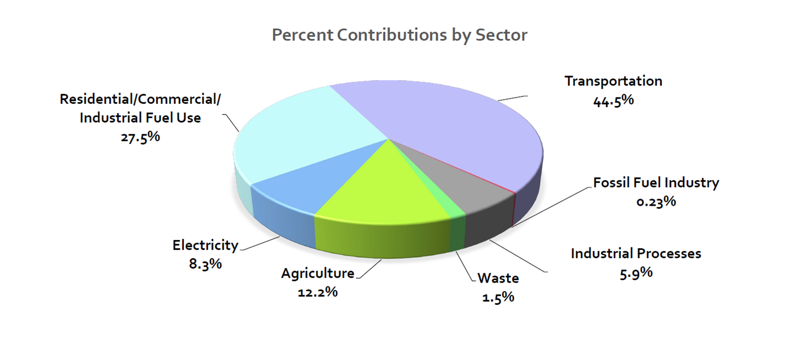
Vermont GHG Emissions by Sector – 2016
Note: Renewable Energy Standard did not become effective until 2017

Slide 3
Focus of Decarbonization Efforts
Transportation and Heating sectors make up almost ¾ of GHG emissions
Electrification is key strategy
Managing electric costs has increased importance
  Fuel switching must be affordable

Slide 4
Renewable Energy Standard
Tiers 1 & 2 – % of electric sales, utilizes renewable energy credits
  Tier 1: existing resources;
  Tier 2: in-state distributed generation (under 5 MW)
Tier 3 – requires distribution utilities to reduce customers’ fossil fuel use

Slide 5
RES Tier 3 – Energy Transformation
  Eligibility: electrification (vehicles, heat pumps); sawmills; sugaring operations; weatherization; Tier 2 RECs​
  Required Amounts: 2% of retail sales in 2017, increasing by 0.67 % each year until reaching 12% in 2032​
  Alternative Compliance Payment = $60/REC in 2017, increasing by CPI annually​
  Costs vary considerably in terms of incentives paid to customers. Average cost was $34/ MWhe in 2019
    Total 2019 program costs of $6 million

Slide 6
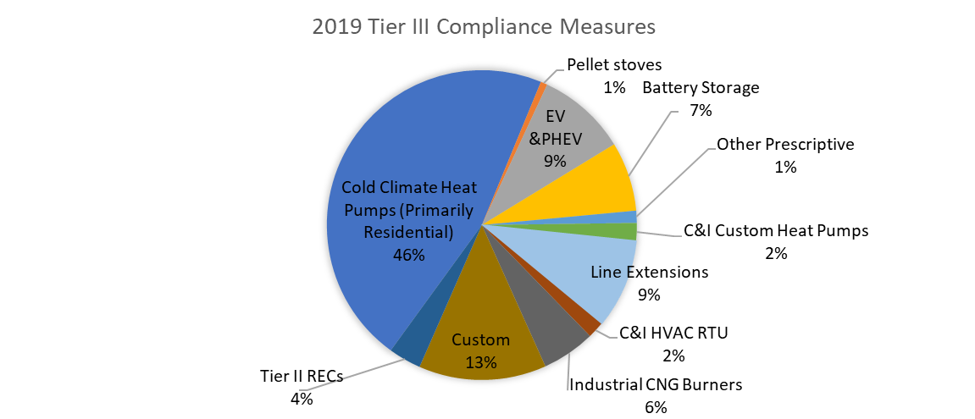
RES Tier 3 Compliance

Slide 7
RES Tier 3 Benefits
  Equivalent of 176,839 MWh of fossil fuel savings in 2019​
  2019 carbon reduction of 11,000 tons​
    Tier 3 savings claims are based on lifetime savings, but emission reductions are on an annual basis and will continue for the life of the project.​
  Increased kWh sales from electrification efforts can reduce electric rates​
    Fixed costs of the system are spread over a greater number of kWh, reducing the cost per kWh for all customers​
    Assumes that new electric loads are managed so they do not increase peak

Slide 8
Load Management
Active Load Control
  Combined with rate design to encourage participation
  Lower rate for controlling specific electrification technology
  Higher rate for opt out of load control
Time of Use pricing
Imperative that there be equitable access to broadband infrastructure to allow for these strategies

Slide 9
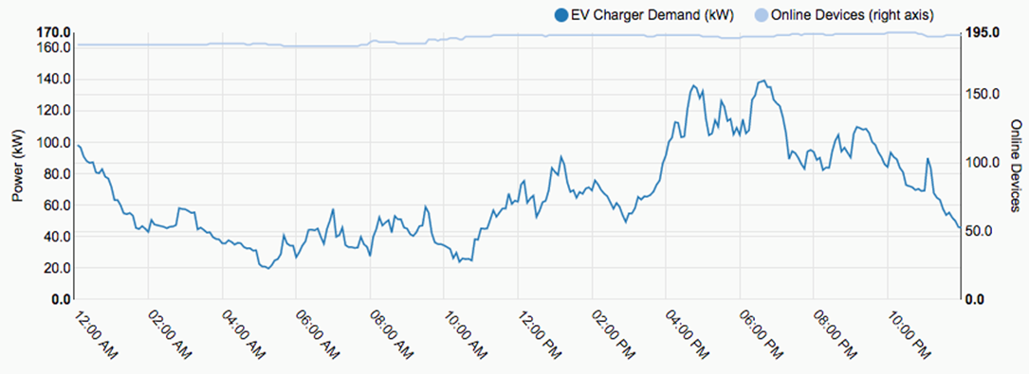

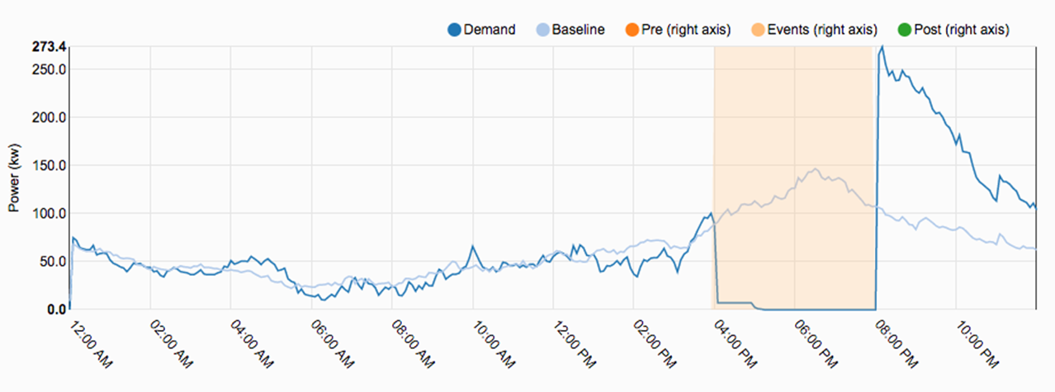
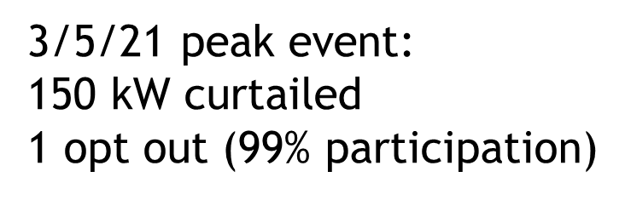
Controlling EV Loads
Source: Green Mountain Power

Slide 10
Appendix

Slide 11
Vermont Energy Policy
Title 30, Section 202a:
To ensure, to the greatest extent practicable, that Vermont can meet its energy service needs:
  In a manner that is adequate, reliable, secure, and sustainable
  Ensuring affordability and encouraging the state’s economic vitality
  Using energy resources efficiently and managing demands cost effectively
  In a manner that will achieve greenhouse gas reductions requirements
Title 30, Section 218c:
Least-cost integrated planning, accounting for GHG cost

Slide 12
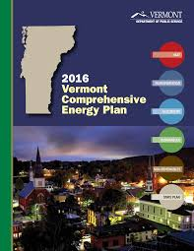
Comprehensive Energy Plan
Comprehensive analysis and projections for 20 years
  Use, supply, cost, environmental effects all energy sources used in VT
Sets 90% by 2050 renewable goal
Must be consistent with GHG goals, Climate Action Plan, relevant goals of Title 24, Section 4302
Must include standards and recommendations for Act 174 energy planning as well as recommendations for State actions

Slide 13
Vermont Global Warming Solutions Act
Requires GHG reductions
  26% from 2005 emissions by 2025
  40% from 1990 emissions by 2030
  80% from 1990 emissions by 2050
Creates 23-member Climate Council
Requires Climate Action Plan by December 1, 2021
  Prioritize most cost-effective, technologically feasible, and equitable GHG emissions reduction pathways, adaptation and preparedness

Slide 14
Additional EV Incentives
DC fast charging stations
  State incentives to support at least one unit within 30 miles of every VT residence
  One electric utility proposing to remove demand charge for DC fast charging units
Increased training of sales staff on benefits of EVs

Slide 15
Additional Heating Incentives
Vermont has long focused on biomass
  Approximately a third of residences have a wood stove
Up-front incentives for automated pellet/woodchip systems
Incentives for expansion of bulk pellet delivery trucks and wood pellet manufacturing facilities

