Slide 2
Forging Sustainable Solar (and Storage) Incentives for New England
New England Electricity Restructuring Roundtable December 14, 2018

Slide 3
Connecticut Programs for BTM Solar
Residential
Commercial/ Industrial
Government
NET METERING
Virtual NET METERING
RSIP SHREC
Connecticut Green Bank
LREC/ZREC Auction
Electric distribution utilities

Slide 4
Renewable deployment from CT programs
*RSIP and Eversource LREC/ZREC data as of December 2018; UI LREC/ZREC data as of August 2018
Notes:
Increase in renewable energy from CT-sponsored programs
Currently at ~5% of CT load from DG
BTM:
241 MW operational
570 MW additional coming online
Grid scale:
120 MW operational
564 additional coming online
Three State RFP:
56 proposals received for 6,200 MW (wind, hydro, solar, fuel cell, storage)
Selected 9 projects (wind and solar) totaling 414.8 MW; sharing MW with MA and RI
Small Scale RFP:
103 proposals received for 1,160 MW (wind, hydro, solar, fuel cell, storage, AD, EE)
Selected 25 projects (wind, solar and EE) totaling 402 MW

Slide 5
Looming Deadlines
2018: No state-wide shared solar program following 2017 pilot
2018: Municipal filled its VNM bucket, state close
2018: End of LREC/ZREC
2019: SHREC hits 300 MW target
2020: Renewable Portfolio Standard ends
Net metering costs not transparent or predictable→ revenues to projects risk being too high or low to achieve deployment goals at sustainable cost

Slide 6
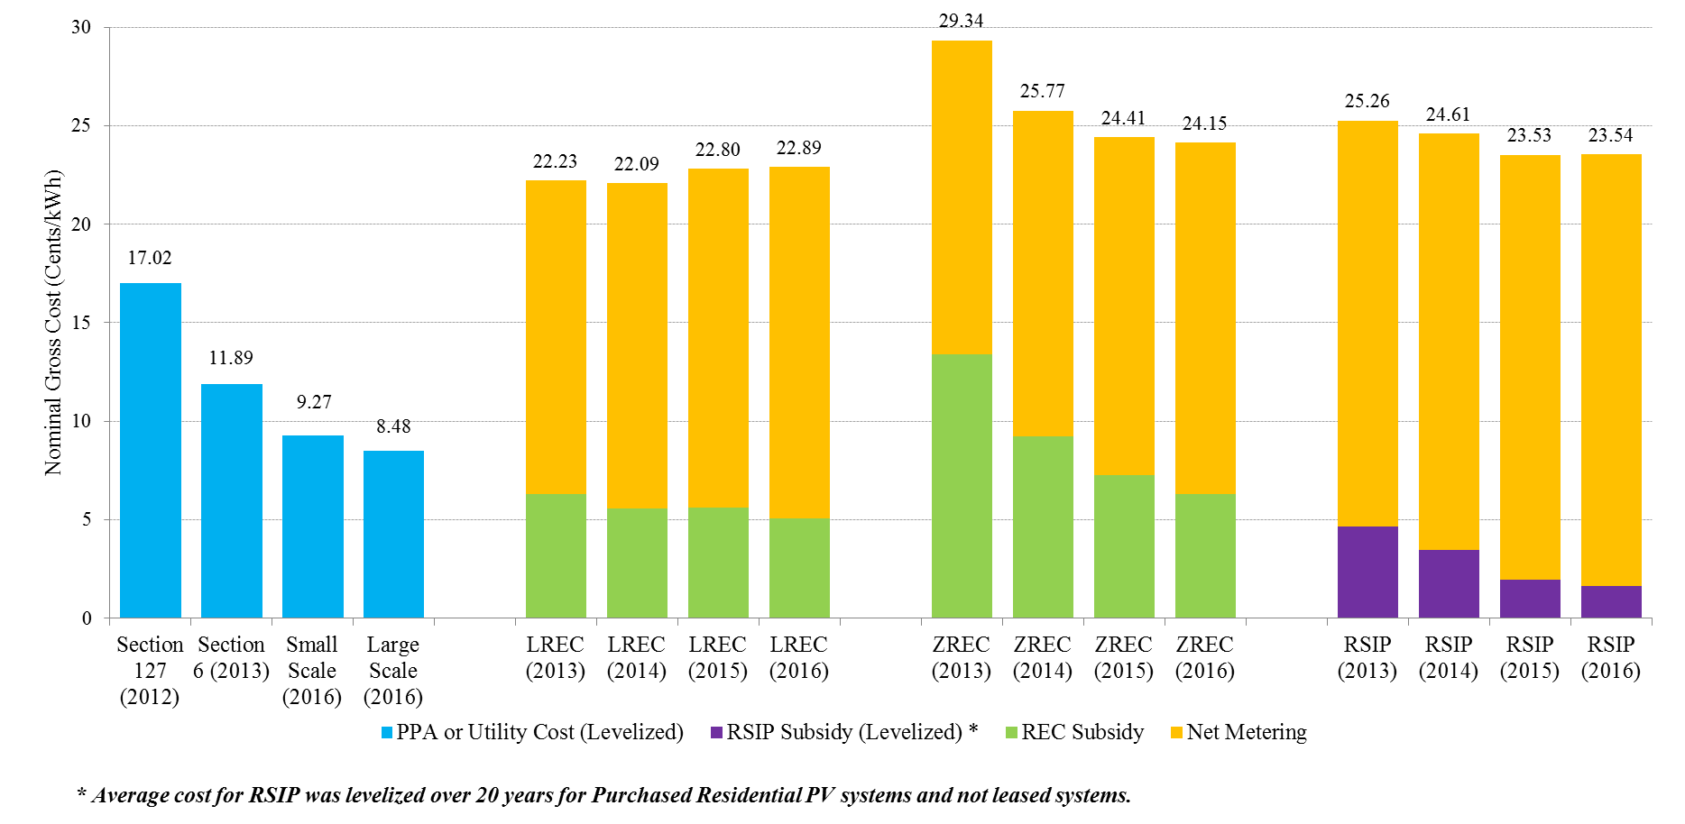
Declining Cost of Clean Energy Programs, Behind the Meter and Grid Side (nominal dollars, 2012-2016)
Notes:
Cost of solar and wind have declined significantly over the past 5 years
Grid scale projects are less expensive than behind the meter programs
Small grid scale projects are competitive with large scale projects, makes smaller project footprints at low cost.
Trade offs, in terms of meeting climate goals, need lots of rooftop but don’t have issues with siting or concerns about procurements considered “out of market”. Our recommendation is to achieve a balance across these programs.
Connecticut Green Bank’s Residential Solar programs (330 MW)
18,000 solar homes and growing
Low Emission and Zero Emission Renewable Energy Credit (LREC/ZREC)
Competitive reverse auction process (least cost)
Estimated 2,000 projects
500 MW total from the 5 year program
Utility-Scale Competitive Renewable Energy Procurements
DEEP requires the EDCs to enter into long-term PPAs through a competitive bidding process.
Large Scale Projects = “Energy + REC” and “REC only Projects”
LREC ZREC = REC Cost Over 15 Years + Projected Average NM Rate over 15 years
Section 6 = REC + Energy
RSIP = RSIP Incentive + Projected Average NM Rate over 20 years
Section 127 = Average 20 Year Cost of Utility Owned Projects

Slide 7
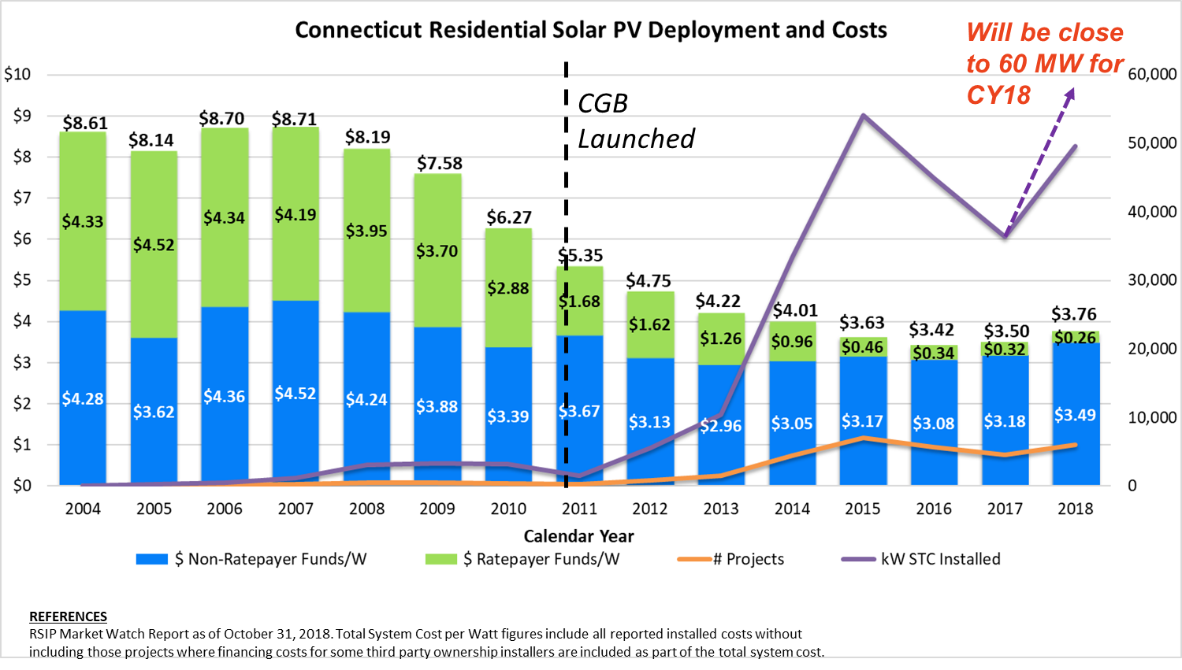

Slide 8


Public Act 18-50
Residential
Commercial/ Industrial
Government
Shared Clean Energy program
DEEP designing program requirements
25 MW Class I
Cost-based rate for energy + RECs
Public Utilities Regulatory Authority
unlimited
Auction for energy + RECs
Electric distribution utilities
50 MW solar 10 MW fuel cells

Slide 9
Outstanding issues
Two customer options: Buy All, Credit All and a netting interval set by PURA (instantaneous, daily or sub-daily)
How netting options pair with storage
RECs bundled with energy, credits only to customers (no 3rd party payments)
Future adders for energy system benefits
  Energy storage
  Location on the distribution system
  Time of Use rates or other dynamic pricing
  Other policy benefits
Interim Rate opportunity?

Slide 10
DEEP’s recommended action items for PURA’s Grid Mod proceeding
Expand data collection on electric vehicle and renewable thermal technology load shape and flexibility
Open a proceeding to explore rate structures that encourage off-peak electric use and incent EV and RTT adoption
Quantify and transparently communicate the distribution system benefits provided by DERs
Conduct or expand pilots on solutions that can lower or meet peak demand, including active demand response and energy storage
Develop a transparent process for the EDCs to consider non-wires alternatives
Investigate costs and benefits of upgrading EDC communications and metering infrastructure, analytical capabilities, and billing and other back-end systems
Establish statewide data standards for cybersecurity and interoperability
Require EDCs to plan for integration of new beneficial electric loads

Slide 11
More on PA 18-50: https://www.cga.ct.gov/2018/act/pa/pdf/2018PA-00050-R00SB-00009-PA.pdf
Connecticut Comprehensive Energy Strategy: http://www.ct.gov/deep/cwp/view.asp?a=4405&q=500752&deepNav_GID=2121%20

