Slide 1
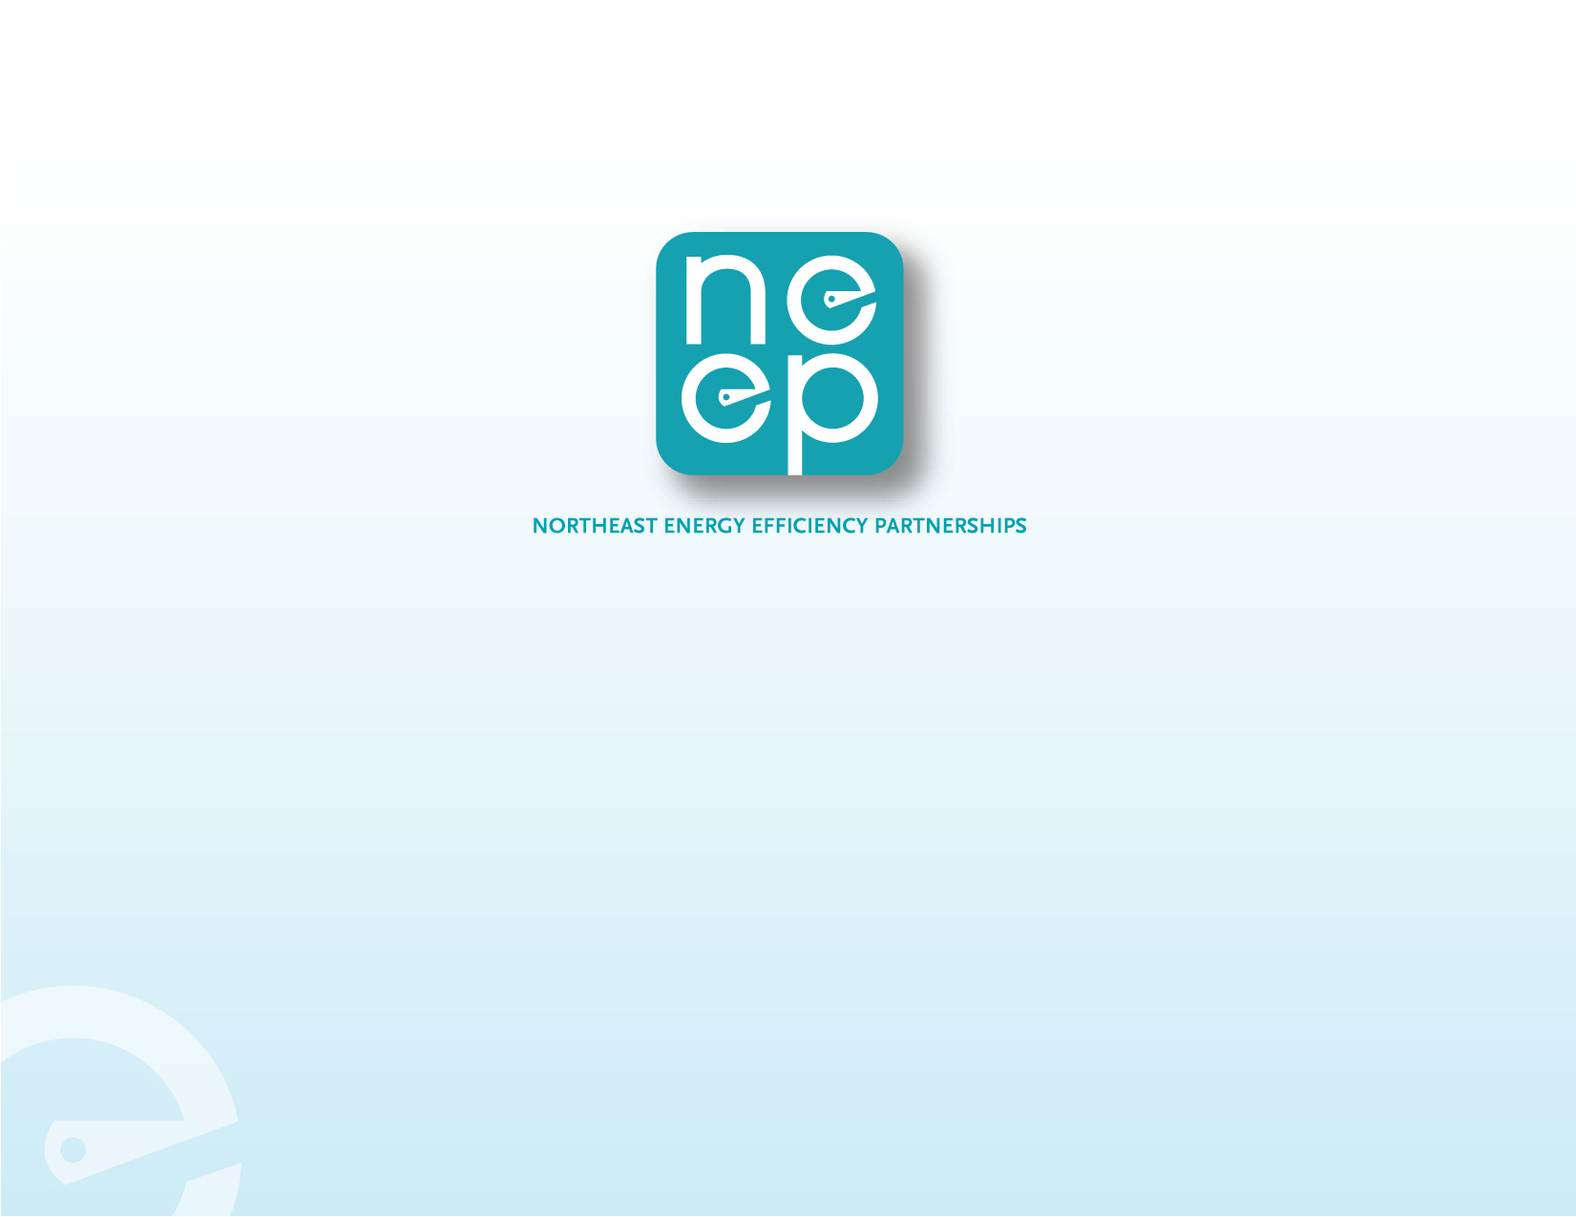
Intro
New England Restructuring Roundtable
Next Wave of Energy Efficiency Plans in New England
June 19, 2015
Energy Efficiency as the Least-Cost Energy Resource
Susan Coakley
Notes:
Title Slide

Slide 2
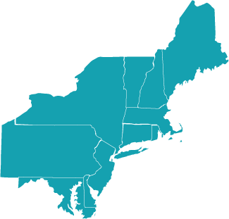
NORTHEAST ENERGY EFFICIENCY PARTNERSHIPS
“Accelerating Energy Efficiency in Northeast & Mid-Atlantic States”
MISSION
Accelerate energy efficiency as an essential part of demand-side solutions that enable a sustainable regional energy system
APPROACH
Overcome barriers and transform markets via
Collaboration, Education & Enterprise
VISION
Region embraces next generation energy efficiency as a core strategy to meet energy needs in a carbon-constrained world
One of six Regional Energy Efficiency Organizations (REEOs) funded by US DOE to link regions to DOE guidance, products and programs
Notes:
About NEEP.

Slide 3
TREND #1 Efficiency Investments Growing
Source: NEEP Regional Energy Efficiency Database www.neep-reed.org and utility efficiency program plans

Slide 4
TREND #2: ENERGY SAVINGS GROWING
Source: NEEP Analysis
4

Slide 5
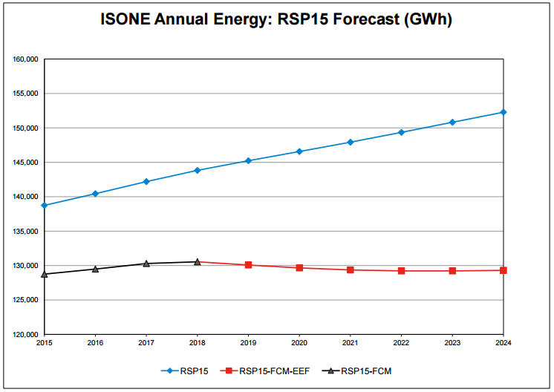
TREND #3: EFFICIENCY SAVINGS HAVE FLATTENED ENERGY GROWTH
Net Energy Use Load Forecast
Forecast minus FCM
Forecast minus (FCM+EE Forecast)
“Essentially no long term growth in electric energy use” -ISO-NE
… and the New England economy continues to grow

Slide 6
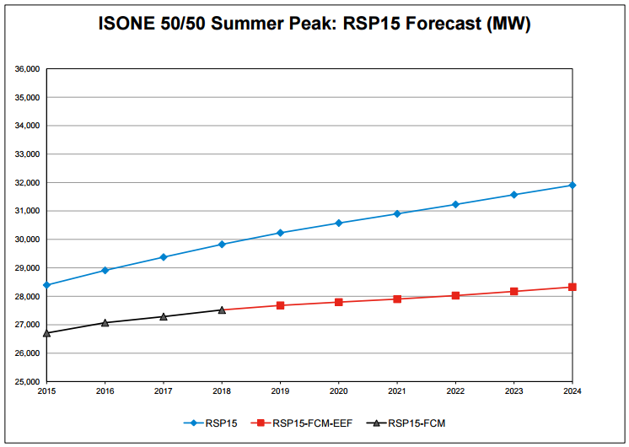
Trend #4: has reduced summer peak
Further focus on peak shaving measures would be economic

Slide 7
TREND #5 substantial net economic benefits
2011-2016:
$12 billion invested,
$36 billion in economic benefits

Slide 8
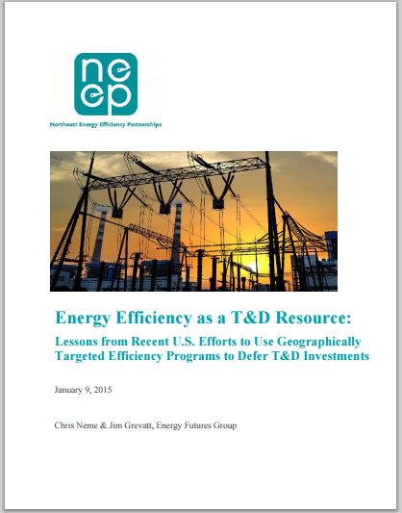
TREND #6 GEOTARGETTING EFFICIENCY AS A RESOURCE
Non-Wires Alternatives:
  Energy Efficiency
  Demand Response
  Distributed Generation
  Energy Storage
Cost-effective, incremental resource
Projects in Rhode Island, New York, Vermont, Maine to defer T&D investments
New York’s Brooklyn-Queens DSM Project is changing the paradigm

Slide 9

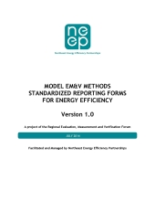
REALIZING EFFICIENCY’S FULL POTENTIAL: key challenges
Efficiency Viewed as a Cost vs. a Resource that Reduces Cost
Regulatory Uncertainty: Utility Business Models of the Future
Cost-Effectiveness: Aligning Benefits and Costs with Public Policy Goals and Customer Values
Lack of EM&V Transparency, Accessibility and Nimbleness
Lack of Comprehensive Regional Analysis of Demand-Side Resource Potential and Impacts
Searching for Deeper Savings

Slide 10
REALIZING EFFICIENCY’S FULL POTENTIAL: key opportunities NEXT Three years
Regional Least Cost Demand-Side Resource Assessments & Procurements
Integrated Efficiency Resource Deployment
  Efficiency with other demand-side resources
  All-fuels including strategic electrification
  Valuation of full stream of public and consumer level benefits
Efficiency as a Clean Air Act Compliance Strategy
  Clean Power Plan – Carbon
  Criteria Air Pollutants
Integrated Building Energy Solutions
  Home and Building System Controls & Dashboards
  Performance through Technology, Behavior
Market Segmentation with Flexible Program Models
Big Data and Data Analytics for Planning & EM&V Support

Slide 11

Thank you!
Sue Coakley, Executive Director
Northeast Energy Efficiency Partnerships
91 Hartwell Ave Lexington, MA 02421
P: 781.860.9177 www.neep.org

