Slide 1



Carbon Free Boston
New England Electricity Restructuring Roundtable June 20, 2019

Slide 2
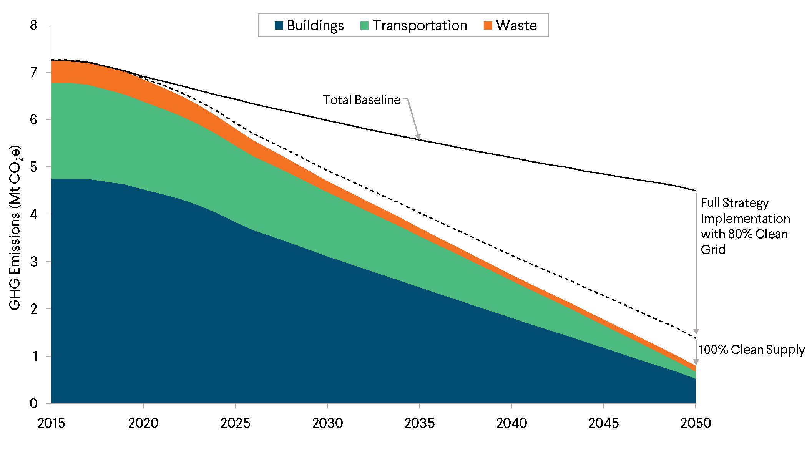
Boston’s Path to Carbon-Neutrality
Notes:
Explain what is happening here
Ban Fuel Oil in 2030
Purchase Clean Electricity
Removing gas

Slide 3



Four Mutually Reinforcing Strategies
Reduce demand for energy and maximize energy efficiency​
Electrify all activity to maximum extent feasible
Use GHG-free fuels and electricity
Improve social outcomes via intentional action
Notes:
A carbon-neutral city minimizes the
demand for energy. Every building is a high-performance
building; travel shifts from single-occupancy vehicles to
public transit, biking, walking, and shared modes; and waste
diversion is maximized.
A carbon-neutral city converts systems
that currently run on fossil fuels, such as cars, furnaces,
and stovetops, to use electricity instead. Heating systems
are converted to heat pumps and electric boilers where
feasible. Light-duty and medium-duty vehicles are powered
by electric motors.
A carbon-neutral city purchases
electricity that is 100 percent GHG-free, and it fully utilizes
the potential for in-city renewable generation, such as
rooftop solar. Sustainably-sourced renewable fuels are used
in highly efficient district energy systems, emergency backup
energy systems, and heavy-duty vehicles.

Slide 4
Summary of Building Options
Strategy | Policy Mechanisms
Thermal Electrification | Incentives and/or mandates
Energy Conservation Measures | Incentives
Performance Requirements | BERDO Expansion
Deep Energy Retrofits | Requirement with sale or major renovation
Low Energy New Construction | Code / Planning Requirements

Slide 5
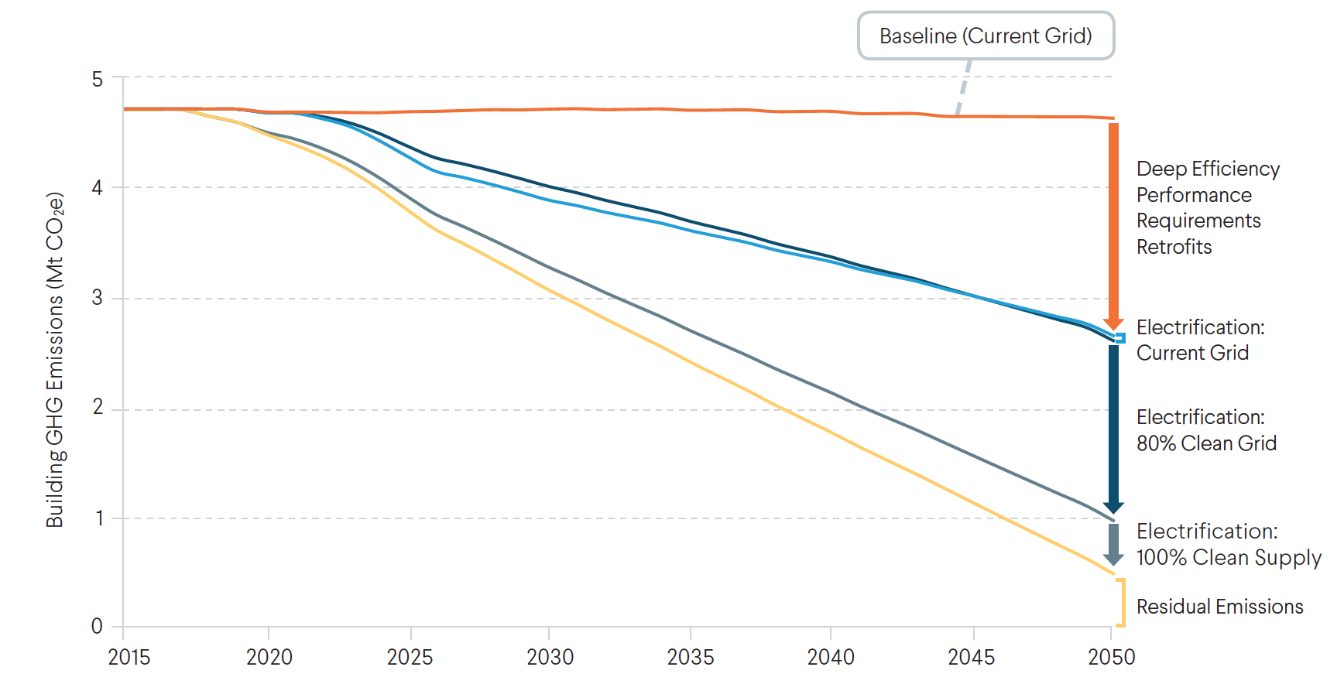
Path to Carbon-Neutrality in Buildings
Notes:
85% of all New Buildings are Low Energy in 2025
Standard and Deep Energy Retrofits applied to time of sale
2000 residential buildings (single family and triple deckers) per year
10 million square feet of commercial floorspace per year
With additional extra effort between 2025-3030 to eliminate fuel oil and

Slide 6
Cost and Magnitude of GHG Reduction in Buildings

Slide 7
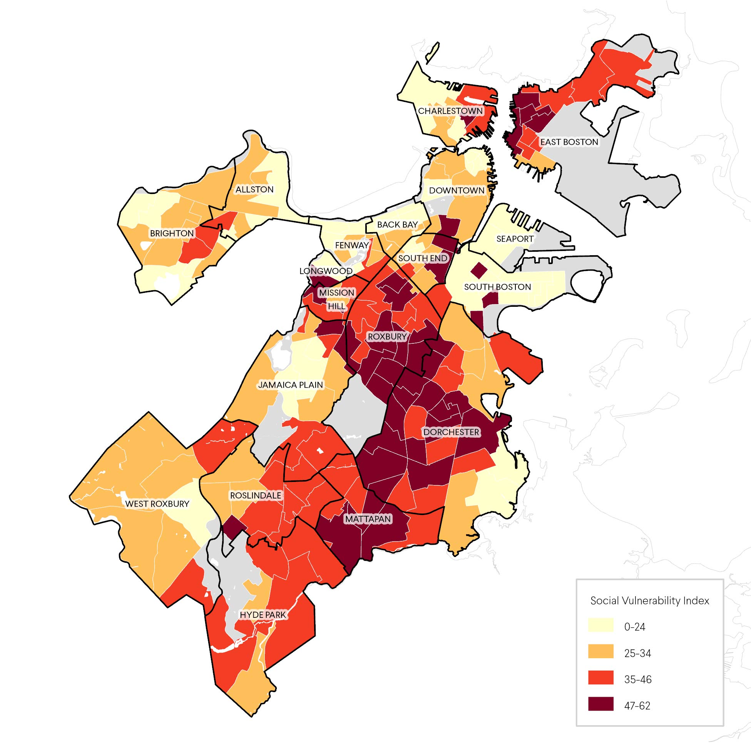
Boston’s Socially Vulnerable Communities

Slide 8
Challenges to Equitable, Carbon-Neutral Housing
Boston has a shortage of affordable housing
Socially vulnerable households experience high levels of energy insecurity
Socially vulnerable neighborhoods have more harder-to-retrofit buildings
Retrofits and rooftop solar can accelerate gentrification and displacement
Notes:
Total HHs: 256,295
owner-occupied: 87,958 (34.3%)
renter-occupied: 168,337 (65.7%)
Easier: 6,556
Harder: 16,183

Slide 9
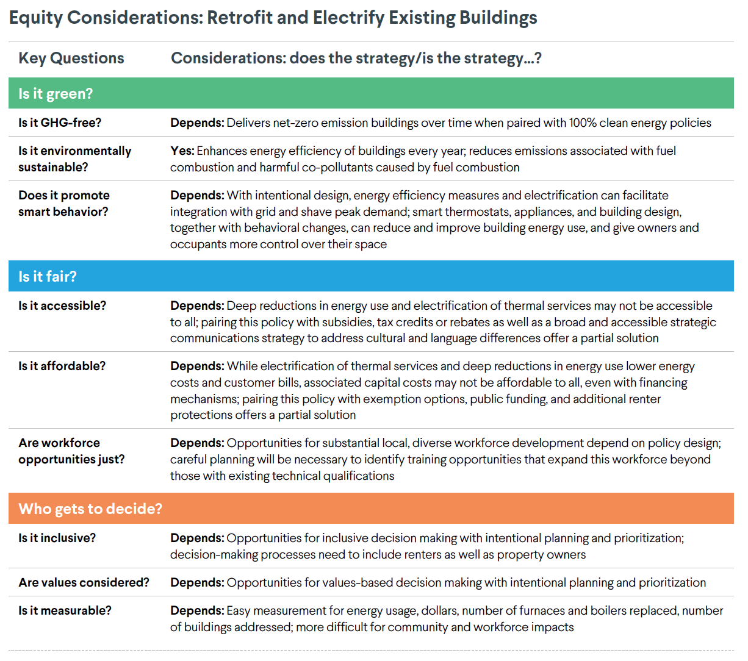

Slide 10
Cutting Buildings Emissions Improves Health, Affordability, and Equity
Benefits
75% reduction in harmful air pollution in 2050 • vulnerable HHs benefit the most
$600 million in energy cost savings in 2050 • reduced energy burden for vulnerable HHs
Health benefits from improved indoor air quality
Economic stimulus (disposable income, jobs, asset value)
Enhanced climate resiliency

Slide 11
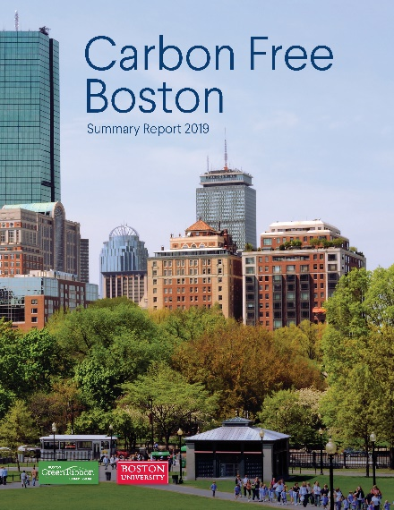

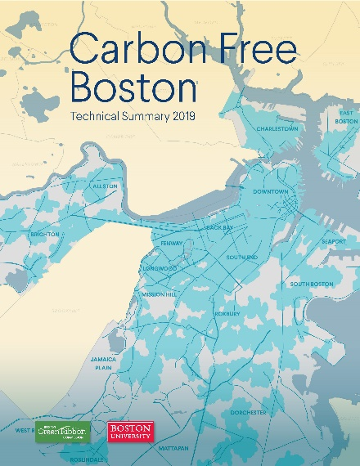
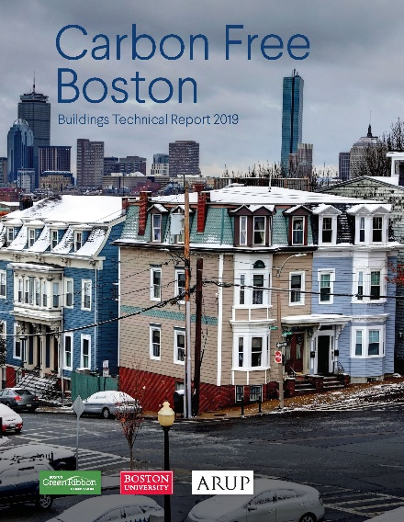



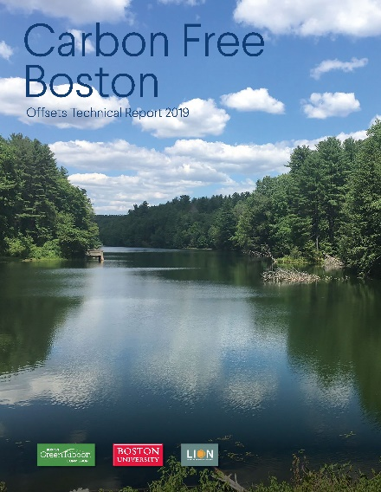
Available online: http://sites.bu.edu/cfb/carbon-free-boston-report-released

