Slide 1
New England Electricity Restructuring Roundtable
Special Roundtable on Transmission for Decarbonization
Undersecretary Judy Chang
Massachusetts EEA
September 24, 2021

Slide 2
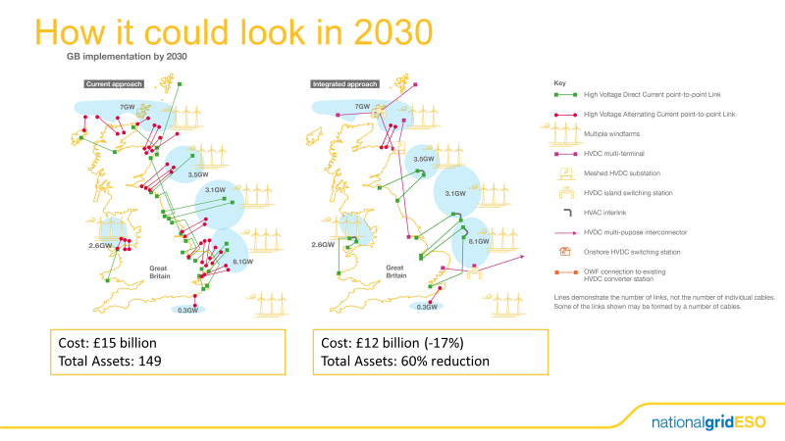
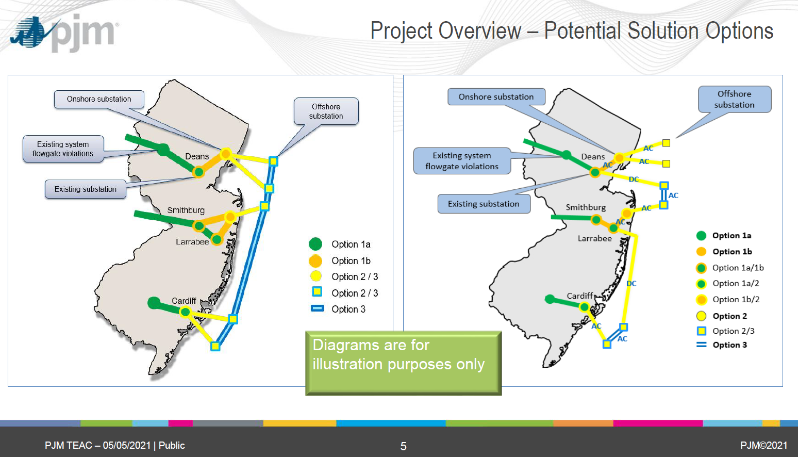
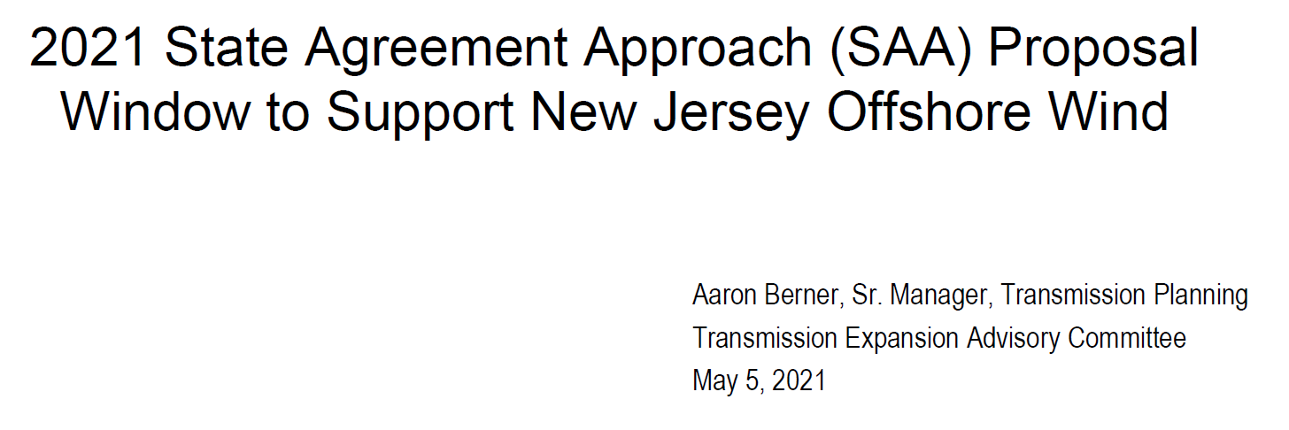
Examples of Offshore Grid Planning with Options
UK’s analysis in planning for offshore network to meet clean energy goals
Dr. Biljana Stojkovska
Transmission Planning Technical Conference, 02 February 2021

Slide 3
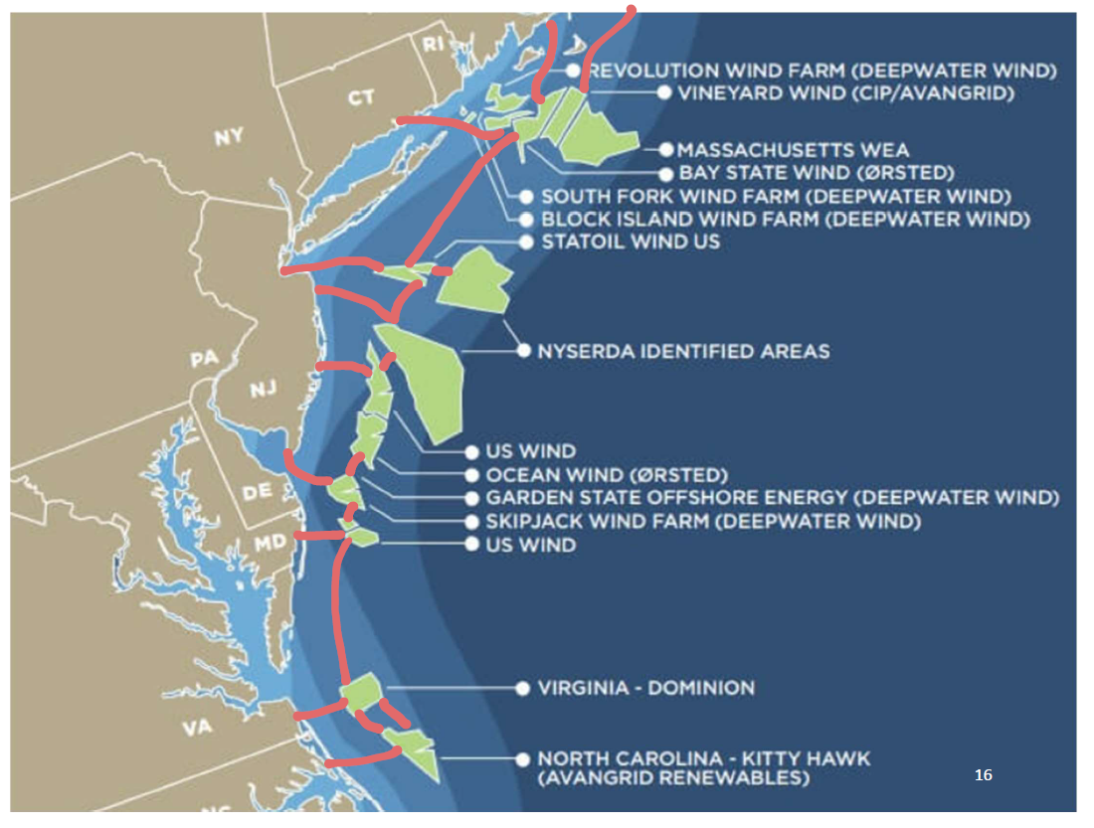
Necessary Work and Opportunities for New England
Explore regional collaboration on offshore grid structure & projects
Conduct coordinated grid planning, with interconnection of clean energy resources
Reach regional agreement on cost allocation framework
Identify portfolio of transmission projects that yield greatest reliability, resilience, economic, and decarbonization benefits to reduce ratepayer costs and risks
Support the use of energy storage and grid-enhancing technologies to “squeeze more” out of expensive transmission investments
Judy Chang
Executive Office of Energy and Environmental Affairs
September 24, 2021

