Slide 1
Regional Wholesale Electricity Markets and System Planning Reforms Multi-State Collaborative Effort
Presented by:
Judy Chang
December 11, 2020

Slide 2
Content
Overall Proposal for Change
Wholesale Electricity Market Structure and Design
Transmission Planning for the Future
ISO-New England’s Governance and Mission

Slide 3
Executive Summary: Proposal for Change
To meet New England states’ climate goals at least cost, we need a regional electricity system operator and planner committed to adapting to New England’s evolving power system needs.
Our Roadmap analysis shows that under all scenarios examined, New England needs:
1,000-2,000 MW of offshore wind/year; 500–1,000 MW of solar PV/year
New transmission upgrades
We expect our partner to fully account for state energy and environmental laws, including decarbonization targets, while ensuring system reliability at the lowest cost:
Proactively develop market-based mechanisms, in concert with state policymakers, that facilitate growth in clean energy resources
Conduct best-in-class system planning activities that proactively address our clean energy needs, and
Adapt the organizational mission and structure to reflect our energy transition, and maintain a high degree of accountability and transparency to participating states and other stakeholders

Slide 4
Proposed Reforms

Slide 5
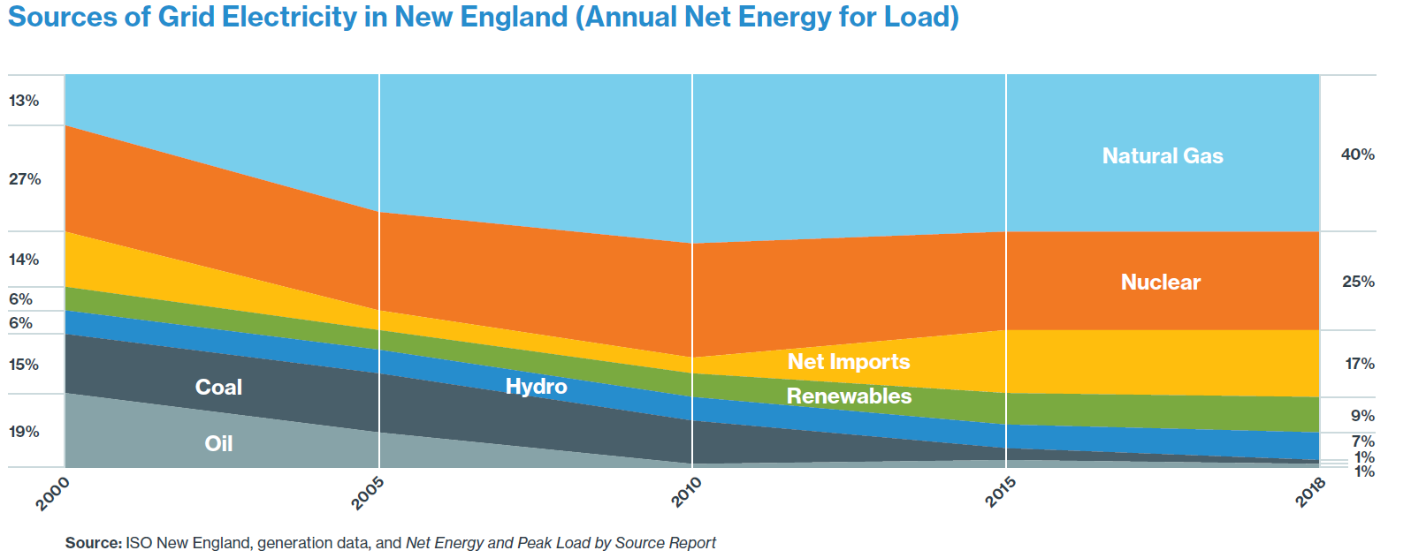
Recent New England Market Resource Adequacy Issues
Low energy and capacity market prices have implications on system reliability (resource adequacy) for New England, recent examples include:
Millstone, the 2,088 MW nuclear plant in Connecticut needed a contract to stay financially viable
Mystic, the 1,700 MW gas plant in Boston needed a contract to continue operation (along with the Everett LNG terminal)
However, a new 650 MW gas combined cycle power plant cleared the capacity market and is expected to be built in Connecticut in 2022
These results show that market design is misaligned with decarbonization laws
Increases region’s reliance on gas -fired power plants

Slide 6
Reform #1: Wholesale Electricity Market Structure and Design
Objective: Pursue a new, regionally-based market framework that delivers reliable electricity services, accounting for and support States’ clean energy laws in an efficient and affordable manner
Currently, New England’s wholesale markets does not fully value clean energy investments made by the ratepayers; thus, ratepayers overpay to meet our decarbonization mandates
Recommendation: A reformed regional wholesale market must:
Meet the states’ decarbonization mandates and maintain resource adequacy at the lowest cost by using market-based mechanisms
Establish effective mechanisms that accommodate existing and future long-term contracts for clean energy resources executed pursuant to state law
Integrate distribution-level resources effectively and efficiently
Allow interested buyers and sellers to participate
Provide for an appropriate level of state involvement in market design and implementation

Slide 7
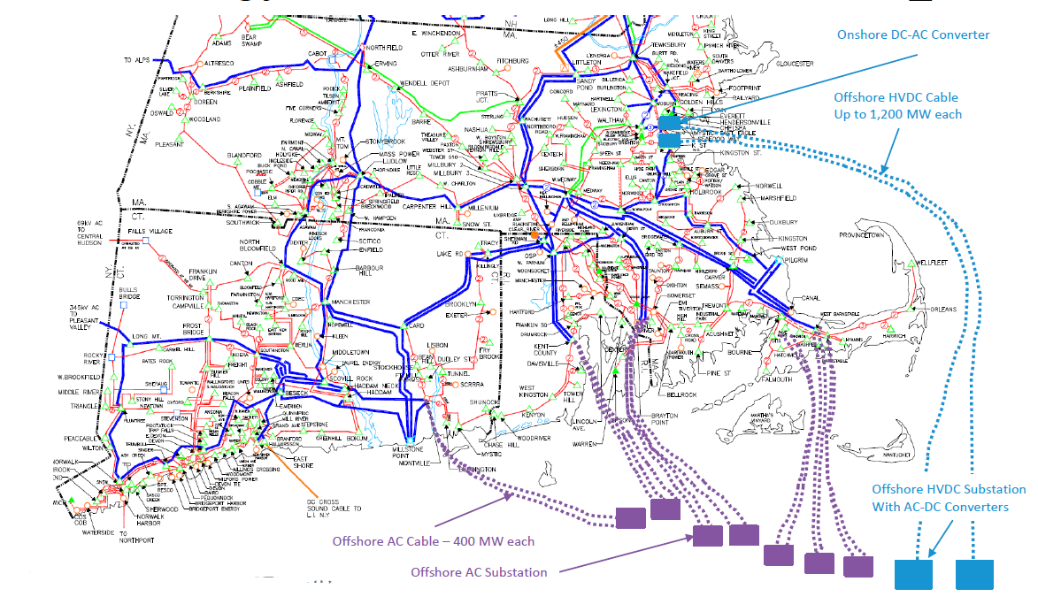
Background on Transmission System Planning
Transmission planning is one of ISO-NE’s core responsibilities
Regional planning can and should incorporate anticipated future needs to integrated renewable and clean resources
Lacking a vision, the region has spent billions of dollars in new transmission without an eye toward how to integrate the clean resources that the region needs
ISO-NE needs to make this its priority going forward
Source: Graphic from ISO-New England, 2019 Economic Study: Offshore Wind Integration, June 30, 2020

Slide 8
Reform #2: Transmission Planning for the Future
Objective: Incorporate state decarbonization pathways into regional long-term transmission planning
As a region, to decarbonize the electricity system, we need a clear understanding of the investments needed to support our transmission infrastructure
Recommendation: Develop and use a planning framework that includes:
Regional planning effort that provides a high-level transmission system plan
Use states’ scenarios as a starting point for developing future transmission needs
Provide needed transmission system planning information to the region, including high level cost estimates,
Conduct detailed analyses for specific scenarios, with the objective being to understand future conditions and needs, including:
Onshore system upgrades needed
Offshore systems that may be needed to support offshore wind resources
Potential options that should be explored, including non-transmission alternatives
Impact of DERs
Conduct stakeholder meetings to discuss the potential use of transmission to integrate all of the necessary energy resources in the region at the lowest cost possible
Informed by States’ direction, conduct detailed planning processes to maximize the use of existing transmission, build new transmission only where absolutely necessary, and use competitive processes to minimize costs to consumers.

Slide 9
System Operator Governance
The current organizational structure does not provide States adequate influence in key decisions

Slide 10
Reform #3: New Governance to Support Energy Transition
Objective: Adjust the ISO-NE’s governance structure and mission to support States’ needs
Recommendation: Explore changes after analyzing the following:
As part of this process, NESCOE seeks to explore reform of ISO-NE governance to achieve greater transparency around decision-making, with a needed focus on
Consumer cost concerns
Support for States’ energy and environmental laws

Slide 11
Next Steps
Starting in January 2021:
Convene technical conferences to explore potential methods of reform
Introduce the principles in the Vision Statement
Solicit proposals from interested stakeholders
Solicit comments and dialogues with stakeholders
Last month through March 2021:
Explore approaches to achieve the reforms needed
Later in 2021:
Report back to the Governors on proposed solutions

Slide 12
Questions?

