Slide 1





December 9, 2016
New England Electricity Restructuring Roundtable
Energy Storage: Real (and Diverse) Projects

Slide 2
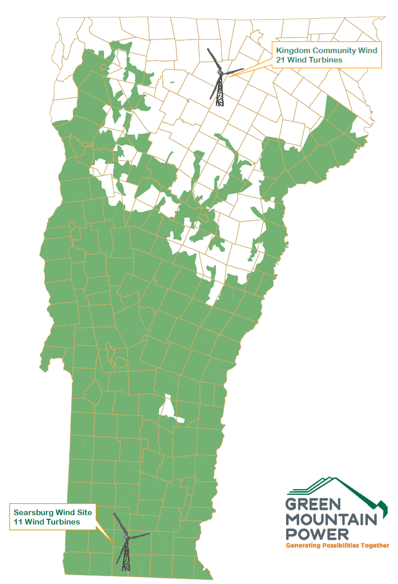
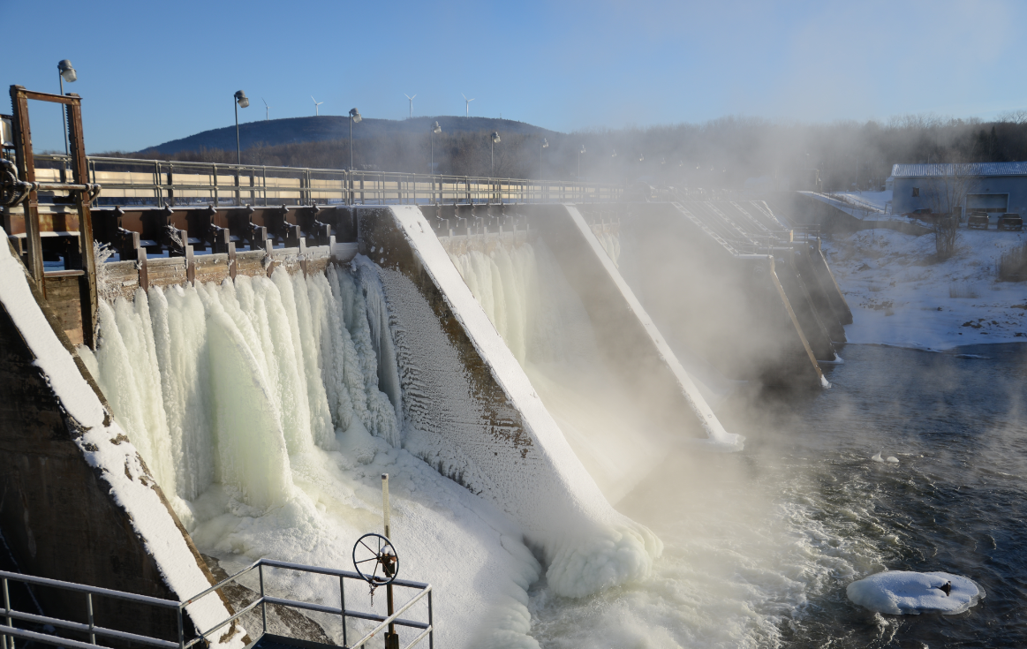
Who We Are
We serve 260,786 Customers in 202 towns in 7,500 square miles of service territory
We operate
  32 Hydro Plants ● 6 Peaking Plants
  12 Solar Projects ● 2 Wind Farms
  3 100KW Wind Turbines
  1 Joint-Owned Biomass Plant (McNeil)
  1 Battery Storage facility
We maintain
  976 miles of transmission lines
  11,273 miles of distribution lines
  185 substations

Slide 3

Today
Today:
Supply goes from one direction over long distances, leading to losses and immense infrastructure requirements
Supply built to accommodate demand => Inefficient asset utilization

Slide 4
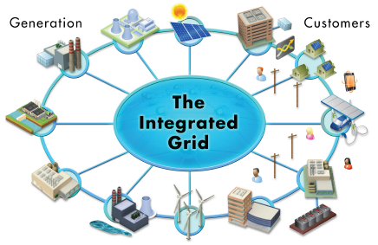
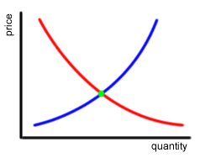
Tomorrow
Guiding Philosophy: Shift the locus of control from the bulk power grid to the near customer distribution grid and subject as much as possible to market forces.
Exploit and create value from energy supply and demand assets behind customer meter
Leverage advanced software and controls to automate grid observation and response functions for greater resilience and efficiency
Complete re-focus on grid investments to maximize local values and resiliency
Distributed Market Platform

Slide 5
The Grid Transformation
Adding Distributed Generation and Controllable energy resources
Micro-Grid control systems
Energy storage is critical to the transformation as it enables:
  Peak load management
  System loss reductions
  Power quality and reliability
  Grid resiliency - islanding
  Renewable integration
  Ancillary grid services (i.e. frequency regulation)

Slide 6
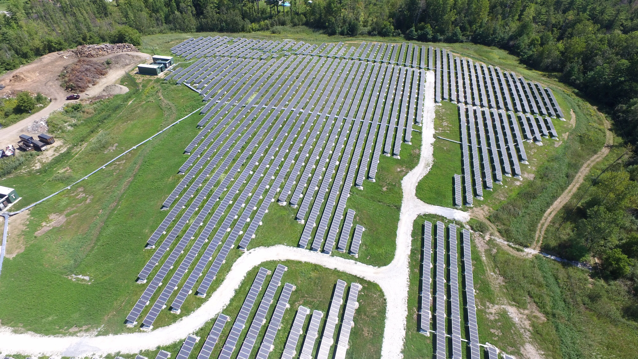
Stafford Today

Slide 7
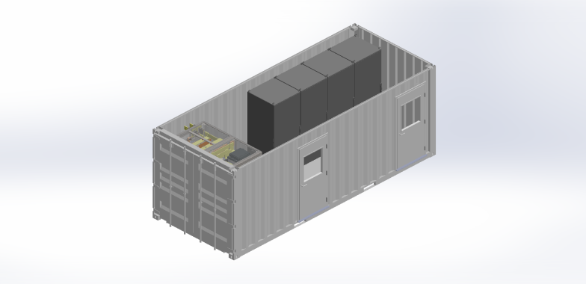
Stafford Design
Stafford Hill Solar+Battery
Topology – 4 identical system in parallel
2.5MW-DC Fixed Solar on Landfill Cap
  About 7000 panels
2MW/1MWH Lithium Ion Batteries
2MW/2.4MWH Lead Acid Batteries
4 – 500KW Multiport Inverters
Peak Demand Management
Solar Smoothing
Frequency Regulation (operation under test)
Voltage and Power Factor Support
Islanding (2017)

Slide 8
Stafford PV and Battery Data

Slide 9
Stafford Output

Slide 10
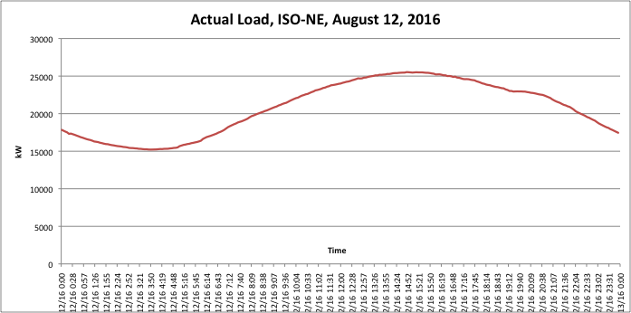
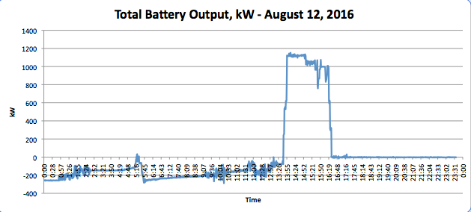
Knocking Down the Peak!
Peak hour 3:00-4:00 PM

Slide 11
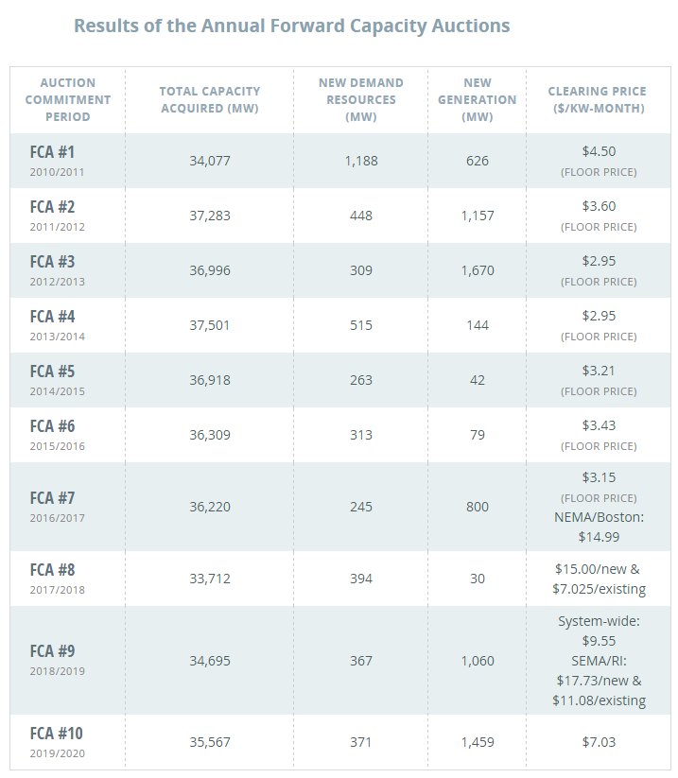
Calculating the Customer Savings
ISO-NE peak on August 12th hour ending 16:00...
The Stafford Storage avoided load-based charges by reducing GMP’s load requirements in the ISO-NE market.
During the projected peak hour, the average combined output of batteries is 1,000kW.
Based on the applicable auction price in the year June 2017 through May 2018 (FCM#8, $7.025/kW-month), and using the 20% reserve margin, the savings from this one hour was over $100,000 from the batteries alone.
When combined with the solar output this project saved GMP customers over $150,000 in that single hour.
Next year, this value would jump to over $200,000

Slide 12
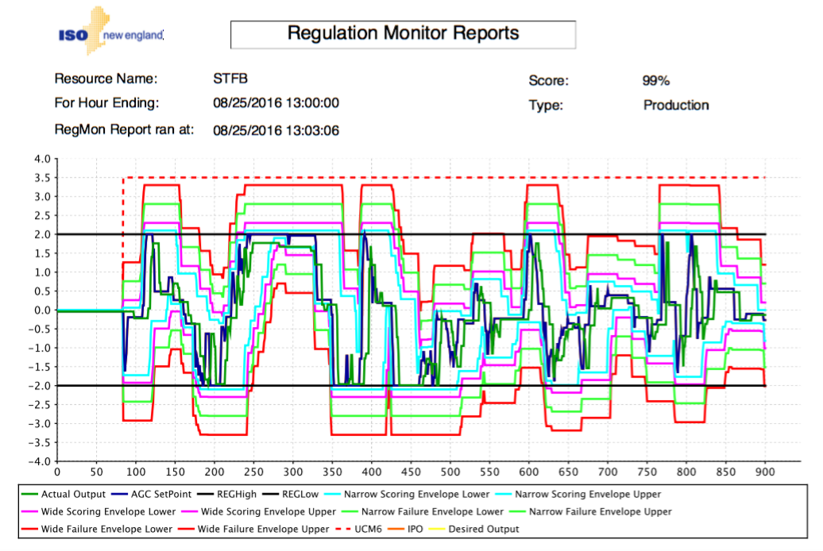
Regulation Services
Stafford Hill is first and only alternative technology resource entered into the
ISO frequency regulation market at this time
First test runs resulted in a performance score of 99%

Slide 13
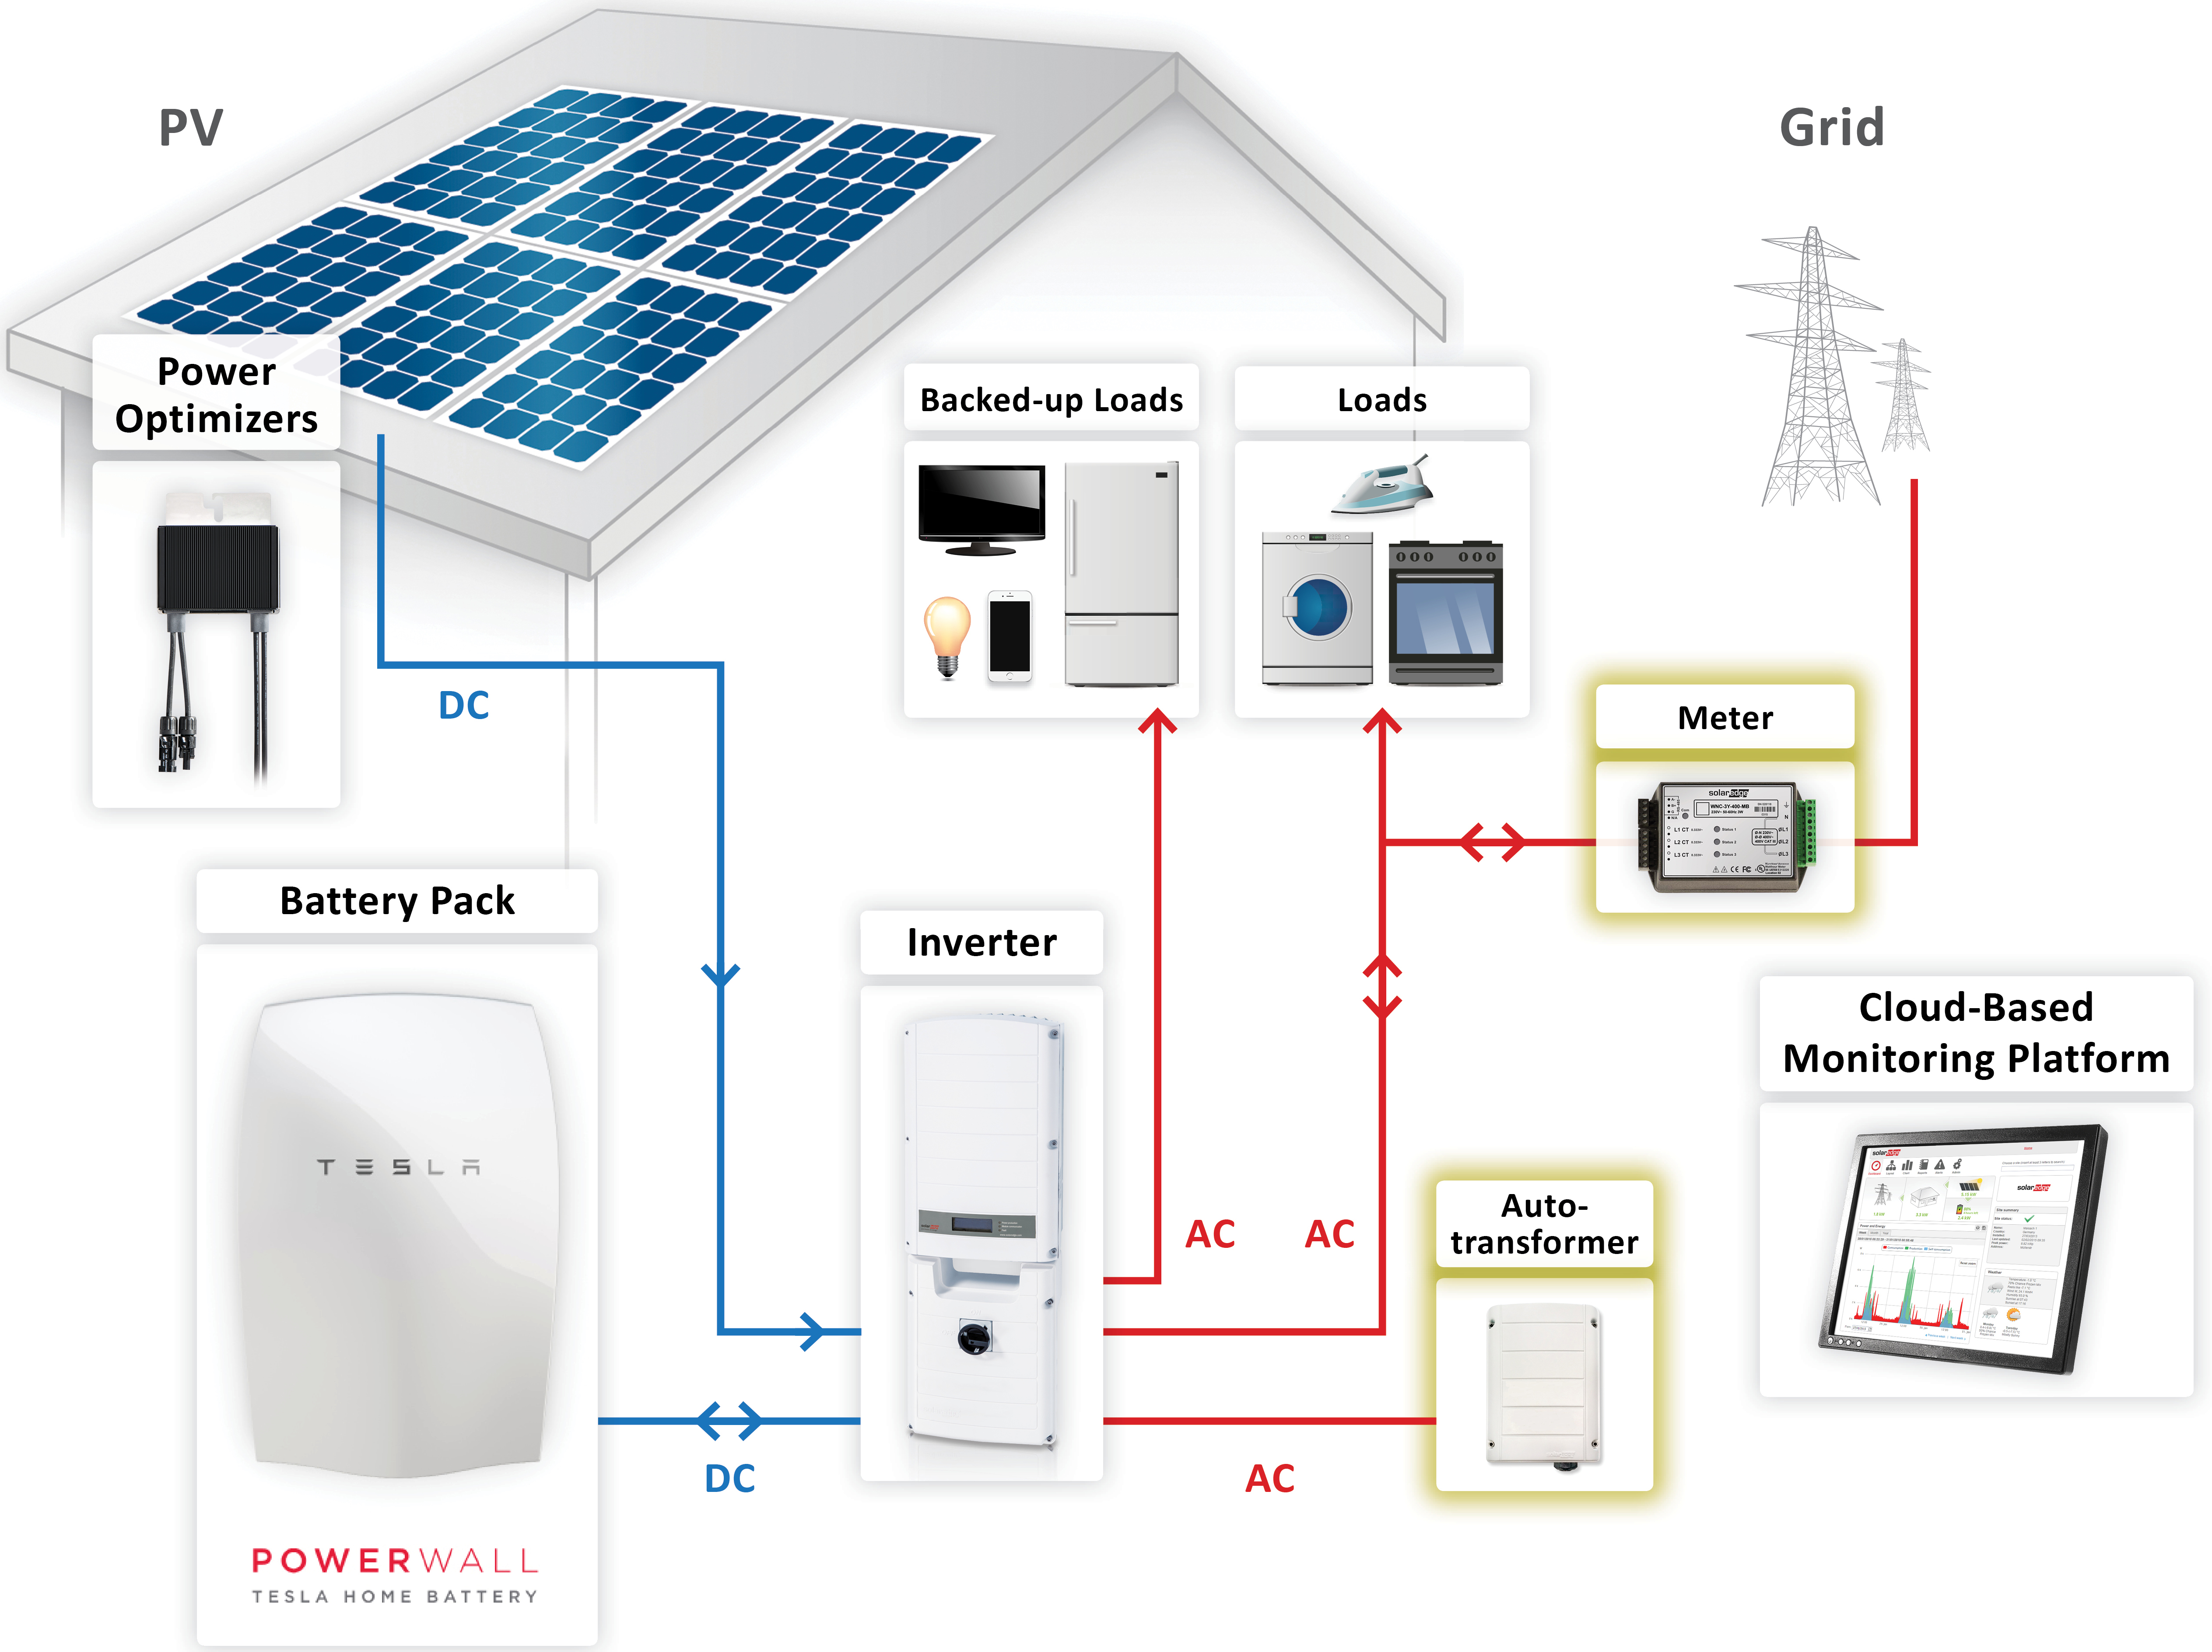
Behind the Meter Storage
Behind the meter storage can provide all the benefits of controlled storage AND customer resiliency

Slide 14
GMP PowerWall Program
3 Customer Options
  Purchase System for $6,500 – No Shared Access
  Purchase System for $6,500 – Share Access with GMP and get a monthly credit of $32
  Lease system, share access with GMP - $37/Month
Option 3 (monthly lease) proven most popular
Where GMP shares access we will call on the battery during Peak Times, reducing our system costs
Due to delays in software upgrades to inverter, rollout began slow – currently at 20 systems installed with approximately 60 customers scheduling installation
Will transition to the PowerWall 2.0 and re-price the offering

Slide 15
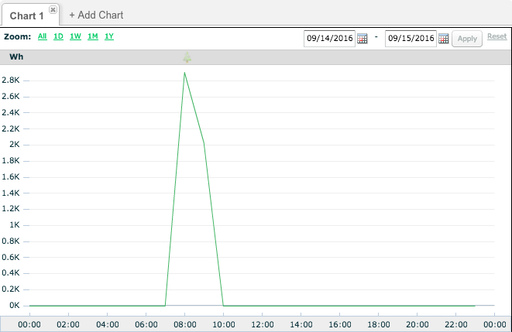
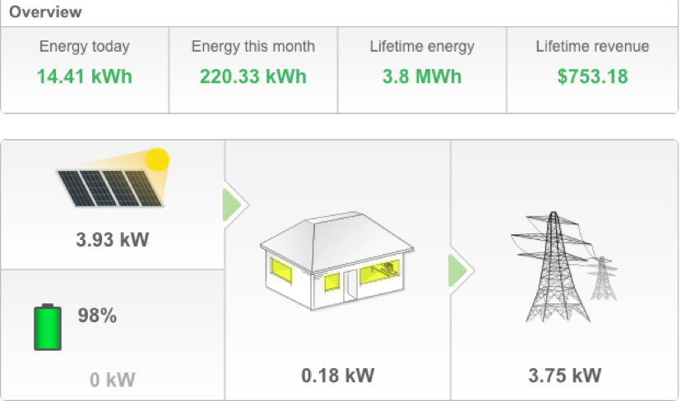
PowerWall In Action
July 23rd Summer Wind Storm
 | Total Energy Discharged | 7/23/16 15:00 | 7/23/16 16:00 | 7/23/16 17:00 | 7/23/16 18:00 | 7/23/16 19:00 | 7/23/16 20:00 | 7/23/16 21:00 | 7/23/16 22:00 | 7/23/16 23:00 | 7/24/16 0:00 | 7/24/16 1:00 | 7/24/16 2:00 | 7/24/16 3:00 | 7/24/16 4:00 | 7/24/16 5:00 | 7/24/16 6:00 | 7/24/16 7:00 | 7/24/16 8:00 | 7/24/16 9:00
Cust 1 | 2079.6353 | 20.8333 | 197.1875 | 135.9375 | 100.4167 | 105.6771 | 89.3229 | 132.8125 | 106.4062 | 253.75 | 149.0625 | 133.8021 | 130.7812 | 193.1771 | 105 | 75.8333 | 78.3333 | 65.0521 | 6.25 | 0
Cust 2 | 3223.2011 | 15.8333 | 252.1875 | 234.1146 | 233.3333 | 233.5938 | 231.7188 | 230.3125 | 243.3333 | 230 | 219.1667 | 210.9615 | 240.5208 | 239.2188 | 233.3854 | 175.5208 | 0 | 0 | 0 | 0
Cust 3 | 1358.6458 | 433.4375 | 586.3021 | 338.9062 | 0 | 0 | 0 | 0 | 0 | 0 | 0 | 0 | 0 | 0 | 0 | 0 | 0 | 0 | 0 | 0
Table above shows battery discharge during grid outage – Customer 1 was able to ride through entire outage duration of nearly 18 hours with plenty of storage to spare (total battery capacity is 6400 watt-hours)
Scheduled battery discharge

Slide 16
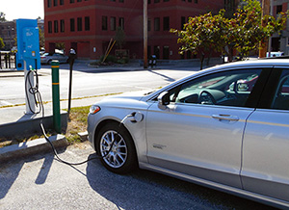
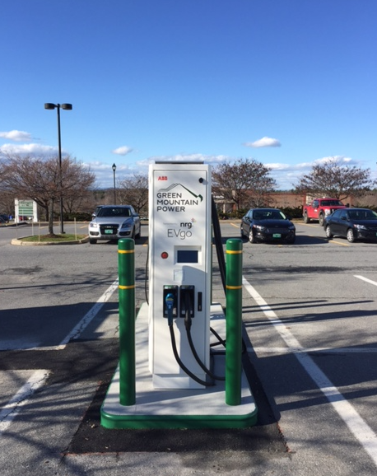
GMP eVGO Network
GMP Partnered with NRG to bring the eVGO car charging network to Vermonters
Comprised of both Level 2 and Level 3 car charging facilities throughout VT
EV owners have option of becoming a member and paying less per charge, or paying as they go when needed.
EV adoption continuing to climb with the Level 3 fast charging stations, like the one in the image to the left, seeing a slow increase in usage

Slide 17
Thank You
QUESTIONS?

