Slide 1
“A Perfect Window…”
New England Electricity Restructuring Roundtable
June 15, 2012
David W. Cash
Commissioner
Massachusetts Department of
Public Utilities

Slide 2
We have a perfect window right now to make clean energy investments.
- Governor Deval Patrick, May 30, 2012

Slide 3
Why?
Because despite how the gas market is changing, there is no change in the fundamental issues that we face in the New England energy market….
AND
Because how the gas market is changing, there is a short- term decrease in energy costs, and we therefore have a window of opportunity to make clean energy investments before prices (and volatility) increase again.

Slide 4
No Change in Fundamental Issues

Slide 5
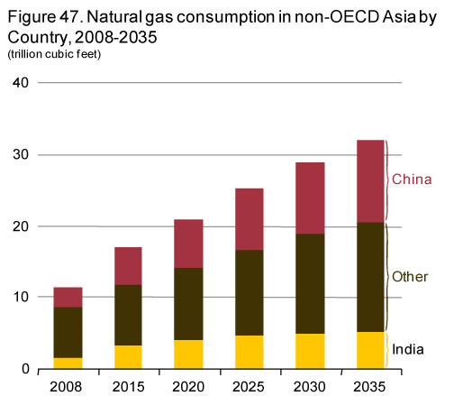
Supply and Demand Basics Still Hold
http://www.eia.gov/forecasts/ieo/nat_gas.cfm

Slide 6
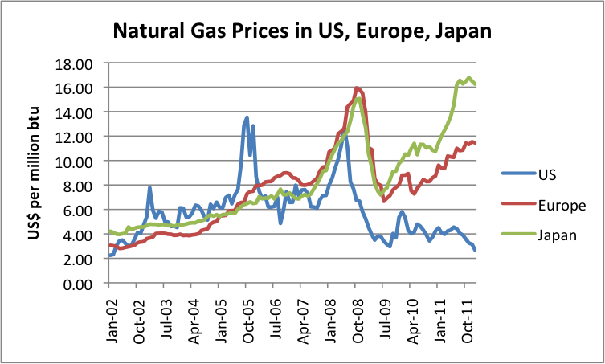
Supply and Demand Basics Still Hold
http://www.forexpros.com/analysis/why-us-natural-gas-prices-are-so-low---are-changes-needed%20-118082

Slide 7
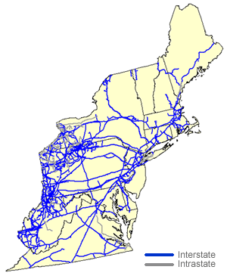
Still at the End of the Energy Pipeline – And It’s Congested

Slide 8
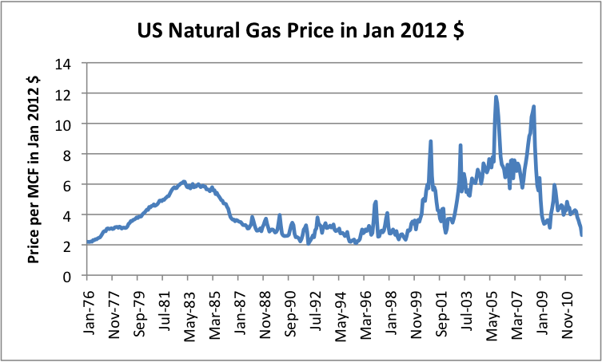
Gas Prices Still Volatile

Slide 9
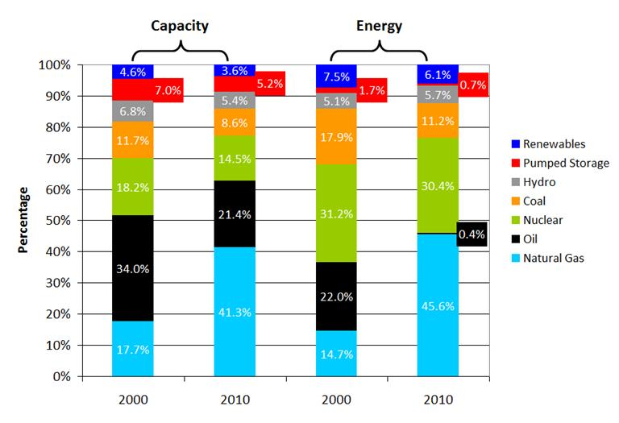
Still Need to Diversify Fuel Mix and Meet Future Demand
ISO-NE

Slide 10
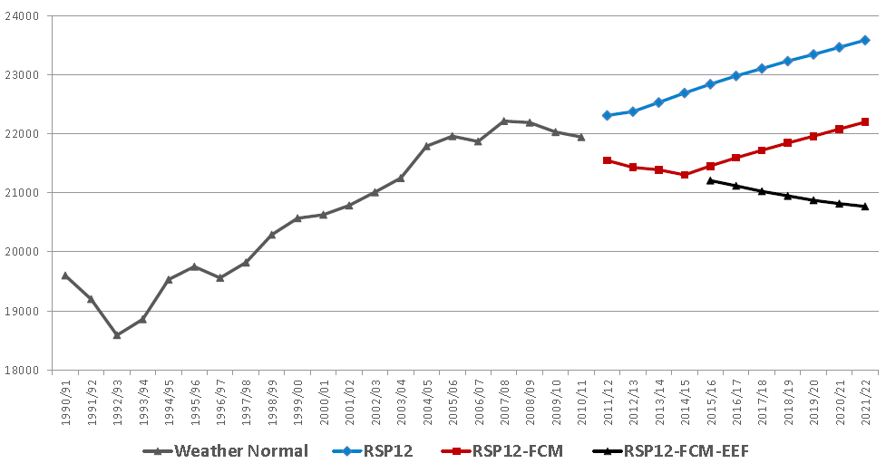
Still Need to Diversify Fuel Mix and Meet Future Demand – And EE has proven to be effective
The Road to Better System Planning: ISO-New England’s Revised Energy Efficiency Forecast. Synapse Energy Economics, Inc. 2012

Slide 11
Clean Energy Still Needs Government Incentives
“…Without the current capital provisions in place, we would not have been able to fail over and over again, which is what it took to advance the technology needed…”

Slide 12
Clean Energy Still Needs Government Incentives
"The development of horizontal drilling took trial and error. Without the current capital provisions in place, we would not have been able to fail over and over again, which is what it took to advance the technology needed to produce the Bakken and numerous other resource plays across America.”
Harold Hamm, the CEO of Continental Resources at the June 12 Senate Finance Committee hearing on the relationship between the tax code and energy policy

Slide 13
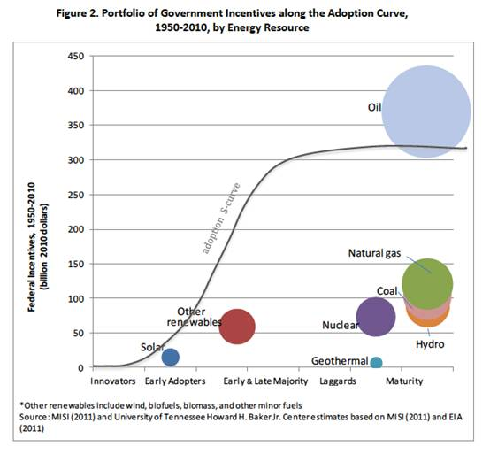
Clean Energy Still Needs Government Incentives
    Market barriers;
    Imperfect market (externalities);
    Investments that companies cannot make b/c too risky
http://www.forexpros.com/analysis/why-us-natural-gas-prices-are-so-low---are-changes-needed%20-118082

Slide 14
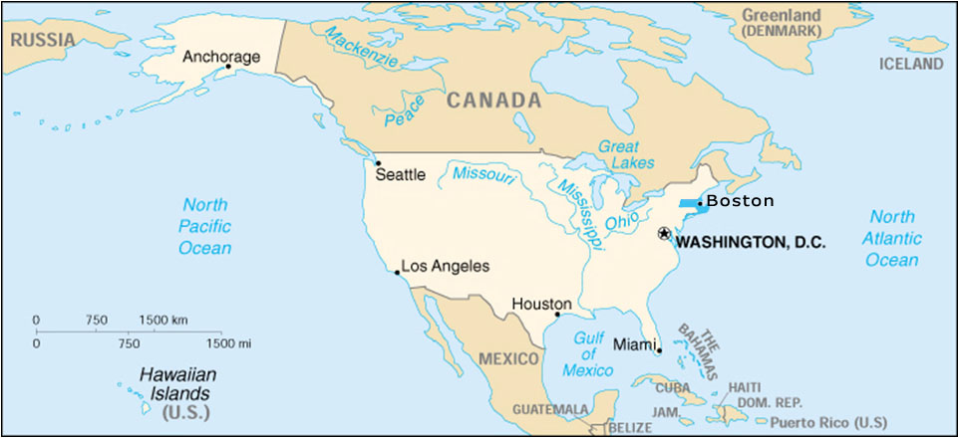
Dollars We Spend on Natural Gas Still Leaves Massachusetts: EE & RE keep $$ & Jobs in NE
Oil & Natural Gas
- Canada
Shale Gas – NY,PA
Natural Gas
- U.S. Gulf Coast
Oil & Natural Gas - Middle East
Natural Gas - Caribbean
Coal – Colombia
Oil - Venezuela

Slide 15
Climate Change is Still Real and We are Still Required to Act

Slide 16
Window of Opportunity

Slide 17
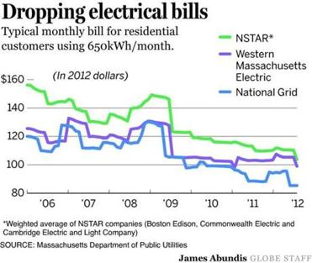
Lowest Rates Since 2006

Slide 18
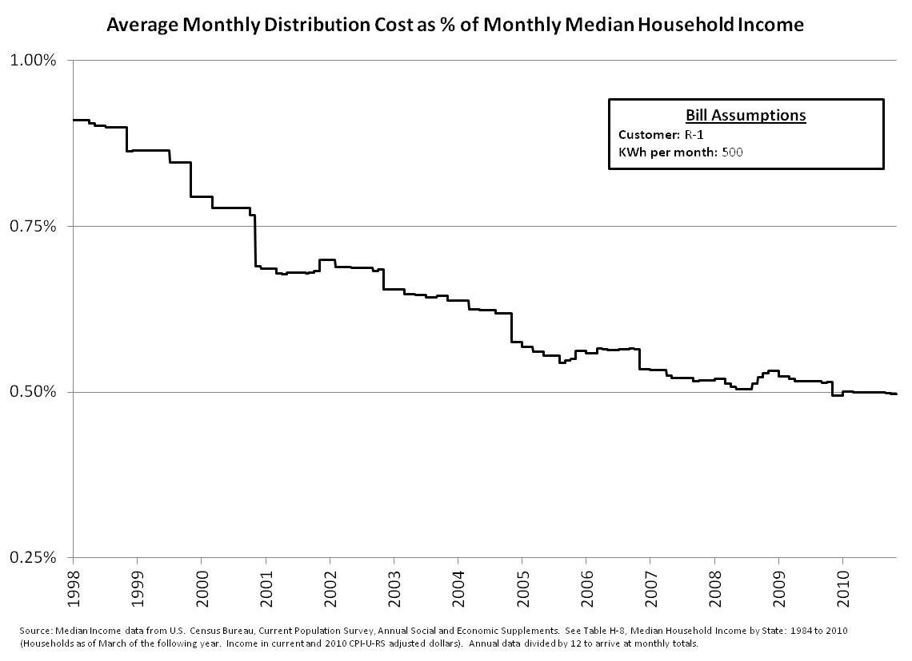
Declining Portion of Household Spending on Energy

Slide 19
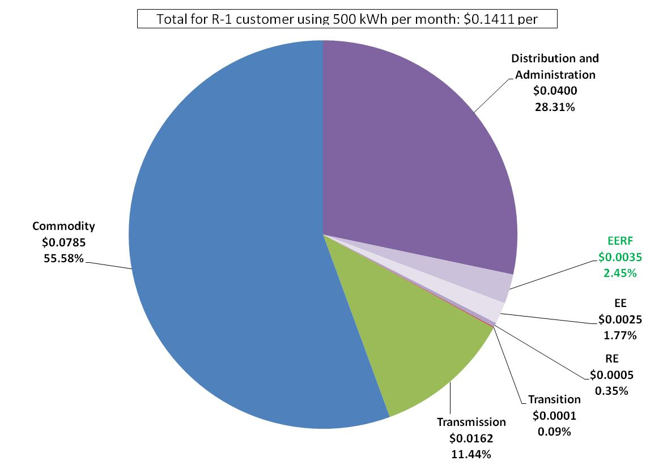
20%-40% = Drop in Electricity Bills;
3-5% = Clean Energy Portion of Bills – upfront investment/lifetime savings

Slide 20
CONCLUSION
Conventional fossil-based market:
The more it changes, the more it stays the same
Regional to global demand will increase prices
Gas prices will stay volatile
NE is congested
Lack of fuel diversity is a challenge
Subsidies still needed
Clean energy sector creates economic opportunities
Need to address air emissions/climate
Window of opportunity is now
Lowest energy prices in years
Investments in clean energy are relatively small and result in significant savings for customers and greater reliability
5 years experience of ramping up the most aggressive EE and RE programs in the country

Slide 21
Clean Energy Still Needs Government Incentives
Source: Congressional Research Service 2011. Some figures may include expenditures related to transportation fuels. To more accurately reflect the value of tax incentives supporting renewable electricity, the “renewables” category does not include expenditures related to alcohol fuels and biodiesel.

