Slide 1
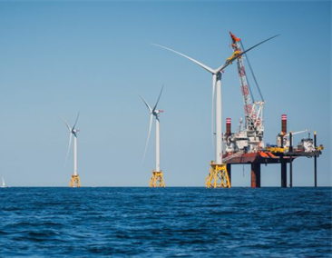
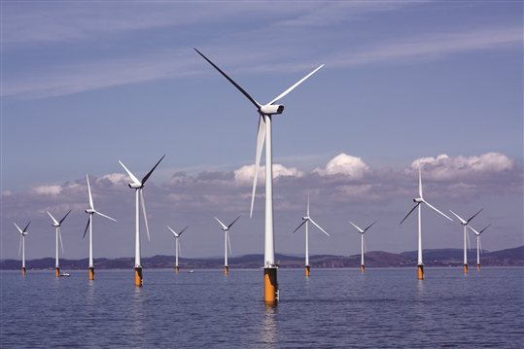
Bringing Offshore Wind to New England’s Shore
Restructuring Roundtable
Mike Calviou
Senior Vice President, Regulation & Pricing
June 16, 2017

Slide 2
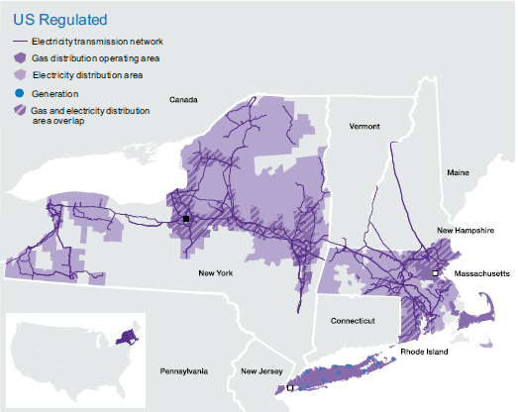
National Grid in the US
Primarily a gas and electric utility delivering energy to 20+ million people
3.5 million electric customers and 3.6 million gas customers
Electric transmission in five (5) states;
Joint owner & operator of US – Canada HVDC interconnector
Largest electric transmission network and gas distribution business in the northeast

Slide 3
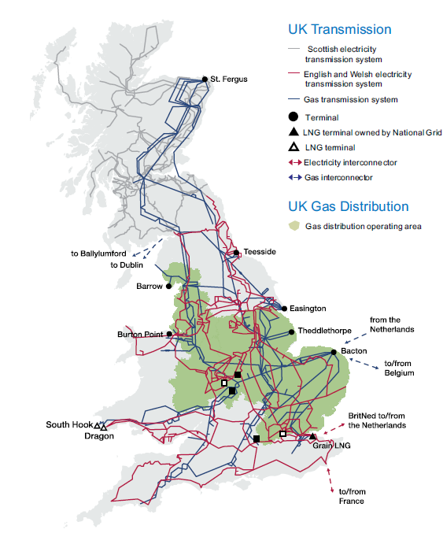
National Grid in the UK
Electric and gas transmission network owner in England and Wales
UK electric system operator
Multiple international HVDC interconnectors:
Existing links to France and the Netherlands
Currently developing links to Belgium and Norway
Potential future projects with Denmark, Iceland, Ireland and France (second interconnector)

Slide 4
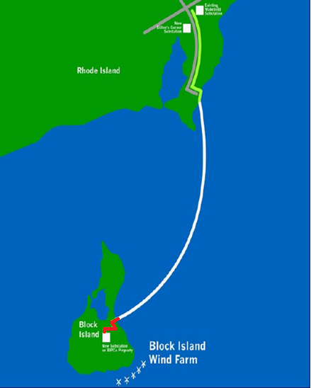
sea2shore: the Renewable Link
First offshore wind farm in the US
National Grid constructed a 20 mile 30 megawatt bi-directional submarine cable to connect Block Island to mainland Rhode Island
The cable connects Deepwater Wind’s 30 megawatt demonstration scale offshore wind farm and Block Island Power Company to the New England wholesale energy market
In-service: December 2016

Slide 5
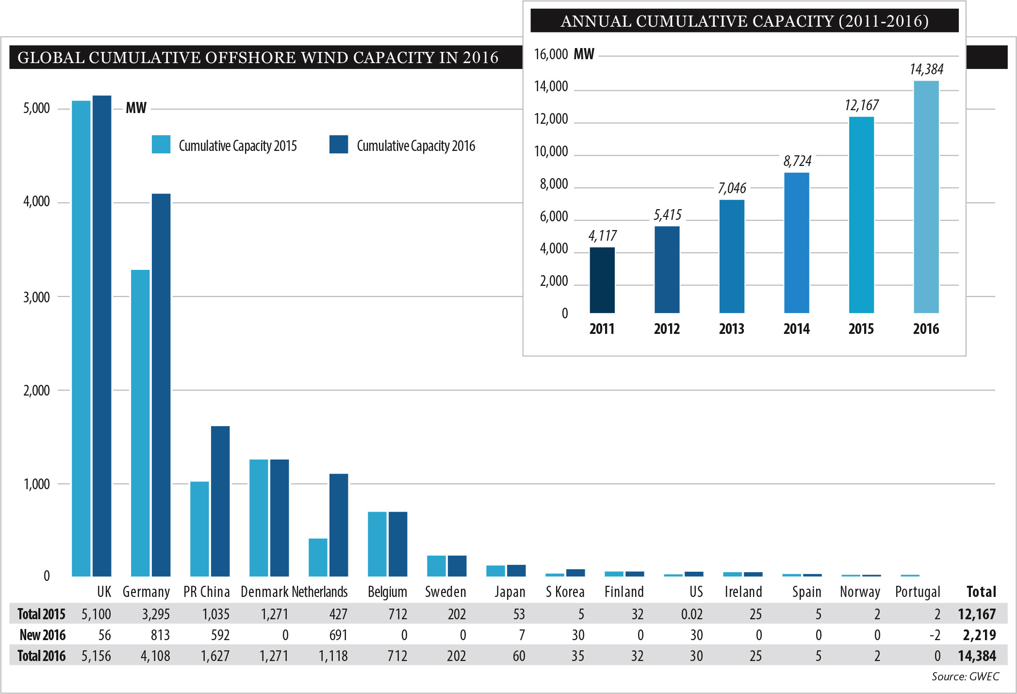
Offshore wind deployment is moving rapidly in the UK and Europe…..
Source: Global Wind Energy Council, Global Wind Statistics 2016

Slide 6
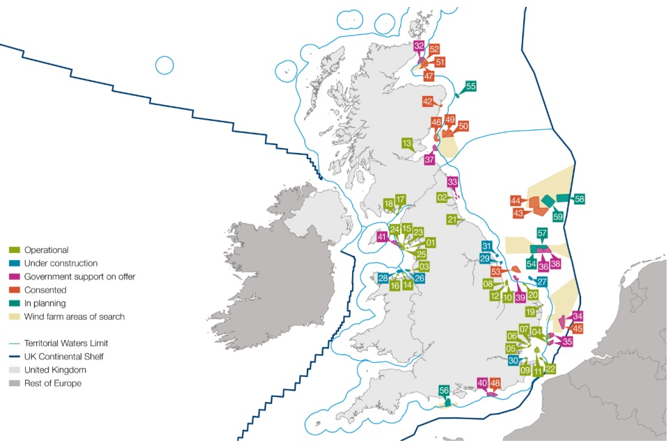
… with large scale developments across the region …..
UK has 5.7 gigawatts of offshore wind operational or under construction.
Comprising 31 wind-farms and ~1,550 turbines
13.4 terawatt hours of electricity produced in 2014
UK offshore wind project pipeline currently comprises ~29 gigawatts
By 2020 offshore wind is expected to meet 10% of UK’s electricity demand
Source: Energy and Infrastructure Key Facts 2015-6 Offshore Wind, The Crown Estate, UK
:

Slide 7
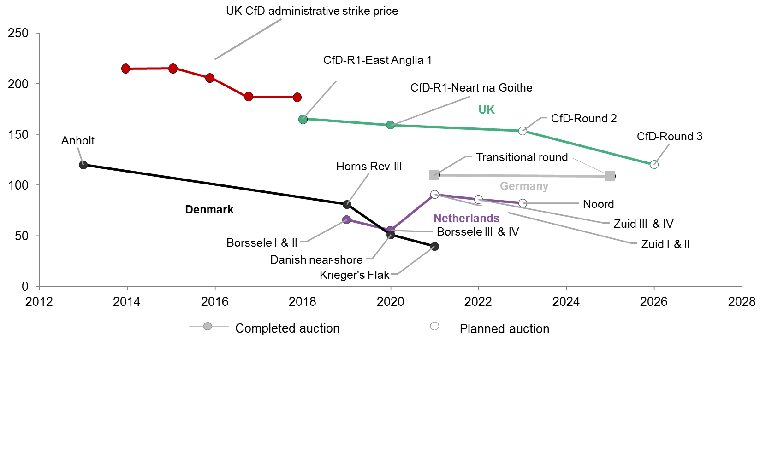
….and progressive reductions in costs
Levelized Cost of Energy (LCOE) by Commissioning Year
2016$/MWh
Source: Bloomberg New Energy Finance, December 2016. Note: UK LCOEs include Transmission costs
Notes:
June 2016 - Borssele I & II = Euro72
September 2016 – Danish Near Shore = Euro64
November 2016 – Krieger’s Flak = Euro49.90
December 2016 – Borssele III & IV = Euro54.50

Slide 8
Coordinated approach to transmission
Coordination provides a range of benefits compared to dedicated connections for each Project
Cost:
Aggregation allows for fewer cables between an aggregating platform and the onshore network generating cost savings.
Reduced permitting complexity:
The single sub-sea cable route and single landfall means a simpler permitting process.
Environment and Safety:
Fewer cables and fewer construction zone mean fewer disturbances of the sea-floor and a safer construction protocol.
Expandability:
Allows for a scalable, integrated design providing for future expansion while optimizing additional cost.

Slide 9
UK study supports the benefits of coordination
The UK has studied coordinated compared to dedicated approaches and confirmed the range benefits associated with the coordinated approach, including:
Permitting benefits, reduced environmental disturbance, fewer asset installations, fewer landings, future-proofing the transmission network and reducing costs to Customers
Overall cost savings in the range of 8-16% were identified
Coordination not pursued so far in the UK due to uncertainty around which offshore wind developments will proceed.
Separate development of the offshore wind generator and the supporting transmission can give rise to coordination concerns (e.g., In the timing of construction and availability)
European experience shows that any risks associated with separation of roles can be mitigated through appropriate arrangements.
Reference: Offshore Transmission Network Feasibility Study, The Crown Estate, National Grid, September 2011

Slide 10
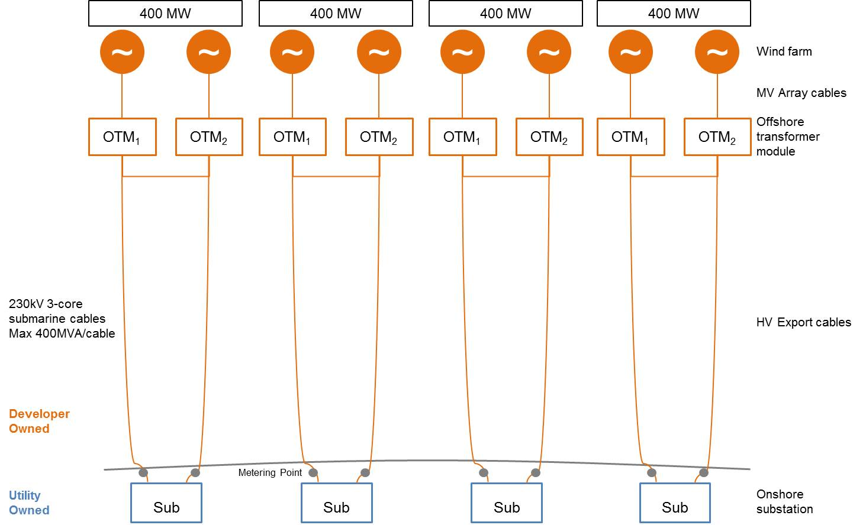
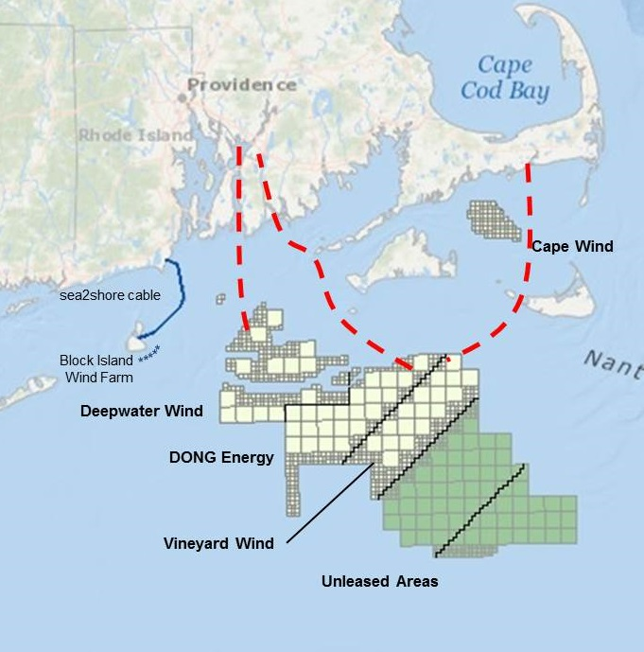
Dedicated Connections for each Project
Source: Conceptual

Slide 11
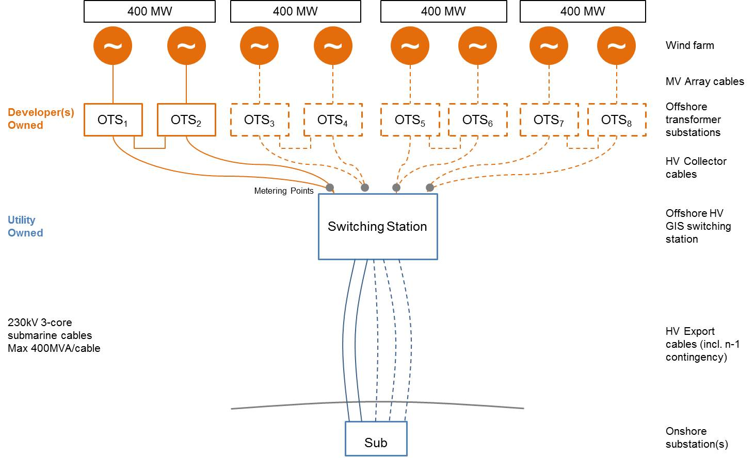
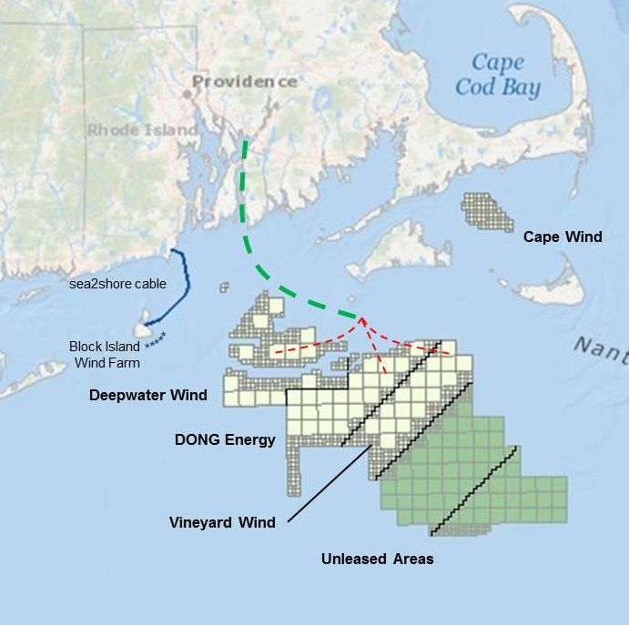
Coordinated Transmission Configuration
Source: Conceptual

Slide 12
Current RFP process
Section 83C draft RFP recognizes that the transmission interconnection of the OSW facility to the onshore network could have a significant impact on Customer costs.
Envisaging that each bidder address in their proposal (either by themselves or with partners),
Fulfilling their delivery needs to shore through a project specific generator lead line proposal, and
An alternative approach envisaging an expandable transmission proposal providing non-discriminatory access for developers to the onshore network
Comments on the form of the RFP express a range of views, supporting diverse approaches but with a common theme of seeking to mitigate risks and deliver cost effective solutions.
Recognizing the short timeframe for the current RFP:
Following the present solicitation there is the opportunity to further explore, validate and support transmission solutions that will deliver the most value for electric Customers across the Commonwealth

Slide 13
Conclusion
Offshore Wind is a priority for Massachusetts and can deliver a range of benefits including clean energy, jobs and economic growth.
Experience from the UK and Europe is available and provides valuable insights to support the region’s development of Offshore Wind.
Given its scale and importance this effort should be focused on providing Customers cost-effective and efficient access to this new resource both now and for potential future developments.
The more cost effective approach for Customers is via a coordinated and expandable approach;
Integrate offshore resources into the onshore system in a coordinated way that reduces costs and minimizes disruption to the environment and our communities
Design, size and deploy offshore transmission in a way that is able to accommodate potential future development of Offshore Wind resources.

Slide 14
Questions
Mike Calviou,
Senior Vice President, Regulation & Pricing
National Grid USA
Email: Mike.Calviou@nationalgrid.com

