Slide 1



New England Electricity
Restructuring Roundtable
Strategic Transmission Planning:
Coordinated Planning and Anticipatory Investment
Are Keys to Success
Mike Calviou
SVP, US Policy & Regulatory Strategy
September 29, 2023

Slide 2
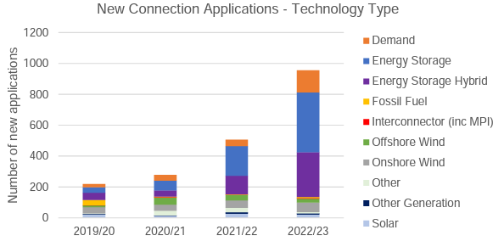
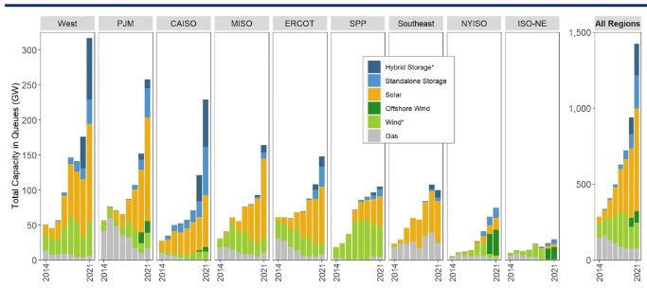
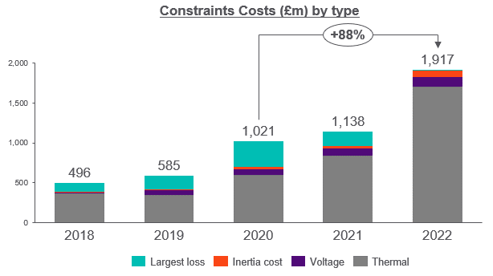
Interconnection Queues and Congestion Costs
Rise Without Adequate Transmission Planning
UK’s Net Zero ambition and the initial strategy of ‘Connect and Manage’ created high interconnection queues and increasing congestion costs over time, with similar trends emerging in the US.
Rising Connection Queue in UK
Rising Interconnection Queues in US
Source: National Grid ESO, Connections Reform, 2023
*Hybrid storage is estimated in some cases, and only provided starting in 2020. Onshore and offshore wind are combined until 2020.
Source: Lawrence Berkeley National Lab, 2023
Rising Congestion Costs in UK
Source: ESO Data Portal: Constraint Breakdown Costs and Volume - Dataset| National Grid Electricity System Operator (nationalgrideso.com)

Slide 3
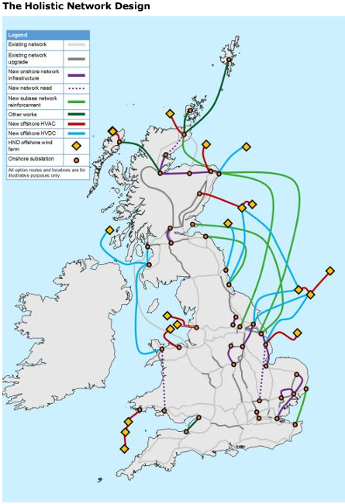
Lessons from UK: Coordinated
Planning & Anticipatory Investment
Holistic network design is helping Great Britain progress towards its ambitious goal of 50 GW of offshore wind by 2030, and net zero by 2050.
  Includes £54B transmission investment
  onshore (£22B) and offshore (£32B) by the
  end of the decade.
  Transmission infrastructure will also have to accommodate UK’s goal of 70 GW of solar by
  2035 and 10 GW of green hydrogen by 2030.
Coordinated system planning and anticipatory investment are key to success.
Utilize a ‘shared network’ design for offshore transmission but retain radial links where appropriate.
  Coordination on offshore transmission will reduce capital costs through 2050 by 18% and reduce number of cables and onshore landing points by 50%.
  Anticipatory investments required onshore and offshore.
Interconnectors Aug’23 | MW
Existing | 8,400
Construction | 1,900
Awaiting Consents | 5,350
Scoping | 17,154
Source: National Grid ESO. Figures may not be inclusive of all planned interconnections.

Slide 4
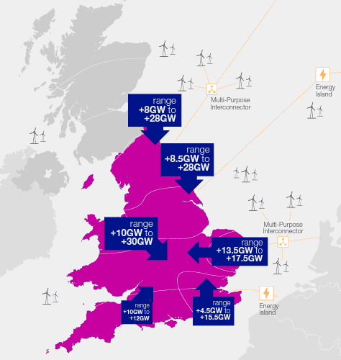
Lessons from UK: Streamlined Regulatory Process for ‘Onshore’ Transmission Projects
Ofgem’s Accelerated Strategic Transmission Investment (ASTI) framework
  Initially will apply to £20B of onshore transmission network investment across 26 projects
  NGET to invest across 17 projects
ASTI is the first wave of major transmission investment required to deliver an unprecedented increase in transmission system capability.
UK Wind Projects (GW) | Onshore | Offshore
Operational | 13.9 | 13.9
Under Construction | 1.5 | 8.8
Planning Permission Received | 3.7 | 9.6
Interconnection Queue | 18.0 | 105.0

Slide 5
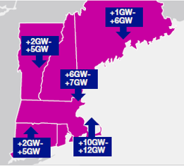
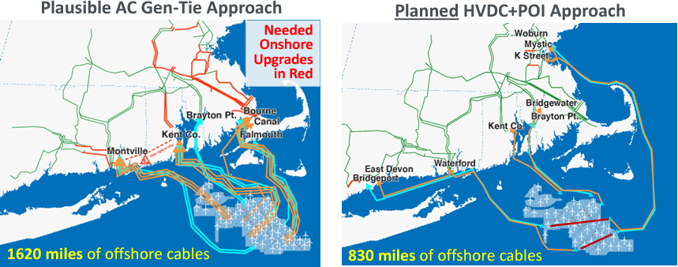
Transmission in US: Coordinated and Anticipatory OSW Planning Across Northeast Is Essential
Northeast states have ambitious offshore wind (OSW) targets of
29 GW by 2040 (likely to expand
to 65-95 GW by 2050)
  MA expected to have 23 GW of installed OSW capacity by 2050
Coordinated and anticipatory transmission system planning will:
  Reduce OSW transmission costs
  Facilitate cost allocation
  Reduce community and environmental impacts
Participants key to success of coordinated and anticipatory planning in New England:
  NE states, NY, neighboring regions, federal government,
  and transmission system operators (ISO-NE, NYISO, and PJM)
Planned Regional Offshore Transmission (example of 8,400 MW total OSW in New England)
Source: The Brattle Group, U.S. Offshore Wind Transmission: Policy and Regulatory Challenges, March 2023

Slide 6
How to Promote Onshore and Offshore Transmission Planning in New England
Coordinated Planning
  ISO-NE’s regional Tx planning process must include offshore Tx
  Improvement in coordinated planning and alignment on goals for onshore/offshore Tx
  networks and interregional Tx among ISO-NE/NYISO/PJM and the NE states and NY
Anticipatory Investment
  Proactive onshore Tx investment to prepare for influx of renewables (including OSW)
  ISO-NE/NYISO/PJM must take comprehensive, long-term views of future needs in
  regional and interregional Tx planning and cost allocation
  Consensus among NE states and NY on cost allocation for OSW-supporting Tx
Streamlined Regulatory Process
  Federal and state action to streamline siting and permitting of utility infrastructure/clean energy
  Expedited permitting for DOE National Interest Electric Tx Corridors (NIETC) projects

Slide 7
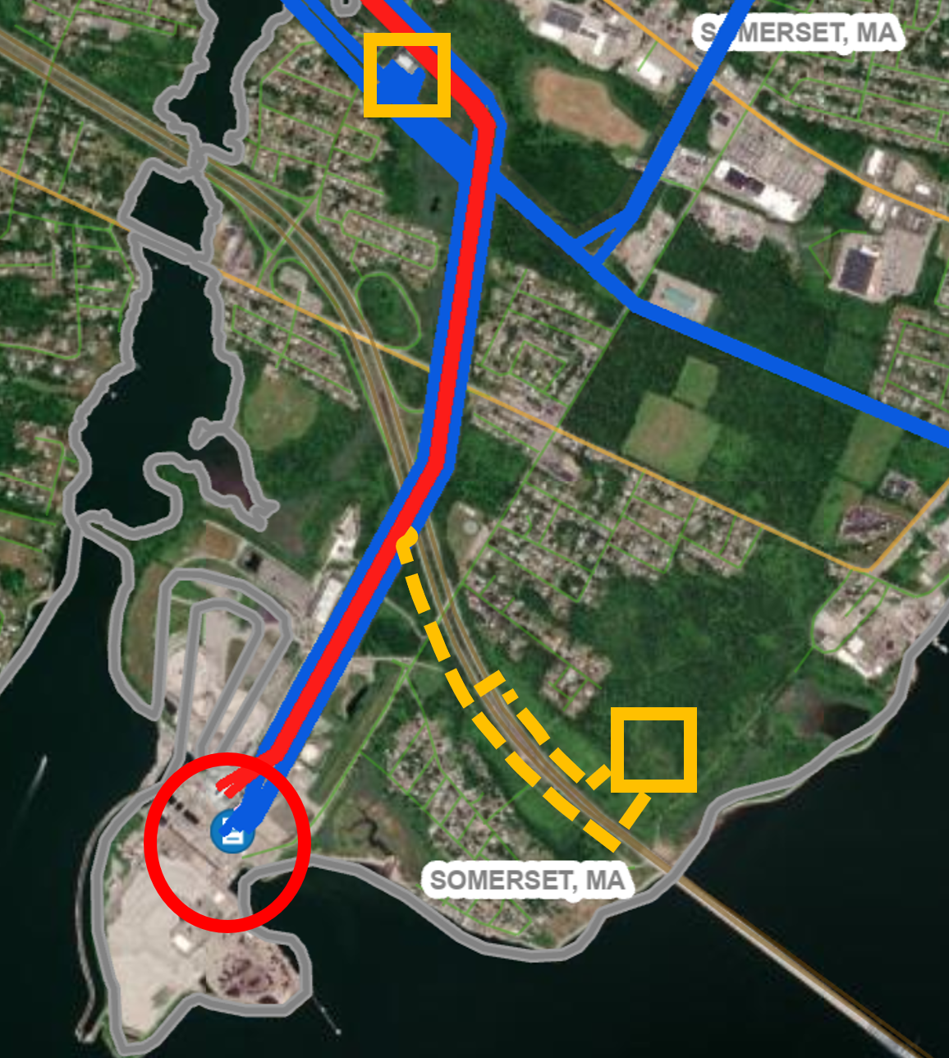
Transmission in US: National Grid’s
Proposed Major Projects in New England
Cleaner Grid New England – Brayton Point
Twin States Clean Energy Link
Onshore hub for OSW and substation upgrades to support increase of up to 2,400 MW of OSW / Energy Storage.
Reduced congestion: Expected economic benefit of $479M over a 10-year period based on production cost.
1,200 MW bi-directional transmission capacity project between Quebec and New England.
New England region will benefit from the increased capacity and reliability.
Underground HVDC co-located on highway ROW (~75 miles)
Twin States Preferred Route
Substation upgrades
Reconductoring
HVDC Converter substation (Comerford)
~106 miles of NEP-owned AC line in existing ROW
Onshore hub for OSW
Existing Brayton Point Substation
Upgraded Substation (Dunbarton)
New Substation (Londonderry)

Slide 8
Questions
Mike Calviou,
SVP, US Policy & Regulatory Strategy
National Grid USA
Email: Mike.Calviou@nationalgrid.com

