Slide 1
Engaging Stakeholders in NE in Envisioning Pathways to 80% GHG Reductions by 2050
Dr. Jonathan Raab, Raab Associates, Ltd.
www.RaabAssociates.org
December 16, 2014
Tufts University—Sponsored by Oak Foundation and German Consulate General

Slide 2
Outline
Brief history of stakeholder engagement on energy and climate issues in New England
Principles for engaging stakeholders in energy and climate issues
First steps for stakeholder engagement in NE on pathways to 2050

Slide 3
New England States: History of Coordination Organizations on Energy/Air Issues
New England Governors Conference
  Colonial Days (informally); 1937 formalized
NE States Coordinated Air Use Mgt. (NESCAUM)
  (6 NE States 1967; NY 1970; NJ 1979)
NEPOOL and ISO New England/RTO
  1971 and 1997/2005
NE States Committee on Electricity (NESCOE)
  2007

Slide 4
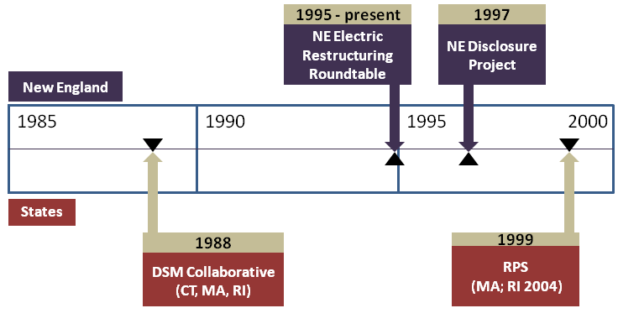
NE Stakeholder Energy/Climate Engagement Timeline: 1988-2000

Slide 5
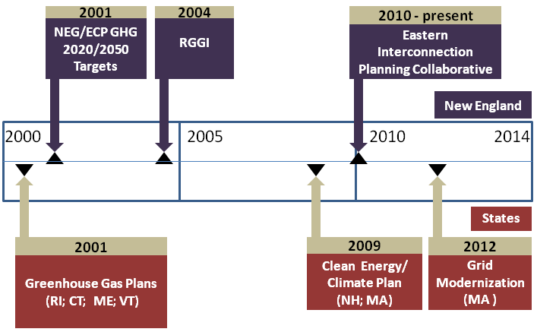
NE Stakeholder Energy/Climate Engagement Timeline: 2001-Present

Slide 6
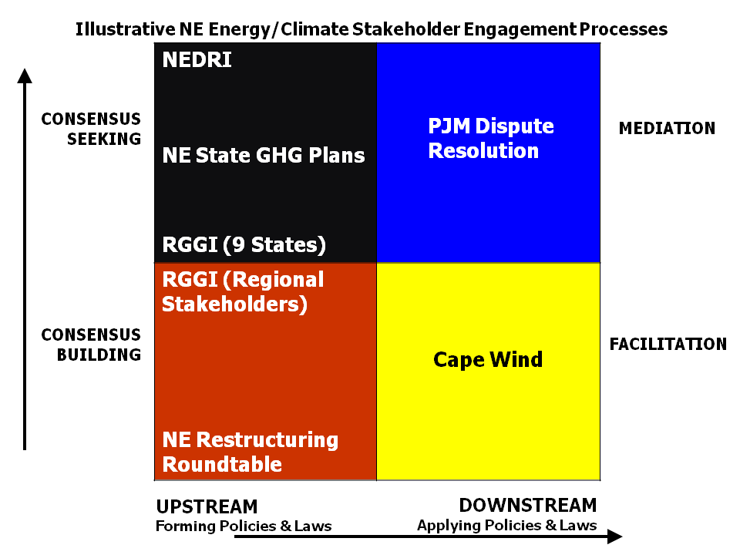
Illustrative NE Energy/Climate Stakeholder Engagement Processes

Slide 7
NE Electricity Restructuring Roundtable
Substance
  Unique forum to discuss “current” energy and now climate policy related issues in New England.
  Multiple perspectives shared, new ideas often road-tested.
Process
  Panels and keynote speakers on current issues/challenges
  143 Roundtables held so far! Have been meeting 5-10 times a year for 18+ years in Boston.
  Roundtable now averages over 200 participants per session plus 100 live streaming, with listserv of over 3,000 New England stakeholders.
  September 2014 Roundtable included US EPA Secretary Gina McCarthy; FERC Chairman Cheryl LaFleur; and ISO New England CEO Gordon van Welie

Slide 8
New England Demand Response Initiative (NEDRI)
Substance
  Developed 38 major recommendations for incorporating demand response into retail and wholesale markets in New England.
  Covered short-term price-responsive load, retail pricing and metering strategies, reliability-driven DR, and longer-term energy efficiency investments.
Process
  Included representative from 45 state and federal agencies, suppliers, consumers, and environmental organizations.
  Met for 19 days in plenary session in 2002-2003 (June); included several work groups—developed “consensus” report
  Funded by US EPA, US DOE, ISO-New England, the New York ISO, and the Energy Foundation
  Regulatory Assistance Project managed technical team (including LBNL/ORNL); Raab Associates facilitated the stakeholder process.
8

Slide 9
Regional Greenhouse
Gas Initiative-(RGGI)
Substance
  Developed a greenhouse gas cap and trade system for electricity sector in 10 Northeast and Mid-Atlantic states
  Reduces GHG emissions 10% below 1990 emissions by 2020, allows for offsets, and establishes a public benefits fund.
  2012 review resulted in decreasing 2014 cap 45%, with additional decreases of 2.5%/year 2015-2020.
Process
  Original RGGI Process: 24-member regional stakeholder group to provide “advice” and act as “sounding board” for states. Included separate resource panel; ICF and REMI ran energy system and economic modeling; Raab Associates facilitated—9 day-long meetings;
  Meanwhile, states negotiated MOU in separate, parallel process, signed in December 2005 by seven states (NY, NJ, VT, NH, CT, DE, and ME) and later joined by MD, RI, and MA.
9

Slide 10
NE States Develop 2020 Greenhouse Gas Plans
Using Stakeholder Processes
Substance
  Comprehensive plans covering buildings, transportation, electricity supply, solid waste, etc.
  Reduce GHG emissions by 10-25% below 1990 levels by 2020
Process
  States used stakeholder processes to develop plans in different ways—generally includes steering committee, working groups, extensive state involvement, technical consultants, and facilitation
  RI (2001-6); CT (2002-4); ME (2003-4); VT (2008); NH (2009); and MA (2010)

Slide 11
EPA Climate Protection Awards
2005—Rhode Island Greenhouse Gas Stakeholders—for the stakeholder process including plan development and implementation
2009—RGGI--recognizing RGGI as model for federal energy legislation, and each state as a climate leader

Slide 12
Engaging citizens, not just stakeholders…
Vermont’s Energy Future (2007)
  What energy supply options should VT pursue in the shadow of potential HQ contracts expiring and VT Yankee relicensing?
  Stakeholder group develops background/options, and polling questions
  5 regional citizen workshops, 800+ Vermonters, small group facilitated discussions, keypad live polling
  100+ random sample of Vermonters for Deliberative Polling weekend
New Hampshire Energy Facility Siting Process (2013)
  How should NH’s siting council and siting process be improved?
  Stakeholder advisory committee
  Stakeholder focus groups/polling
  5 regional citizen workshops, 300+ NH citizens, presentations, small group discussions, keypad live polling

Slide 13
VT REGIONAL WORKSHOPS
Which resource options do you think should be the highest or lowest priorities to meet Vermont’s future electricity needs considering all factors (cost, environmental attributes, reliability, etc.)?
Resource | High % | Low % | Difference | Rank
Energy Efficiency | 25% | 1% | 24% | 1
Wind | 22% | 2% | 20% | 2
Hydro | 15% | 0% | 15% | 3
Solar | 16% | 2% | 14% | 4
Wood | 8% | 2% | 6% | 5
Methane from farms or landfill | 7% | 2% | 5% | 6
Natural gas | 1% | 8% | -6% | 7
Nuclear | 6% | 24% | -19% | 8
Oil | 0% | 27% | -27% | 9
Coal | 1% | 32% | -32% | 10
13
mean n = 507
Notes:
13

Slide 14
Figure 12: Continue to Buy from VT Yankee?

Slide 15
Principles for Designing Meaningful Stakeholder Engagement on Climate and Energy Issues
Initiate consensus building/seeking as early as possible
Include all major legitimate stakeholder groups (either directly or through caucuses)
Consider ways of incorporating meaningful citizen input during the process
Do not exclude contentious or sensitive issues from stakeholder process
Seek as much agreement as possible

Slide 16
Principles for Designing Meaningful Stakeholder Engagement on Climate and Energy Issues
6. Use a joint-fact finding framework wherever possible
Structure stakeholder process to supplement traditional (and state by state) regulatory & adjudicatory processes, while modifying the traditional processes to better accommodate the stakeholder processes
Choose your convener(s) carefully--government entities or other trusted/respected entities (foundations, academia, etc.)
Provide adequate resources—consulting, modeling, meeting space/logistics
9. Use a professional facilitator/mediator to help design and run the process

Slide 17
Envisioning 80% by 2050 in New England
Has Begun…
NE Governors/Eastern Canadian Premiers set target—75-80% by 2050, and some states establishing in legislation
State GHG plans primarily focused on 2020 to date, but can be expanded beyond 2020—as can RGGI
Acadia Center Energy Vision 2050 and The Solutions Project—already lay out potential pathways to 2050 in NE
MA GWSA Implementation Advisory Committee; and Barr retreat w/advocates, MA/Boston began dialogue
However, no formal process in place for to develop 2050 road-map while engaging stakeholders and citizens

