Slide 1
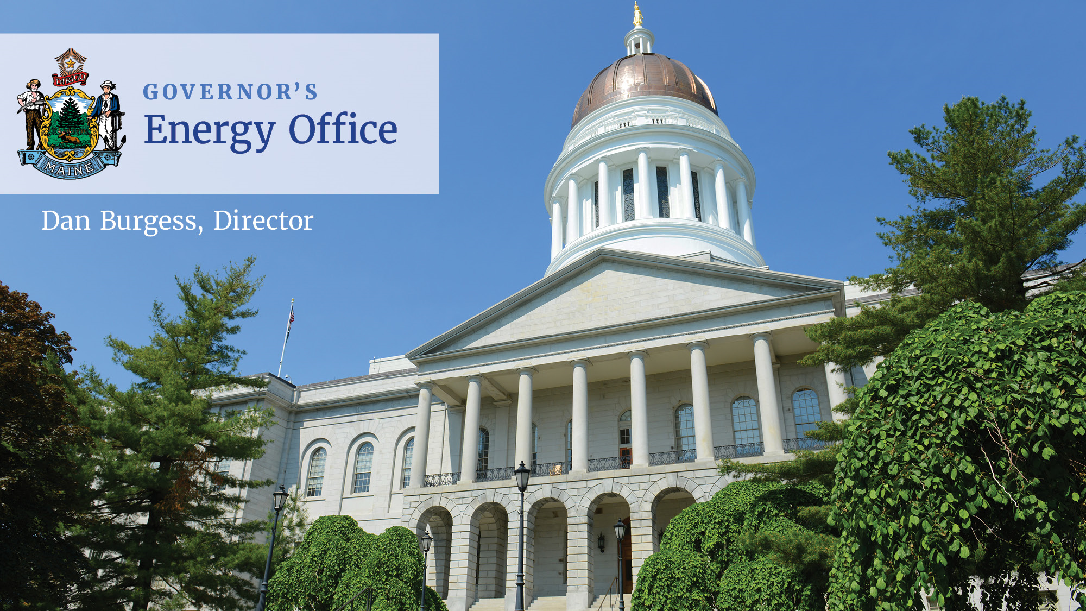

Slide 2
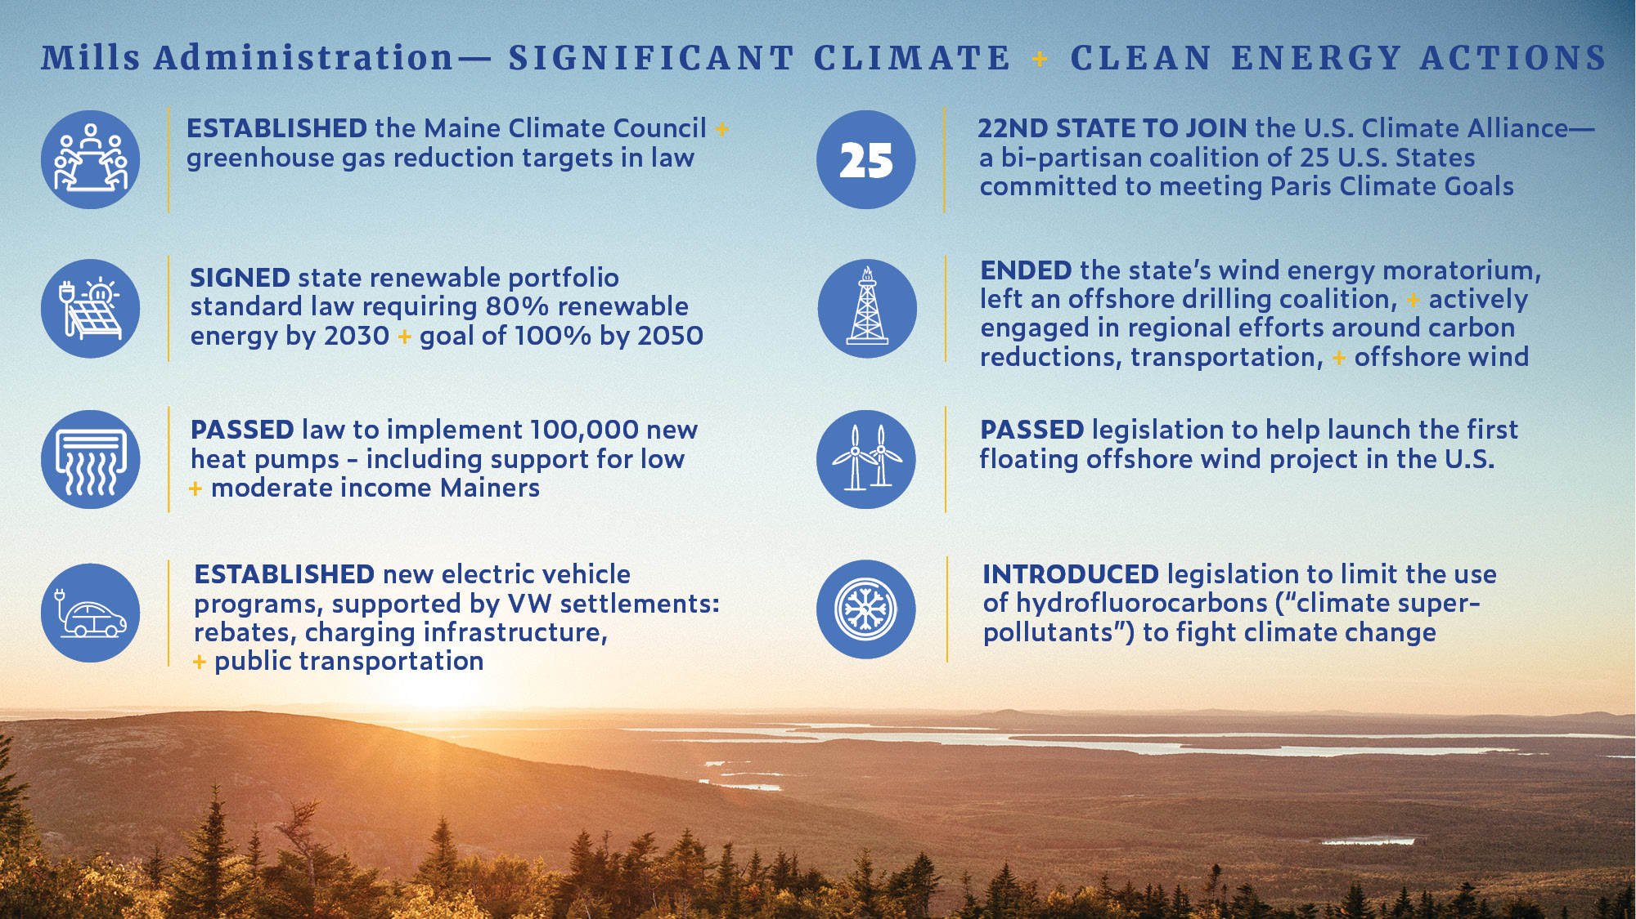

Slide 3
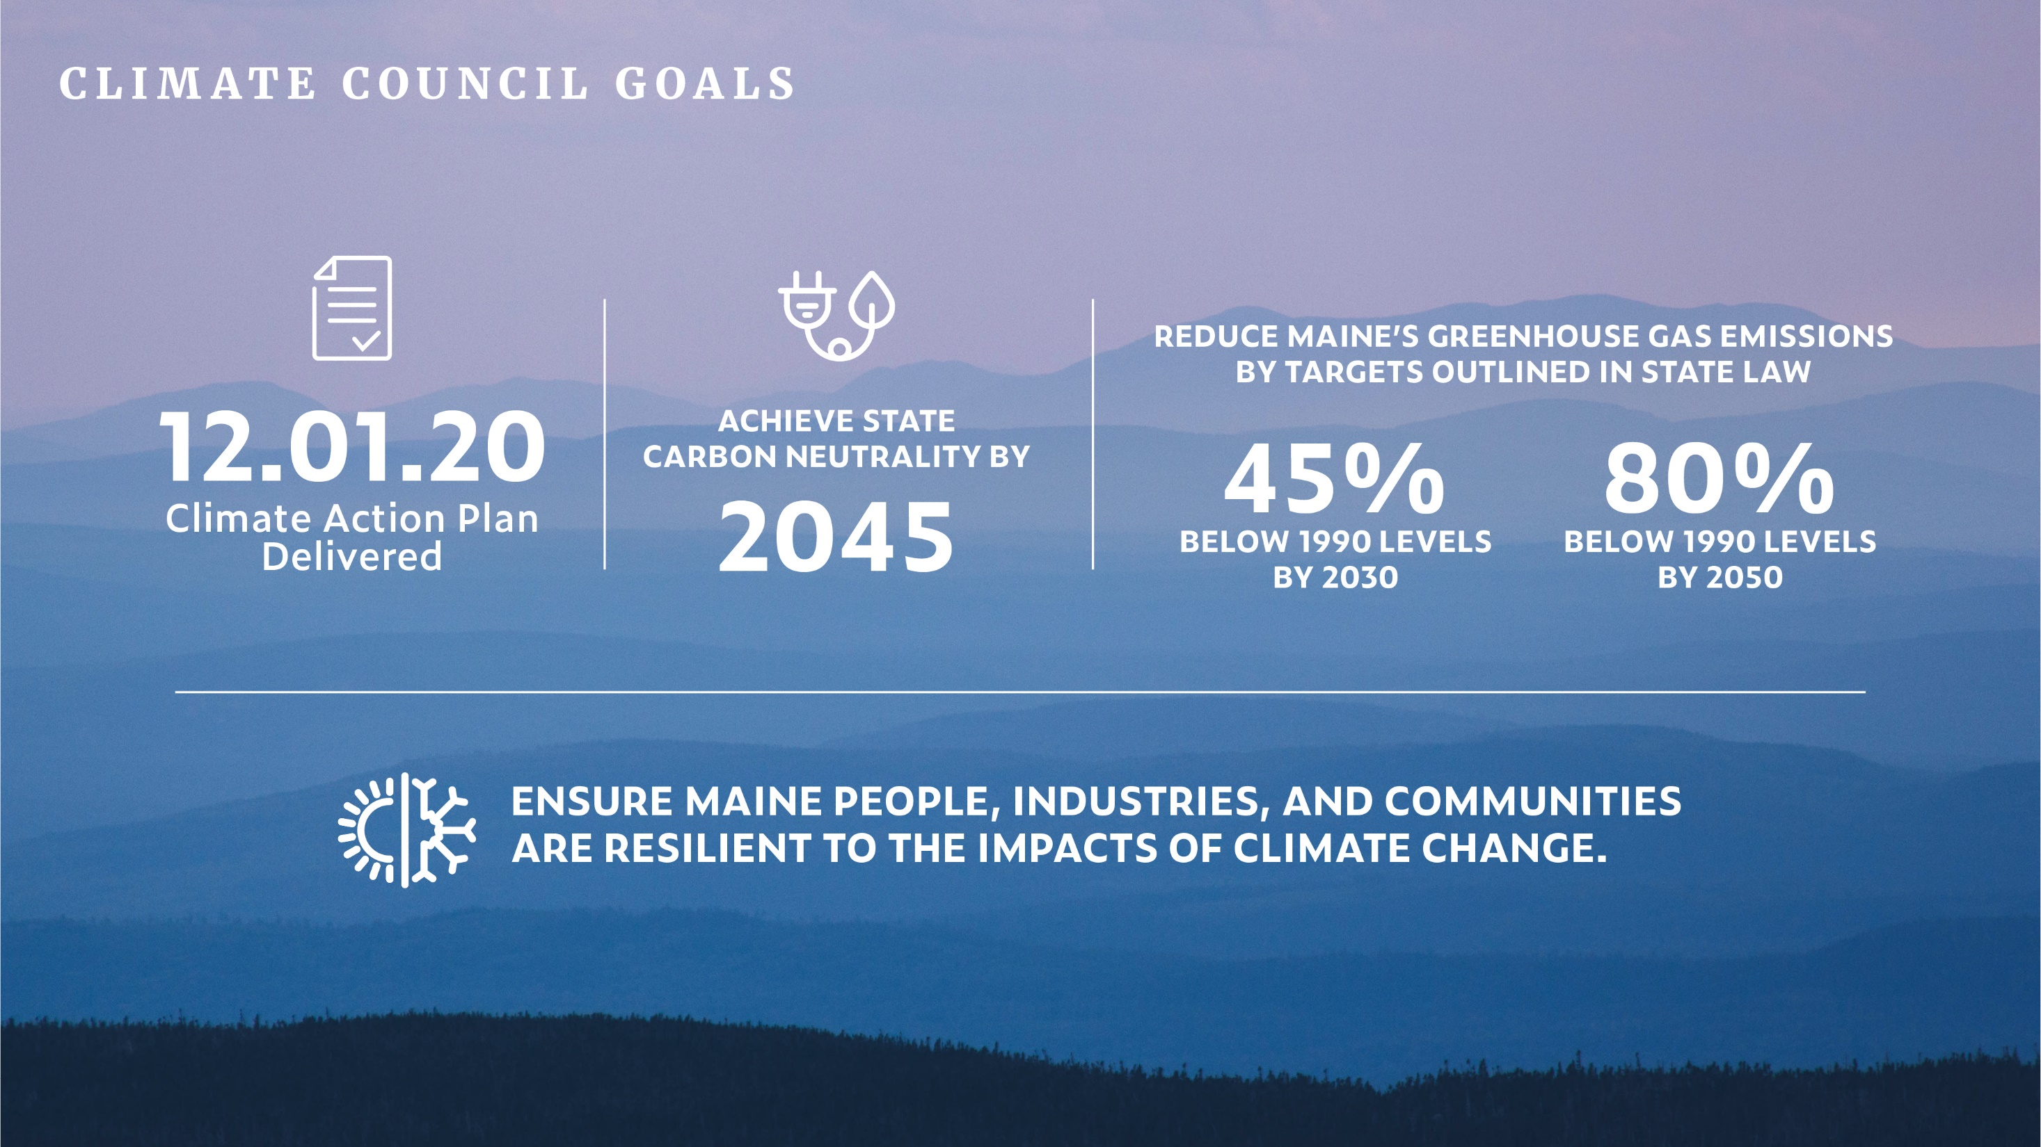
Notes:
The same legislation established two ambitious GHG reduction targets
And instructions to ensure the state also builds resilience to impacts of CC
The MCC is charged with developing the plan to meet these targets and goals.
The first plan is due this December 1st.

Slide 4
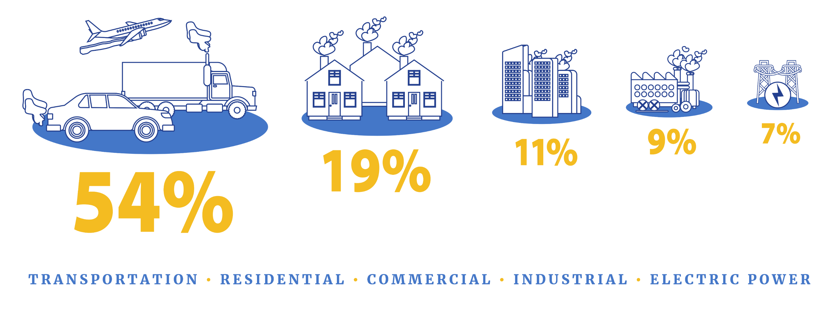
In Maine, most greenhouse emissions come from transportation, followed by residential, commercial and industrial sources. Finding ways to reduce them is a key goal of the Climate Council.
Data source: Maine Department of Environmental Protection 8th Biennial Greenhouse Gas Emissions Report
climatecouncil.maine.gov
Notes:
¾ of GHG emissions from transp and building heating
In a moment you will see that a number of proposed strategies aim to reducing reliance on combustion of fossil fuels through efficiency and weatherization, and by electrifying transp and building heating and cooling

Slide 5

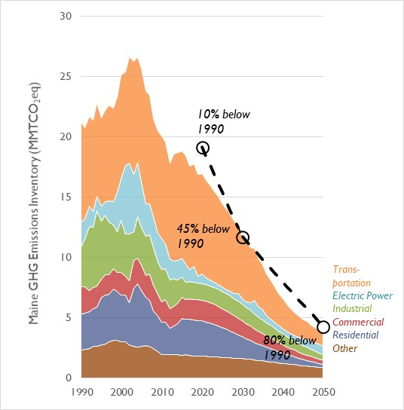
Potential Emission Reduction Pathway
Metric​ | 2025 Outcome​ | 2030 Outcome​
Number of EVs or equivalent clean cars​ | 41,375​ | 219,271​
EV Share of New Light-Duty Vehicle Sales​ | 28%​ | 85%​
Clean/EV Share of New Heavy-Duty Sales​ | 2%​ | 4%​
Renewable Energy on Maine's Electricity Grid​ | ​ | 80%​
Homes weatherized​ | 20,000​ | 40,000​
Reduction in Light-Duty VMT per Vehicle​ | 10%​ | 20%​
Number of Households with Retrofit Heat Pumps (installed after 2018)​ | 80,151 ​ | 130,419 ​
Number of Households with Whole Home Heat Pump Systems​ | 34,607 ​ | 115,636 ​

Slide 6








Maine’s 8 Climate Action Strategies
A. Embrace the Future of Transportation
in Maine
D. Grow Maine’s Clean Energy Economy and Good Jobs
G. Invest in Climate-Ready Infrastructure
E. Protect Maine’s Environment and Working Lands and Waters, Increase Carbon Sequestration
H. Engage People and Communities
in Climate Impacts
and Program Opportunities
B. Modernize Maine's Buildings
C. Reduce Carbon Emissions the Energy and Industrial Sectors through Clean Energy Innovation
F. Build Healthy and Resilient
Communities

Slide 7


Heat Pumps - Cumulative Forecast through 2025
Goal: 100,000 New
Heat Pumps by 2025

Slide 8
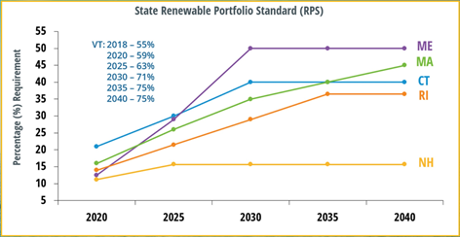
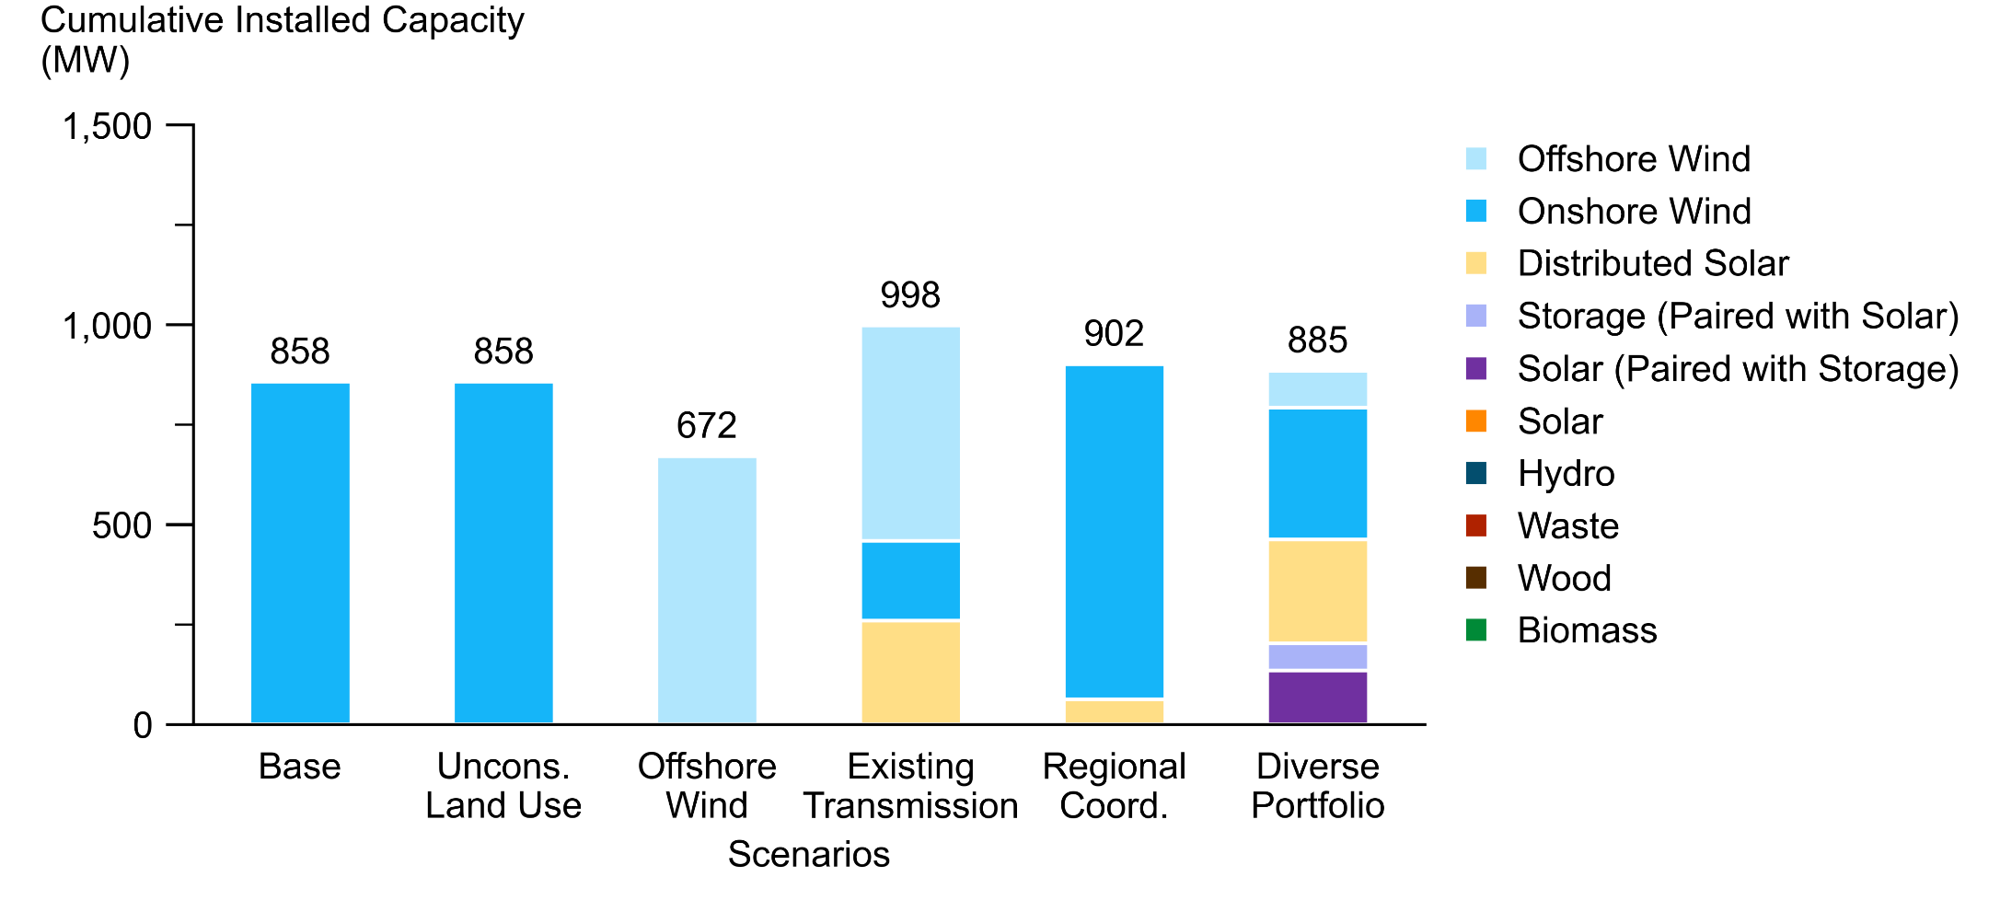


Maine Renewable Energy Goals Market Assessment
Key Findings
Maine is on track to meet its near-term RPS goals through 2026; new resources will need to be online to meet increasing goals thereafter
Transmission will be a key driver of renewable development
Storage paired with solar provides value to Maine’s grid
A technologically diverse portfolio helps lower risk
  - Offshore Wind, Onshore Wind, Solar, Solar+Storage
Regional coordination on building transmission can help lower the costs of meeting Maine’s RPS
Energy equity benefits and challenges cut across four dimensions: resource diversity, customer-sited resources, geographic resource distribution, and cost.
Source: ISO New England

Slide 9
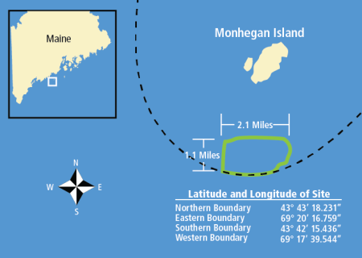
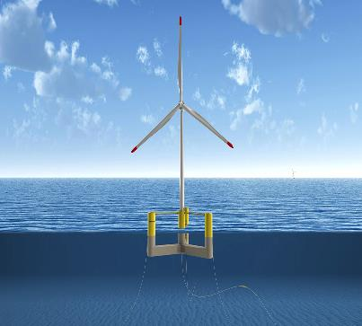
Renewable Energy Activity (Strategy C)
RPS Procurements
  Tranche 1 Bid Selections
  - 17 renewable projects ~9.5% of State electric load); 546 MW selected; (solar, wind, biomass, hydro)
  - 450+ jobs (FTE) during construction; Initial capital spending of $145+ million
  Tranche 2 (Issued January 2021)
  - Roughly 4.5% of State electric load; Bids were due March 2021
Distributed Generation
- Net Energy Billing
Offshore Wind
- Maine Offshore Wind Initiative and
Offshore Wind Roadmap ($2.1 million from US EDA)
- New England Aqua Ventus Demonstration Project
- Floating Offshore Wind Research Array
- Searsport Infrastructure and Market Potential Assessment
Maine Legislative Session Underway

Slide 10
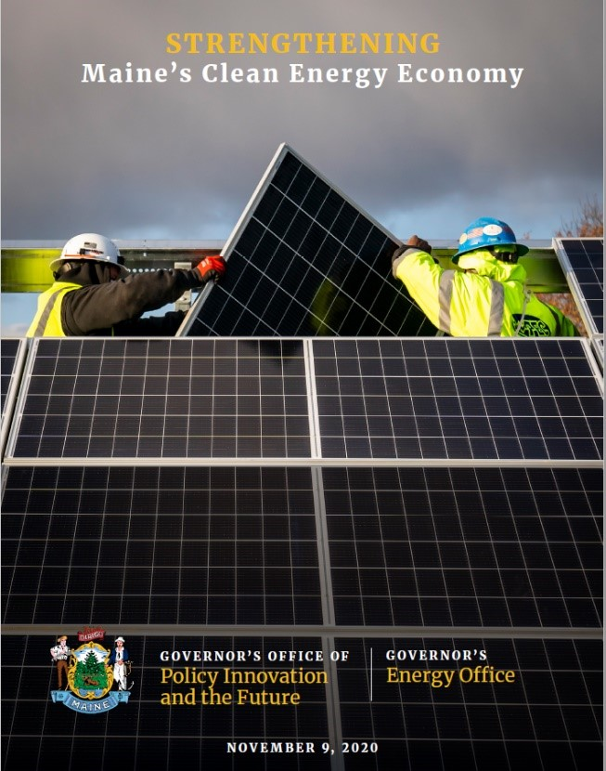
Strengthening Maine’s Clean Energy Economy
Strengthening Maine’s Clean Energy Economy, published in November of 2020, is a detailed analysis of the momentum within Maine’s clean energy economy, and how the sector is emerging as a source of economic growth and workforce opportunities. Strategies focus on:
- Policy and Program Development
- Workforce Development and Recruitment
- Support and Promote Cleantech Innovation
- Incorporate Equity and Just Transition
Governor Mills’ goal:
30,000 clean energy jobs by 2030

Slide 11

Thank You
Dan.Burgess@maine.gov
www.maine.gov/energy

