Slide 1
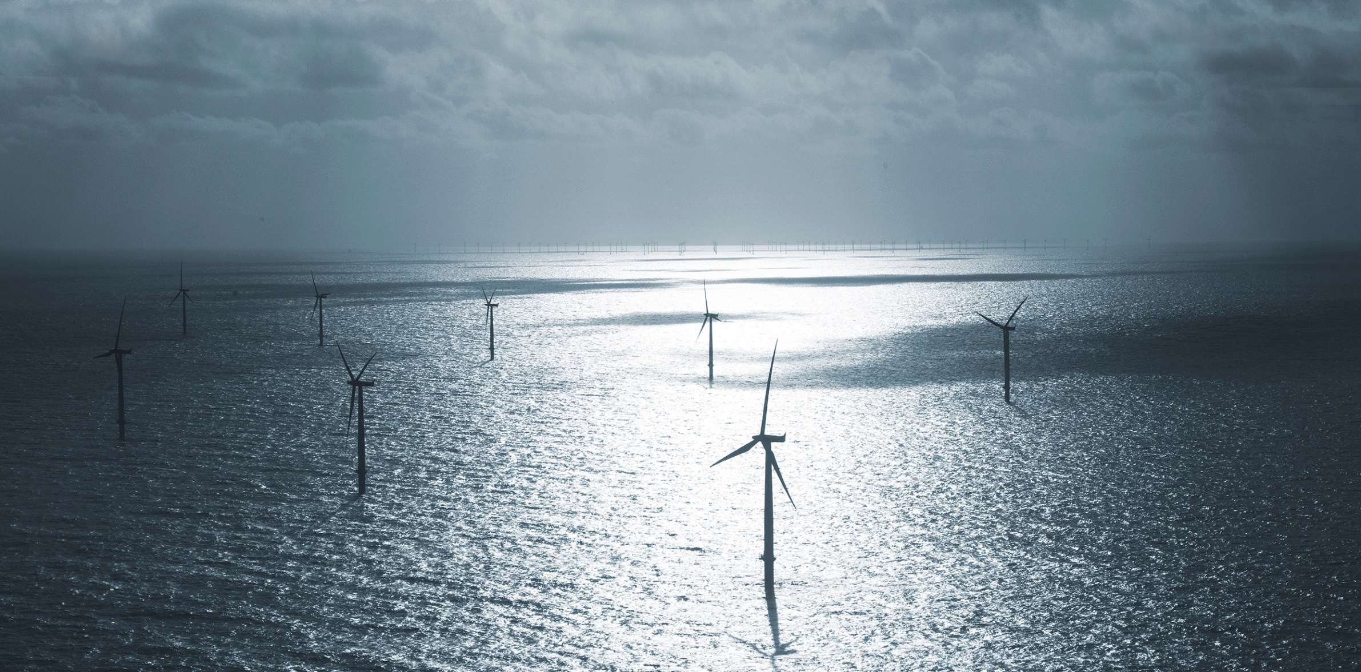
Offshore wind power New england Electricity Restructuring Roundtable
Thomas Brostrøm, General Manager U.S.
May 18th 2016

Slide 2
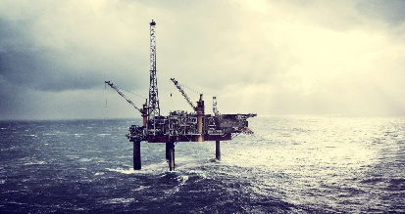
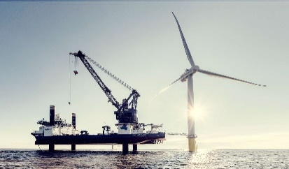
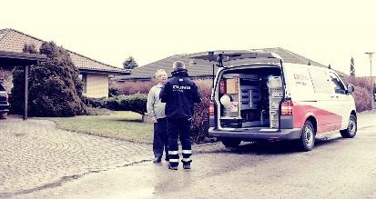
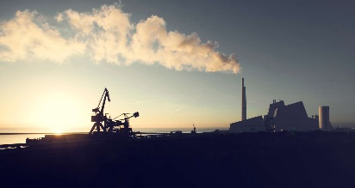
DONG Energy at a glance
EBITDA 2015 USD bn
DONG Energy
Oil & Gas
Wind Power
Distribution & Customers Solutions
Bioenergy & Thermal Power
2.8
1.5
1.0
0.3
0.1
Energy group operating in Northwestern Europe
Revenue of 11 USDbn
Employs 6,700 FTEs
Oil and gas exploration and production
Production of >100 kboe/day
Strong North Sea and West-of-Shetlands platform
Development, construction and operation of offshore wind farms
Global leadership position
Strong visibility on pipeline towards 2020
Strong portfolio for post 2020
Private and commercial gas & power sales, and distribution
Long-term gas contracts
LNG business
Centralised commodity management
Electricity and heat generation from power stations
Leading Danish power generator, ~44% of thermal capacity
Replacing coal and gas with biomass in Danish plants
Exchange rate used: 1 DKK = 0.15 USD

Slide 3
DONG Energy Wind Power
Wind power
DONG Energy Installed Pipeline Capacity
MW
6.5x
CORE BUSINESS
Development, construction and operation of offshore wind
Approx. 2,350 employees dedicated to offshore wind
Over 20 years of experience
MARKET POSITION
Global market-leader
Has constructed over 26% of global offshore wind capacity
17 projects under operation (3GW)
5 projects under construction (3.3GW)
11 projects under development (>5GW)
On track to meet 2020 target of 6.5GW installed
2010
2011
2012
2013
2014
2016
2020
DONG Energy Cost Reduction Target
EUR/MWh (real 2012)
-35-40%
2012
2014
2016
2020

Slide 4
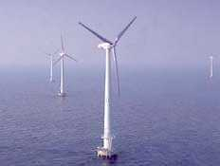
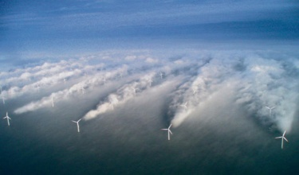
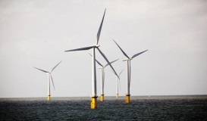
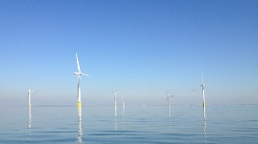
DONG Energy is building on +20years of offshore wind experience
Total constructed capacity by DONG Energy, (MW)
Race Bank
573 MW
Hornsea 1
1,218 MW
Gode Wind
582 MW
Burbo Bank Ext.
258 MW
Walney Ext.
660 MW
6,500 MW
Horns Rev 2
209 MW
London Array¹
315 MW
Westermost Rough
210 MW
Borkum Riffgrund 1
312 MW
Horns Rev 1
160 MW
Barrow
45 MW
Gunfleet Sands
173 MW
Walney I + II
367 MW
Anholt
400 MW
West of Duddon Sands²
389 MW
3,009 MW
Middelgrunden
40 MW
Nysted
166 MW
Burbo
90 MW
2,487 MW
2,098 MW
Vindeby
5 MW
1,371 MW
476 MW
1,004 MW
5 MW
50 MW
1990
2000
2005
2010
2012
2013
2014
2016
2017
2018
2019
2020
Examples
Vindeby
First offshore wind farm in the world
Horns Rev 1
First large scale offshore wind farm in the world
London Array
The largest operational offshore wind farm in the world
Hornsea 1
The world’s largest offshore wind farm once constructed
5 MW
160 MW
630 MW
1,218 MW
Note 1: London Array was constructed by a consortium owning the wind farm. DONG Energy was a 50% owner during construction
Note 2: West of Duddon Sands is structured as an unincorporated join venture. The construction of the wind farm was lead by DONG Energy

Slide 5
DONG Energy is the global leader in offshore wind with a unique pipeline of future projects
Bay State Wind
Ocean Wind
Anholt
Walney 1 + 2
Horns Rev 1 + 2
Middelgrunden
Walney Ext.
Westermost Rough
West of Duddon Sands
Hornsea 1
Vindeby
Hornsea 2 + 3
Nysted
Isle of Man
Race Bank
Gode Wind 2
Lincs
Gode Wind 3
Barrow
Gunfleet Sands 1 + 2
Gode Wind 1
Burbo Bank Ext.
Borkum Riffgrund 1
Burbo Bank
Borkum Riffgrund 2
Gunfleet Sands 3
Borkum Riffgrund West 1+ 2
London Array 1
In operation
Courseulles-sur-Mer
Fécamp
Under construction
Under development
Saint-Nazaire

Slide 6
Transformation of European power generation
Significant build-out of renewables expected to continue towards 2030
Bioenergy 6%
Other renewables 3%
Solar PV 5%
Other renewables 1%
Wind 7%
Bioenergy 7%
11%
1%
16%
12%
7%
28%
32%
41%
12%
Wind 19%
9%
2.6 PWh
3.2PWh
3.4PWh
23%
16%
12%
31%
2%
27%
20%
1990
2013
2030
Coal
Nuclear
Oil
Gas
Hydro
Renewables

Slide 7
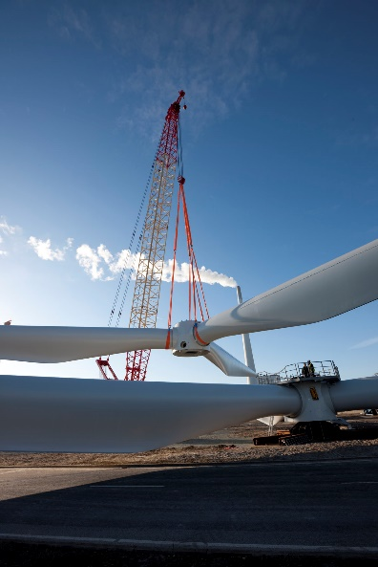
Offshore wind is a fast growing new energy technology industry
Installed capacity in Europe by end of 2015
MW
Offshore wind is a part of the strong Danish wind industry
11.027
Full-time Employment: 30,000
Gross Revenue in Denmark: 84.4 bn DKK (~13 bn USD)
Export: 53.5 bn DKK (~ 8.2 bn USD)
5.061
3.295
1.271
UK
DE
DK
BE
NL
SE
Rest of Europe
Total
Constructed by other developers
Constructed by DONG Energy
Source: EWEA, 2015 and DONG Energy
Source: Danish Wind Industry Association, 2015. Data for 2014

Slide 8
Why Offshore Wind?
Beneficial to developing a US market?
Reason
Description
Can be deployed on a large scale..
✓
Can be deployed at a large scale providing:-
Greater economies of scale,
More efficient development ($/MW),
Faster deployment of capacity.
Reliable and increasingly so..
✓
Capacity factors of close to 50% in Denmark and UK.
Future capacity factors of above 50%.
Costs are falling, and fast..
✓
DONG Energy’s target of €100/MWh¹ (approx. $110/MWh) for projects taking final decision in 2020.
Recent auction prices were 27% and 32% lower than previous projects in UK and DK.
Jobs are created..
✓
A typical DONG Energy project will create up to:-
1,000 jobs during construction,
100 jobs during 25 year operation phase.
1) Euro 2012 (real)

Slide 9
Why USA?
Driver
USA
Description
World Class Offshore Wind Areas
✓
Large federal designated lease areas
World class site conditions
Pre-permitting work by BOEM
Further-from-shore projects
An Energy
System in Transition
✓
Energy system under transition
Significant capacity retirements
Desire for clean, reliable, local energy
Promising Legislative Agenda
✓
Draft diversified energy bill in MA including offshore wind specific element
Legislation in New Jersey
BOEM New York Auction
Timing encouraging

Slide 10
The US is a market full of opportunities
WHAT DOES THE MARKET LOOK LIKE?
US Presents Attractive New Market
Good site characteristics (similar to Europe)
Decommissioning of capacity (coal, oil & nuclear)
Legally binding renewable energy targets (state level)
Load centres along the coast line
Energy security issues
Offshore wind lease planning through Bureau of Ocean Energy Management (BOEM)
National Renewable Energy Laboratory (NREL) Offshore Wind Resource Maps
ISO New England Economic Study of Offshore Wind
Maine
Oregon
New York
Massachu-
setts
New Jersey
Rhode Island
Illinois
Maryland
Delaware
Virginia
North Carolina
South Carolina
Hawaii
State with Offshore Wind Activity
State with Offshore Wind Plans
*Bureau of Ocean Energy Management (“BOEM”), similar to The Crown Estate in the UK

Slide 11
By 2025 offshore wind will be truly global…
Strong growth in established and new offshore wind markets
Installed Capacity, GW
+8 GW
15%
82.7
+6 GW
28%
40.4
+1 GW
35%
11.7
0.9
0.4
2004
2015
2020
2025
New markets
Europe
#
GW addition/year
%
CAGR
Source: Bloomberg New Energy Finance (BNEF), H1 2016 offshore wind market outlook

Slide 12
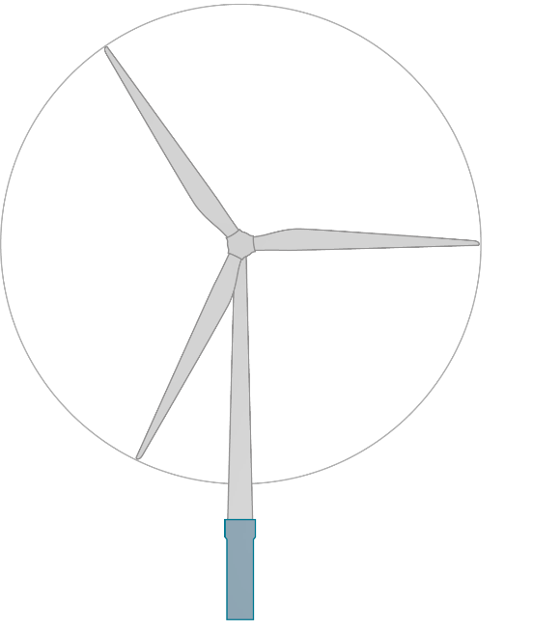
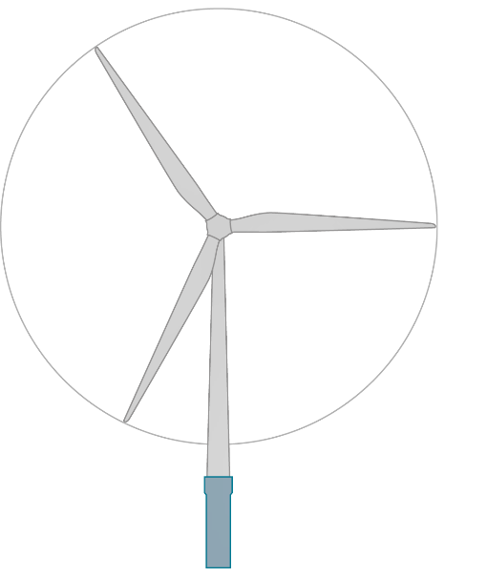
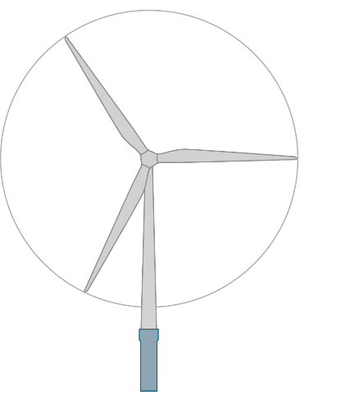
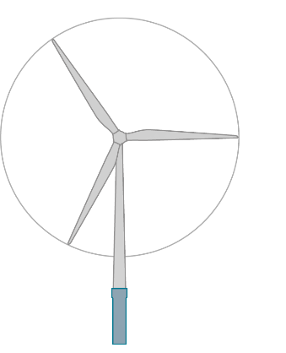
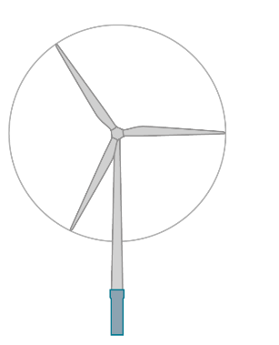
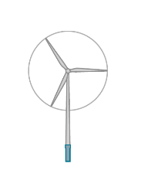
Industry evolution in perspective; wind turbines
AIRBUS A380 - 800
Wing span: 79.8 m (261 ft.) Length: 72.7 m (238 ft.)
Height: 24.8 m (79 ft.)
Capacity: 555 passengers
DONG Energy wind farms | 1991 | 2001 | 2010 | 2013 | 2015 | 2017
Turbine capacity | 0,45 MW | 2 MW | 2,3 MW | 3,6 MW | 6 MW | 8 MW
Rotor diameter | 35 m | 76 m | 93 m | 120 m | 154 m | 164 m
Hub height from water level | 35 m | 64 m | 68 m | 81,6 m | 102 m | 105 m

Slide 13
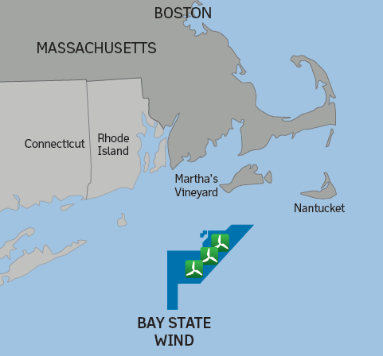
Introducing Bay State Wind…
100% DONG Energy ownership
+1,000MW capacity
15 nautical miles from Martha’s Vineyard
Connecting into Massachusetts
Water depths 40-60m (130-160ft)

Slide 14
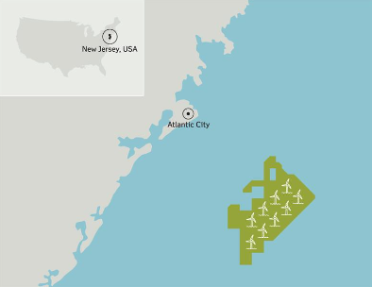
Introducing Ocean Wind…
DONG Energy will take over project rights, following BOEM approval
+1,000MW potential capacity
10 nautical miles from shore
Connecting into New Jersey
Water depths 20-30m

Slide 15
