Slide 1
Connecting the Dots:
Policy, Markets and the Clean Energy Future
New England Restructuring Roundtable
Boston, MA
September 30, 2016

Slide 2
Northeast Clean Energy Council
NECEC’s mission is to create a world-class clean energy hub in the Northeast delivering global impact with economic, energy and environmental solutions.
NECEC helps clean energy companies start, scale and succeed with our unique business, innovation and policy leadership.

Slide 3
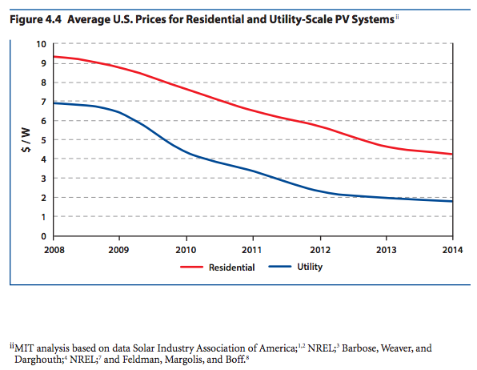
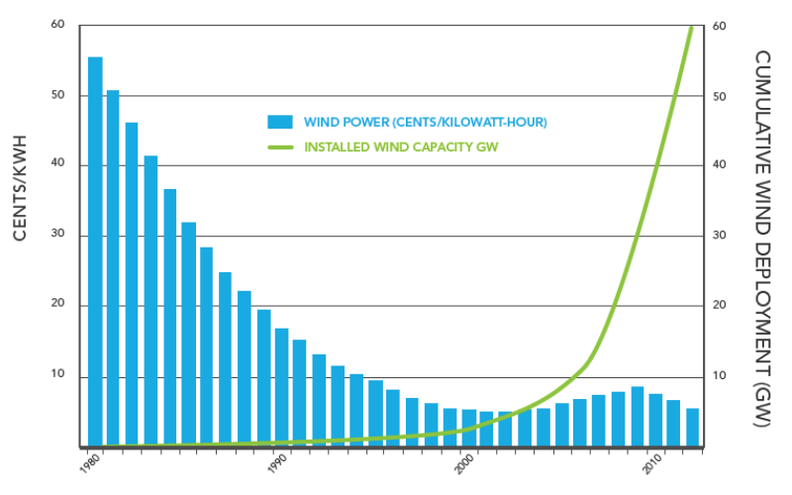
Advancing Clean Energy
Changing electricity industry
New customer expectations
  Driven by
    Fundamental economics
    Technology innovation
3

Slide 4
Public policy
Renewable Portfolio Standards
www.dsireusa.org / August 2016
WA: 15% x 2020*
ME: 40% x 2017
ND: 10% x 2015
NH: 24.8%x 2025
MT: 15% x 2015
MN:26.5%
x 2025 (IOUs)
31.5% x 2020 (Xcel)
VT: 75% x 2032
OR: 50%x 2040*
(large utilities)
MA: 15% x 2020(new resources)
6.03% x 2016 (existing resources)
SD: 10% x 2015
WI: 10% 2015
MI: 10% x 2015*†
NY:50% x 2030
RI: 38.5% x 2035
IA: 105 MW
CT: 27% x 2020
IN: 10% x 2025†
OH: 12.5% x 2026
NJ: 20.38% RE x 2020
+ 4.1% solar by 2027
NV: 25% x
2025*
UT: 20% x 2025*†
IL: 25% x 2026
CO: 30% x 2020 (IOUs) *†
VA: 15% x 2025†
PA: 18% x 2021†
CA: 50%
x 2030
KS: 20% x 2020
MO:15% x 2021
DC
DE: 25% x 2026*
NC: 12.5% x 2021 (IOUs)
MD: 20% x 2022
NM: 20%x 2020 (IOUs)
OK: 15% x 2015
DC: 20% x 2020
AZ: 15% x 2025*
SC: 2% 2021
TX: 5,880 MW x 2015*
29 States + Washington DC + 3 territories have a Renewable Portfolio Standard
(8 states and 1 territories have renewable portfolio goals)
U.S. Territories
HI: 100% x 2045
NMI: 20% x 2016
Guam: 25% x 2035
PR: 20% x 2035
USVI: 30% x 2025
*
Renewable portfolio standard
Extra credit for solar or customer-sited renewables
Renewable portfolio goal
†
Includes non-renewable alternative resources
4

Slide 5
CE Meets Multiple Objectives
Energy benefits
  Diversity, security, reliability, resiliency
Environmental benefits
  GHG and other pollutant reductions
Economic benefits
  Jobs and investment, efficiency
5

Slide 6
Policy Is Shaped by Objectives
Distributed energy resources (DER) incentives
  Local economic development – jobs
  Customer choice, managing bills and usage
Grid-scale clean energy long-term contracts (LTCs)
  Meeting GHG requirements
  Diversifying supply
Offshore wind
  Potential to be at beginning of “energy pipeline”
  Diversity, GHG reductions and jobs
New technologies – e.g., storage
  Efficiency (reducing costs)
  Resiliency (integrating DER, enhancing reliability)
6

Slide 7
Connecting the Dots –
Policy & Markets
Policy and markets inextricably linked in electricity industry
  Public utilities
  “Imbued with public interest”
  Electricity is necessity of modern life
Not a choice between policy and markets
  Any IMAPP mechanism(s) should not replace state policies but rather align markets with policies
Policies create markets and provide a long term sustainable framework when they rely on market mechanisms
  E.g., RPS, RGGI (and competitive LTCs)
(And markets rely on policies – e.g., capacity market to provide revenues foregone in capped price energy market)
7

Slide 8
Connecting the Dots – Dx & Tx
To capture value of clean energy for system & customers
Distribution – grid modernization “policy” to enable DER markets
  Reduce costs
  Improve system efficiency
  Enhance reliability and resiliency
  Integrate DER
Transmission – to deliver grid scale clean energy to load
  [Big] factor in MA procurement and tri-state RFP
Funding investment – evaluating benefits and costs (and to whom)
8

Slide 9
Other Connectors
Regulatory framework needs to align utility and customer and public policy interests
Power flows – two-way
Information/data flows – two-way
  Customer usage
  System status
Dollar flows – cost recovery
  Distribution – state by state
  Transmission – regional/federal
Rate design
  Timely, actionable information to customers
  Revenues to cover costs to utilities
9

Slide 10
Evolving Policy to Markets
Build on existing policy
  Incentives reduced over time as technology matures
  Support new, emerging technologies to maturity
Move beyond regulated utilities as vehicle for policy
  E.g., “Corporate renewables” – large customers and aggregations of customers buying clean energy
  Customers and communities want choices
Spur innovation
  Allow utility RD&D and demonstration projects
  Provide access to system and customer information so 3rd parties can provide solutions
10

Slide 11
Interconnecting Policy & Markets
Essential to achieve policy goals
  Clean energy
  GHG reductions
  Economic development
Essential for efficient functioning of markets
  Creating demand
  Enabling supply
Recognize fundamental drivers
  Economics, technology and policy
11

