Slide 1
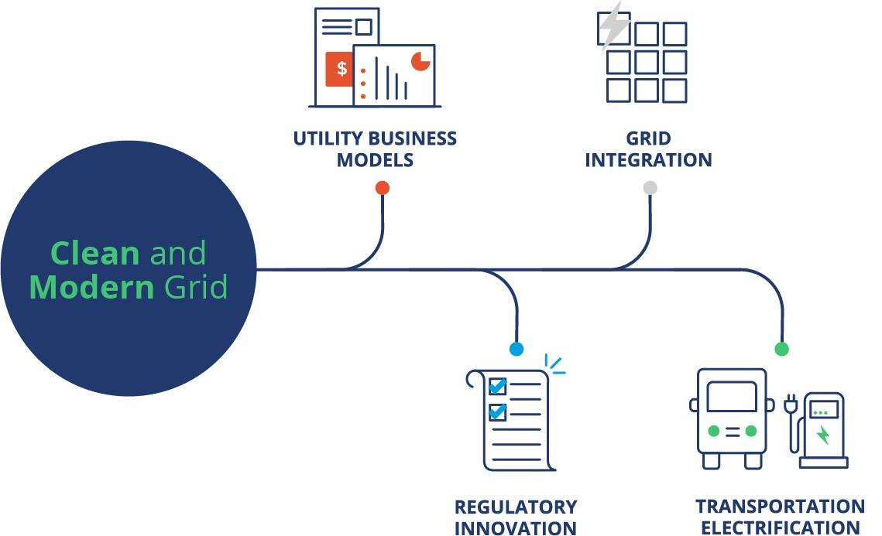
DER Policy Evolution
Janet Gail Besser
Managing Director,
Regulatory Innovation &
Utility Business Models
New England Electricity Restructuring Roundtable
December 13, 2019

Slide 2
SEPA Mission
SEPA’s mission is to facilitate the electric power industry's smart transition to a clean and modern energy future through education, research, standards and collaboration.
Notes:
SEPA is a national not for profit alliance of over 1,150 members made up of utilities, technology solution providers, regulators, research centers and government entities -- the full ecosystem taking part in the energy transition underway.
Our vision is a carbon free energy future by 2050.
We are dedicated to facilitating the electric power industry’s smart transition to a clean and modern energy future. We do this through research, standards development and educational offerings.

Slide 3
SEPA’s Pathways
Tackling the Most Daunting Challenges the Electricity Sector Faces Today
Utility Business Models
Utilities need sustainable business models and practices to allow the utility to serve customers in new ways based on their evolving needs.
Regulatory Innovation
State regulatory processes must be flexible and agile, enabling the timely and effective deployment of new technologies, partnerships and business models.
Grid Integration
Clean energy must be easily integrated and result in maintained or improved levels of affordability, safety, security, reliability, resiliency and customer satisfaction.
Transportation Electrification
The nation’s fleet of light, medium and heavy-duty vehicles should be powered by carbon-free electricity.
Notes:
SEPA has identified four areas of focus, or pathways, to help guide the industry at large toward achieving their bold goals.
Need to ensure that the utility business model can evolve to facilitate and orchestrate these new solutions. Sustainable models and practices to allow the utility to serve customers in new ways based on their evolving needs.
And state and regional regulatory processes must become more nimble to enable the timely and effective deployment of these technologies - allowing for more outside of the box solutions and creative partnerships
While greater access to affordable technology solutions will have a tremendous impact on the growth of clean energy, we must ensure that these solutions are easily integrated into our physical and cyber infrastructures. A flexible, coordinated grid that can aptly handle two-way flow of energy and DERs without sacrificing reliability or impacting cost.
And finally, must acknowledge the growing nexus between our transportation and stationary electricity needs as electric vehicles become a viable reality and a potential resource to the grid. Having a plan in place to use EVs as a grid asset.
BUSINESS MODELS, REGULATORY INNOVATION / POLICYI, GRID INTEGRATION ARE INTERTWINED….

Slide 4
Renovate Initiative
The Renovate mission is to spur the evolution of state regulatory processes and practices to enable innovation, with a focus on scalable deployment of new technologies and operating models, to meet customer needs and increasing expectations while continuing to provide all with clean, affordable, safe, and reliable electric service.

Slide 5
Contact Information
Janet Gail Besser
Managing Director,
Regulatory Innovation and
Utility Business Models
202-552-4411
jbesser@sepapower.org

