Slide 1

Secretary Matthew Beaton
New England Electricity Restructuring Roundtable
Friday, March 24, 2017
Notes:
Good morning and thank you for having me at the Raab New England Electricity Restructuring Roundtable.
I am Matthew Beaton, Secretary of the Massachusetts Executive Office of Energy and Environmental Affairs and on behalf of Governor Baker and Lt. Governor Polito, I am excited to be here to discuss the impressive progress the Commonwealth has made over the last couple of years in growing our clean energy sector and supporting innovation.
One of our mission at EEA is to create a clean, affordable, resilient energy future for Massachusetts.
We are developing a comprehensive energy portfolio, or as Governor Baker likes to call it a “combo platter”, that includes:
Clean hydroelectric power
On-shore and off-shore wind
Solar
Energy efficiency and demand response
And new grid technologies such as energy storage.

Slide 2

Clean Energy Legislation
“An Act Relative to Energy Diversity”
  Governor Baker signed bi-partisan, comprehensive energy diversification legislation on August 8, 2016.
  Among other things, the legislation:
    Requires utilities to competitively solicit and contract for approximately 1,200 megawatts (MW) of clean, baseload hydroelectric generation;
    Allows for the procurement of approximately 1,600MW of offshore wind generation;
    Directs DOER to determine if an energy storage procurement target is prudent and, if so deemed, to set a target;
    And establishes definition for energy storage and clarifies that utility ownership of storage is permissible.
Notes:
Working with our partners in the Legislature, Governor Baker signed bi-partisan, comprehensive energy diversification legislation on August 8, 2016.
This legislation comes on the heels of 18 months of work by Governor Baker and our energy teams to work with our partners in the legislature to pass legislation that secures Massachusetts’ energy future.
Consistent with the Baker-Polito Administration’s previously filed legislation authorizing the procurement of hydropower generation, An Act Relative to Energy Diversity requires utilities to competitively solicit and contract for approximately 1,200 megawatts (MW) of hydropower by 2022.
In addition to recognizing the necessity of hydropower generation to provide reliable generation to meet Massachusetts’ energy demand and achieve the greenhouse gas emissions goals of the Global Warming Solutions Act, the legislation signed by Governor Baker allows for the procurement of approximately 1,600MW of offshore wind by 2027.
Additionally, the legislation:
Directs DOER to determine if an energy storage procurement target is prudent and, if so deemed, to set a target;
Clarifies the definition of energy storage and that utility ownership of storage is permissible;
Establishes a commercial Property Assessed Clean Energy (PACE) program;
And instructs the DPU and DEP to establish an investigation into the impacts of Grade 3 natural gas leaks.

Slide 3


Clean Energy Legislation
“An Act Relative to Energy Diversity”- Hydro
  Utilities are required to competitively solicit and procure long term contracts for approximately 1,200 MW of clean energy generation – base load hydropower, onshore wind and solar supported by hydropower, standalone onshore wind, solar, or other Class I renewable resources.
  Independent Evaluator for 83C and 83D procurements hired
  The RFP is at the DPU for review
  Solicitations by April 1, 2017
  Contracts by December 31, 2022
Notes:
With the signing of this legislation, Massachusetts utility companies now have the authority and mandate to procure clean, baseload hydroelectric generation for the first time.
That generation can include:
base load hydropower,
onshore wind and solar firmed by hydropower,
standalone onshore wind, solar, or other Class I renewable resources.
Hydroelectric power provides:
Clean and reliable generation that is available 24/7 and can replace some of the baseload generation the region is set to lose;
Is readily available to meet our regional energy demand;
And will help us achieve our greenhouse gas emissions goals.
This legislation will assist Massachusetts not only in meeting our environmental goals, but help to reduce and stabilize the cost of energy for consumers.
The need for large scale hydro to meet our Global Warming Solutions Act targets is imperative. According to our Clean Energy and Climate Plan, hydroelectric power will deliver 1/5th of our 2020 GWSA 25% reduction goal, which makes hydro essential to that commitment.

Slide 4

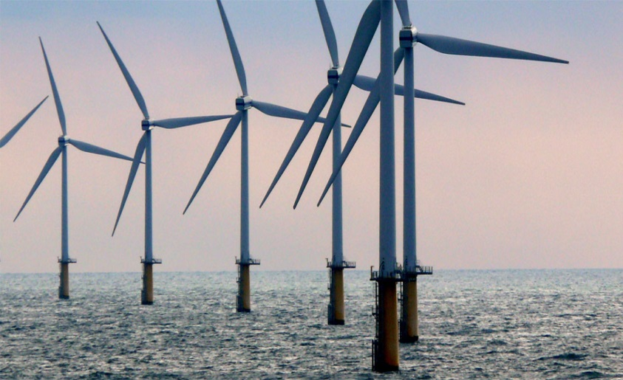
Clean Energy Legislation
“An Act Relative to Energy Diversity” Offshore Wind
  Utilities are required to competitively solicit and procure long term contracts for approximately 1,600 MW of offshore wind.
  Solicit by June 30, 2017 and June 30, 2019
  Contract by June 30, 2027
  Individual solicitations of no less than 400MW
Notes:
The bill spurs the development of an emerging offshore wind industry to create jobs and represent the largest commitment by any state in the nation to offshore wind.
The procurement of 1,600MW of off-shore wind is expected to generate approximately 6.3 million MWh per year, which represents about 10-12% of current MA electric demand.
It also is equivalent to the amount of electricity needed to power nearly 740,000 MA homes and avoids GHG emissions equivalent to taking approximately 450,000 cars off the road
In September, Governor Baker signed a Letter of Intent with DONG Energy, Deepwater Wind and OffshoreMW to lease the New Bedford Marine Commerce Terminal as a staging and deployment location for future wind projects.
The agreement with the developers, who hold leases in the federally identified offshore wind energy development areas located 14 miles south of Martha’s Vineyard, builds upon the Commonwealth’s commitment to a diverse energy portfolio and position as a national leader in offshore wind, and will strengthen the state’s clean energy economy.

Slide 5

SMART – Solar Massachusetts Renewable Target
  Governor Baker signed legislation in 2016 directing DOER to develop a new incentive program that creates a stable and equitable solar market at a reasonable cost to ratepayers.
4 Major Objectives of New Program
    Cost Reductions for Ratepayers
    Protect Land Conservation as Solar Deployment Grows
    Develop an Additional Option for Solar Development when Net Metering Caps are Hit
    Provide an Orderly Transition with Minimal Market Disruption
  Robust Stakeholder Process to Develop Next Program
    Over 40 stakeholder meetings
Notes:
In April of 2016, Massachusetts Governor Charlie Baker signed, An Act Relative to Solar Energy, which directed my agency to develop the a new solar incentive program that would create a stable and equitable solar market at a reasonable cost to ratepayers.
DOER approached this process with four major objectives:
Cost Reductions for Ratepayers
Protect Land Conservation as Solar Deployment Grows
Develop an Additional Option for Solar Development when Net Metering Caps are Hit
Provide an Orderly Transition with Minimal Market Disruption
To develop this program DOER undertook a robust stakeholder engagement process that included a straw proposal that was released in September 2016, extensive public comments, and over 40 stakeholder meetings.

Slide 6

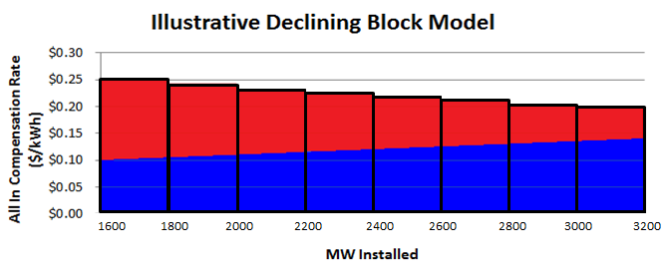

SMART:
Solar Massachusetts Renewable Target Design Details
  DOER released SMART – Solar Massachusetts Renewable Target – on January 31
    Declining block program
    1600 MW program with 8 x 200 MW blocks declining by 4%
    Developer receives 10-20 year “all in” fixed price for long-term financing predictability
  Doubles the amount of solar for half the cost to ratepayers
Incentive
Energy
Notes:
On January 31st DOER released it’s new program, called the Solar Massachusetts Renewable Target (SMART) program, where we expect to double the amount of solar in the state at half the cost to ratepayers as the first 1600 MW incentive program.
Key features:
Declining block model using an all in tariff rate paid to developers for 10 – 20 years
A solar facility receives a single compensation rate that accounts for both the energy and the incentive, and is structured to net out the value of energy to ensure that the resulting incentive payment is no more required.
Initial rate set by competitive procurement
The all-in compensation rate for solar projects declines by 4% for every 200 MW of solar built
Developed an on bill crediting system that gives developers an additional option for transferring energy credits
Puts Massachusetts forefront of a nation leading effort to steer project development away from open space by assigning additional values for projects in preferred locations and reducing the incentive for projects in un-preferred locations
This program provides long-term revenue certainty (10-20 years) to developers which reduces financing risks and in turn, lowers costs for developers. This enables immediate savings for ratepayers bringing down the cost for all ratepayers.

Slide 7

Energy Storage Update
  Storage Target
    On December 27, 2016, DOER determined that a storage target was prudent.
      Requested additional stakeholder feedback on scale, structure and mechanism of a target
      DOER is in the process of evaluating the received feedback
    DOER will adopt a target by July 1, 2017
Energy Storage Demonstrations RFP
  DOER and MassCEC released an RFP for demonstration projects in March.
  $10 million in funding for projects - up to $1.25 million per project.
  Responses due by June 9, 2017.
Notes:
The Department of Energy Resources (DOER) solicited written stakeholder input addressing whether Massachusetts should adopt targets for energy storage systems and on December 27, 2016 we announced that we have determined that setting a target is prudent for the Commonwealth.
DOER then solicited further stakeholder input with regard to target scale, structure and mechanisms, with the comment period closing January 27.
The legislation required DOER to adopt the energy storage targets by July 1, 2017.
Earlier this month DOER and the Mass Clean Energy Center released the long awaited RFP for energy storage demonstration projects, the final component of Governor Baker’s Energy Storage Initiative.
The RFP will make $10 million of funds available for projects with a maximum of $1.25 million per project.
Submissions are due by June 9th.

Slide 8
Thank You!

