Slide 1
Enabling Consumers in NE: New Technologies, Practices, & Policies to Transform Retail Energy Markets
Restructuring Roundtable
February 26, 2016
Dan Allegretti

Slide 2
Getting Retail Right
Empowering Customers
Removing Barriers
Modernizing the Retail Experience

Slide 3
These Things Can Inhibit Competition
Net Metering
Need EDI
Need Consistent Meter Data Wholesale and Retail
Customer Confusion
Education
Too Many Disclosures
Too Many Bill Regulations
Resource Planning
Long Term Contracts
RPS Changes
Other Charges (Gas Pipelines?)

Slide 4
These Things Need to Be Modernized
Enrollment
Instant Connection
Enroll With Your Wallet
Billing
One Bill (Supplier)
On Bill Financing
Data
Privacy
Ease of Supplier Access
Customer Expectations
Seamless Moves
Like Going to the Hardware Store

Slide 5
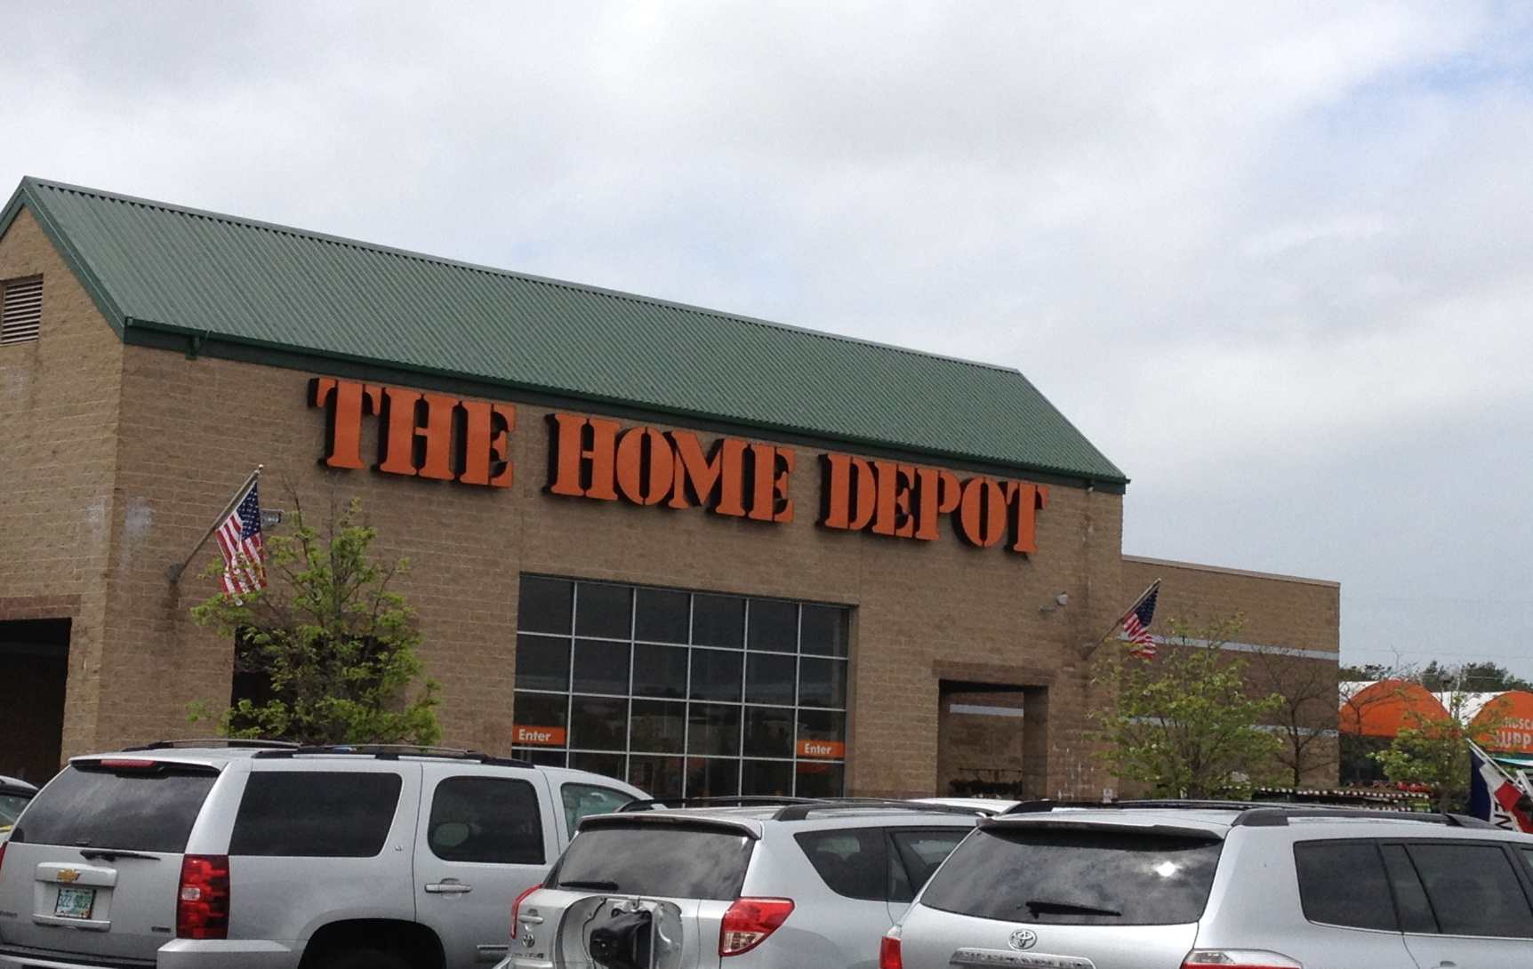
Customer Choice – Home Depot, Concord, NH

Slide 6
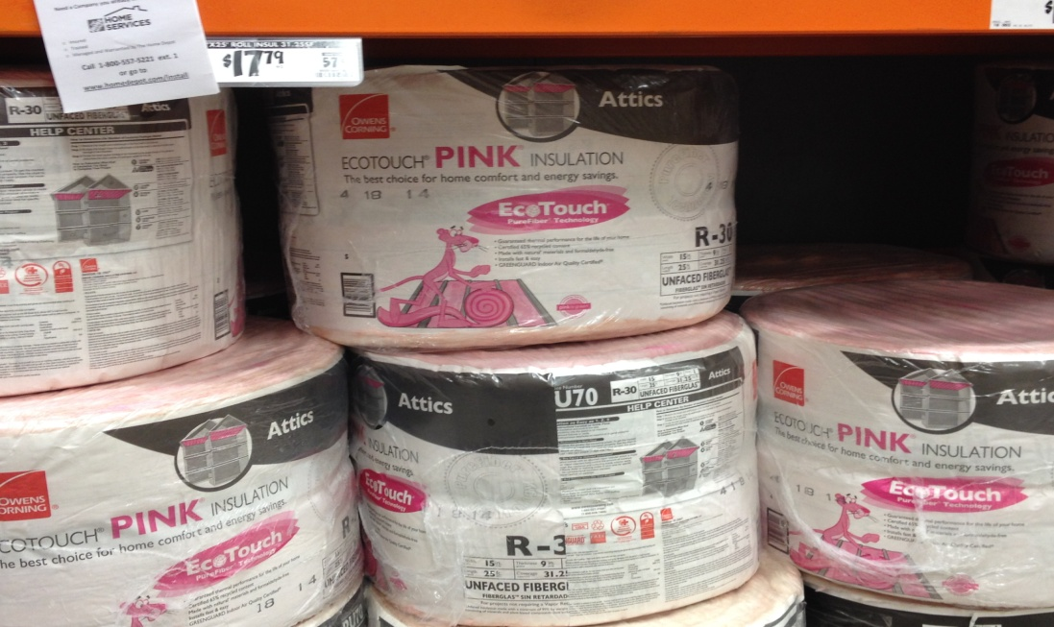
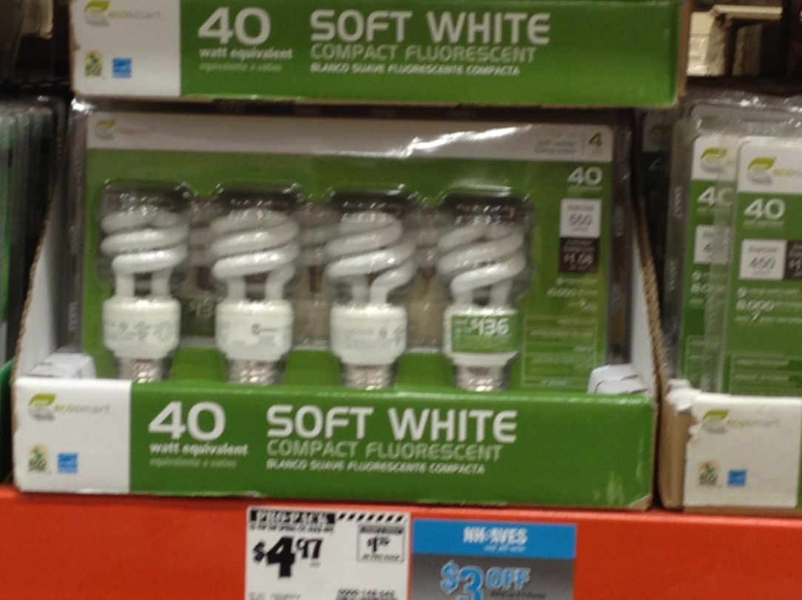
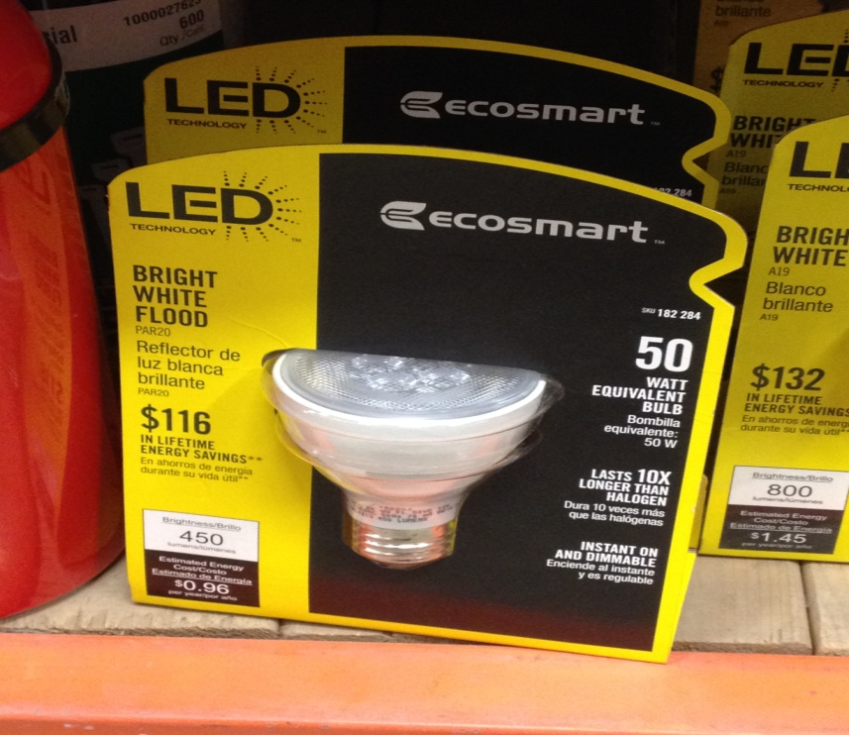
Energy Efficiency Aisles 2 & 30

Slide 7
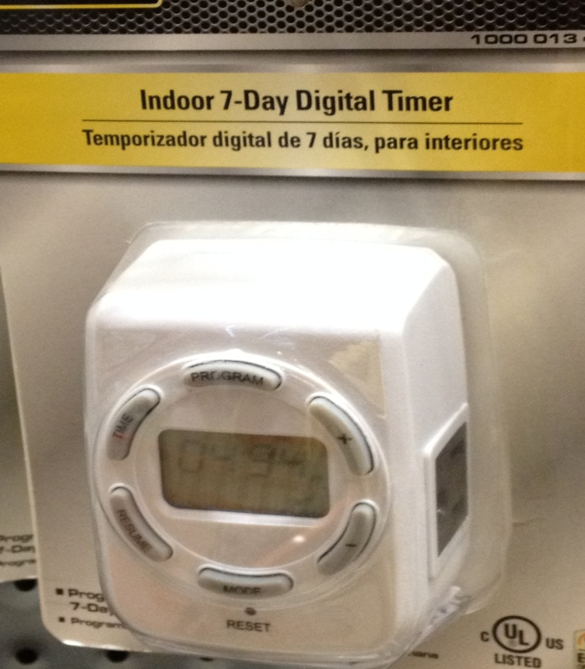
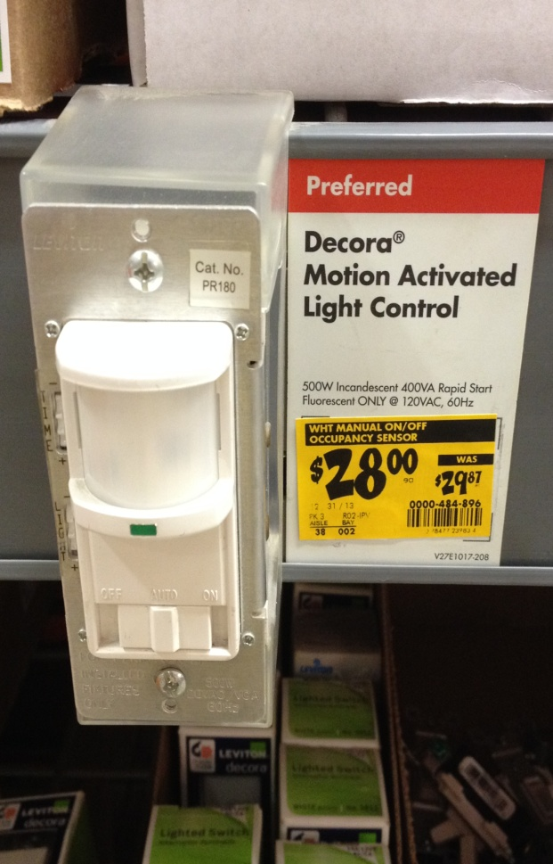
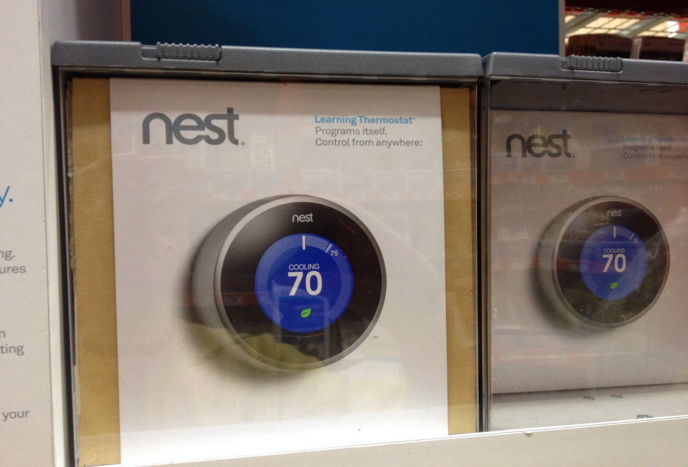
Demand Response Aisles 1 & 17

Slide 8
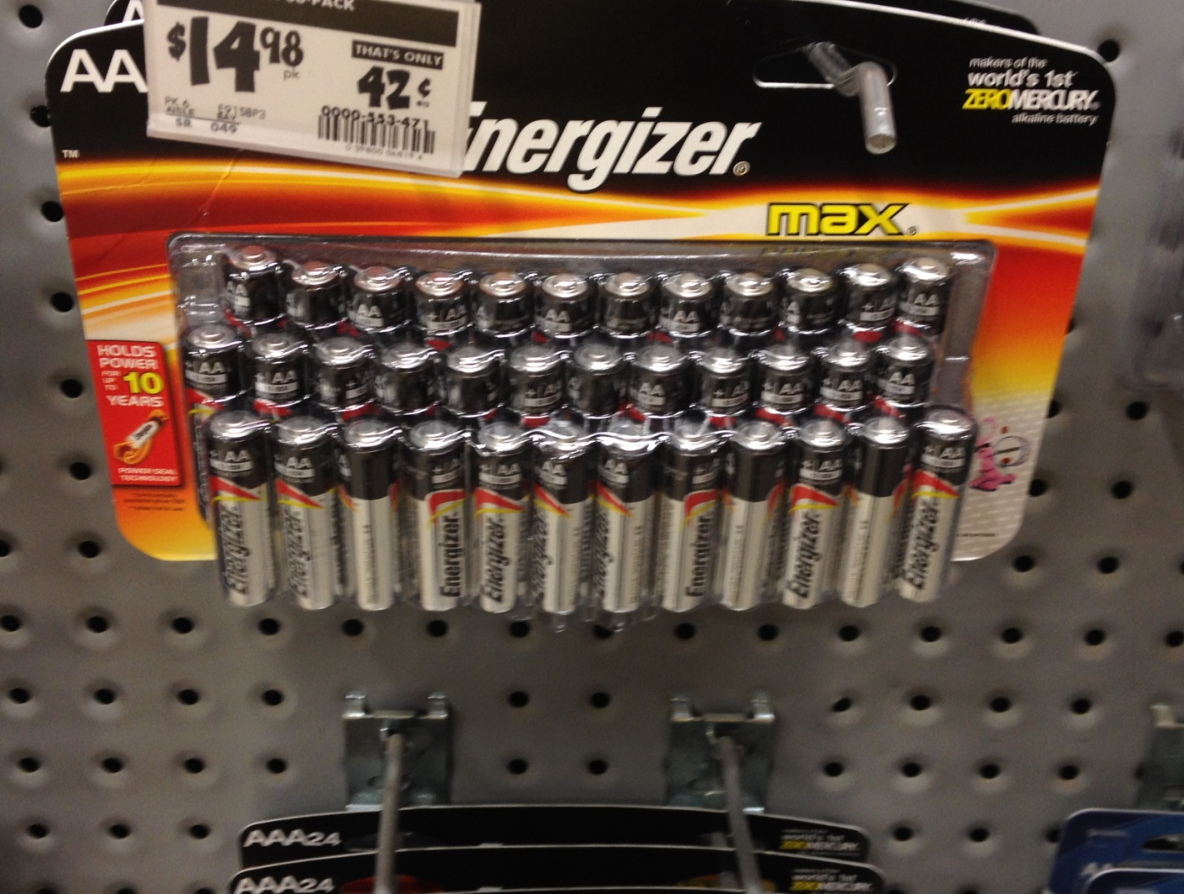
Energy Storage Aisle 10

Slide 9

Distributed Generation Aisle 1

Slide 10
Disclaimer (An exciting message from the legal department!)
The information contained herein has been obtained from sources which Constellation Energy Group, Inc. (“CEG”) and its subsidiaries, NewEnergy, Inc. (“CNE”) and Constellation Energy Commodities Group, Inc. (“CCG”) (collectively referred to as the "Constellation Entities") , believe to be reliable. The Constellation Entities do not represent or warrant as to its accuracy or completeness. All representations and estimates included herein constitute the Constellation Entities’ judgment as of the date of the presentation and may be subject to change without notice. This material has been prepared solely for informational purposes. The Constellation Entities do not make and expressly disclaims, any express or implied guaranty, representation or warranty regarding any opinions or statements set forth herein, and shall not be responsible for any reliance upon any information, opinions, or statements contained herein or for any omission or error of fact. All prices referenced herein, if any, are indicative and informational and do not connote the prices at which these entities may be willing to transact. This material shall not be reproduced (in whole or in part) to any other person without the prior written approval of the Constellation Entities.

